Slide 1
NASA’s OLYMPEX Field Campaign
Developed for Secondary School audiences to help them learn about NASA’s upcoming Ground Validation Campaign, the Olympic Mountain Experiment (OLYMPEX)
October 2015
Dorian Janney
GPM Education Specialist
Notes:
This presentation has been developed to use to help explain why NASA studies Earth from space, and to give them a general sense of how that is accomplished. They will also learn about an upcoming ground validation campaign, known as “OLYMPEX”, that will take place in Washington State this winter.

Slide 2
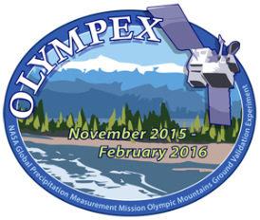
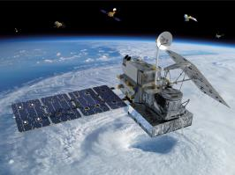
Objectives:
From this presentation, you will:
Gain an understanding of how and why NASA measures precipitation from space
Be able to describe the upcoming OLYMPEX ground validation campaign
Explain the purpose of ground validation campaigns for Earth-observing satellite missions

Slide 3
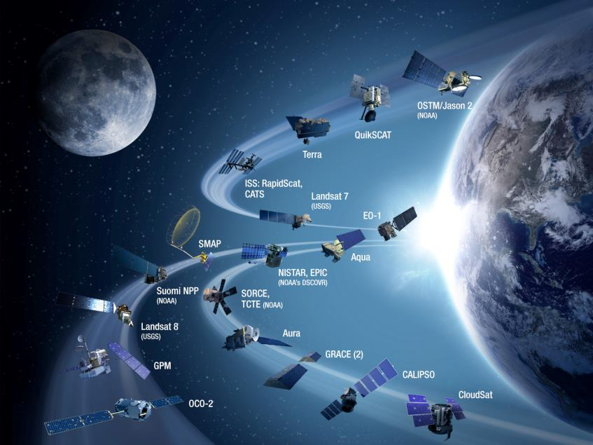
Earth-Observing Satellites
Notes:
Explain that these are many of the 25 currently operating NASA Earth-observing satellites. Ask students the following: Why does NASA use satellites to study Earth from space? Answers could include that it is impossible to collect data from all areas on Earth, and using a satellite enables you to gather data from places you can’t reach on Earth, as well as being able to study Earth from a global perspective and view the interactions of Earth’s systems globally. Click on the picture to open a video (2:39) called “Getting the Big Picture” which explains how satellites use remote sensing to collect data about Earth’s systems. You can go to http://pmm.nasa.gov/education/videos/water-falls-getting-big-picture and download the video if you don’t have an internet connection, or if your connection is slow.

Slide 4
Measuring Earth’s Precipitation
“Our Wet Wide World”
Notes:
Have students watch this short video (2:01) which describes the Global Precipitation Measurement mission and explains how it is able to measure precipitation from space.. You can click on the name to open it from the internet, or download it ahead of time at this url- http://pmm.nasa.gov/education/videos/our-wet-wide-world-gpm-overview

Slide 5
Ground Validation Campaigns
Satellites make their measurements using very complicated instruments. In order to be sure that the instruments are making accurate measurements, scientists and engineers need to conduct special tests, known as “ground validation campaigns”.
In these campaigns, large groups of scientists and engineers make a plan to figure out how to best make measurements from the ground so they can compare them with what the satellite is “seeing”- the data the satellite is collecting.
The goal is to make sure that the satellite’s instruments are accurately collecting data for lots of different types of locations.

Slide 6
OLYMPEX Ground Validation Campaign
Notes:
Show the students this patch for the upcoming campaign, and ask them what they can tell by looking at the image. When is the campaign going to take place? What is it called? Where will it take place? Explain that this campaign will focus only on the GPM satellite mission.

Slide 7
OLYMPEX
What is OLYMPEX?
A Ground Validation field campaign to verify and validate a precipitation measuring satellite called the Global Precipitation Measurement Mission (GPM)
Will take place November 2015 through February 2016 on the Olympic Peninsula
Will measure the rain and snow amounts and precipitation characteristics over the ocean, the coast, and the mountains.
Will track storms, their clouds and precipitation characteristics and their modification as they move from the ocean to the windward then to the leeward side of the Olympic Mountains
Notes:
This slide gives information about the basics of the campaign.

Slide 8
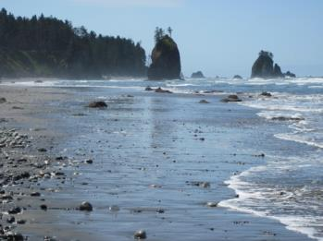
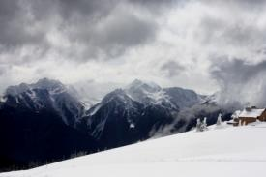
OLYMPEX
How can we measure rain?
Hard to measure precipitation in remote locations such as over the oceans and mountains
A good way to monitor these locations is using satellites
Need to calibrate these satellite measurements to ensure good data.
GPM Core Observatory
Hurricane Ridge
Olympic Nat’l Park
Notes:
This wraps up some of the information they learned in the previous slides.

Slide 9
Where will this campaign be?
Notes:
Have the students look at the map and talk about some of the geological features they observe: mountains, rivers, oceans, lakes, forests, etc. Ask them about the kind of weather they think might occur in this location between November and February. Ask them to think about how the surface features they observed might impact the weather in that region.

Slide 10
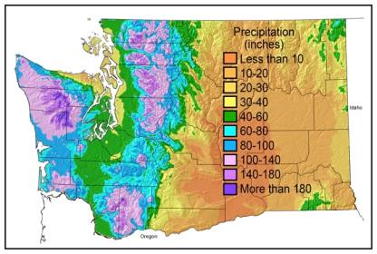
The Climatology of the Olympic Peninsula
Annual average precipitation in inches from PRISM (Parameter-elevation Regressions Independent Slopes Model)
Climatology of MSLP from Nov-Feb from NCEP Reanalysis grids 1979 – 2012
Persistent moist onshore flow produces extraordinary annual precipitation totals
2500 mm (100”) on the coast and more than 4750 mm (180”) in the interior

Slide 11
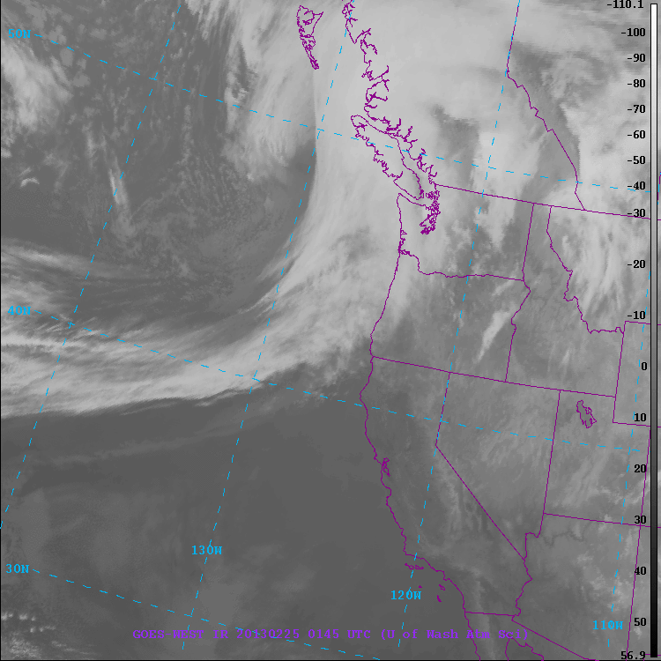
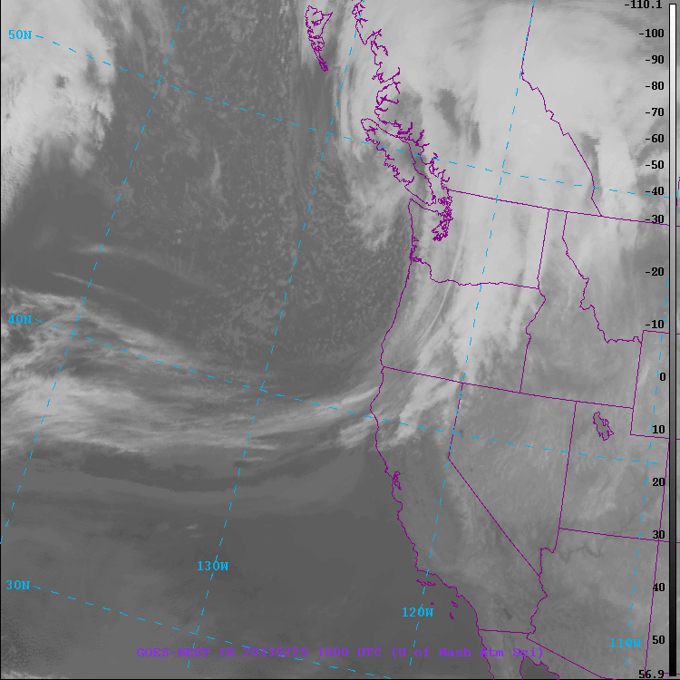
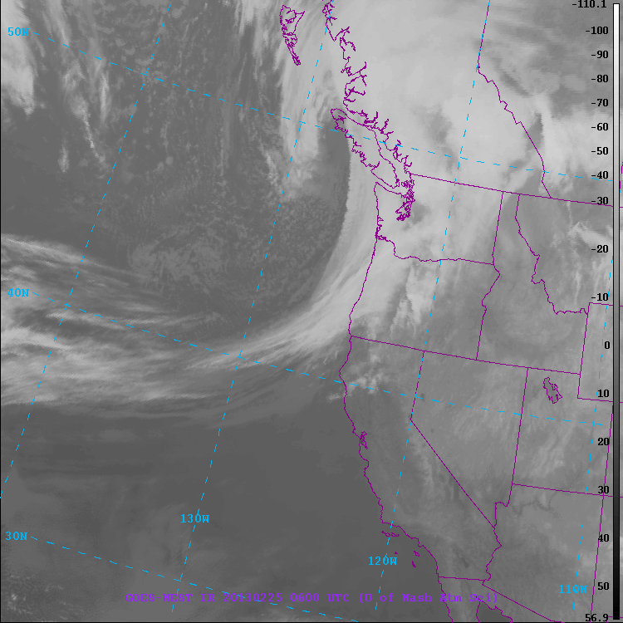
Typical Frontal Passage Three different regimes!
Prefrontal
Frontal
Postfrontal

Slide 12
Typical Frontal Passage Three different regimes!
Prefrontal
Frontal
Postfrontal
SW side of Olympics gets rain well ahead of front
SW side gets rain during front
SW side gets post-frontal showers

Slide 13
Go to the Olympics to measure rain!!!
Want to measure rain and snow and the weather systems that produce them
Rainfall characteristics – How big are the raindrops? How many raindrops with how much liquid water?
How does rain/snow vary with terrain?
Melting level variability
Snow pack accumulation
How are we going to do that?
Ground instrumentation (precipitation gauges, microphysical instruments, snow cameras, snow surveys) Oct. 2015 – April 2016
Ground-based weather radars, Nov. 2015 – Dec. 21, 2015 and Jan 2 – 15, 2016.
Aircraft-based measurements Nov. 6, 2015 – Dec. 21, 2015.

Slide 14
Geographical Regions
Leeward side
Quinault
High Terrain
Chehalis
Ocean - offshore
Windward side – Quinault and Chehalis are river basins where we are monitoring the response of the rivers to falling rain and snow

Slide 15
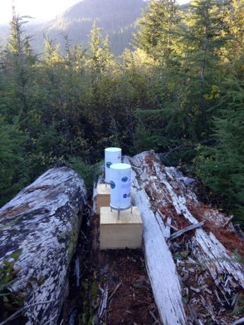
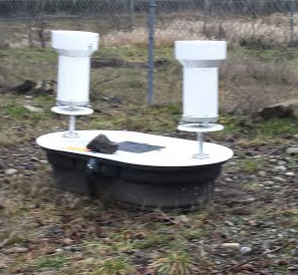
Ground Instruments – Measuring Rain
Rain Gauges
Tipping Bucket style (single and Dual)
Need to be in lower elevations

Slide 16
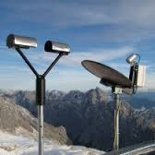
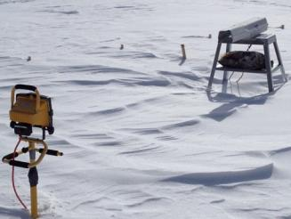
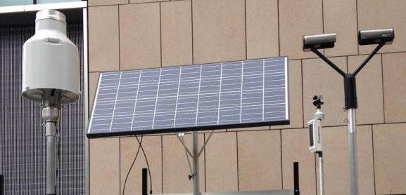
Ground Instruments – Measuring Rain
Instruments that measure characteristics of the precipitation – drop size, reflectivity, etc.
PIP – Can measure snow crystal shapes
MRR – Micro Rain Radar, a radar that looks up only
MRR
PIP
Pluvio: Weighing rain gauge for rain/snow
Parsivel – Can measure the number of drops and their sizes

Slide 17
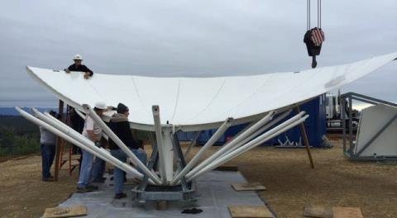
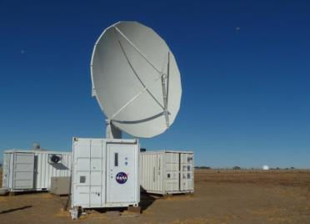
Ground Sites Radar – NASA Polarimetric Weather Radar (NPOL)
Ocean View
Olympics
Just installed NPOL Radar on the Quinault Indian Nation near the coast with clear views towards the Ocean and towards the Olympic Mountains
Putting together the reflector
The NPOL radar when operating

Slide 18
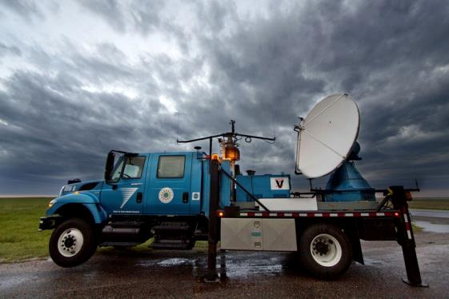
Ground Sites Radar - Doppler on Wheels (DOW)
Will be installed at Lake Quinault so it can make measurements where the NPOL cannot see up the Quinault Valley.

Slide 19
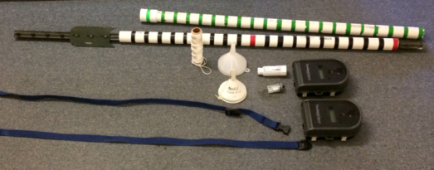
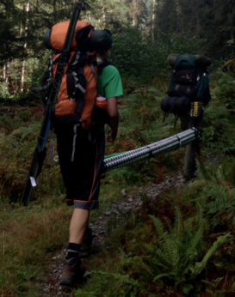
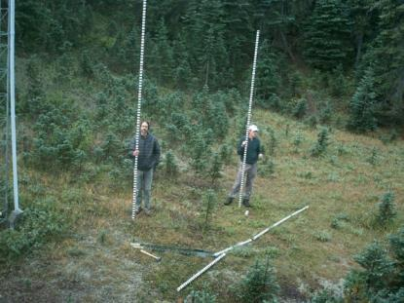
Ground Instruments – Measuring Snow
Using marked poles and time-lapse cameras to measure snowfall accumulation and melt-off.

Slide 20
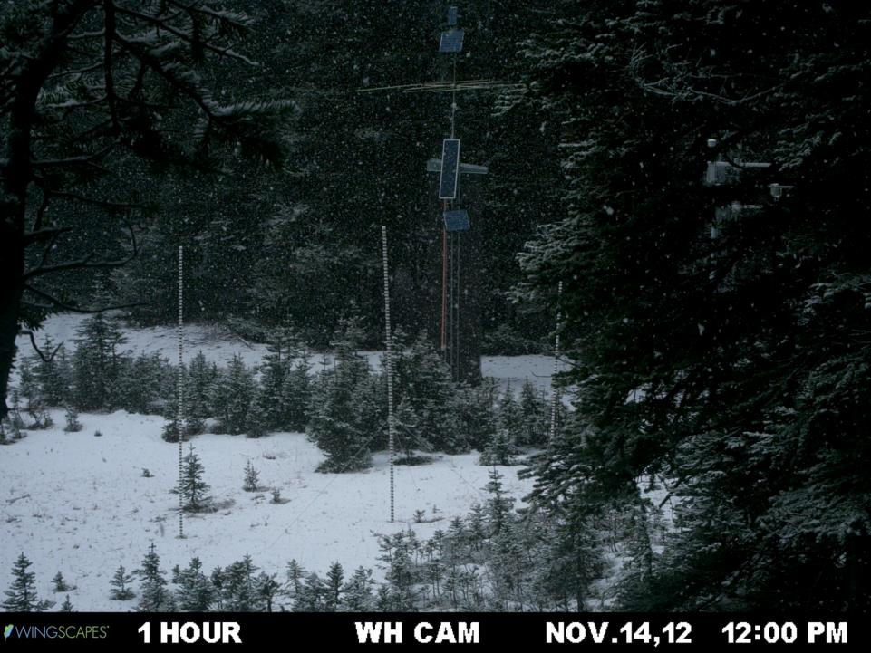
Precipitation event (snow) + Accumulation 1 of 2

Slide 21
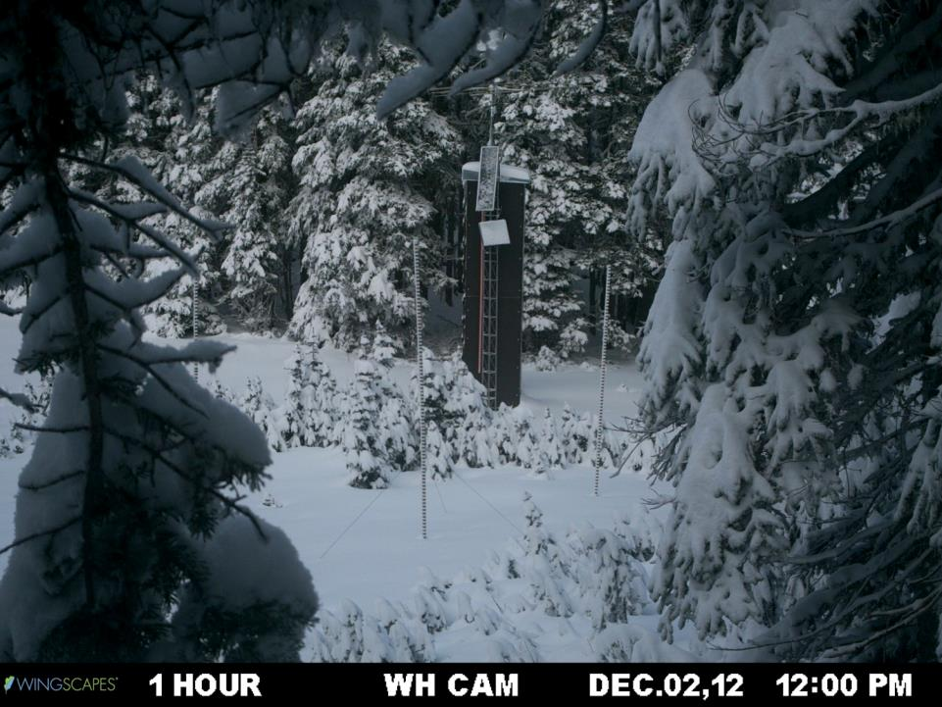
Accumulation 2 of 2

Slide 22
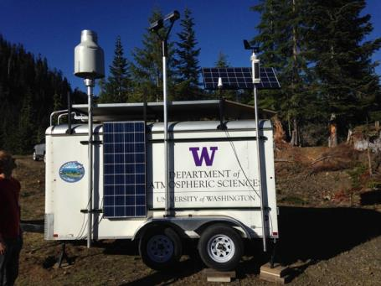
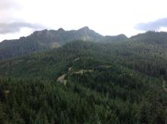
Ground Instruments – Measuring Rain/Snow at remote locations and no power
Has Pluvio – measures rain/snow amount)
Has Parsivel – measures rain/snow characteristics
Powered by 8 batteries and solar panels
Placed instrumented trailer at high elevation location (>3000’). It will remain on site all winter through spring

Slide 23
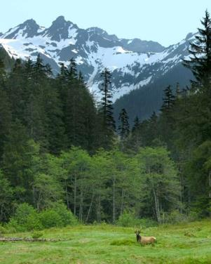
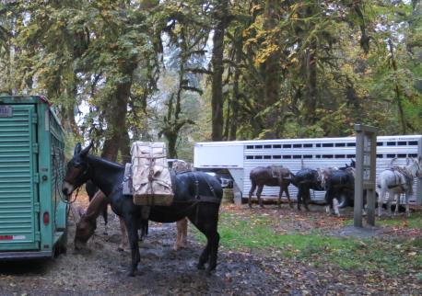
Ground Instruments – Measuring Rain/Snow at remote locations and no power
Will do second installation of the same instruments plus batteries and solar panels where we have to hike 15 miles and the gear is carried by a Mule Train
Photo by Larry Workman QIN

Slide 24
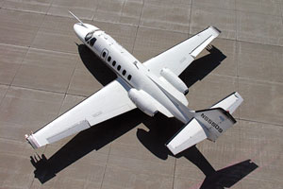
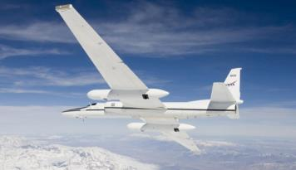
Measuring Rain and Snow from Aircraft
Citation
DC-8
Satellite Simulator instruments
Dropsondes over the ocean
Flies at ~30,000 ft
ER-2
Cloud Microphysics instruments
Flies at 2000 ft above highest obstacle
Satellite Simulator instruments and Flies at ~60,000 ft

Slide 25
Summary
OLYMPEX is a ground validation campaign for the GPM satellite
OLYMPEX primary objective is to measure and document the characteristics of rain/snow from ocean to coast to complex terrain.
Will have installations of ground instruments at a variety of elevations and locations to measure rain/snow amounts and precipitation characteristics
High terrain measurements include snow cameras, 2 installations of sophisticated instruments where power is available, and 2 installations running on batteries/solar.
There will be 2 radars and 4 upper-looking micro radars and one DOW.
There will be 3 aircraft from Nov 6 – Dec 21 that will fly during intensive observation periods when we have approaching storm systems (complicated operations).
Graduate students will be helping with daily forecasting, assisting the Mission scientists, maintenance of ground instrumentation and operating the radars.

Slide 26
Acknowledgments
Most Photos are taken on the Olympic Peninsula
Photo credits:
Bill Baccus, Olympic National Park
Joe Zagrodnik, grad student University of Washington
Dave Wolff, NASA Wallops
Jessica Lundquist and students, Civil and Environmental Engineering, University of Washington
Larry Workman, Quinault Indian Nation
This work is supported by the National Aeronautics and Space Administration Grant NNX14AO64G (OLYMPEX).

