Slide 1
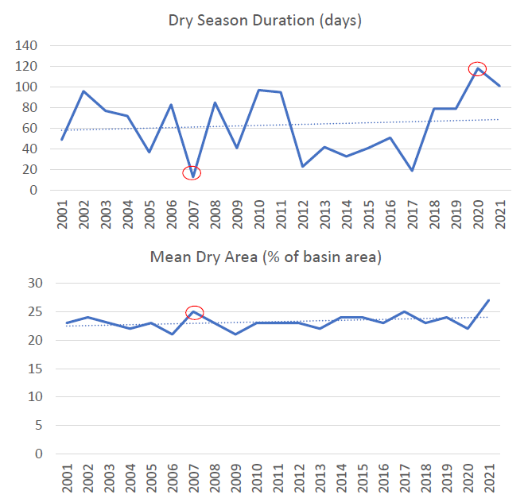
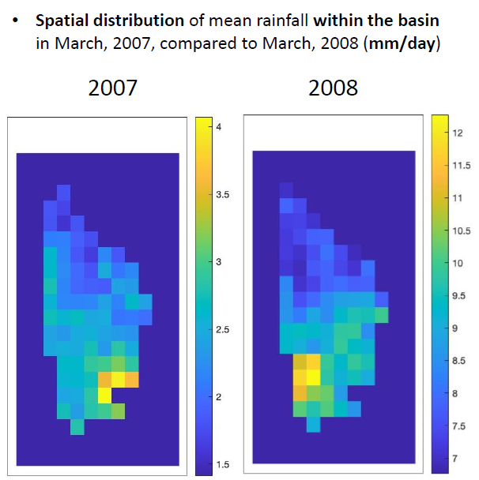


Characterizing Tropical Droughts Using GPM Data
Overview of Project
The National Water Agency (ANA) in Brazil explored the use of IMERG Final Daily data for seasonal rainfall characteristics to detect changes in tropical drought patterns in river basins in central region of Brazil.
Extraction of drought statistics using IMERG included number of wet and dry days per year and duration of dry season per year.
Detecting changes in dry season patterns can help water management decisions related to irrigation timing at the farm scale, and to water allocation at the river basin scale.
Dissemination of results are planned to support drought monitoring in Brazilian organizations including ANA and National Center for Monitoring and Early Warning of Natural Disasters (CEMADEN).
Next steps:
  Extend analysis to other river basins
  Input data into hydrological models to derive drought indicators
Extracting drought statistics using IMERG F (left). Spatial distribution of mean rainfall within the basin (right).
Credit: Alan Vaz Lopes
2023 Team
PMM Mentor:
Joe Turk
NASA JPL
Mentee:
Alan Vaz Lopes
ANA

Slide 2
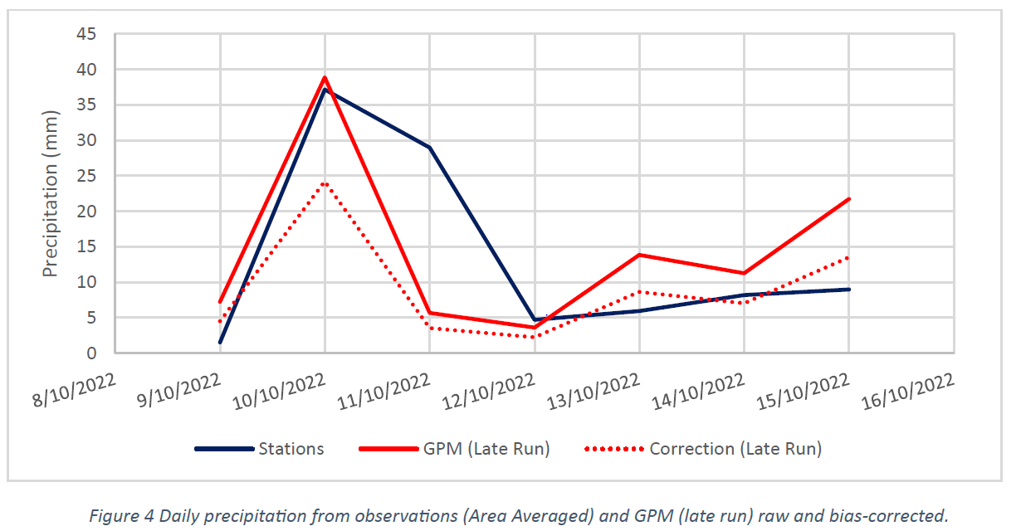
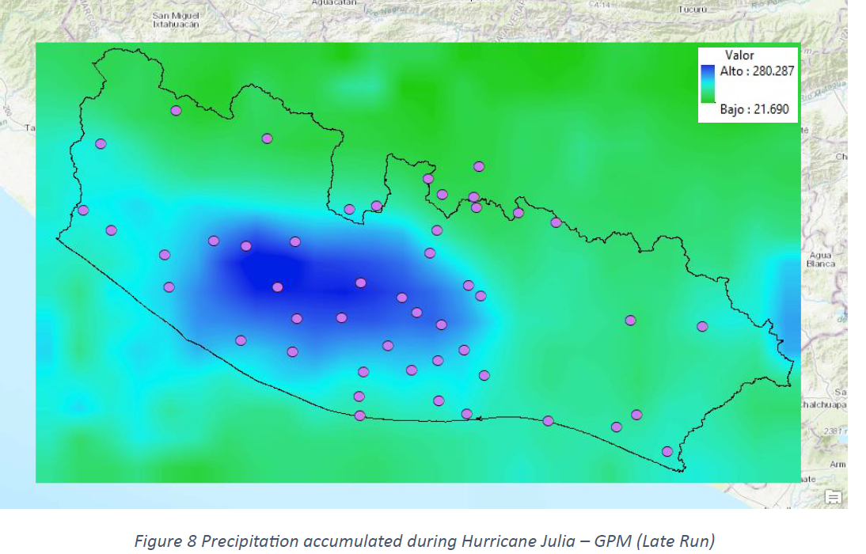
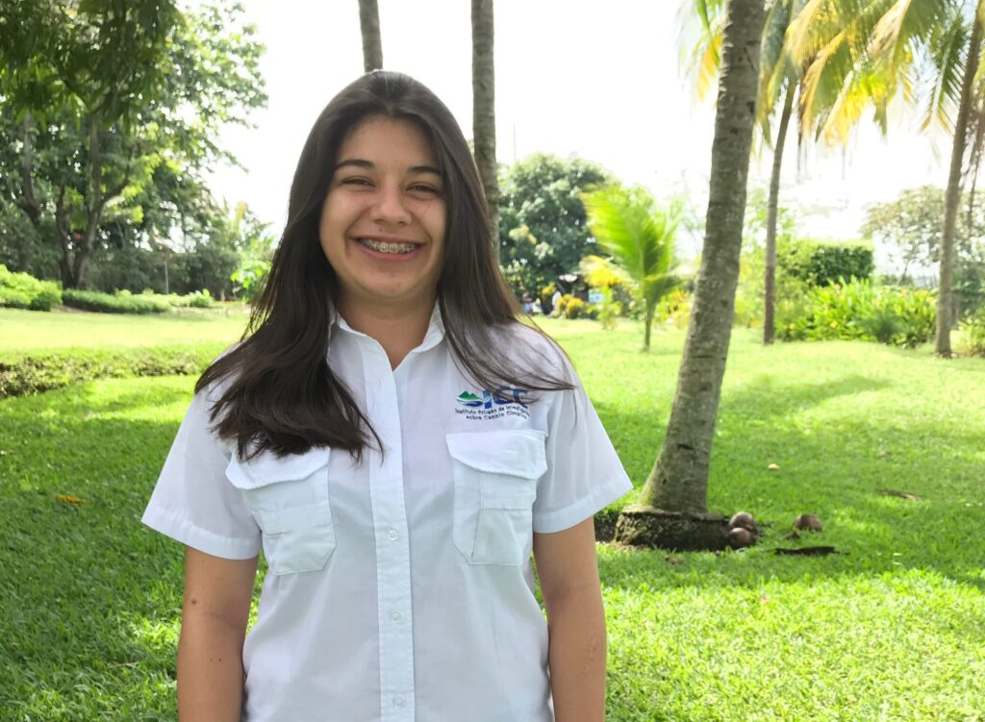
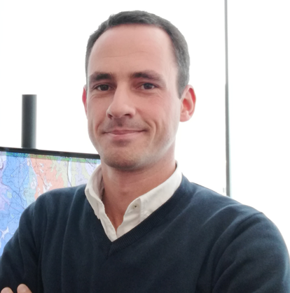



Improving Water Resource Management Practices using GPM
Overview of Project
The Private Institute of Climate Change Research (ICC) in Guatemala works with government institutions and the agro-industrial sector to support disaster risk reduction efforts by understanding potential risks and monitoring them over time.
To help support this effort, ICC evaluated the use of IMERG in western Guatemala to increase coverage and information to enhance their extreme precipitation analysis efforts.
ICC then assessed biases between IMERG estimates and data collected from 48 local weather stations in the region.
ICC now plans to use IMERG as a complementary dataset to station data for hydrological analysis and establish basin base flows that will allow a better understanding of the planning and management of water for their stakeholders.
Screenshots of data and analysis provided by ICC team member, Amy Molina.
Top: Daily precipitation using IMERG Late.
Right: Accumulated precipitation using IMERG Late.
2023 Team
PMM Mentors:
Vasco Mantas, U. of Coimbra
Zhong Liu, NASA/MSU
Mircea Grecu, NASA/ MSU
Andrea Portier, NASA/SSAI
Mentee:
Amy Molina
ICC

Slide 3
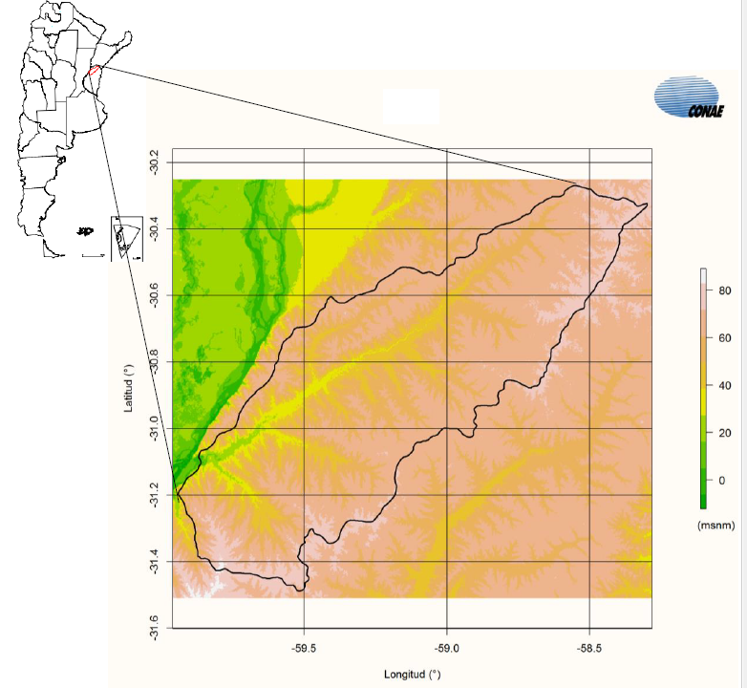
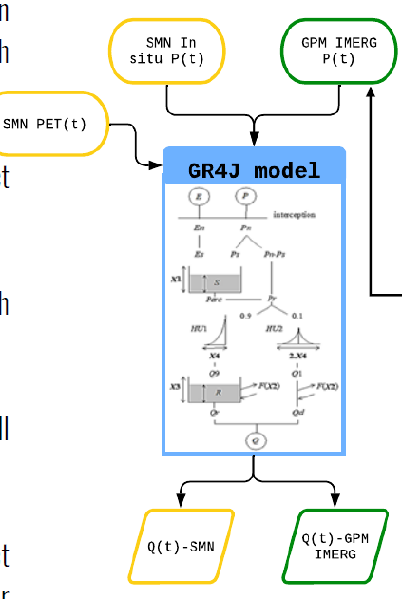
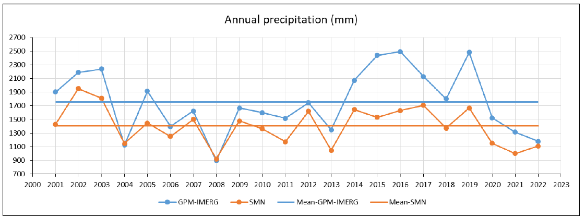


Hydrological Modeling with GPM IMERG
Overview of Project
The team explored the use of IMERG as input to hydrological models for Argentina’s lowland Feliciano Basin and compared results with those obtained with in-situ measurements.
IMERG was used to:
  calculate mean precipitation
  run statistical analysis on detection of intense storms
  feed into model to obtain streamflow time series
The team plans to continue the evaluation of the use of IMERG into models to generate more accurate hazard warning systems that cater to lowland catchment areas in Argentina.
Left: Feliciano Basin in NW Entre Ríos province, Argentina.
Below left: Annual precipitation using IMERG.
Below right: Screenshot of model inputs.
Credit: Ana Mari Pinilla, CONAE
2023 Team
PMM Mentor:
Marcelo Uriburu Quirno
CONAE
Mentee:
Ana Maria Pinilla
CONAE

Slide 4
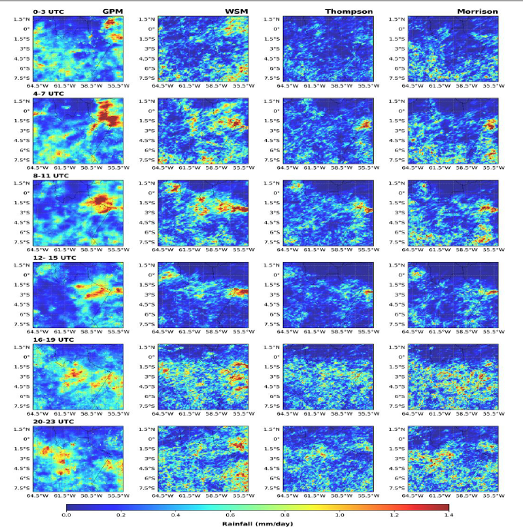


Investigating Diurnal Cycle of Precipitation in the Amazon Rainforest
Overview of Project
The Amazon Rainforest is one of the world’s hot spots of convective activity.
However, models do not produce a realistic representation of precipitation.
To explore this topic, the team compared three microphysical schemes (WSM6, Thompson, Morrison) of the WRF model against GPM precipitation data near Manaus, Brazil.
Results indicate that the coarser resolution WRF model inadequately captures GPM precipitation and the WSM schemes exhibit superior performance in compared to other schemes.
2023 Team
Future Work: Model simulation at a finer spatiotemporal resolution to enhance accuracy and detail.
PMM Mentor:
Mei Han
NASA/MSU
Mentee:
Chetan Gurung
UMBC
Results from project- Investigating diurnal cycle of precipitation with GPM vs three different microphysical schemes. Credit: Chetan Gurung.

Slide 5
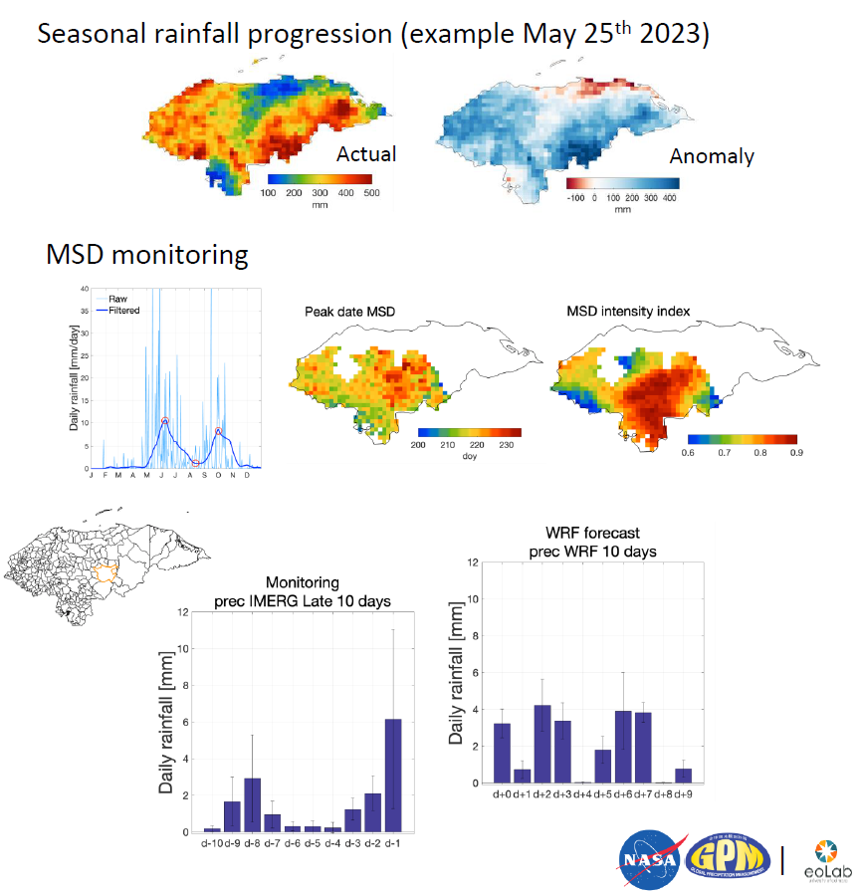

Using IMERG in Monitoring Rainfall & Midsummer Drought in Honduras
Overview of Project
Rainfall variability and the Midsummer Drought (MSD) (canícula) shape multiple socio-economical activities in Honduras.
The International Maize and Wheat Improvement Center (CIMMYT) aim to develop a framework for the use of IMERG Final and Late runs in monitoring rainfall and MSD.
Integration into national monitoring and forecasting systems of Honduras is underway for the National Weather Service (CENAOS) and for agricultural extension organizations (InfoAgro):
  Monitoring + weather and seasonal forecasts of rainfall and the MSD
  Recommendations for specific crops and regions
Ongoing work includes interactive platform for visualization and data source for agromet bulletins.
Summary of results from project. Credit: Carlo Montes (CIMMYT)
2023 Team
PMM Mentors:
Vasco Mantas, U. of Coimbra
Zhong Liu, NASA/MSU
Mircea Grecu, NASA/ MSU
Andrea Portier, NASA/SSAI
Mentee:
Carlo Montes
CIMMYT

Slide 6
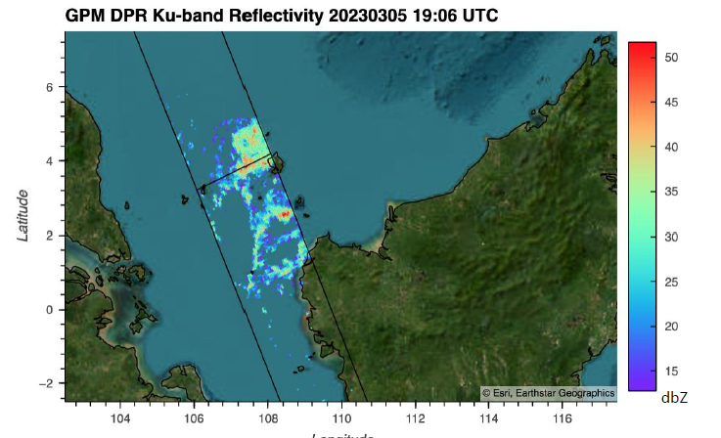
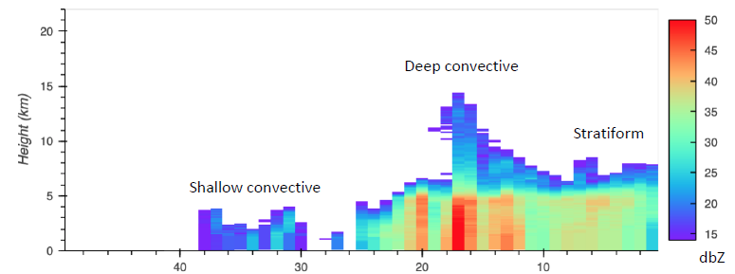
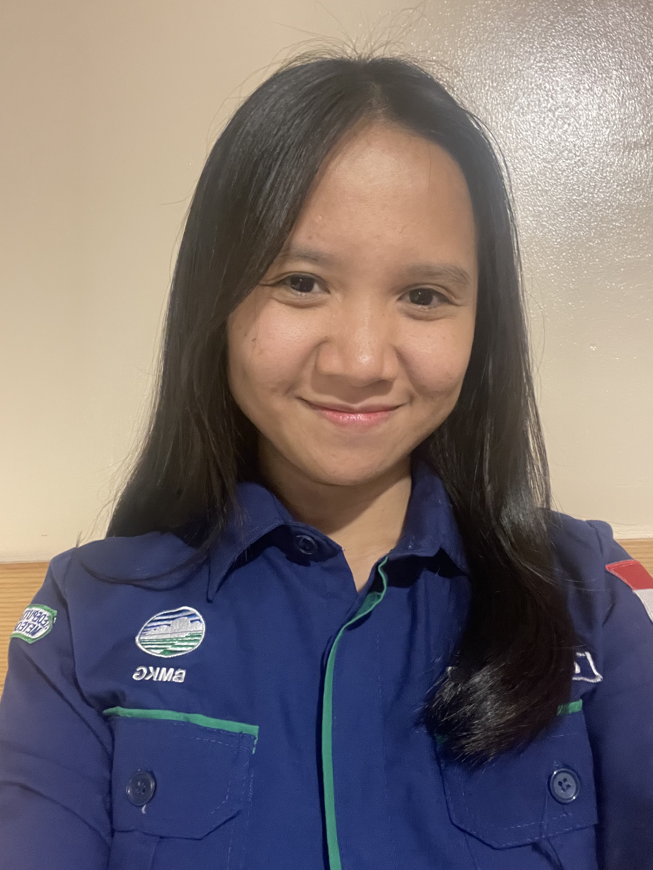


Evaluation of Rainfall During the Borneo Vortex Event using IMERG and DPR
Overview of Project
The Borneo Vortex is a meteorological phenomena in SE Asia that results in heavy rainfall and convective storms.
Working with mentors, a representative from Indonesia’s Met agency (BMKG) evaluated rainfall patterns during Borneo Vortex events using IMERG and DPR data to gain a comprehensive understanding of the phenomenon.
  IMERG data was used to analyze rainfall patterns and intensity, which were then compared with observed rainfall data.
  DPR data was used to assess the vertical structure of storms, allowing accurate estimation of rainfall levels and detection of potential indicators of severe weather conditions.
  Results will support the formulation of effective strategies for disaster risk reduction and early warning systems. For example:
    Understanding the Borneo Vortex will help BMKG forecasters develop more accurate weather forecasts, especially around potentially affected areas.
DPR reflectivity data from March 6, 2023 from Serasan Island. Heavy rainfall led to several landslides in the area.
2023 Team
PMM Mentor:
Courtney Schumacher
TAMU College Station
Mentee:
Clara Avila Dea Permata
BMKG
PMM Mentor:
Aaron Funk
TAMU College Station

Slide 7
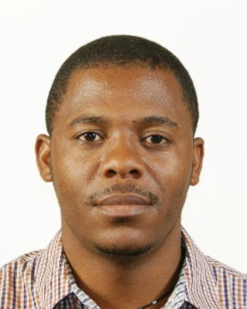
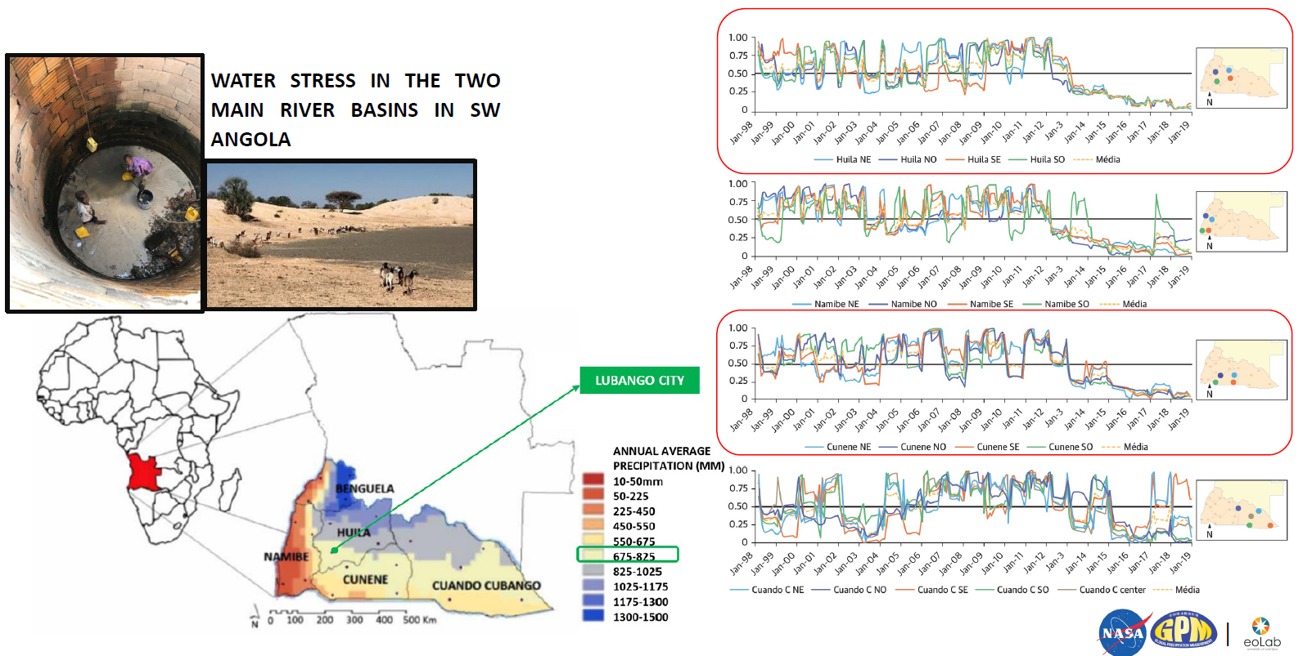
Impact of Climate Change in SW Angola: Discovering Solutions with GPM
Overview of Project
Creating measures in support of water and food security in Angola is highly needed.
A precipitation climatology was developed using IMERG to evaluate impacts of climate change within the southwest region of Angola and help advance the analysis for systematic monitoring and enable disaster preparedness in real time.
2023 Team
PMM Mentors:
Vasco Mantas, U. of Coimbra
Zhong Liu, NASA/MSU
Mircea Grecu, NASA/ MSU
Andrea Portier, NASA/SSAI
Mentee:
Edson Baptista
Huila Provincial Water & Sanitation Company
This will help integrate an efficient vision of water resources in the Okavango and Cunene watersheds of Angola.
Next steps: Involvement with stakeholders
    Ongoing political dialogue and analytical work with multiple governments = essential to advance systematic monitoring
    Review and strengthen information-action mechanisms for drought preparedness and drought response programs
    Develop drought and extreme weather preparedness programs for emergency water supply and associated training
Summary of rainfall data using TRMM and GPM data across SW Angola region and provinces. Credit: Edson Baptista, Huila Provincial Water and Sanitation Company.

Slide 8
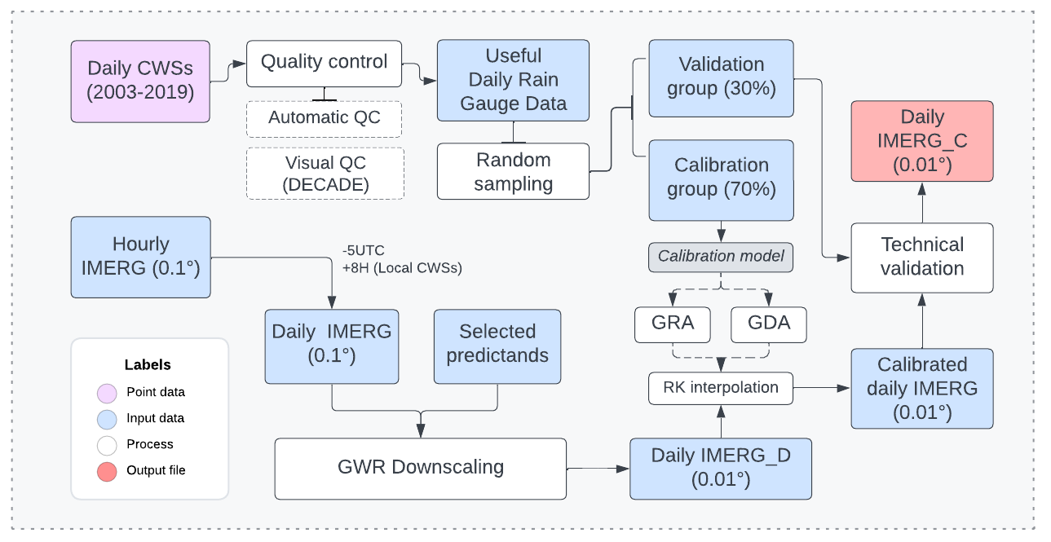
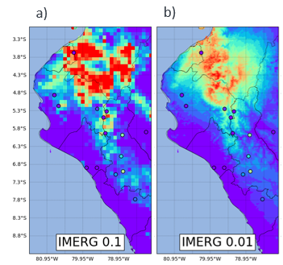


Spatial Downscaling of IMERG Final Over the North Coast of Peru
Overview of Project
The coarse resolution of precipitation products have insufficient precision for direct use in finer scale hydrological and meteorological applications.
To address this issue, the team explored a spatial downscaling approach based on the relationship between precipitation and multigeospatial factors.
A geographically weighted regression (GWR) method was used to reduce the spatial scale of IMERG Final from 0.1° to 0.01 ° on the north coast of Peru, focusing on the summer season.
By improving spatial resolution in precipitation estimation, it is expected to improve monitoring of extreme weather events, optimize water resource management, and support informed decision-making regarding food security, hydrological and meteorological forecasting, and early disaster prevention alerts in the region.
Top: Flowchart of the applied methodology. Right: Spatial distribution of original IMERG and downscaled for March 01, 2017. Credit: G. Bastidas
2023 Team
PMM Mentor:
Chuntao Liu
TAMU
Mentee:
Gianella Botetano Bastidas
National Agrarian University

Slide 9
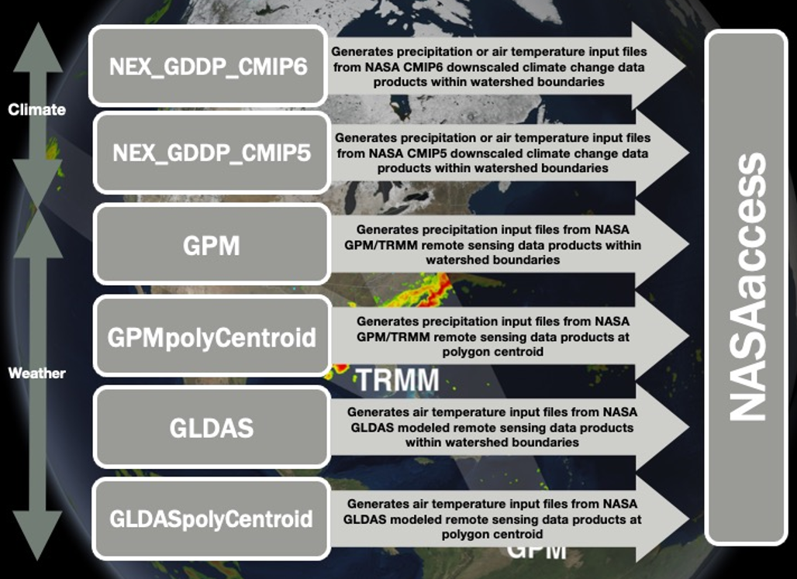
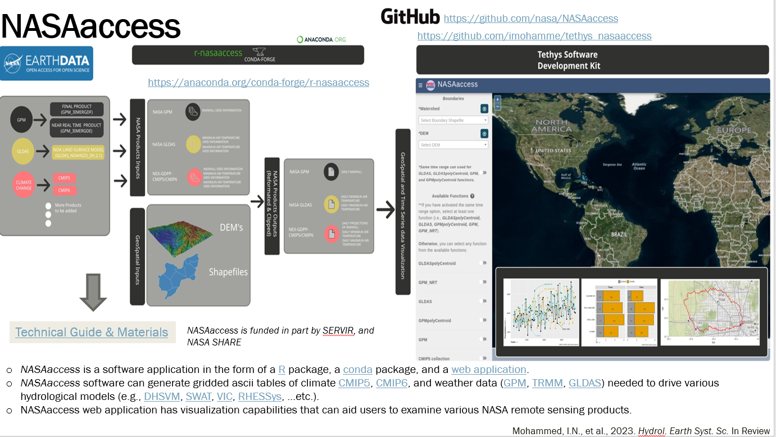
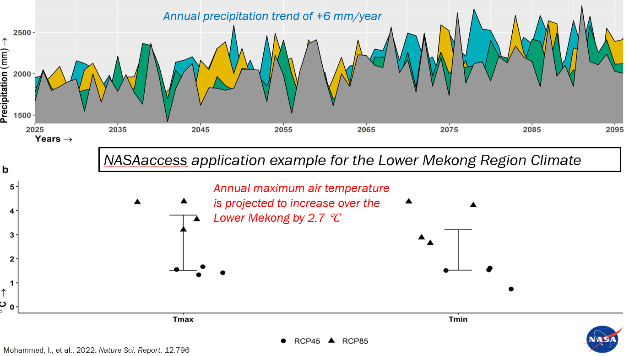


Exploring GPM Data via the NASAaccess Tool
Overview of Project
NASAaccess is an open-source platform for accessing and presenting quantitative remote sensing Earth observation, and climate data products in an interactive format.
The tool allows users with easy access and retrieval capabilities to weather and climate data for any watershed.
Top: Datasets included in the NASAaccess tool. Right: NASAaccess is a software application in the form of a R package, a conda package, and a web application. Bottom:
NASAaccess application example for the Lower Mekong Region Climate.
Taking advantage of the platform, the team did a preliminary analysis of precipitation using GPM over oceans.
The goal of the research is to analyze different regimes of precipitation through different analyses and focus on extreme events in particular.
2023 Team
PMM Mentor:
Ibrahim Mohammed
NASA/SSAI
Mentee:
Giorgio Dalmasso
University of Pavia

Slide 10
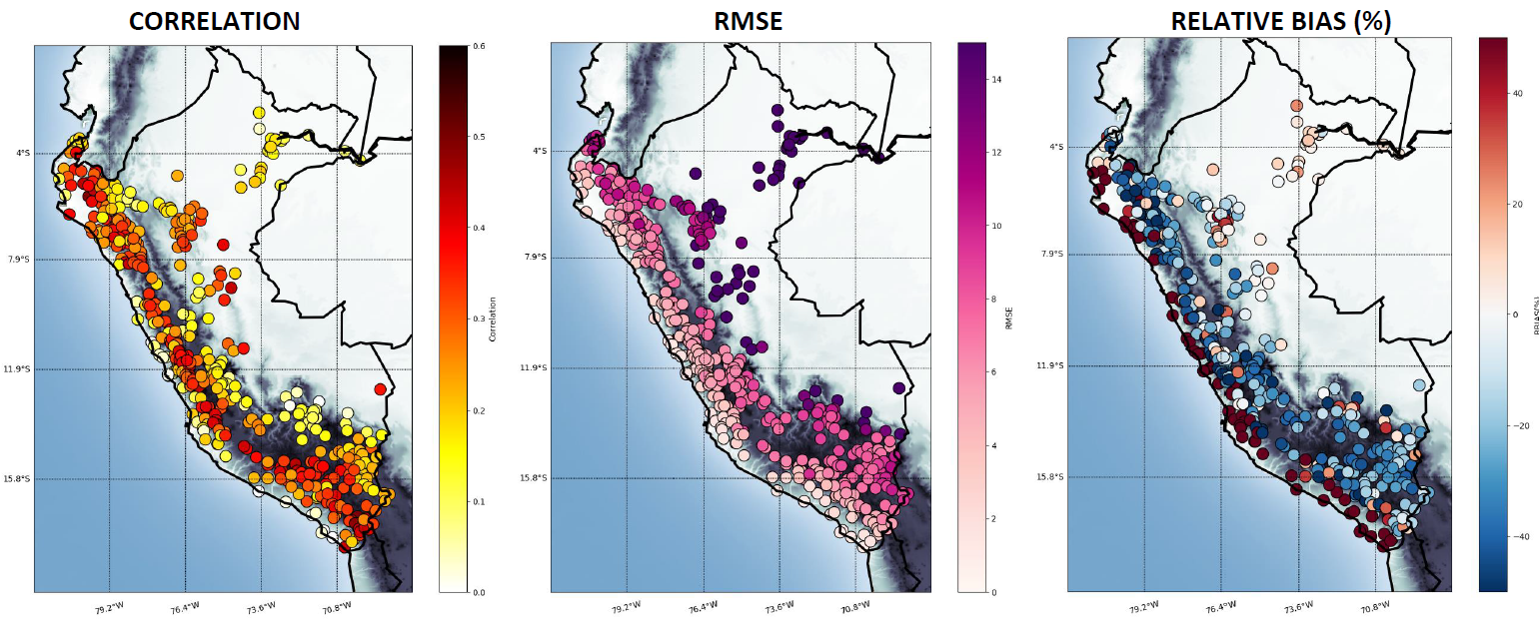

Evaluation of IMERG Products for Daily Precipitation Analysis Over Peru
Overview of Project
The spatial coverage of rain gauge stations in Peru are insufficient for adequate monitoring and forecasting of extreme rainfall events.
The National Service of Meteorology and Hydrology of Peru (SENAMHI) analyzed the performance of IMERG products to represent daily rainfall in Peru using the following statistical metrics:
  Correlation; RMSE; Relative Bias (%)
Summary of results assessing performance of IMERG with different statistical metrics. Credit: Gustavo De La Cruz (SENAMHI).
Results show that biases in IMERG daily products may be corrected by statistical techniques.
Ongoing work includes applying bias correction methodologies for the IMERG-E product (example machine learning) and develop an operational bias correction system for daily rainfall monitoring purposes.
These data will serve as input for forecasting with the goal of reducing human and economic losses that occur during extreme events such as El Niño.
2023 Team
Mentee:
Gustavo De la Cruz
SENAMHI
PMM Mentors:
Vasco Mantas, U. of Coimbra
Zhong Liu, NASA/MSU
Mircea Grecu, NASA/ MSU
Andrea Portier, NASA/SSAI

Slide 11
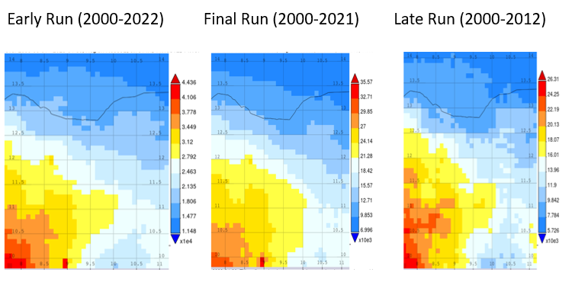
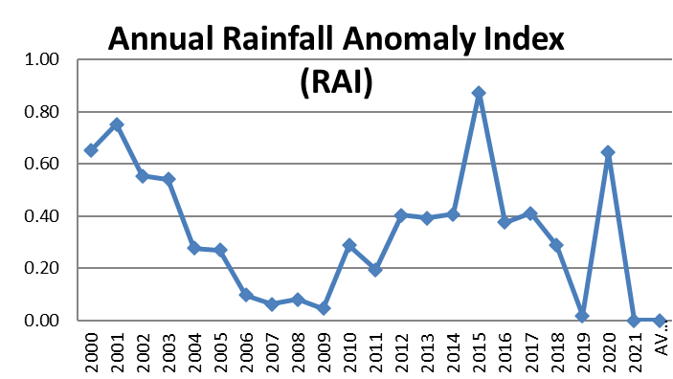

Assessing Impact of Climate Change in Northern Nigeria
Overview of Project
Increasing climate variability in Nigeria is causing more intense and untimely rainfall.
Working with mentors, a representative from the Economic Community of West African States (ECOWAS) in Nigeria explored various ways to access and download publicly available precipitation data.
Using IMERG 20+ year record, ECOWAS analyzed the frequency and intensity of precipitation in northern Nigeria to develop a new algorithm for flood monitoring and forecasting.
Future efforts include working with governmental bodies to develop flood vulnerability maps and operational tools in areas that are most vulnerable to flooding.
Mapping precipitation using IMERG. The red area is an indicator of precipitation extremes. Credit: Idris Baba (ECOWAS).
2023 Team
Mentee:
Idris Baba
ECOWAS
PMM Mentors:
Vasco Mantas, U. of Coimbra
Zhong Liu, NASA/MSU
Mircea Grecu, NASA/ MSU
Andrea Portier, NASA/SSAI
Using IMERG, the annual RAI was used to analyze the frequency and intensity of dry and rainy years. Credit: Idris Baba (ECOWAS).

Slide 12

Evaluation of IMERG Over Nepal’s High Himalayan Region
Overview of Project
Observing rainfall over remote regions of steep topography and at high altitude remains a challenge.
Working with mentors, a representative from Nepal’s Department of Hydrology and Meteorology (DHM) assessed IMERG’s ability to measure rainfall in the Solukhumbu region of Nepal by comparing IMERG daily rain rates to the rain gauge observations.
Project objectives include understanding of new data and data access as well as improving rainfall estimates and information over Nepal where ground information is limited.
These efforts can be beneficial to local communities, including Sherpas as well as tourists and mountain climbers.
Future efforts include exploring DPR data to calculate phase changes and improve detection of severe weather.
Assessment of IMERG in the Solukumbu region, Nepal. IMERG slightly overestimates higher rain rate events but misses some weaker events. Results consistent with Khadka et al 2022. Credit: K. Ghimire (DHM).
2023 Team
PMM Mentor:
Courtney Schumacher
TAMU College Station
Mentee:
Kaman Ghimire
Nepal DHM
PMM Mentor:
Aaron Funk
TAMU-College Station

Slide 13
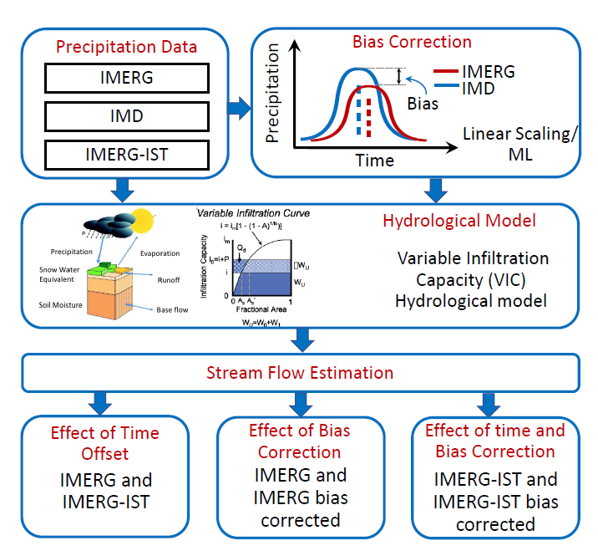

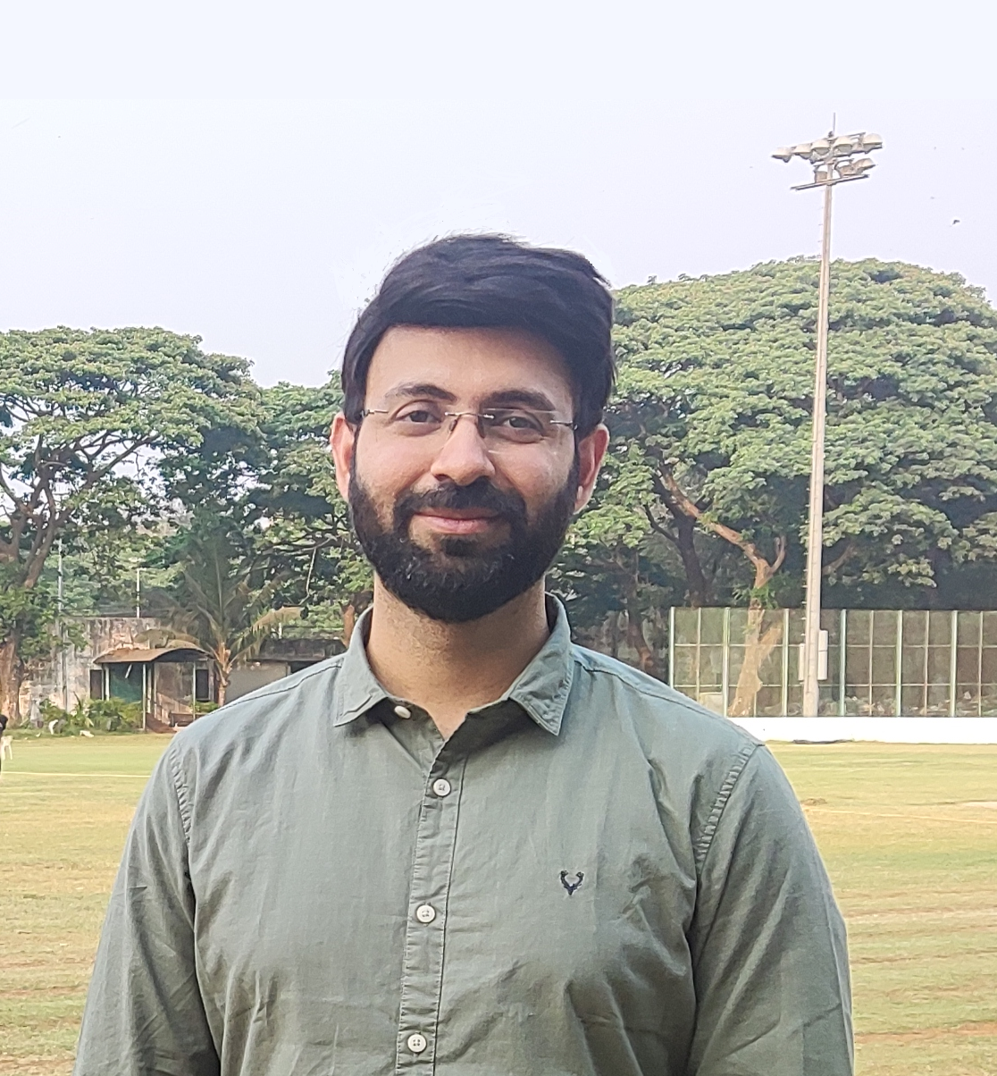
Comparing the Performance of IMERG: Implications for Streamflow Simulation
Overview of Project
The team compared the variation of IMERG HH vs daily to investigate its adequacy on streamflow simulation and quantify the effect of the bias correction in the Western Ghats through machine learning.
Ongoing work:
  Compare output of hydrological model with gauged streamflow at daily scale.
  Test machine learning approach for bias correction.
  Assess changes in streamflow due to effect of time offset and bias in precipitation estimates.
The participant plans to continue this effort to use IMERG as input for hydrological modeling research to support water resource management and climate analysis activities.
2023 Team
PMM Mentor:
Jackson Tan
NASA/UMBC
Mentee:
Kashish Sadhwani
Indian Institute of Technology Bombay
Methodology of project. Credit: K. Sadwani

Slide 14
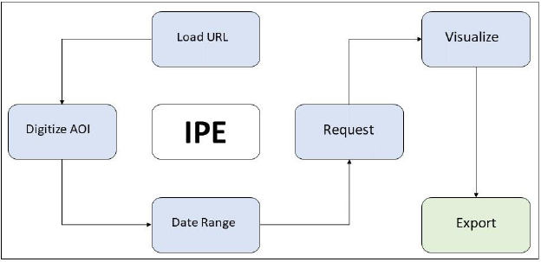
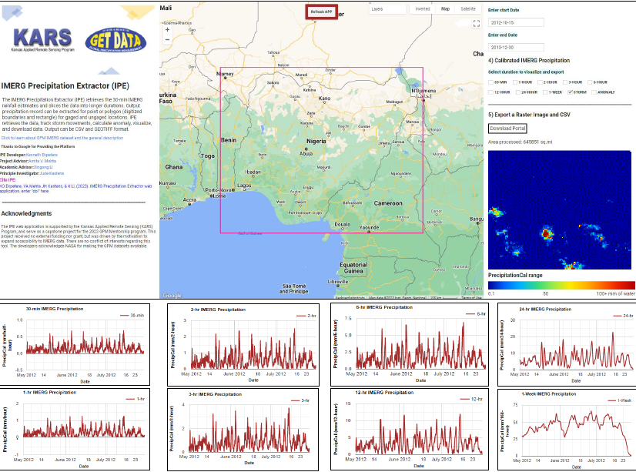


IMERG Precipitation Extractor Tool
Overview of Project
Users face issues with accessing and processing IMERG data for local analysis and for calculating monthly anomalies.
To address this issue, the team developed
the IMERG Precipitation Extractor (IPE)
  A tool for rapid extraction, visualization,
  and downloads of IMERG precipitation
  data throughout the globe.
  The tools allows users to
  Extract IMERG time series estimates
  (short and long intervals)
  Calculate monthly deviations from
  annual estimates using IMERG
  Track storms to see direction of movements and intensities
Btm. left: Method and interface. Right: IPE outputs. Credit: K. Ekpetere.
https://cartoviews.users.earthengine.app/view/ipe
Check out the full results via the Project PPT!
2023 Team
  This can be especially useful for stakeholders that would like to enhance their data extraction capabilities and model impacts of extreme events.
PMM Mentor:
Amita Mehta
NASA/UMBC
Mentee:
Kenneth Ekpetere
University of Kansas

Slide 15
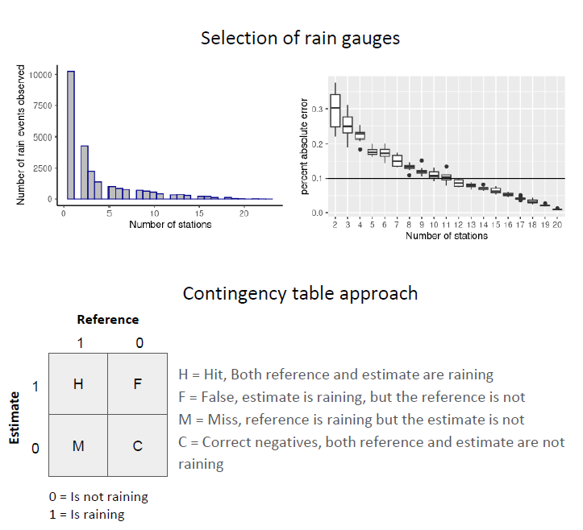

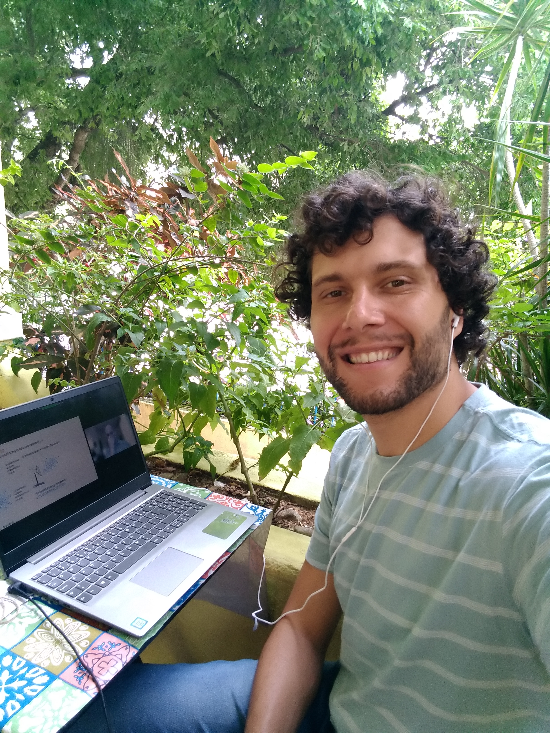
Ground Validation of Hourly IMERG in Brazil
Overview of Project
The team assessed the performance and reliability of IMERG Late and Final estimates in capturing rainfall events over urban areas in the São Paulo Metropolitan Region (SPMR) using a novel selection of rain gauges managed by CEMADEN.
IMERG L and F were validated considering contingency table statistics and correlation metrics.
The project helped form a framework for analyzing CEMADEN database for hourly precipitation and enhance the monitoring networks for flood risk assessment.
Next steps:
  Publish findings
  Expand the study to different scales
  Test the method to other urban areas
  Compare rain gauges with estimates from different sensos
  Test the new Version 7 when released
Top: Screenshot of results and applied methodology. Credit: M. Benso.
2023 Team
PMM Mentor:
Ali Tokay
NASA/UMBC
Mentee:
Marcos Roberto Benso
University of São Paulo

Slide 16
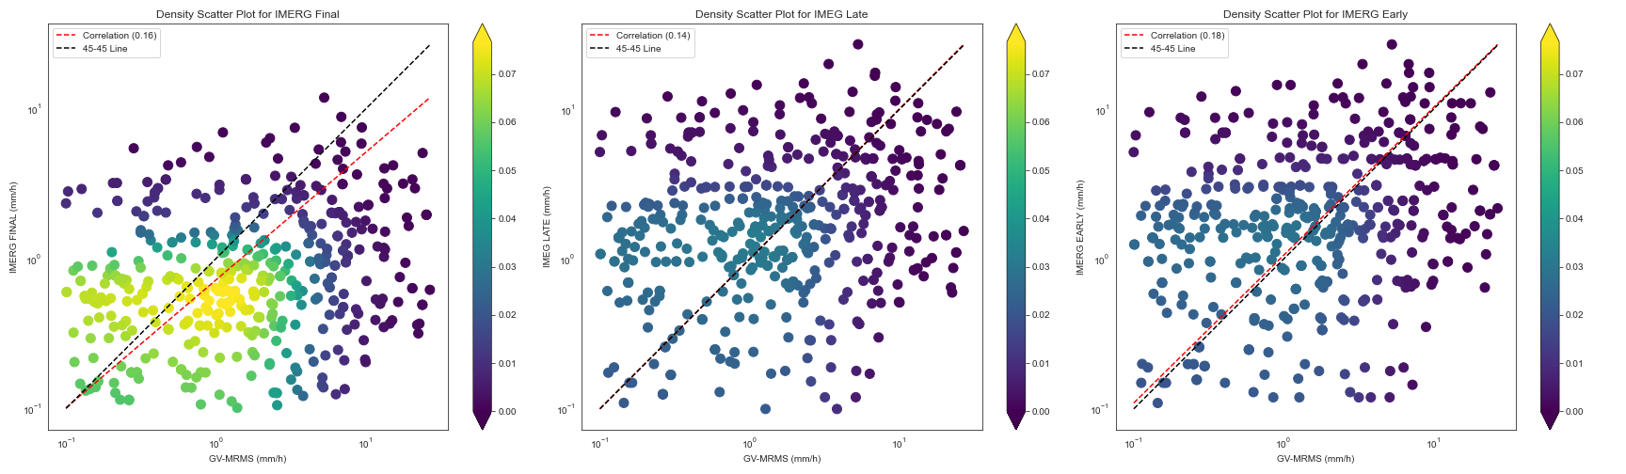



Analysis of a Flash Flood Event using GPM Data
Overview of Project
Satellite data products suffer from errors, especially when estimating extreme precipitation.
This stresses need to validate satellite-based data with ground observation and understand the source of errors.
Scatter density plot for (L to R) Final, Late and Early against GV-MRMS data . The participant noted that precipitation activities in IMERG-E are observed, particularly in the 0.75 quantile. This quantile closely matches the GV-MRMS. Credit: M. Akin
The team analyzed one notable
flood event that occurred in Death
Valley National Park, California on October 18, 2015.
Project goals:
  Evaluate IMERG products against GV-MRMS ground data
  Select IMERG products that could be useful for flash flood events
  Convey results that can be beneficial to scientific community, national meteorological services, and flood early warning systems.
  Next steps:
    Conduct work in a wider area with a longer dataset.
2023 Team
Mentee:
Melek Akin
Istanbul Technical University
PMM Mentor:
Yagmur Derin
Uni. Of Oklahoma
PMM Mentor:
Pierre Kirstetter
Uni. Of Oklahoma

Slide 17
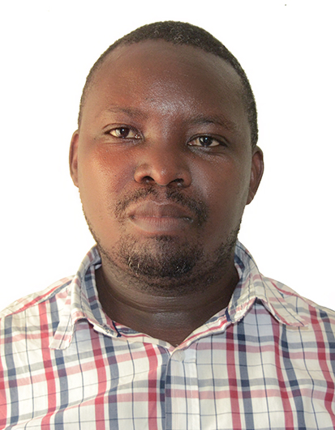


Hail Detection Using GPM Data Over Rwanda
Overview of Project
Between Sep 2013 and Sep 2021, 126 hail events took place in Rwanda damaging hectares of crops and infrastructure and impacting livelihoods.
These hail events are based on reports in the field. There is a need to validate these reports against data by observing systems such as radars and satellites.
Daily observed hail cases in Rwanda. Credit: P. Ayabagabo
Daily probabilities of severe hail cases based on the Bang & Cecil, 2019 and computed based on the modified TRMM and GPM satellite polarization corrected temperature features (TPCTF and GPCTF), respectively. Credit: P. Ayabagabo
Working with mentors, a representative from Rwanda Met Agency compared reports on the ground for observed hail cases in Rwanda against hail detection using GPM’s Microwave Imager (GMI) dataset.
Results of these efforts will help improve monitoring and forecasting of these events and enhance applications in agriculture and disaster response.
2023 Team
PMM Mentor:
Becky Adams-Selin
AER
Mentee:
Prosper Ayabagabo
Rwanda Meteorology Agency
PMM Mentor:
Linda Bogerd
Wageningen U. & Research

Slide 18
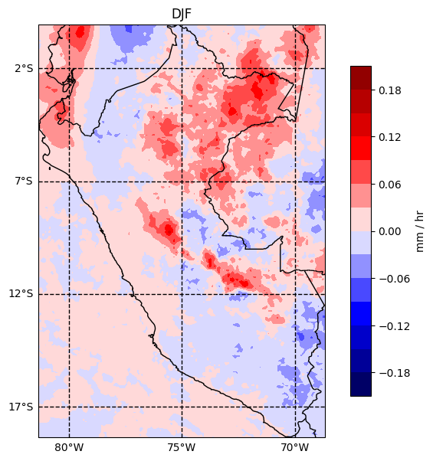
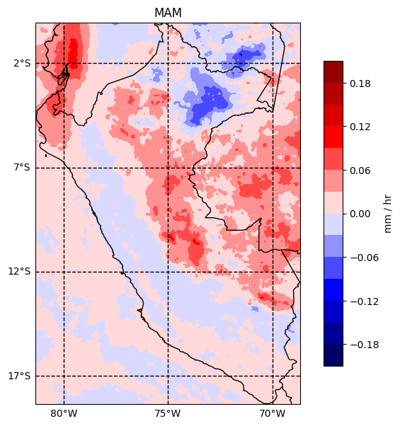
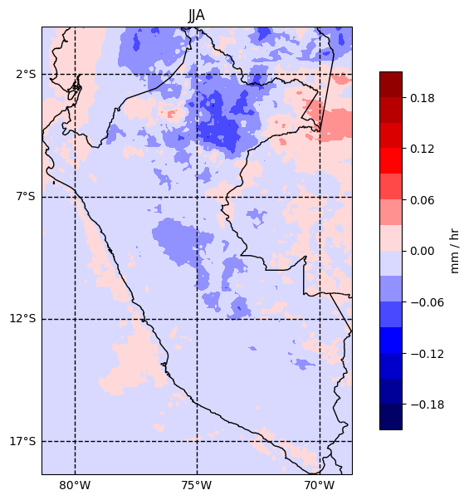
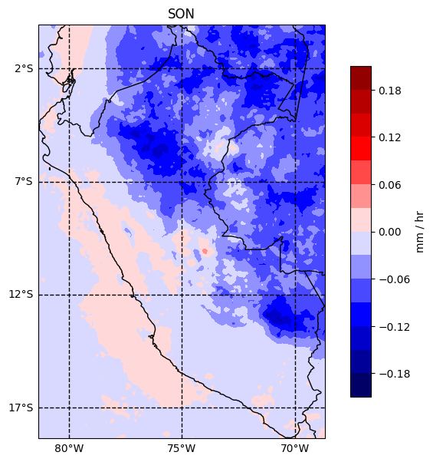


El Niño and La Niña Events: Comparison of Monthly Precipitation in Peru
Overview of Project
Peru is a country directly affected by coastal El Niño and La Niña, causing extreme precipitation and flooding events.
Working with a mentor, a representative from the Ministry of the Environment of Peru (MINAM) used IMERG monthly data to gain a better understanding of the probability of occurrence and magnitude of precipitation in Peru in the periods of coastal El Niño (and La Niña) during the period 2000-2021.
Understanding more about these events can help the government to mitigate the effects of El Niño and La Niña in Peru.
2023 Team
PMM Mentor:
Andrey Savtchenko
NASA/GES DISC
Mentee:
Rogelio Campos
MINAM
Results from project- Subtraction of El Niño and La Niña average monthly precipitation for 2000-2021 (mm/hr), by season. Credit: R. Campos.

Slide 19
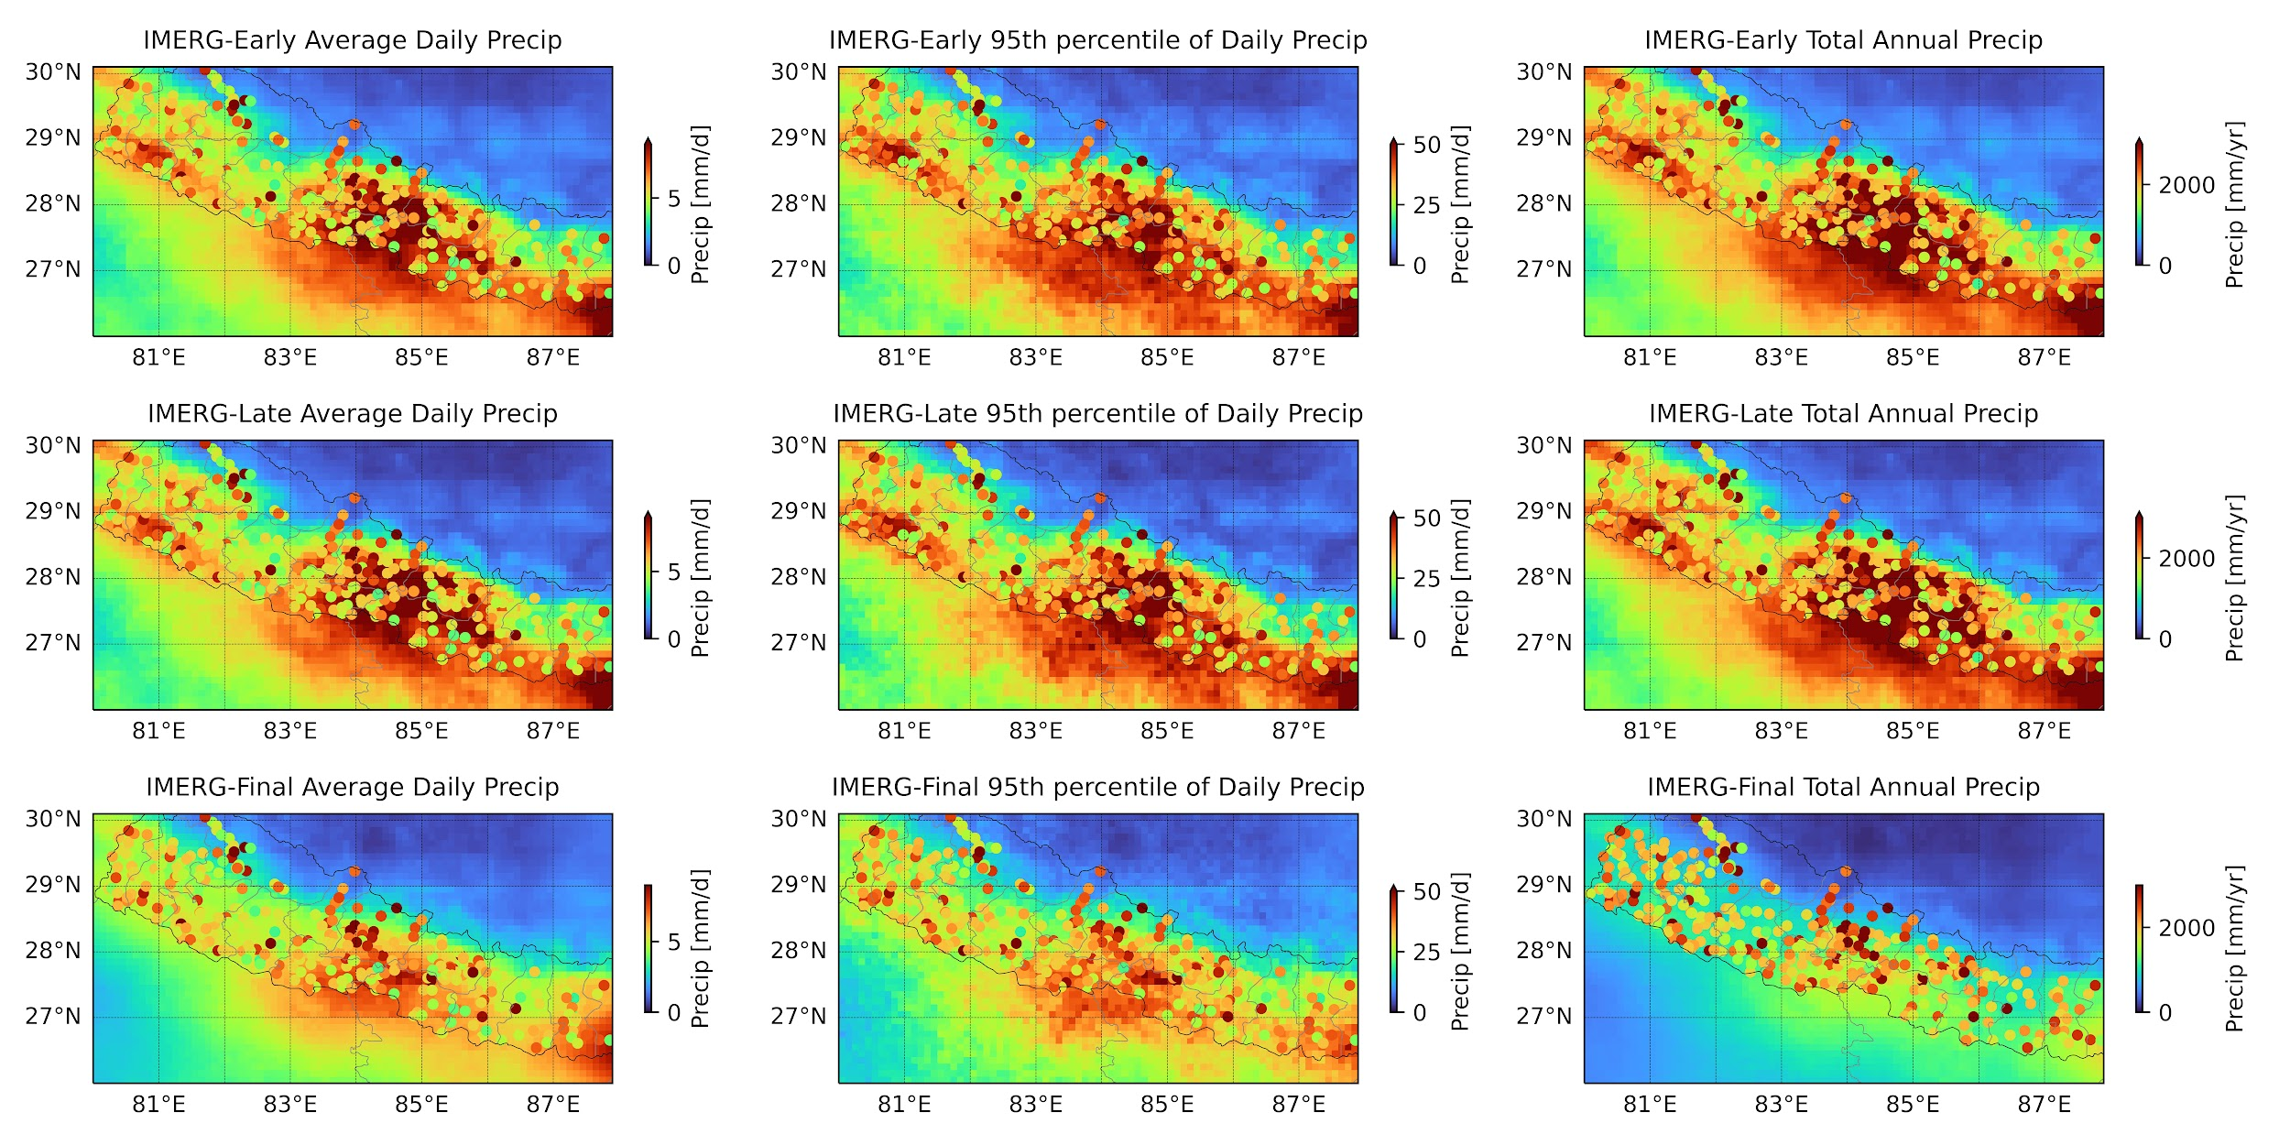



Investigating the Application of IMERG in Ungauged Regions in Nepal
Overview of Project
Gauge data is limited in mountainous regions of Nepal, creating a need for satellite precipitation data.
Working with mentors, a representative from Nepal’s Department of Hydrology and Meteorology (DHM) evaluated IMERG Early, Late, and Final products to understand which product is most suitable for precipitation estimates in high elevation, ungauged regions of Nepal.
Previous research projects compare a single version of IMERG to gauge data in Nepal, but they do not compare accuracy of multiple IMERG products.
The goal of these efforts are to determine whether IMERG can fulfill the region’s need for precipitation data and help improve weather forecasts.
Results will help DHM:
  Understand climatology and current precipitation in ungauged regions.
  Increase trust that the best product is being used.
Precipitation statistics (average daily precip, 95th percentile of precip, and average annual precip) for IMERG E, L, F (top to bottom). Note the high spatial variability among gauge stations that IMERG is unable to capture. Credit: R. Lamichhane.
PMM Mentor:
Ankita Pradhan
University of Wisconsin-Madison
2023 Team
Mentee:
Rojan Lamichhane
Nepal DHM
PMM Mentor:
Sam Hartke
NCAR

Slide 20
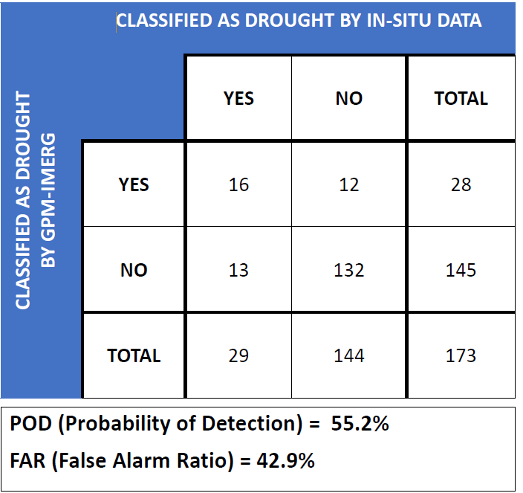

Evaluation of IMERG for Drought Classification
Overview of Project
Argentina’s economy is mainly based on the export of raw materials such as meat, corn and soybeans.
This stresses the need for both local and national governments and producers to classify the magnitude of drought.
The team explored the suitability of IMERG throughout the Pampas region of Argentina to classify drought conditions through the computation of the Standardized Precipitation Index (SPI).
  This will help support local and national government initiatives for early drought warning systems.
Results indicate that as IMERG database grows, thus reducing the sampling error, the reliability of the IMERG based drought classification will increase.
Using IMERG daily for the 2000 to 2020 years a gamma probability distribution function was fitted against monthly accumulated precipitation for six locations where in
situ data is available in the most fertile region of Argentina. Above show results for detecting drought. Credit: S. Villar.
2023 Team
PMM Mentor:
Marcelo Uriburu Quirno
CONAE
Mentee:
Santiago Villar
U. Of Buenos Aires

Slide 21
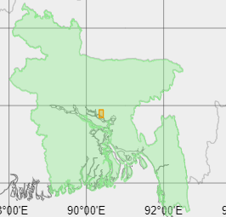
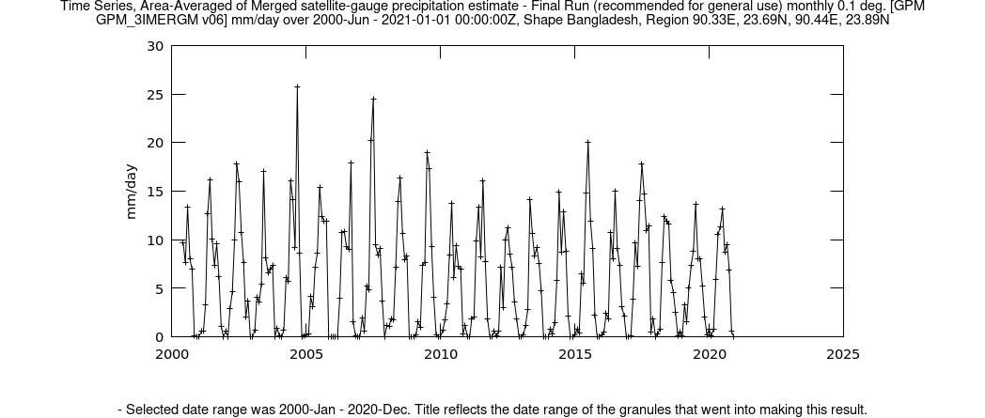

Understanding Data Access Tools to Assess Urban Flooding Events
Overview of Project
To examine scenarios of urban flooding caused by climate factors in Dhaka, India, the participant explored the use of IMERG to gain a deeper understanding of long-term precipitation patterns and potential impacts on the local ecosystem and human activities.
The participant was introduced with data access tools across the GPM webpage and GES DISC sites, including Giovanni.
Next Steps:
  Analyze extreme events using IMERG
  Calculate event frequency and duration
  Explore temporal patterns through time series plots
  Assess interannual variability
  Detect trends using statistical methods
  Results will be able to demonstrate an urgent need to plan and manage development in a way that preserves and enhances hydrological connectivity.
Monthly Average Precipitation calculation from 2000 to 2020 using IMERG in Dhaka. Map highlights designated area of interest. Credit: Zahrun Zannut (Bangladesh University)
2023 Team
PMM Mentors:
Vasco Mantas, U. of Coimbra
Zhong Liu, NASA/MSU
Mircea Grecu, NASA/ MSU
Andrea Portier, NASA/SSAI
Mentee:
Zahrun Zannut
Bangladesh University

