Slide 1
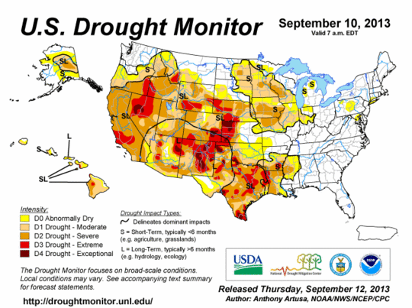
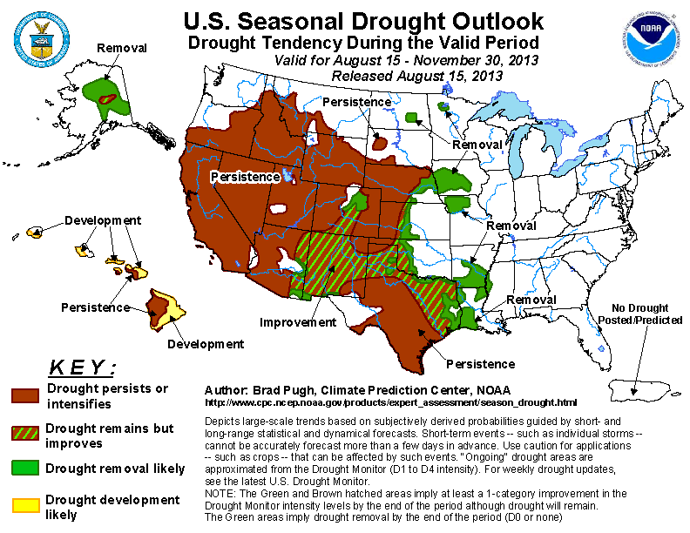
Challenges in Drought Monitoring and Prediction:
Kingtse Mo
Climate Prediction Center,
NCEP/NWS/Noaa

Slide 2
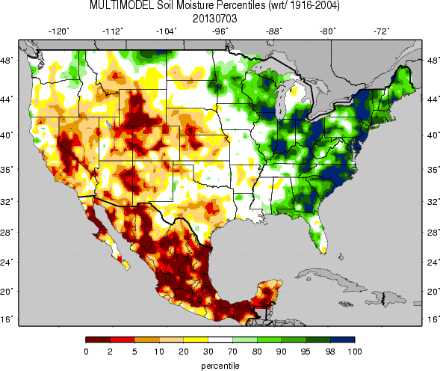
Soil moisture % from ensemble NLDAS
Agricultural drought
NCEP/EMC
U Washington
Both captures the wetness over the Eastern and East-Central regions of the United States and dryness over the Southwest and the Plains,
But intensity differs
Notes:
Uw plot from http://www.hydro.washington.edu/forecast/monitor/curr/conus.mexico/CONUS.MEXICO.vic.stot_qnt.gif

Slide 3
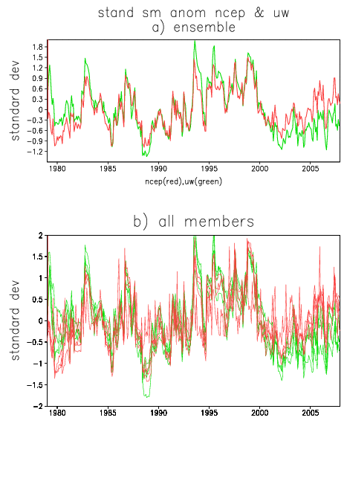
Differences are large in the real time period
Differences between two systems are larger than the spread among members of the same system
The differences are not caused by one model. They are caused by forcing.
In general, SM anomalies from the UW (Green) are larger than from the NCEP (red)
Real time
Historical period
standardized SM anomalies for area 38-42N,110-115W
NCEP(red),UW(green)

Slide 4
Experiments (CPC and UW)
The VIC model of 0.5 degrees resolution from the UW system was chosen for experiments.
All experiments started from Jan 1 1979 using the same initial conditions from the UW VIC model in the UW system.
Experiments end on 31Dec 2008
Forcing terms have two components
P forcing :Precipitation
F forcing : Tmax, Tmin and wind speed
Mo et al. 2012 JHM

Slide 5
Four experiments
Comparison between
Exp (P uw F uw) vs Exp(Pncep,Fuw) and
Exp (Puw, Fncep) vs Exp(Pnecp,Fncep)
indicates the differences caused by Precip
Comparison between
Exp (P uw F uw) vs Exp(Puw,Fncep) and
Exp (Pncep, Fuw) vs Exp(Pnecp,Fncep)
indicates the differences caused by F forcing (Tsurf and winds)

Slide 6
Experiments :RMS differences of SM %
Same F forcing
Same P forcing
Large differences between experiments with the same F forcing but different P forcing

Slide 7
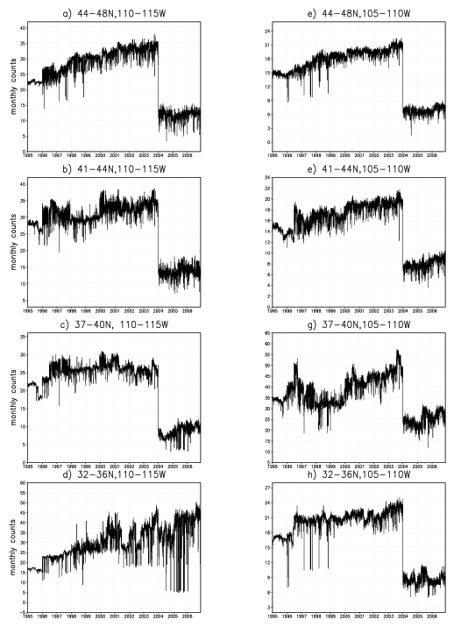
Challenges: improving drought monitoring
Number of reports /month averaged over the box
Large drop in real time
Improve real time Precipitation data and analyses
—GPM can help
9

Slide 8
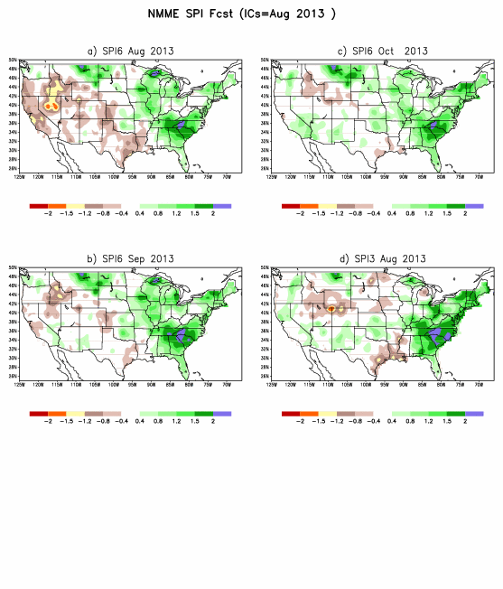
Real time SPI fcsts in operation since Jan 2013
Example: 201308
verification

Slide 9
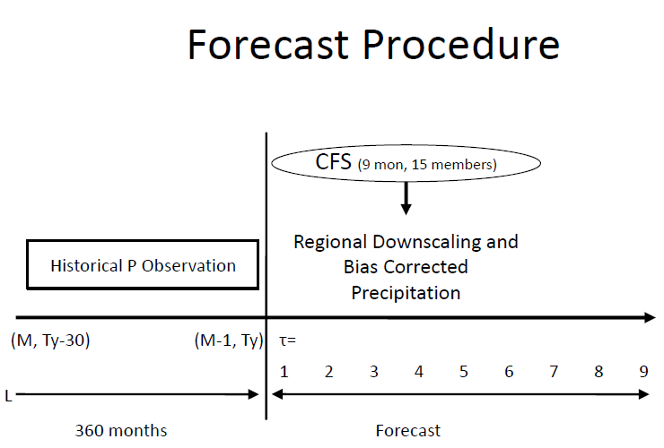
SPI forecast
If you have precip monthly mean fcsts, you can have the SPI forecasts
CGCM
Yoon et al. JHM 2012
Yoon et al. (2012), JHM
SPI3 at lead-1 has 2 months P analysis
and one month predicted P

Slide 10
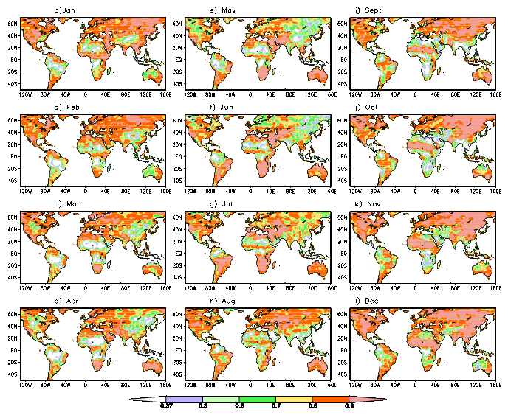
SPI3 Lead=1 mo: High skill contribution from P analysis—CPC gauge analysis

Slide 11
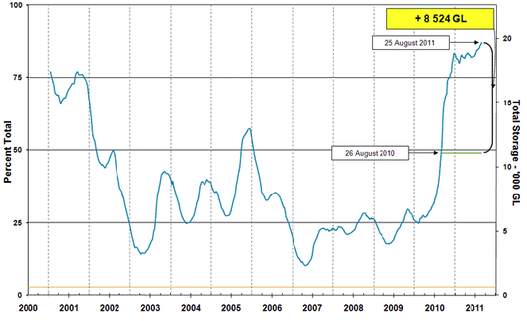
Water storage in the Murray Darling Basin (Australia) from BMRC- Australia Big dry
august
Multi year drought
Murray Darling basin (dry area with weak annual cycle)

Slide 12
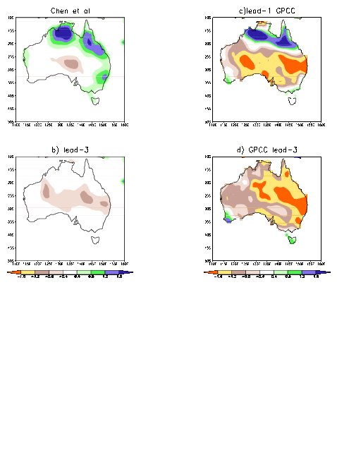
SPI3 prediction for the Australia 2006 August
CPC Gauge
Chen at al
Lead -1
GPCC
GPCC captures the drought
Lead-3

Slide 13
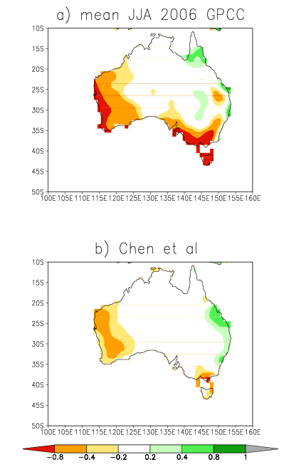
Seasonal mean P anomaly for JJA 2006
The reason that the GPCC captures the Australia drought in 2006 JJA
is that the GPCC has better analysis and
The dryness can be found in the seasonal mean of JJA 2006
BUT GPCC is not real time operation
CPC Gauge

Slide 14
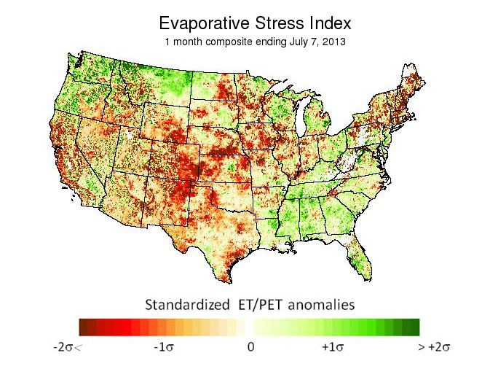
Satellite data used for monitoring
Directly
Evaporative Stress Index– Martha Anderson
Advantages _ no NLDAS model used ( independent index)
Disadvantage – not for winter
Indirectly– through P analysis
Gauge-OLR based Precip –Pingping Xie

Slide 15
Discussion
Better Precipitation Analysis will improve drought or extreme events monitoring and prediction
For gauge only products, the real time data inputs have been poor(drop one third), satellite data can fill the gap.
Satellite rainfall from CMROPH etc does not have long enough records to use for monitoring of climate drought /extreme events –Merged products?
In verification, intraseaonal oscillations and many others, satellite rainfall can be valuable
To be useful to our applications, we need real time operation.

