Slide 1
The Use of Weather Satellite Data in Aviation Operations and Research
NASA GPM-ACCP Transportation and Logistics Workshop
Randy Bass
Manager, Weather Research Branch
2 Nov 2020

Slide 2
Outline
COVID-19 Impacts on Aviation Operations and Weather Data
NextGen Weather Architecture
NextGen Aviation Weather Division Overview
Use of Satellite Data in Current Operations
Use of Satellite Data in Aviation-Weather Research
Summary and Questions

Slide 3
COVID-19 Impacts
Commercial flights in the US are down 60% since March
  Down 80% at the peak in April
  Passengers per day went above 1M around 18 Oct for the first time since March; pre-COVID average was 2.9M per day
  While some increase in flights and passengers is temporarily expected for the Thanksgiving and Christmas holidays, overall demand and numbers of flights will probably be steady at least until the spring

Slide 4
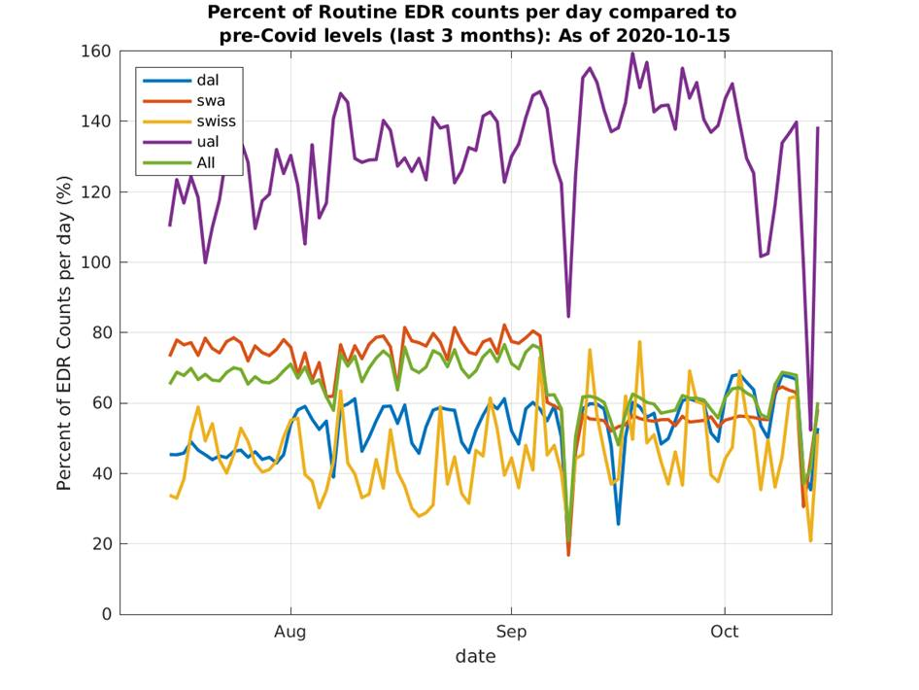
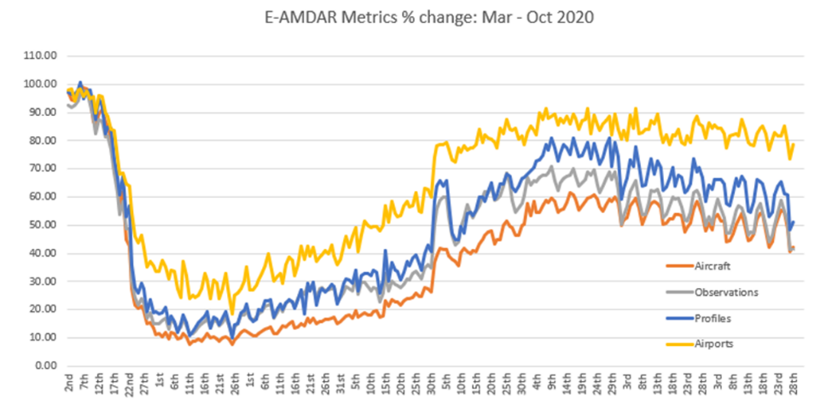
COVID-19 Impacts (cont.)
Airborne observation data has been impacted
  AMDAR data is down 47% since March (low of 88% in April)
  Eddy Dissipation Rate (measure of turbulence intensity) is around 55% of pre-COVID levels
The drop in airborne observations has slightly impacted the accuracy of weather models
  Very hard to quantify since there wasn’t a complete denial of observations
  Not as severe as aftermath of 9/11 when no aircraft were flying

Slide 5
Outline
COVID-19 Impacts on Aviation Operations and Weather Data
NextGen Weather Architecture
NextGen Aviation Weather Division Overview
Use of Satellite Data in Current Operations
Use of Satellite Data in Aviation-Weather Research
Summary and Questions

Slide 6
NextGen Weather Architecture

Slide 7
NextGen Weather Products – Non-Gridded

Slide 8
Outline
COVID-19 Impacts on Aviation Operations and Weather Data
NextGen Weather Architecture
NextGen Aviation Weather Division Overview
Use of Satellite Data in Current Operations
Use of Satellite Data in Aviation-Weather Research
Summary and Questions

Slide 9
Aviation Weather Division
Vision: A National Airspace System (NAS) free of weather caused delays, cancellations, diversions and accidents/incidents
Mission: Assure the development, enhancement, dissemination, and integration of productive weather information into Air Traffic Management decisions by pilots, controllers, flight operations and airport operators

Slide 10
Desired Goals and Outcomes
FAA’s recognized source of aviation weather expertise
Increase the number of advanced weather capabilities used in aviation
Provide engineering, evaluation, and technical services to support aviation weather initiatives
Solve aviation weather problems and implement solutions for the NAS
Provide operational weather guidance and standards enabling pilots to stay safe
Collaborate global harmonization of weather standards and requirements in alignment with NextGen
Coordinate with FAA operations, safety and standards organizations, NWS and commercial sector to improve and integrate weather information into aviation decision making

Slide 11
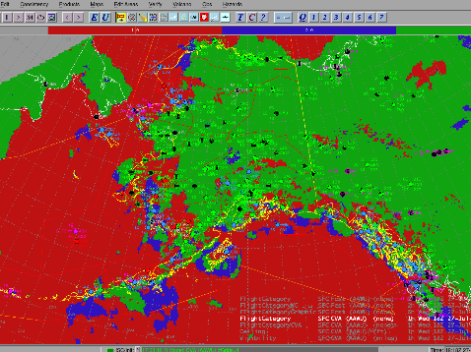
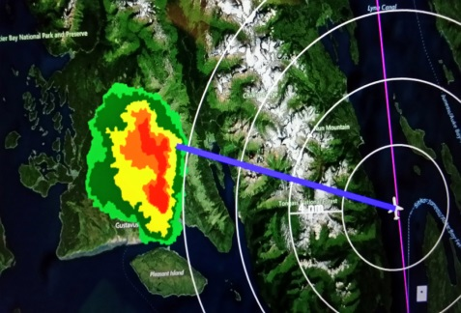
Weather Research Branch
Conducts research to mitigate the impact of weather on aviation by transitioning the research to operations
Core Functions:
  Manage the Aviation Weather Research
  Program
  Manages the Weather Technology in the
  Cockpit (WTIC) Program
  Coordinate research with other Federal
  agencies
  Transition technologies (R2O)

Slide 12
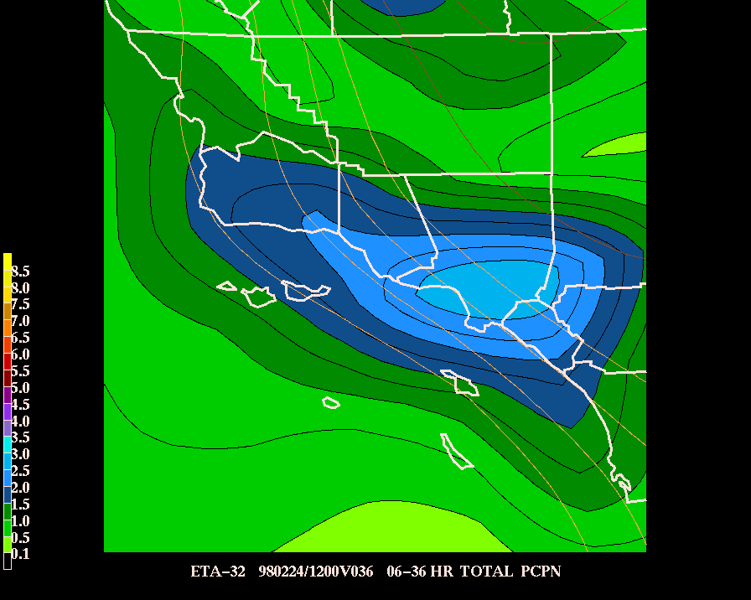
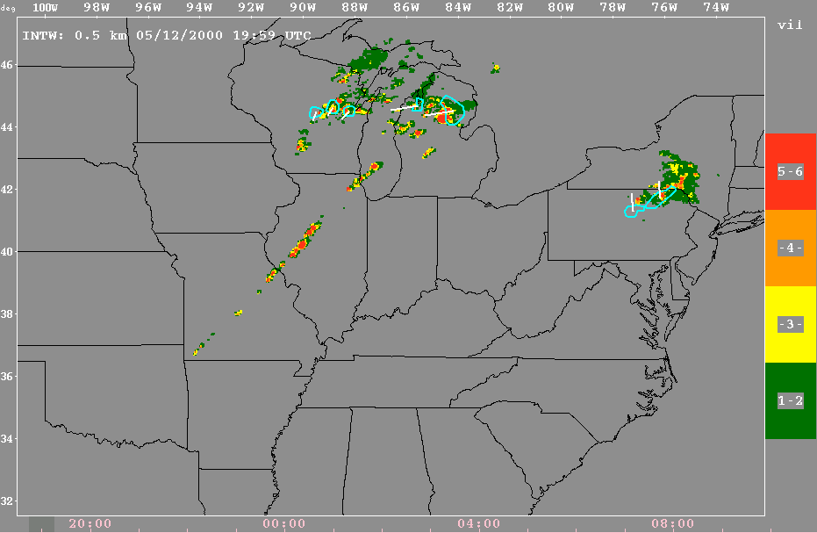
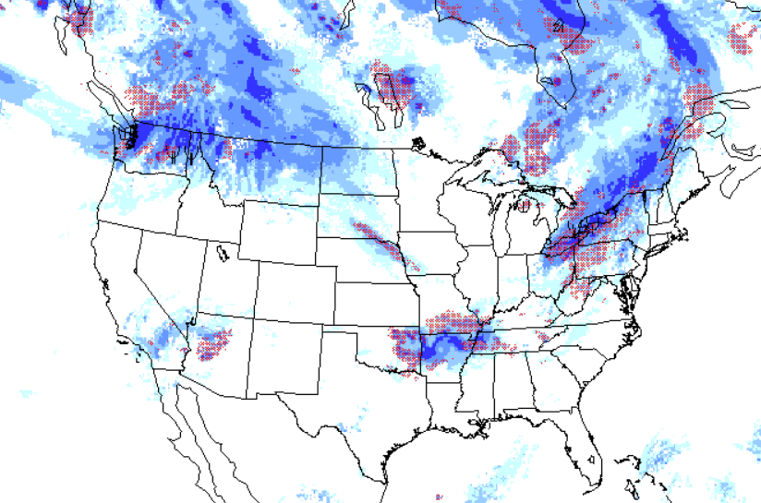
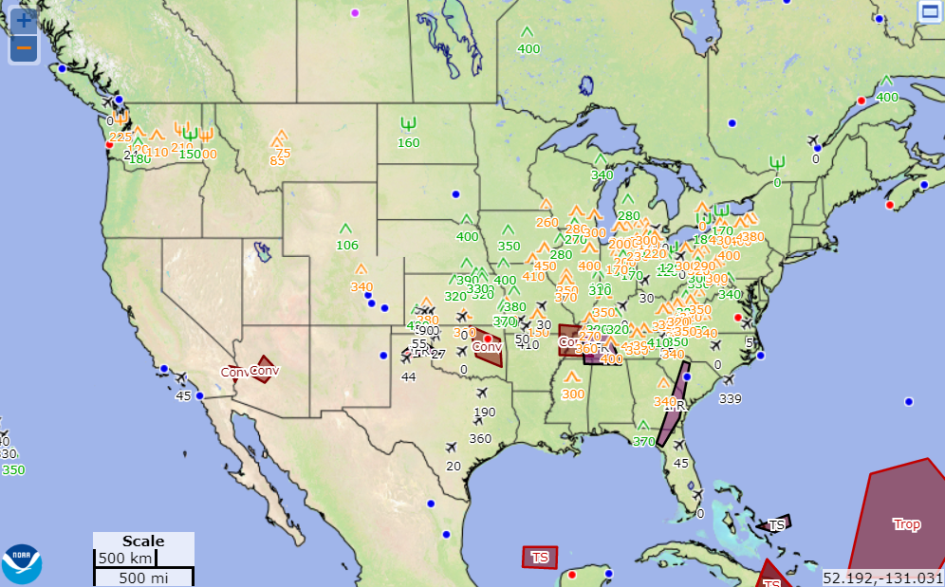
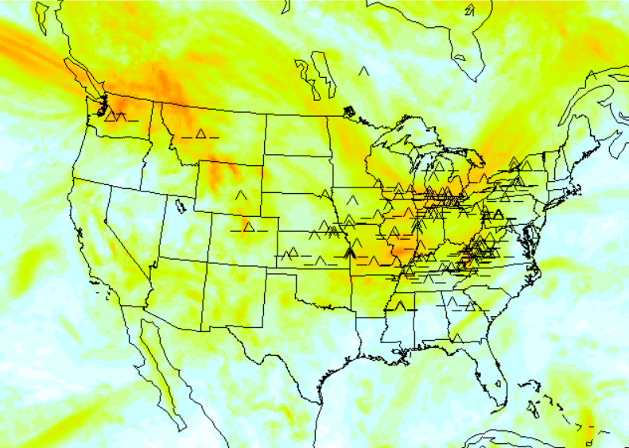
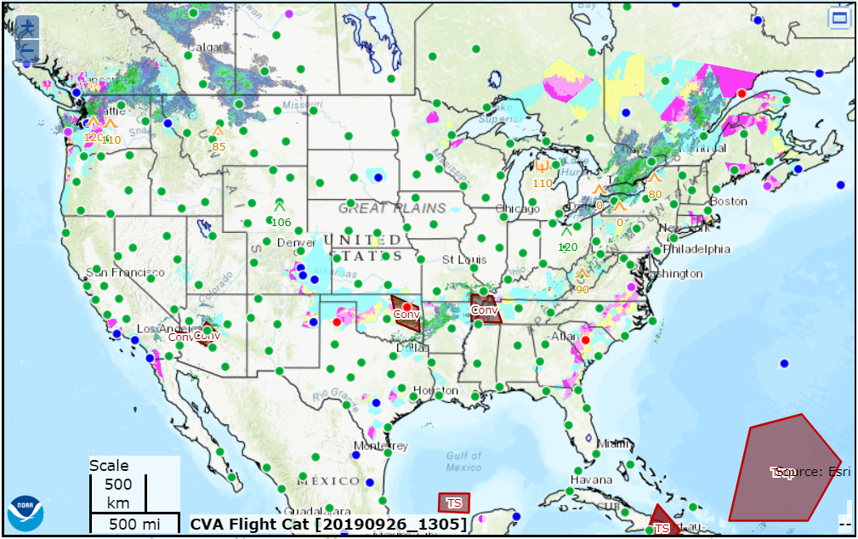
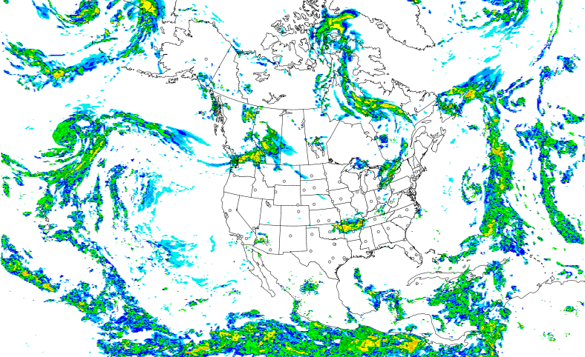
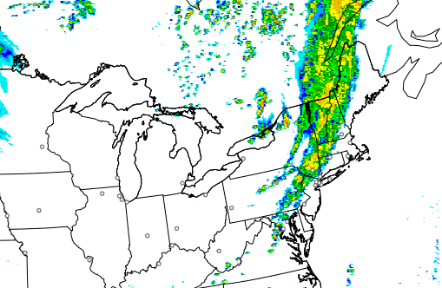
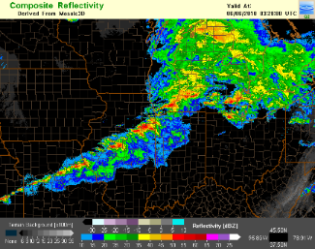
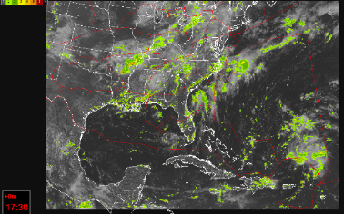
AWRP 20 Year History of Success
2002: CIP; 2004: FIP; 2011: FIP Severity;
2012: CIP/FIP RAP; 2014: CIP/FIP High
Res; 2018; IP Alaska
2003: Aviation Digital Data Service (ADDS);
2016: aviationweather.gov
2003: GTG; 2010: GTG2 (Mid-Levels);
2015 GTG3 (MtnWv & Low Lvl);
2019 GTG-N (Experimental)
1998: 40KM; 2002: 20KM;
2005: 13KM
2001
Rapid Update Cycle (RUC)
National Convective Wx Forecast
Icing Forecasts
Web-based Products
Turbulence Forecasts
2007: Experimental ADDS
2015: Operational ADDS
2012; Updated 2018
2014; Updated 2018
2014
2017
Helicopter Emergency Medical Services
Rapid Refresh (RAP)
High-Resolution Rapid Refresh (HRRR)
Multi-Radar, Multi-Sensor (MRMS)
Offshore Precipitation Capability (OPC)

Slide 13
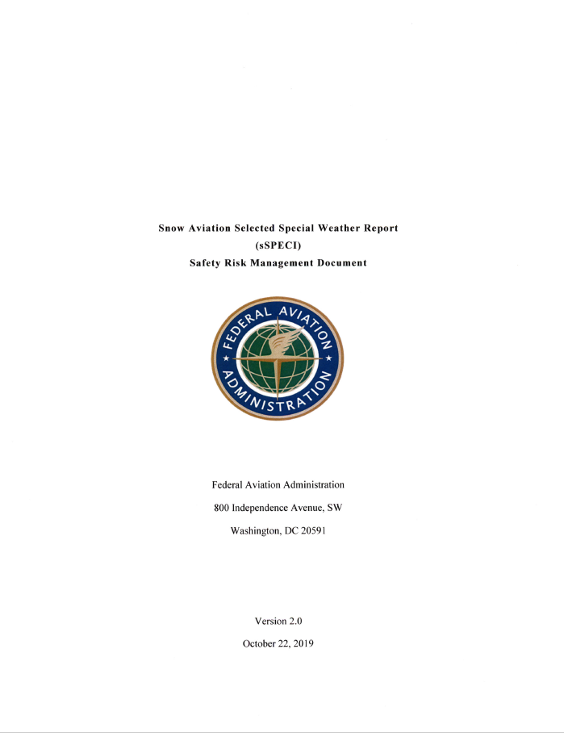
New Weather Concept Development Branch
Bridges the gap between available and/or emerging weather products and services with operational weather requirements for Air Traffic Managers Decision Support Processes/Decision Support Tools (DSPs/DSTs) through weather integration
Core Functions
  Leads weather integration initiatives for DSPs/DSTs
  Manages contract vehicle awards and initiatives
  Generates and processes procurement requests
  Tracks division's budgetary allocations
  Manages division's Safety Risk Management initiatives
  Coordinates and aggregates FAA’s inputs for Office of the
  Federal Coordinator for Meteorology annual updates
Notes:
Weather Integration - Pull Mode: The bi-directional (pull mode) refers to coordination with air traffic managers (ATMs) in effort to comprehend their weather needs as it relates to making optimum “weather related” National Airspace System (NAS) decisions.
Weather Integration - Push Mode: The push mode involves leveraging weather information, technology, and/or products that are currently available and/or emerging from research that could benefit ATM DSPs/DSTs. This includes demonstrating the usability of weather products or services and engaging ATM decision makers to validate that the products and/or services can positively contribute (from a weather perspective) to improving NAS efficiency and safety.

Slide 14
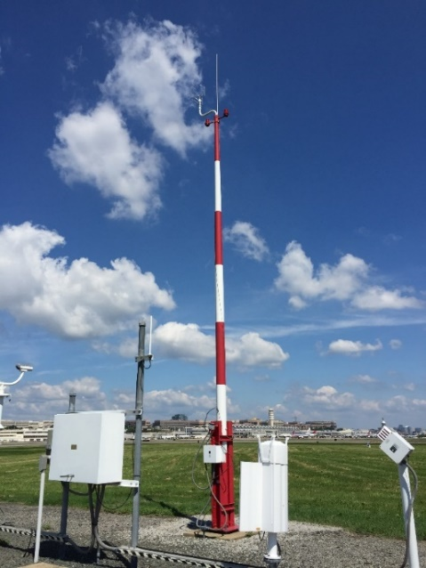
Weather Engineering and Evaluation Branch
Provide engineering, evaluation, and technical services to support aviation weather initiatives. Capabilities include weather system and user laboratories as well as Airport Operations Area testbeds
Core Functions:
  Conducts Aviation Weather Demonstrations and Evaluations
    Coordinates Quality Assessments of recent research
    Partners with users to test and evaluate new products and tools
  Integrates new technologies into the NAS for all users and
  stakeholders with NextGen Weather Processor/Common
  Support Services-Weather
    Test and Evaluation support for baseline system
    Program Management for Enhancements 1 package
  Leads engineering support for RVR program
  Leads Weather Observation Improvements Project Level Agreements (PLA)

Slide 15
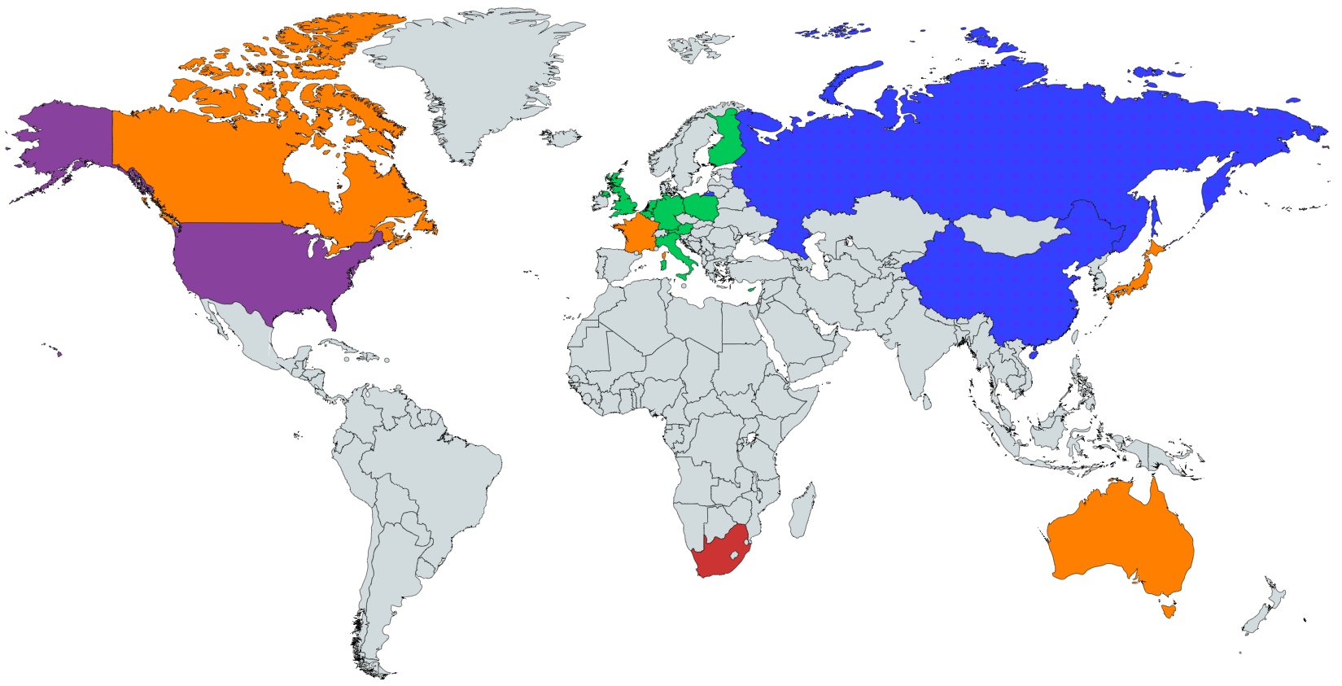
Policy and Requirements Branch
Identifies and coordinates domestic and international weather requirements
Core Functions:
  Collaborates with international partners
  to develop weather requirements
  Entry point for new weather service requests
  Leads Weather Information Modernization
  and Transition
    Stakeholders coordination for future aviation
    weather capabilities
    Looks for ways to streamline product suite and promote consistency
  Leads ATM Weather – Weather Transition PLA

Slide 16
Outline
COVID-19 Impacts on Aviation Operations and Weather Data
NextGen Weather Architecture
NextGen Aviation Weather Division Overview
Use of Satellite Data in Current Operations
Use of Satellite Data in Aviation-Weather Research
Summary and Questions

Slide 17
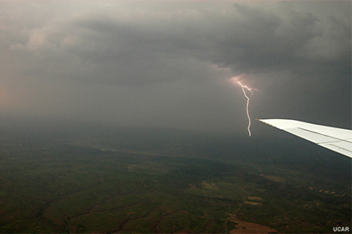
GLM at AWC
The Aviation Weather Center became the first National Center to use Geostationary Lightning Mapper (GLM) operationally (spring of 2018)
Used primarily by the Convective SIGMET and Tropical Desks
  MRMS and GLM overlay = 2 minute
  GOES 16/17 and GLM overlay = 5 minutes
  Full disk views important for cross Atlantic flights
    First real look at intra-cloud lightning over the Atlantic, Pacific, and Caribbean
Full disk mode allows the global graphics desks to view convection over South America
    Verification
Courtesy of AWC – Amanda Terborg

Slide 18
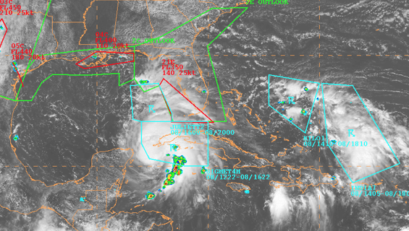
GLM and Tropical
AWC Tropical Desk
  SIGMETs for convection
  SIGMETs for tropical cyclones
First real look at intra-cloud lightning offshore
  Provides additional observations where there is no radar
Additional observations provide more confidence in the extent of the SIGMET needed
  Jet Routes potentially impacted if full extent not covered
  Particular impact to oil operations in the Gulf of Mexico/Caribbean and helicopter pilots
Courtesy of AWC – Amanda Terborg

Slide 19
High Pass Filter and Probability of Moderate or Greater Turbulence
ABI and AHI (Himawari) have sufficient spatial and temporal resolution to detect many turbulent episodes
  Some features in clear sky, some in clouds (technically over clouds)
Deep Learning is used to relate satellite obs to the likelihood of Moderate or Greater (MOG) turbulence
  Thousands of turbulent and non-turbulent cases are used to create the predictive model
    Infrared Window Channel (10.3 μm) and (upper-level) Water Vapor Imagery (6.2 μm)
    Aircraft-based obs of turbulence (at 30,000 - 40,000 ft) are used to train and validate the model
The turbulence product is probabilistic (%); interpreted as the probability of MOG…
  At any level within typical cruising altitude (30,000 - 40,000 ft)
  For large aircraft (ex: Commercial Passenger)
  At least once during a 10-minute period
Courtesy of AWC – Amanda Terborg

Slide 20
High Pass Filter and Probability of Moderate or Greater Turbulence
Which Channels are Used?
  Water Vapor imagery is preferable, but a window channel-only option is available for times when the GOES-17 Loop Heat Pipe is not cooling the ABI enough
  For Window Channel only
    Predictions of Turbulence are about 1/3rd less precise
    Regions of predicted turbulence are larger and more smoothed out
Does It Matter What Is Producing The Turbulence?
  Better Detection
    Strong gravity waves that perturb clouds
    Developing convection
  Poorer Detection
    Subtle gravity waves that emerge near convection or jet-stream shearing
  Especially true when only Band 13 (10.3 μm) is available
Courtesy of AWC – Amanda Terborg

Slide 21
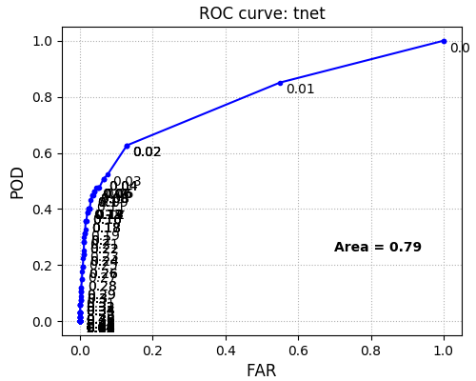
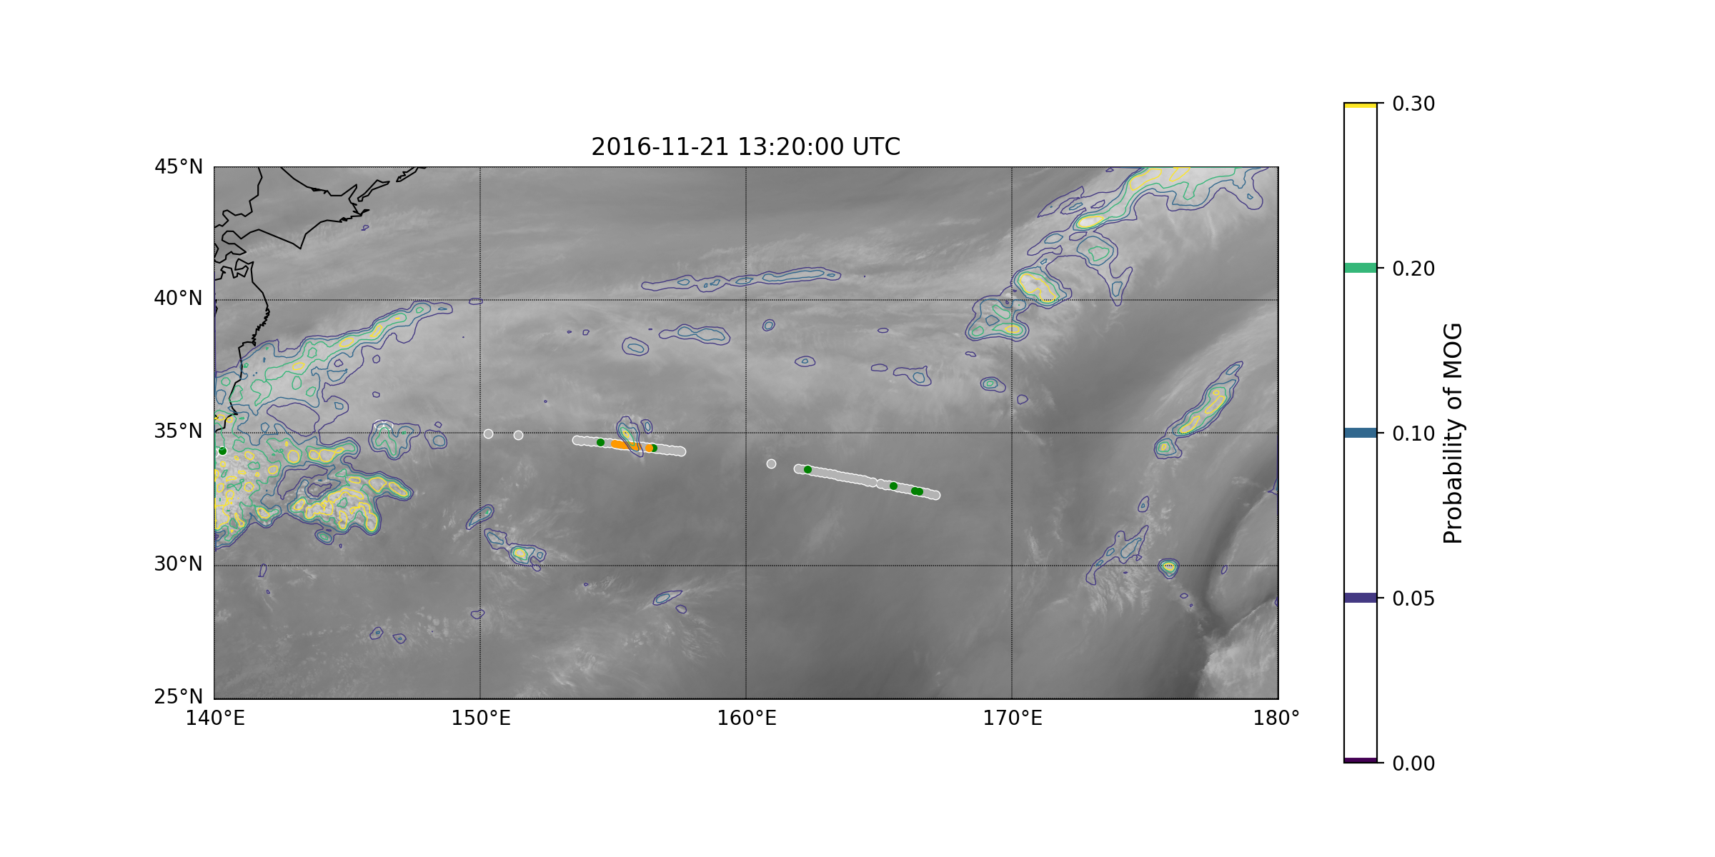
Performance
Precise estimation of turbulent regions confirmed by observations (orange = MOG observation)
Detects ~45% of turbulence at cruising altitude with very low false alarm rate
Courtesy of AWC – Amanda Terborg
Images: Courtesy of Scott Lindstrom and Tony Wimmers of CIMSS

Slide 22

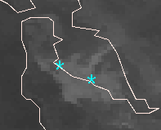
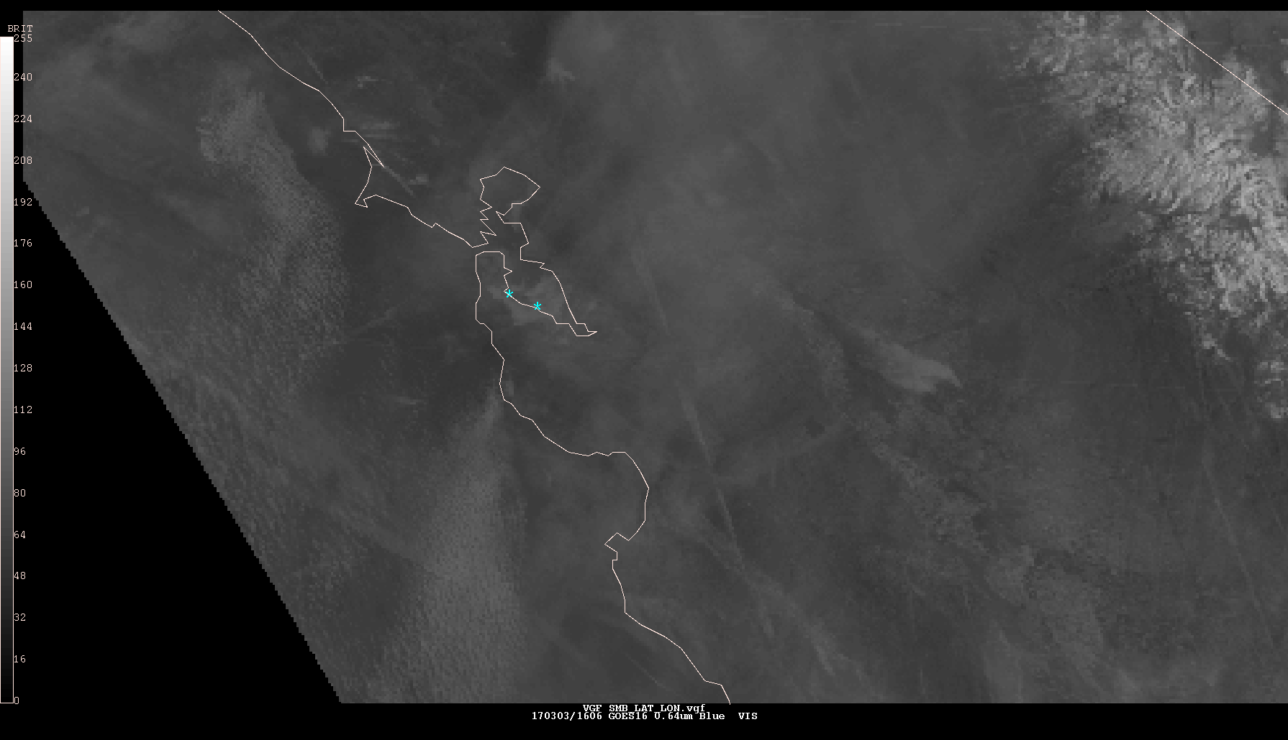
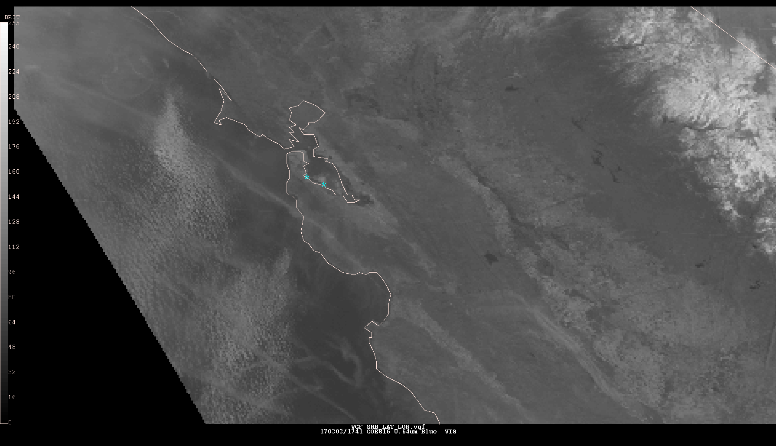
IDSS @ SFO using GOES-16
(03/03/17)
Courtesy of AWC/NAM – Michael Eckert
1631Z
SFO
SMB
1741Z

Slide 23
IDSS @ SFO using GOES-16
(03/03/17)
1600Z - Patch of Stratus formed over SFO & SMB necessitating a Ground Delay Program 1700z-1959z
1700Z – GOES-16 loop shows edges starting to erode
1715Z – GOES-W (legacy) loop shows edges starting to erode
1719Z – NAM coordinates with CWSU ZOA & ATCSCC Specialists that Stratus is clearing rapidly
1730Z – GOES-16 loops shows stratus almost clear
1747Z – CWSU ZOA reports Pilots are getting Visuals into SFO
1756Z – ATCSCC cancels GDP
Original GDP impacted 48 flights @ 38 min average delay per flight
48 x 38 = 1824 minutes of delay x $81.00/min cost = ~$150,000.00 (Total Delay Costs)
GOES-16 Estimated Savings:
32 flights freed up
32 x 38 = 1216 min of delay recovered x 81.00/min = ~$100,000.00 (Costs recovered)
GOES-W Estimated Savings:
16 flights freed up
16 x 38 = 608 min of delay recovered x $81.00/min = ~$50,000.00 (Costs recovered)
minus
Estimated cost savings related to GOES-16 = ~$50,000
GOES-16… 5 min updates & higher resolution –vs- GOES-W… 15 min updates & lower resolution provided AWC/NAM with earlier & higher confidence that clearing would hold
Imparting this information to the FAA resulted in the earlier Ground Delay Program cancellation
Courtesy of AWC/NAM – Michael Eckert

Slide 24
Outline
COVID-19 Impacts on Aviation Operations and Weather Data
NextGen Weather Architecture
NextGen Aviation Weather Division Overview
Use of Satellite Data in Current Operations
Use of Satellite Data in Aviation-Weather Research
Summary and Questions

Slide 25
Offshore Precipitation Capability (OPC)
Blends weather satellite imagery, lightning data and weather model data to produce a near-real-time estimate of precipitation, including thunderstorms, for areas that lack radar coverage
Provides offshore situational awareness of weather activity for Air Traffic Controllers beyond the range of current weather radar
Initial domain is the Gulf of Mexico, Caribbean, and Atlantic Ocean adjacent to the Southeastern US
  Expanding domain this fall into Pacific
Machine learning techniques are used to blend the data and generate the radar-like output
The result is blended with existing radar mosaics so that users have a seamless radar mosaic extending into offshore and oceanic regions

Slide 26
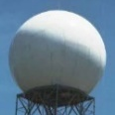
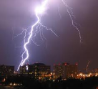
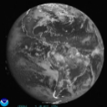
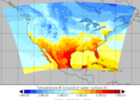
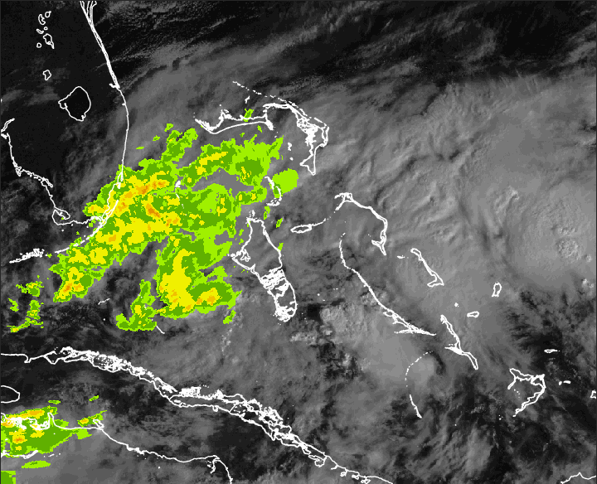
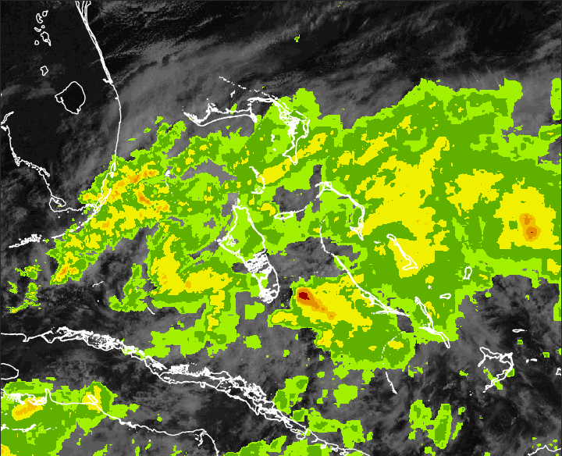
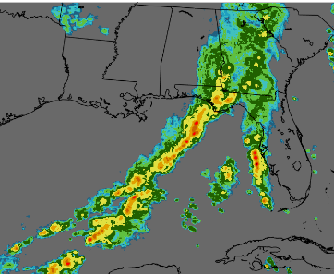
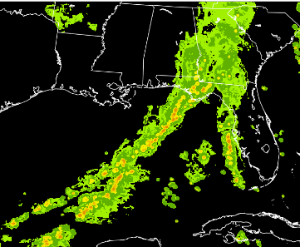
OPC
Offshore Precipitation
Capability (OPC)
Multi-Sensor Data Collection
Weather Radar
Lightning
Satellite
Numerical Model
Machine Learning
No
Radar
…
Convolutional Neural Network (2016)
Offshore Storm Height and Precipitation Intensity
Detects weather outside radar coverage
High spatial resolution
Accuracy of location
Rapid update, low latency
Storm Height Analysis (kft)
6-Level Precipitation Intensity
Notes:
This slide provides an overview of the OPC system. The goal of OPC is to detect hazardous weather outside radar range and present it to users in a way that resembles traditional weather radar. OPC was built to be rapidly updating, have a high spatial resolution, and to be accurate in both storm placement and intensity.
[Top Right] OPC works by fusing together data from multiple weather sensors. Radar, lightning, satellite and numerical model data are combined using advanced machine learning and artificial intelligence to estimate radar-derived fields in regions outside weather radar range. This estimated field is then combined with existing radar mosaics to fill in radar coverage gaps in areas like the Gulf of Mexico, Caribbean, Atlantic Ocean, and many other regions.
[Bottom Right] Two products are created by OPC, a storm height field, and a precipitation intensity field. The precipitation intensity can be viewed in either a 6 color green to red scale as shown here on the bottom right, or can be shown in the 3 color blue presentation commonly seen on the WARP display.
[Back to top left] By applying OPC, the radar analysis seen in the top left, which fails to detect any weather away from the Florida coast, is extended…
[Click forward]
…and now includes weather throughout the region.

Slide 27
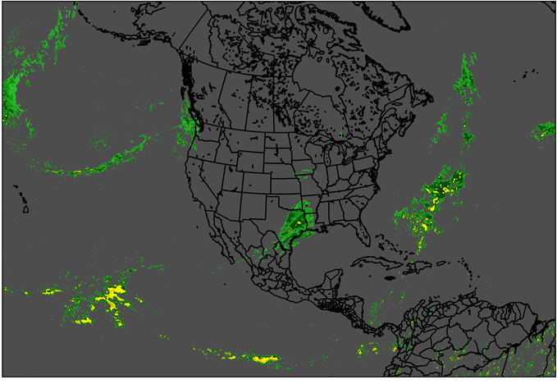
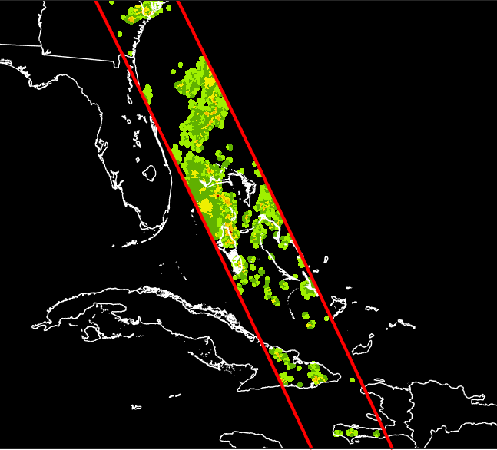
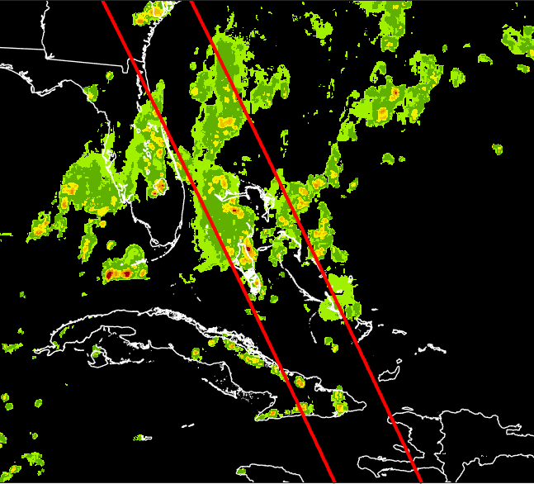
OPC
Uses legacy imagery channels from GOES 16/17
  Successful research using new ABI channels
Incorporated GLM lightning feeds from GOES 16/17 into OPC
  Improved depiction of storm intensity
Global Precipitation Measurement used for verification and validation
Expanded Domain
Legacy Domain
GPM DPR
Precip
OPC
Precip

Slide 28
Remote Oceanic Meteorology Information Operational (ROMIO)
Operational demonstration to evaluate the feasibility of uplinking convective storm information to commercial aircraft flying routes over remote and oceanic regions for display on an electronic flight bag
Identify minimum meteorological information for remote and oceanic regions
Conduct cost benefit analysis for both safety and efficiency
  Analysis of 18,326 commercial flights shows that strategic weather deviations using ROMIO could save 355 lbs of fuel per flight
  Annual fuel consumption savings of 6.8 million pounds or $1.8 million of fuel savings ($1.82/gallon)

Slide 29
ROMIO
GOES 16/17 scanning area
Satellite mosaics are created at 10 min intervals using latest data available
Provides outside shell of convective cloud top and anvil and not within the cloud
Information communicates cloud structure with maximum altitude and where convective hazards associated with strong updrafts / downdrafts are located

Slide 30
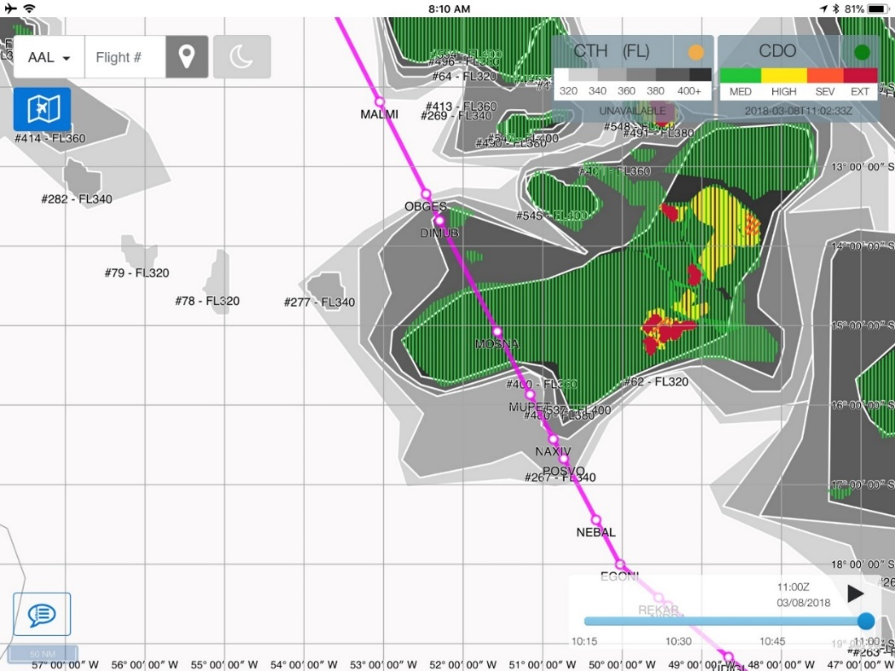
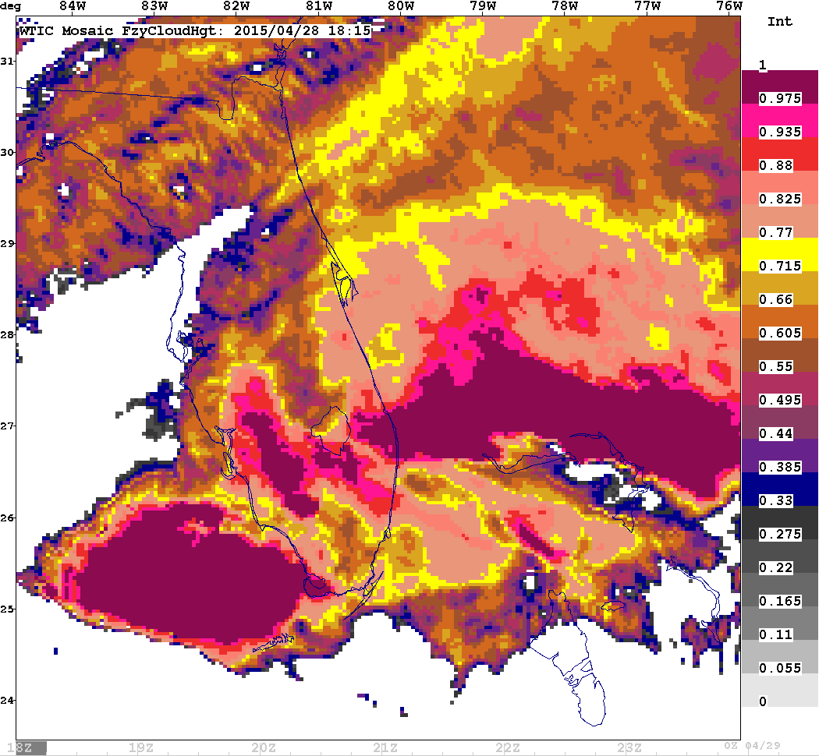
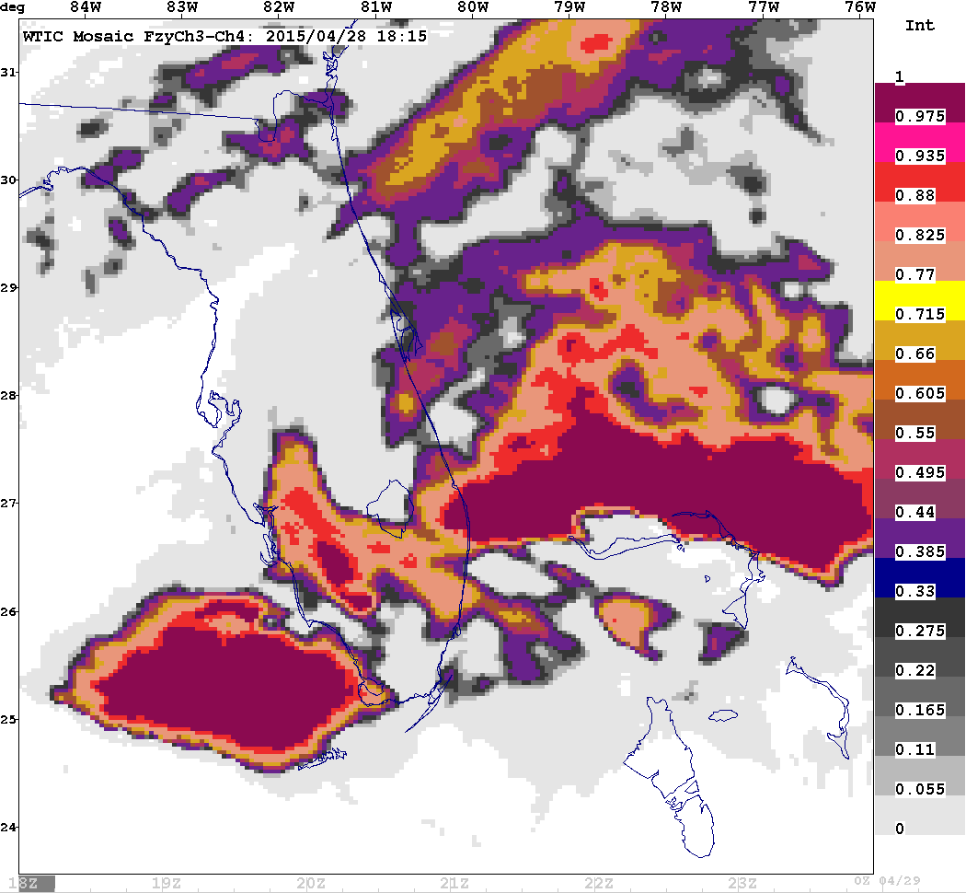
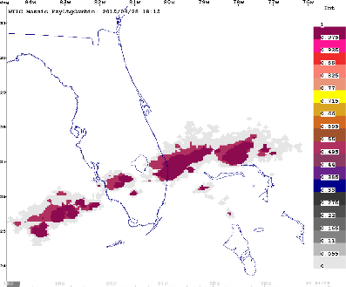
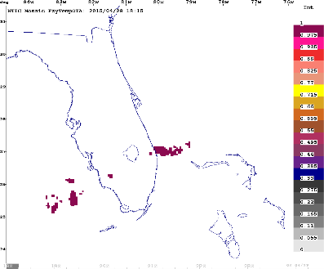
ROMIO
CTH / CDO Example and Inputs
Cloud Top Height
Global Convective Diagnosis
Combined Lightning
15, 30, 60 min accum
Overshooting Tops
Input Interest Fields after Membership Function Applied
Weights =1 or =3 for Combined Ltg

Slide 31
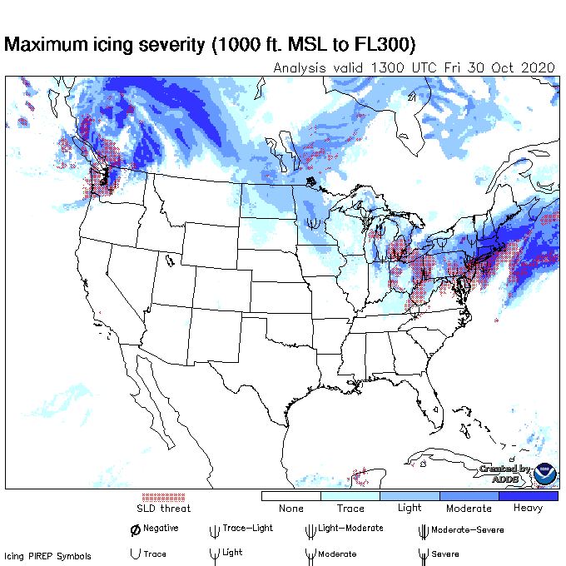
Icing Detection
Current Icing Product (CIP) – an hourly diagnostics tool to determine icing threat areas
  Integrated algorithm that uses satellite imagery, numerical weather prediction model output, radar and lightning data, surface weather observations, and pilot reports
CIP currently uses three GOES 16 ABI channels based on legacy methods
  Used to infer the presence of clouds in the cloud module
  Calculates cloud top temperatures which are used in the subsequent calculations of Icing Probability, Severity, and Supecooled Large Drop Potentials
All sixteen GOES 16/17 channels and several channel differences undergoing research for detection of supercooled liquid clouds
Research underway on using GLM data to identify convection which in turn identifies and maximizes Icing Probability and SLD Potential within CIP
Icing Product Alaska (IPA) provides experimental guidance for Alaska and surrounding areas
  Developed using the CIP as a foundation
  IPA enhancements will include additional observational sources for Alaska such as polar orbiting weather satellites

Slide 32
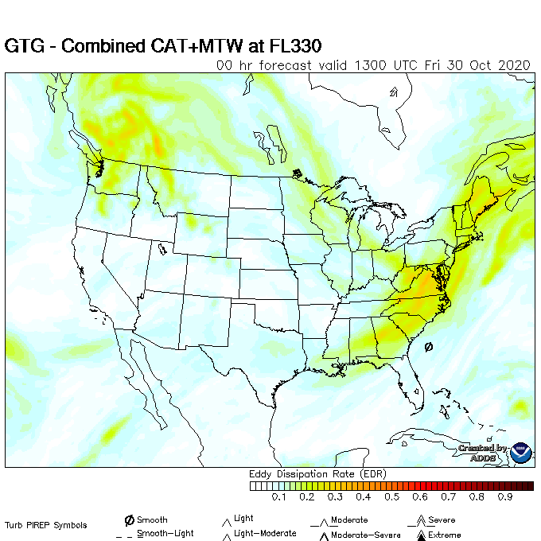
Turbulence
Incorporating satellite data (e.g. GLM and wave detection data) into Graphical Turbulence Guidance – Nowcast v2
Comparing/overlaying GOES visible and infrared satellite data with the flight track and in situ measurements of Eddy Dissipation Rate values
Establishing contracts with CIMSS and CIRA to leverage capabilities developed in GOES and JPSS proving grounds for turbulence detection, including development and implementation of satellite-based turbulence diagnostics

Slide 33
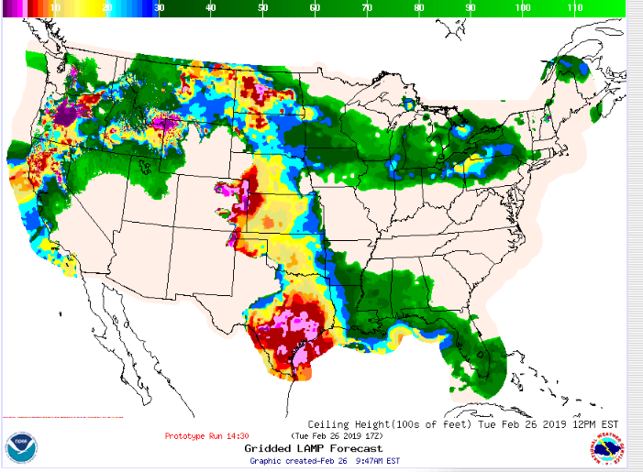
Cloud Ceiling and Visibility
Investigating usability of satellite data for ceiling height guidance
  Examining GOES16/17 datasets from University of Wisconsin CIMSS and NASA Langley
  Determine if satellite data can serve as observations between traditional observing stations
  Incorporate satellite data to produce 15-minute Gridded LAMP guidance for ceiling height and flight categories
Investigating usability of satellite data to improve LAMP visibility
LAMP C&V and Sky Cover Development

Slide 34
Future Needs and Research
Integration of polar satellite data in OPC
Convective Initiation
  Leverage satellite data to forecast CI before it starts (temporal and spatial)
  CrIS, ATMS, OMPS
  Explore the use of sounding data for detection of icing, turbulence and C&V
  Exploit satellite data for wind speed and direction through the atmosphere
  Use of GLM for airport ramp closures
  Lightning strikes to aircraft
    Can satellite data be used to analyze/forecast areas conducive to triggering lightning strikes to aircraft?
  Continued use of satellite data for validation and verification

Slide 35
Summary
COVID-19 has impacted the number of commercial flights in the US (and worldwide), which has in turn reduced the amount of airborne observations fed into numerical weather prediction models
NextGen weather architecture will reduce/eliminate standalone systems and streamline information for those systems
Weather is threaded throughout the FAA’s Mission
Aviation Weather Division has four branches, working together, to address aviation weather problems in the NAS
Weather satellite data is critical for aviation operations
Satellite data is being integrated into all facets of aviation weather

Slide 36
Questions?
Randy Bass
Manager, Weather Research Branch
FAA
randy.bass@faa.gov
202-267-2800

