Slide 1
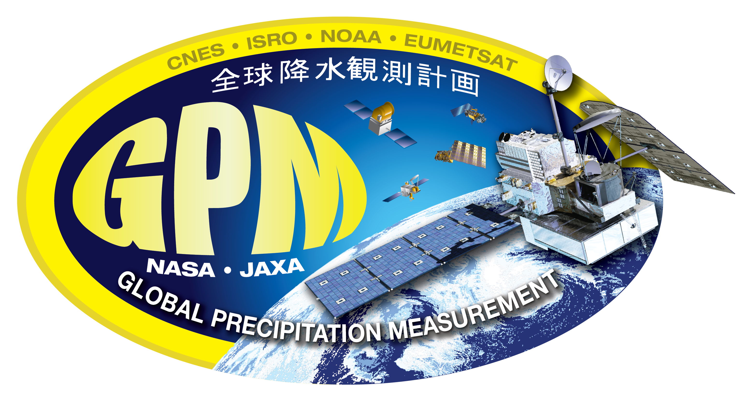
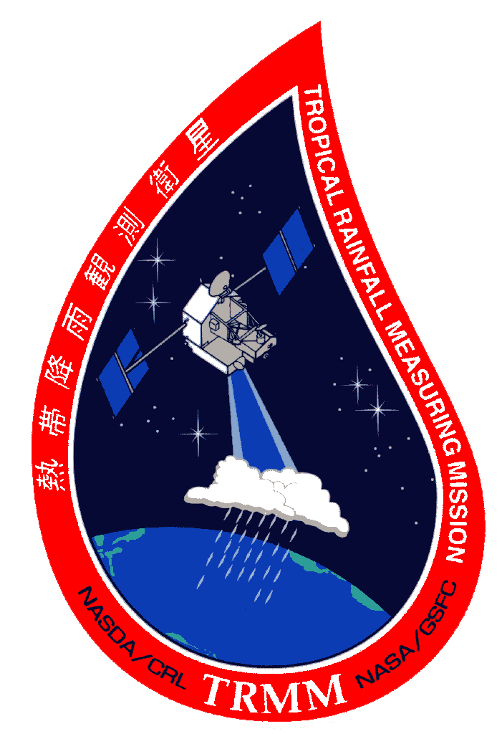
ACCP Applications Overview Applications Impact Team (AIT):
Emily Berndt (MSFC), Dalia Kirschbaum (GSFC), Ali Omar (LaRC)
Bryan Duncan (GSFC), Amber Soja (LaRC), Olga Kalashnikova (JPL),
Svetla Hristova-Veleva (JPL), Aaron Naeger (MSFC),
Anita LeRoy (MSFC), Patrick Gatlin (MSFC)

Slide 2
What is Applications as defined by the 2017 Decadal Survey
Direct use of remote sensing products in an operational and forecasting context
Use scientifically-sound remotely sensed data and information to enhance stakeholder and policy-relevant decisions
As our Earth system changes rapidly, NASA capabilities and observations add significant value to inform stakeholder decisions and policy
Introducing applications in Pre-Phase-A mission studies such as ACCP ultimately amplifies the societal benefit of NASA missions
Slide from the January 2018 press conference for 2017 Decadal Survey: "Thriving on our Changing Planet: A Decadal Strategy for Earth Observations from Space“
https://www.nap.edu/resource/24938/public-briefing-slides.pdf

Slide 3
Slide from the January 2018 press conference for the 2017 Decadal Survey:
"Thriving on our Changing Planet: A Decadal Strategy for Earth Observations from Space"
https://www.nap.edu/resource/24938/public-briefing-slides.pdf

Slide 4
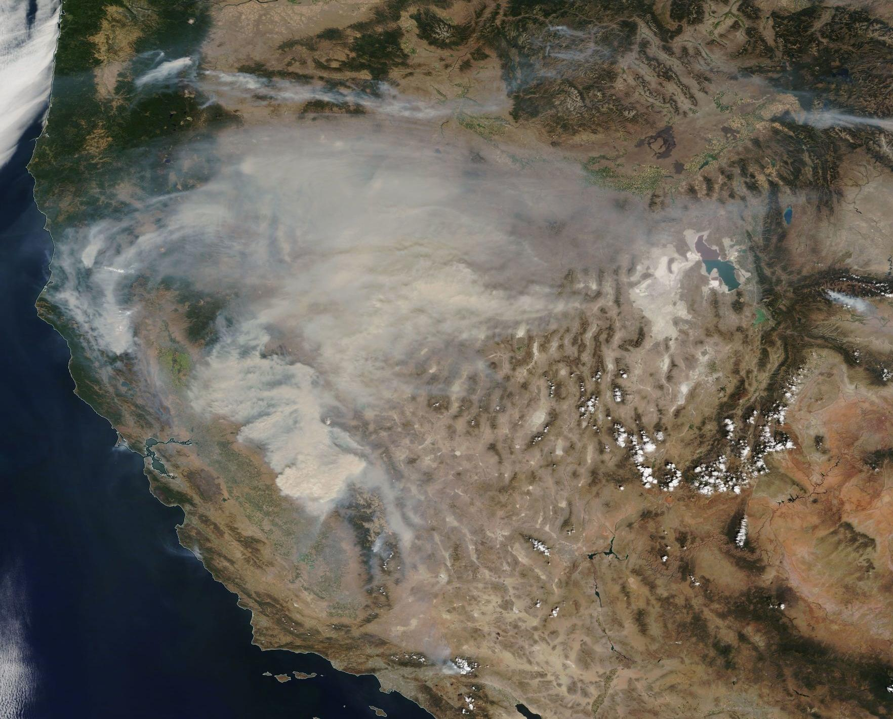
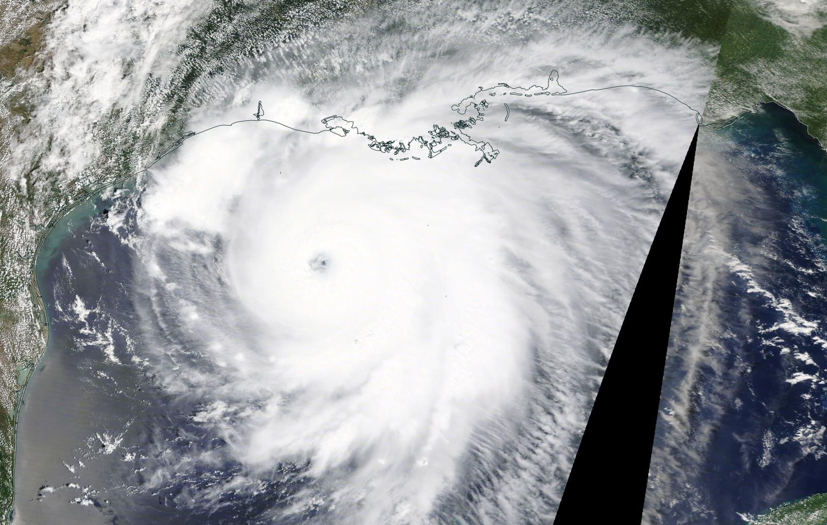
The ACCP Applications Impact Team (AIT) is charged with ensuring that applications are considered to the greatest extent possible in mission design
ACCP AIT objectives include:
Define the key applications criteria to be considered in the final mission concept
Identify applications and their readiness relevant to the ACCP mission early in its lifecycle (Pre-Phase A)
Assess the feasibility of integrating end-user needs in mission design and development
Engage users and solicit feedback to integrate user needs in the ACCP mission design concept and grow an Early Adopter Program
Develop a Community Assessment and Report (CAR) and characterize applications communities who currently use NASA products and those who could potentially use NASA products, i.e., Communities of Practice and Potential, respectively.
California Wildfires: Sep. 6
Hurricane Laura: Aug. 26

Slide 5
Applications Impact Team Deliverables and Approaches
Applications Traceability Matrix Summary of 27 Enabled Applications (EA) with relevant Geophysical Variables and Observables, end users and decision approaches
Applications Benefit Scoring
Utility scoring of geophysical variables for a selection of unique EAs based on applications novelty and continuity
Applications Benefit Narrative
Will accompany the quantitative scores for each presented architecture and provide additional information on end user needs
Prototyping
Prototyping
End user engagement and synthesis of group expertise across ACCP thematic areas
Conducted from interviews, surveys, webinars, trainings and workshops
Creating end user database
Community Assessment Report (CAR)
Research conducted by RTI, contracted by NASA HQ
Engaging with RTI to identify 12 thematic groups/companies to interview as part of this effort
Notes:
Dalia

Slide 6
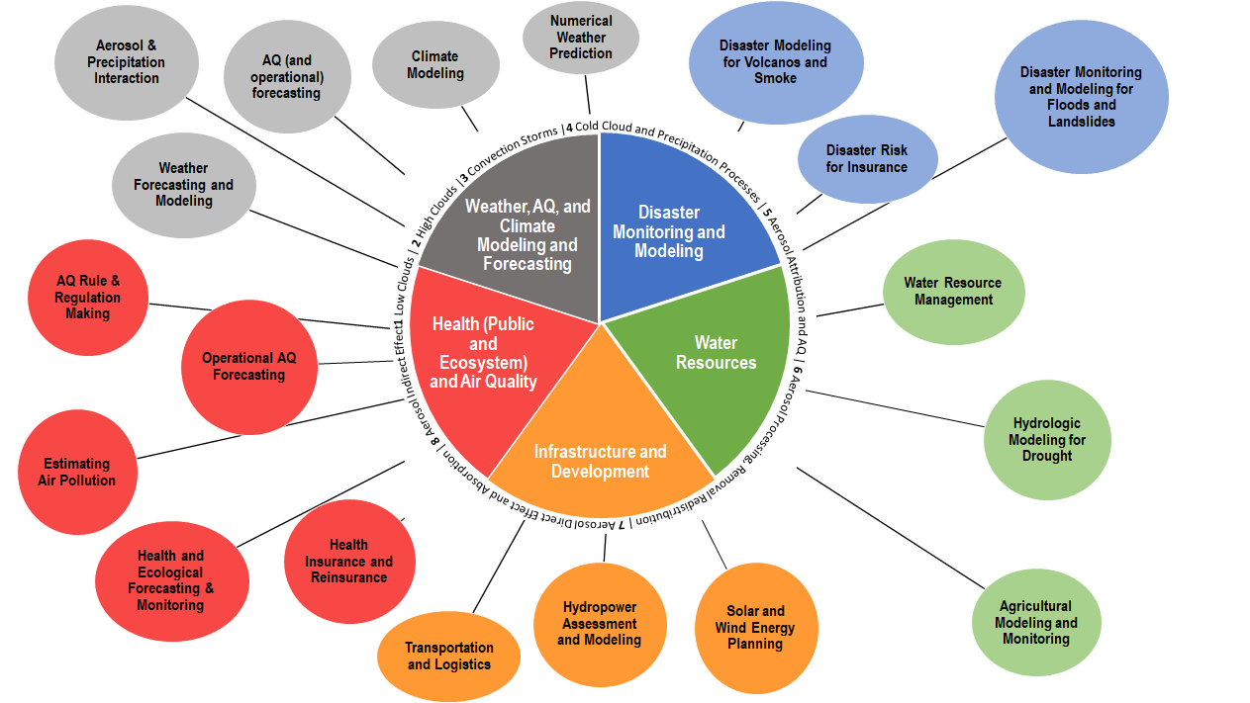
Applications Thematic Areas and High-level Enabled Applications
Notes:
Dalia

Slide 7
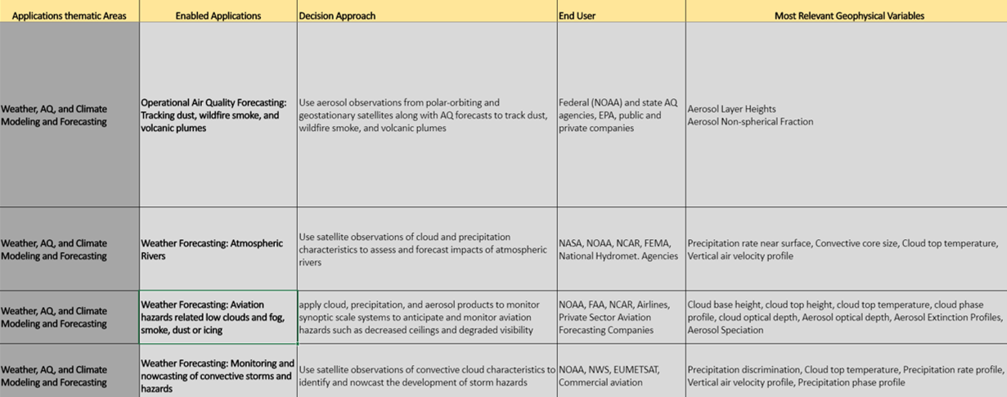
Sample Applications Traceability Matrix Entries

Slide 8
Applications Benefit Scoring and Narratives
We consider the needs of the diverse stakeholder community and what is technologically and financially feasible. Assigning a quantitative score for applications benefit is difficult due to the array of stakeholder needs and possible applications. A narrative is necessary to explain the advantages/disadvantages of architecture from an applications perspective
Assess applications benefit based on two main perspectives
Continuity: measure the ability of a given suite of instruments or architecture to provide products that are currently provided by other program of record missions and, that the Applications community relies on in a sustainable way to provide products for societal benefit
Novelty: measure of ability of the proposed improvements in instrument suite, instrument capabilities, and/or orbit to improve data (above program of record) for current applications and/or enable new applications and stakeholder groups (i.e., "raises the bar")
Identify the attributes important to stakeholders
The discussion of higher level products (L2-L4) is critical to understanding applications value and where the instruments will provide information vs what we are expecting from the program of record
Horizontal Resolution
Vertical Resolution
Temporal Resolution
Swath Width
Latency
Accessibility

Slide 9
Sample Precipitation Properties User Needs Table
Relevant GVs | Community Needs / Applications Products | Desired Vertical/Horizontal Res | Sampling/Swath needs | Higher Level Products (L3-L4) | Enabled Applications
Precipitation rate (@surface) | Information for storm & hydrologic forecasting, Gridded products for hydrology, agriculture, NWP validation | N/A / 1-5 km | 100's of km GPM as a baseline 750 km okay (radiometer) Wider swath (~250 km) for radar | L2 Precipitation Rate (swath), L3 Gridded surface precipitation rate | 5, 11, 12, 14, 16, 17, 18, 19, 21, 25, 26, 27
Precipitation Phase | Snow vs rain vs mixed for transportation logistics, NWP validation, climate monitoring | 500 m / 5 km | 100's of km | Fractional precipitation phase (e.g., water budgets, forecasting) | 1, 2, 6, 8, 11
Precipitation Rate (profile) | Storm intensity monitoring & forecasting | 125-250m / 1-5 km | 100's of km | L2 precip rate profile | 1, 2, 7, 8, 11, 12, 27
Precipitation Discrimination: | Characterization of 2D convective/stratiform, Shallow/Deep convection | N/A / 5 km | 100's of km | Fraction of Precipitation types | 2
Latent Heating Profile | Parameterization, assimilation, validation for NWP models | 125-500m / 5 km | 250km for radar | Level 2 Latent Heating profiles | 13
Notes:
Svetla

Slide 10
Sample Cloud Properties User Needs Table
Most Relevant GVs | Community Needs / Applications Products | Desired Vertical/Horizontal Res | Sampling/Swath needs | Higher Level Products (L3-4L) | Enabled Applications
In-cloud Vertical Air Velocity | Vertical motion for aviation (cloud top), NWP (cloud profile desired) | 125m / 1-5 km | 100s of km | Turbulence, Convective initiation/growth | 1, 2, 3, 6, 7, 8, 11, 12
Cloud Top Phase | Cold vs warm cloud for aviation (icing) and NWP (validation) | N/A / 1-5 km | 100's of km | Ice cloud fraction, Icing potential | 4, 6, 7, 8, 13
Cloud Geometric Top Temperature | Storm intensity forecasting and cloud type | N/A / 1-10 km | 100's of km | Gridded cloud top temperature | 1, 2, 3, 4, 6, 13
Cloud Optical Depth | NWP validation | N/A / >10 km | 100's of km | Vertical extent of cloud (model validation) | 4, 6, 13, 15
Cloud Top Droplet Size | NWP parameterization & validation | N/A / >10 km | 100's of km | Largely L2 products (mainly research use) | 7, 8, 11, 12, 13
Convective Core Size | Storm intensity forecasting | N/A / 1-5 km | 100's of km | Convective cloud fraction/mask | 3
Cloud Top Height | Storm intensity forecasting | N/A / 1-5 km | 100's of km | Gridded cloud top height | 4, 13
Cloud Radiative Heating | Parameterization, assimilation, validation for NWP models | 250-m / 1-5 km | 100's of km | Largely L2 products (mainly for NWP assimilation) | 12
Notes:
Svetla

Slide 11
Sample Broader Precipitation & Cloud Narrative
What communities really need:
Most prefer gridded L3 precipitation characteristics (e.g., intensity and phase at surface); advanced communities can utilize well-calibrated instantaneous L2 products
Cloud cover & characteristics (e.g., phase, temperature, depth, vertical motion) for aviation and NWP assimilation
When they need it: <3 hr for nowcasting/forecasting; <6 hrs for assimilation and 12-24 for model validation
Who are the communities:
Precipitation—weather forecast/modeling/hydrology (e.g., NWS, private sector, international), agriculture, logistics, disasters, climate modeling, energy planning (e.g., hydroelectric)
Cloud—aviation, tropical cyclone forecasting, NWP modeling/assimilation/validation
What drives their decisions to use products: Coverage/sampling, confidence, accessibility (ease of use and latency)—covers the area I need, when I need it, and is reliably accurate
Notes:
Svetla

Slide 12
Example of translating user feedback to architecture requirements
Weather/Hydrology Community (e.g., application that uses IMERG)
Preferred Channels Wide swath Ku radar Radiometer - 183 GHz, ideally 89 GHz (sub-millimeter channels are not currently utilized) Lack of low frequency radiometer channels is concerning | Geographic Coverage / Time of Day Near global like GM orbit 65N-S, or multiple orbits Diurnal coverage is critical for resolving precipitation
Revisit/Frequency <2 day revisit for specific instrument, but ideally with a constellation <3 hours - ultimately a L3/4 product will leverage PoR and modeling to get temporal frequency of <1 hr. | Swath 750 km of Radiometers is sufficient for integration into multi-satellite products
DeltaT Possibly relevant if interval is 15-30 minutes, otherwise, may not be used | Latency < 3-4 hour operational weather for precip/flooding forecasts 12 hr for agricultural applications > 4 hours post-event analysis
Current POR / ground meas. GPM, AMSR-3, DMSP satellites, MetOp next gen satellites (but other than GPM these are all polar) | Orbit (inclined/polar) Inclined orbit essential for overlap and calibration and obs all times of day

Slide 13
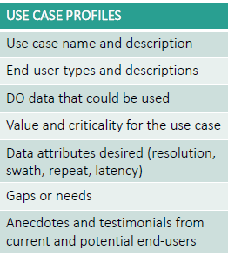
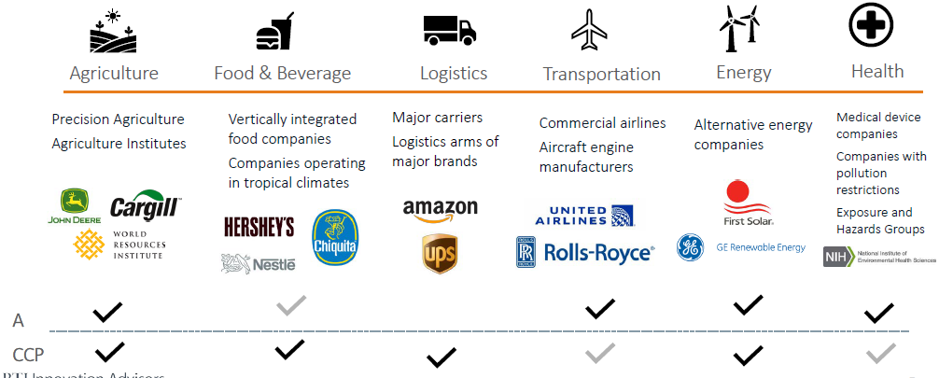
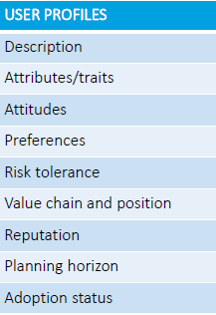
Other AIT activities: Community Assessment Report
CAR serves to document the information gathered concerning applications communities for an observing system/mission.
CAR Updates and Moving Forward:
Developed profile of current and future potential uses and end-users: AIT User Directory and AIT Contact "Wishlist"
Identified 12 user communities to engage and build use case and user profiles
DRAFT OF COMMUNITIES

Slide 14
Summary
As our Earth system changes rapidly, NASA capabilities and observations add significant value to inform stakeholder decisions and policy
Introducing applications in Pre-Phase-A mission studies such as ACCP ultimately amplifies the societal benefit of NASA missions
The ACCP Applications Impact Team (AIT) is charged with ensuring that applications are considered to the greatest extent possible in mission design
Applications Traceability Matrix
Architecture Applications Benefit Scoring and Narrative
Community Assessment Report
Interaction with stakeholders is key to anticipating and developing the applications potential of ACCP in the future

Slide 15
A-CCP AIT Team and Experience
Designated Observable:
Aerosols
Clouds, Convection & Precipitation
Both
Name | Center | Contact | Mission Experience
Leads
Ali Omar* | LaRC | ali.h.omar@nasa.gov | CALIPSO, PACE
Dalia Kirschbaum* | GSFC | dalia.b.kirshbaum@nasa.gov | GPM
Emily Berndt | MSFC | emily.b.berndt@nasa.gov | Terra/Aqua, S-NPP/JPSS, GOES-R, GPM, TROPICS
Team Members
Bryan Duncan | GSFC | bryan.n.duncan@nasa.gov | Aura
Amber Soja | LaRC | amber.j.soja@nasa.gov | CALIPSO, MODIS, Associate Program Mngr. -Fire
Olga Kalashnikova | JPL | olga.kalashnikova@jpl.nasa.gov | MISR, MAIA, EMIT, PACE
Svetla Hristova-Veleva | JPL | svetla.hristova@jpl.nasa.gov | GPM, CloudSat
Aaron Naeger | MSFC | aaron.naeger@nasa.gov | CloudSat, CALIPSO, TEMPO
Patrick Gatlin | MSFC | patrick.gatlin@nasa.gov | GPM, ISS LIS
Anita LeRoy | MSFC | anita.leroy@nasa.gov | TRMM, GPM,TROPICS
 |  |  | * SALT Representative

