Slide 1
Current Status of the Aerosols-Clouds-Convection-Precipitation Decadal Survey Study
Scott Braun, Science and Applications Leadership Team co-lead
Other SALT Members: Arlindo da Silva (GSFC), Graeme Stephens (JPL), Duane Waliser (JPL), Walt Petersen (MSFC), Rich Ferrare (LaRC), Dave Winker (LaRC), Meloë Kacenelenbogen (ARC), Dalia Kirschbaum (GSFC), Ali Omar (LaRC), Emily Berndt (MSFC)
ACCP Study Management Team: Vickie Moran (GSFC), Chip Trepte (LaRC), Deb Vane (JPL)
Science Impact Team (SIT) Co-Leads: Jay Mace (U. Utah), Jen Redemann (U. OK)
Science Community Committee Co-Leads: Sue van den Heever (CSU), Greg Carmichael (U. IA)

Slide 2
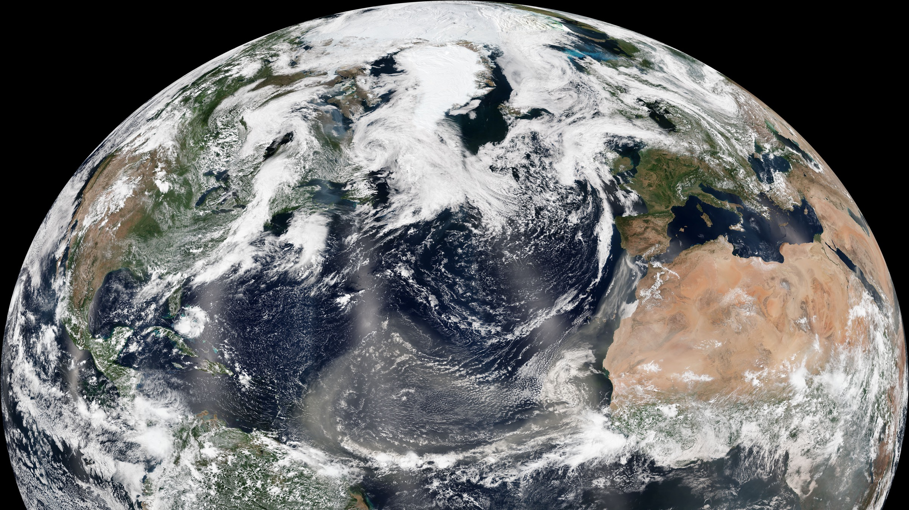
✓
✓
✓

Slide 3
2017 DS Recommendations : A & CCP
The 2017 Decadal Survey (DS) recommended cost-capped missions with specified caps, creating challenges for teams to envision new science but ensure an implementable observing system.
Aerosols (A) and Clouds, Convection & Precipitation (CCP) represent 2 of the 5 Designated Observables (DOs) recommended by the DS.
 | Aerosols (A) | Clouds, Convection & Precipitation (CCP)
Observable Priorities | Aerosol properties, aerosol vertical profiles, and cloud properties to understand their effects on climate and air quality | Coupled cloud-precipitation and dynamical state for monitoring global atmospheric hydrological cycle and understanding contributing processes and cloud-climate feedback
Anticipated Measurement Approaches* | Backscatter lidar and multichannel, multi-angle/ polarization imaging radiometer | Radar(s), potentially with Doppler, with multi-frequency passive microwave and sub-mm radiometer
*Space-based, with expectations of complementary suborbital field programs with more capable airborne instruments.

Slide 4
ACCP Overarching Statement
• ACCP will deliver integrated space-based, airborne, and ground-based observations fundamental to characterizing coupled aerosol-cloud-precipitation processes that profoundly impact weather, air quality and climate and play a critical role in feedbacks to the global water and energy cycles.
• Central to this observing system are observations of the vertical structure of these constituents, along with the first-ever measurements of convective vertical mass transport and unprecedented aerosol microphysical and optical properties, using active profiling sensors unique to ACCP in the future global observing system.
• ACCP will integrate its own measurements with others using advanced modeling and algorithms to generate synergistic data for scientific research and in near real time for applications of societal and economic benefit.

Slide 5
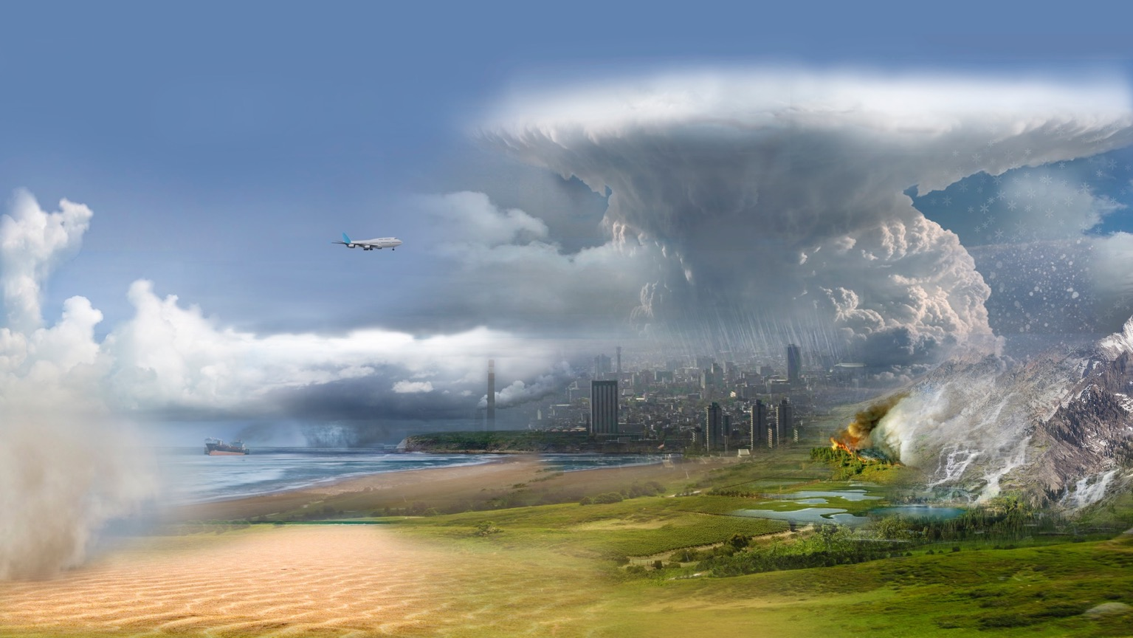
Mission Study on Aerosol and
Clouds, Convection & Precipitation
ACCP Science
8 Science Objectives
Traceable to the 2017 Decadal Survey
Convective Storm Systems
High Cloud Feedback
3
2
Aerosol Absorption, Direct & Indirect Effects on Radiation
Aerosol Redistribution
6
Cold Cloud & Precipitation
4
7
8
Low Cloud Feedback
Aerosol Attribution
& Air Quality
1
5
Notes:
From a holistic perspective, A-CCP addresses a broad set of science objectives that represent the most pressing challenges to
advancing extreme weather and air quality prediction and reducing uncertainties climate projection.

Slide 6
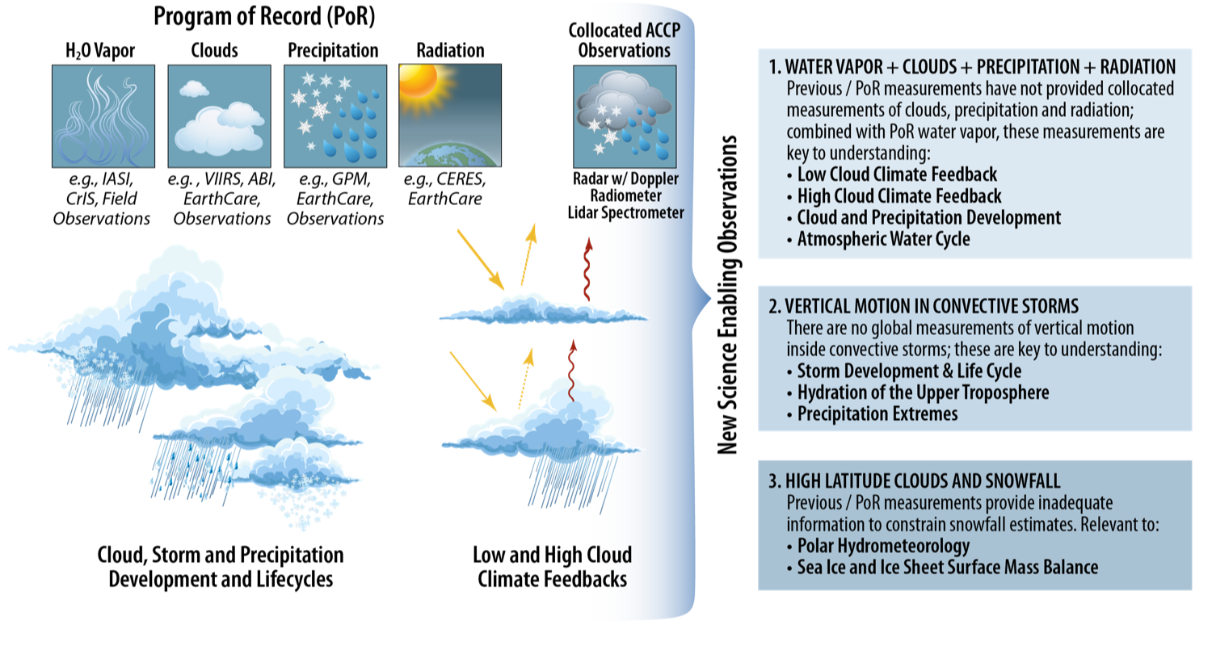
The Importance of ACCP To Cloud Feedbacks And Processes
First-ever global measurements of vertical motions within cloud systems, their relation to cloud and precipitation properties, and role in the global water and energy cycles
Notes:
ACCP will make the first-ever global measurements from space that reveal how ice and water move vertically within clouds, improving our knowledge of storms, the rain and snow they produce and the effects of weather on air quality. ACCP will also reveal the sensitivity of such vertical motions to changes in the amount and character of aerosols surrounding the clouds. These unique observations will directly link convective heat transfer in clouds to the physical properties of clouds and to radiation in Earth's atmosphere, which is key to understanding climate feedbacks, climate sensitivity and changes to Earth's water and energy cycles.

Slide 7
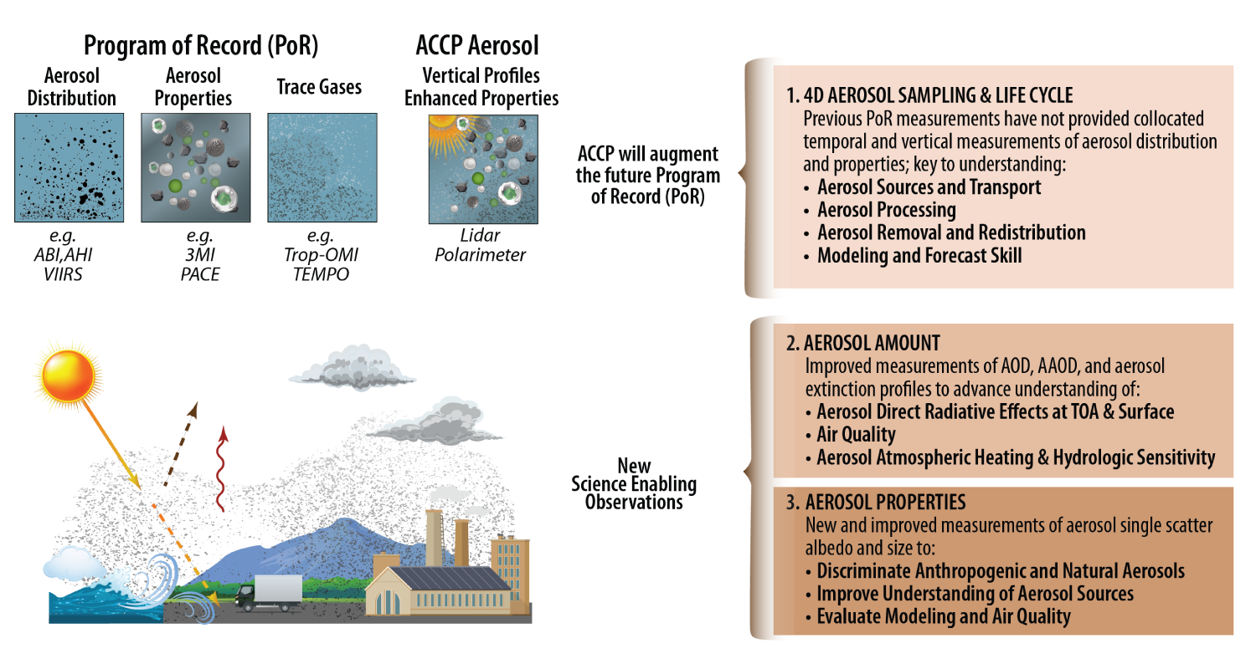
The Importance of ACCP To Aerosol Properties and Distributions
ACCP will observe vertically resolved aerosol microphysical and optical properties at an unprecedented level of detail and accuracy

Slide 8
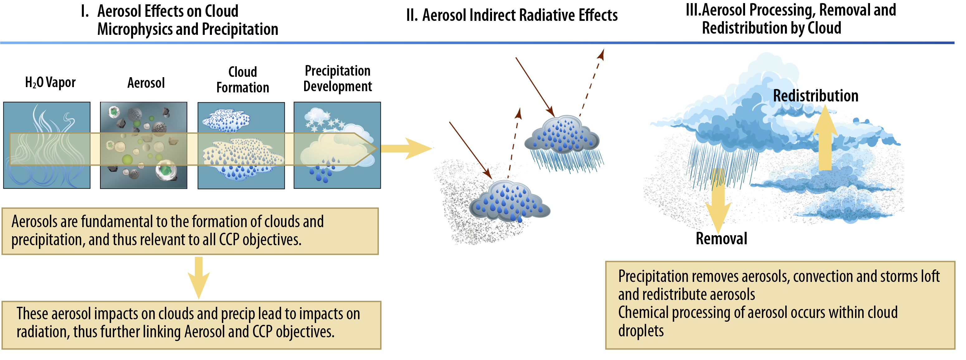
The Importance of Joint Aerosol and Cloud/Precipitation Processes
ACCP will deliver observations fundamental to characterizing coupled aerosol-cloud-precipitation processes that profoundly impact weather, air quality and climate and play a critical role in feedbacks to the global water and energy cycles

Slide 9
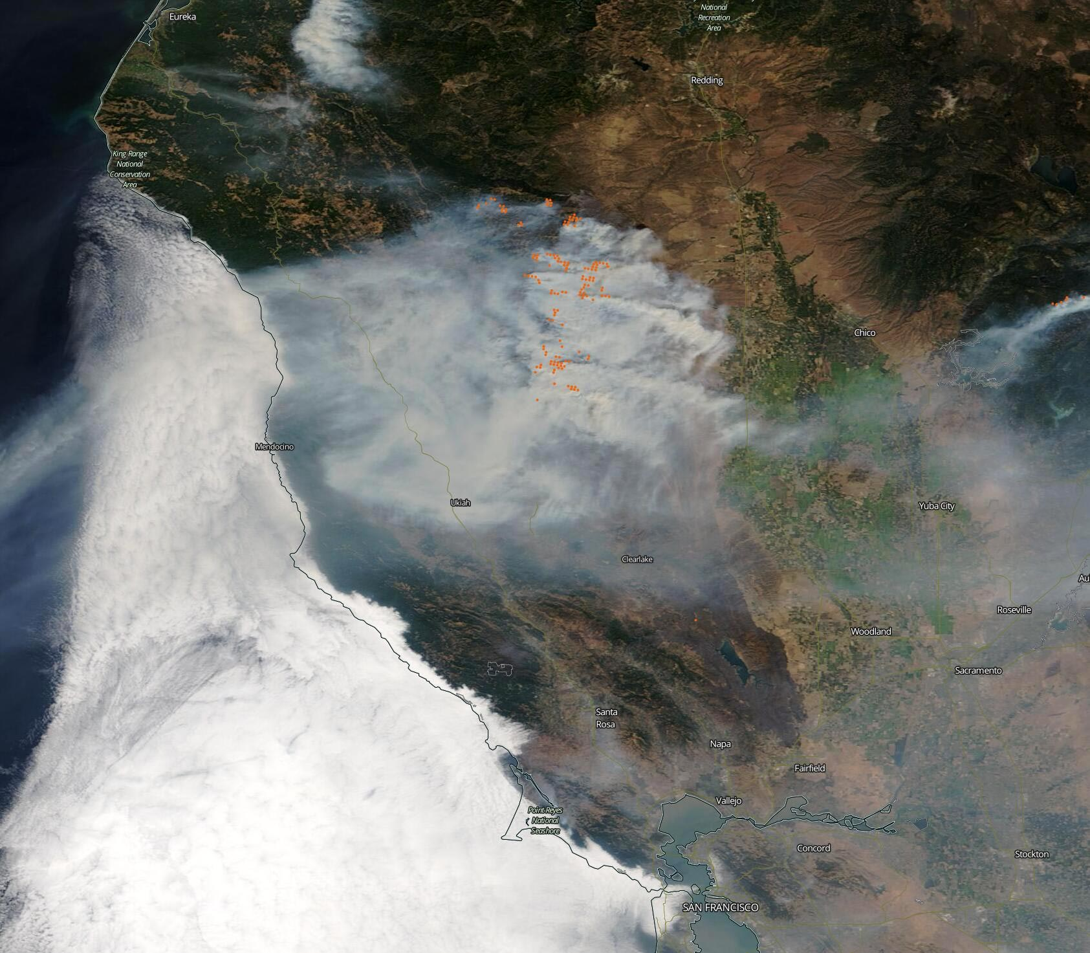
INSTRUMENTS
ACCP Aerosols, Clouds, Convection, and Precipitation Study
LIDAR
Multi-wavelength (2 visible, maybe 1 UV)
Backscatter and/or HSRL
RADAR
Multi-wavelength (W, Ka and/or Ku)
Doppler or “Delta-T”
SPECTROMETER
Multi-wavelength (UV-VIS-NIR-SWIR-LWIR-FIR) reflectances and brightness temperatures
POLARIMETER
Multi-wavelength, VNIR-SWIR;
Multi-angle
RADIOMETER
Multi-wavelength Microwave
(~100-900 GHz)
ACCP requires a suite of spaceborne instruments* to measure and characterize the complexity of hydrometeors and aerosols.
*To also include as, or more capable, airborne in-situ and remote sensing instruments, deployed in synergistic/complementary suborbital campaigns.

Slide 10
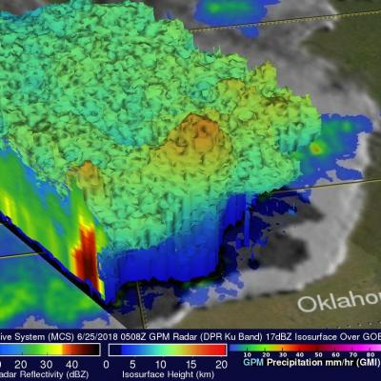
Radar Capabilities Could Be Transformative
Architectures contain different radar capabilities
Cloud and precipitation measurements at nadir
Precipitation across a swath
Doppler capabilities for estimating air vertical motion
JAXA radar example
Doppler simulation performed by Pavlos Kollias

Slide 11
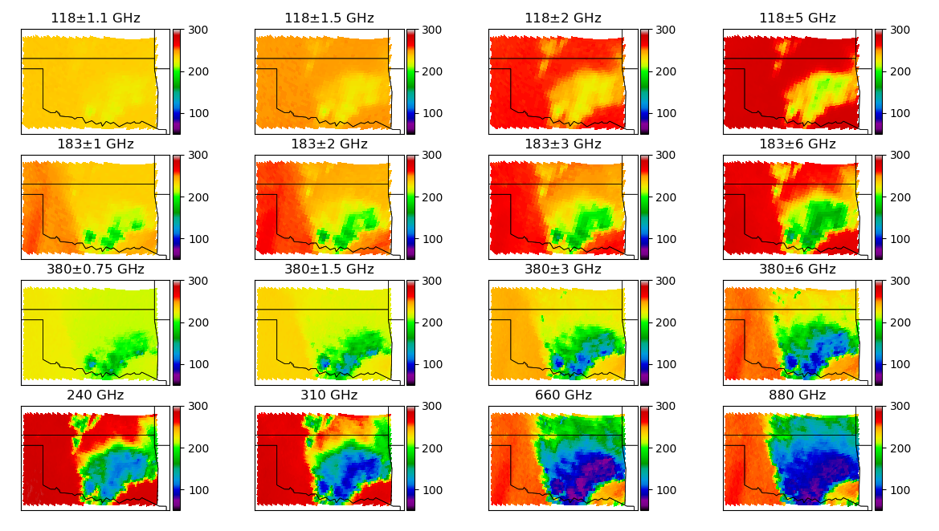
Passive Microwave Radiometer Capabilities
Two radiometers have featured prominently in architectures
Provide wide-swath coverage
Emphasize measurements of atmospheric ice particles that relate to precipitation
Two instruments ~minute apart provide information of rates of change
Swath of ~770 km
Footprints: ~10-25 km for option 1
~3-5 km for option 2
Option 1
Option 2
Simulations produced by Joe Munchak

Slide 12
Lidar Capabilities—Daytime
CALIPSO Simulation
Aircraft data
Cirrus Clouds
Aerosol Layer
Backscatter Lidar Simulation
HSRL Simulation
Simulations produced ACCP Lidar Working Group

Slide 13
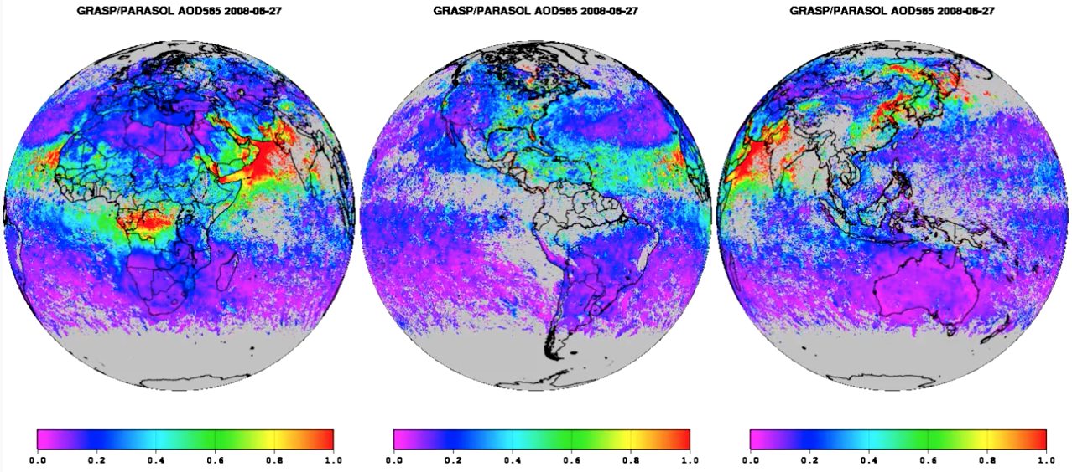
Polarimeter Capabilities
Polarimeter retrievals for cloud-top microphysics and aerosol retrievals
Polarimeter provides constraints for improve aerosol property retrievals
Swath/resolution of either
1130 km/1 km
550 km/0.5 km
AOD
Example taken from POLDER instrument on the Parasol satellite

Slide 14
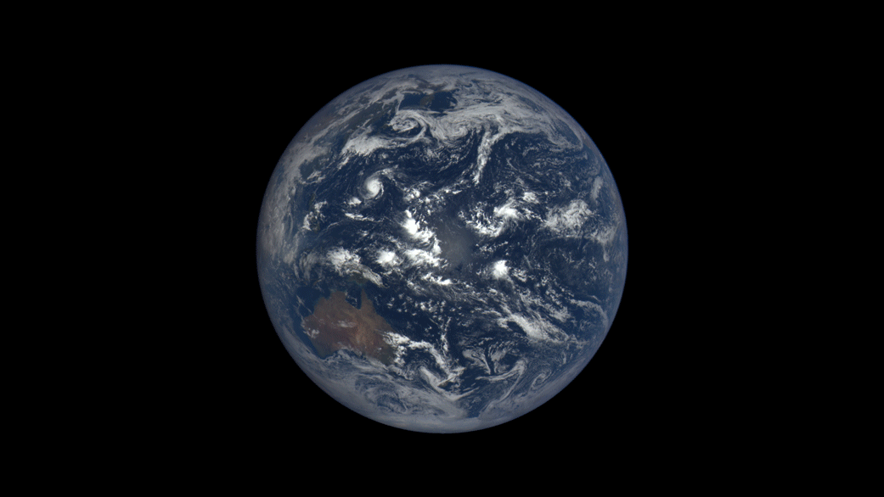
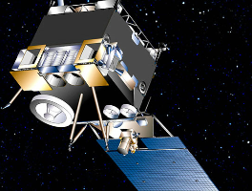
Instrumentation
Core Capabilities in Polar Orbit
Profiling of clouds and precipitation in the troposphere with improved sensitivity for low clouds and snowfall near the surface.
Measurement of vertical air motions in precipitating cloud systems; particle phase and possibly microphysics information.
Profiling of aerosol optical and microphysical properties for air-quality, aerosol radiative effects and aerosol-cloud interactions. Direct measurement of particulate backscatter.
Coincident radiation measurements to link cloud and aerosol vertical structures to radiative effects.
Combined active-passive measurements for improved constraints on profile quantities
W, Ka Doppler Radar
Radiometer
HSRL Lidar
Polarimeter
Spectrometers

Slide 15
Potential Augmentations
Single Orbit
+ Δt
+ Ku Radar
+ limb aerosol and humidity
Polar Core
W, Ka Doppler Radar
Radiometer
HSRL Lidar
Polarimeter
Spectrometers
+
OR
Dual Orbit
+ Diurnal A+CCP obs.
+ Diurnal CCP obs.
+ Δt
Notes:
This is an alternative to Vickie’s Implementation Strategies…
Mention that there is no Ku on inclined orbit

Slide 16
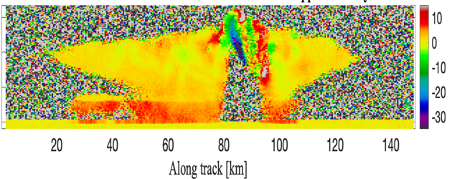
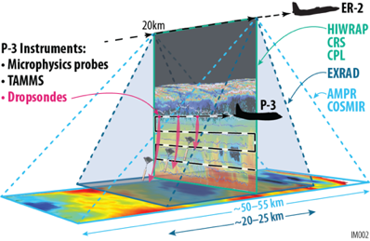
ACCP will provide transformative space-based and suborbital observations of essential cloud, precipitation, and aerosol processes, leading to improved predictions of weather, air quality, and climate for the benefit of society
Continuity with the Past
Combined with Sensor
Advancements of the
Present
An integrated global observing system of the future
CloudSat
Doppler Radar
PoR
CALIPSO
ACCP
Lidar
TRMM & GPM
Suborbital Science
Earth System Models
Polarimeters
Aqua/Terra MODIS

Slide 17
Next Steps
Currently ~9 architectures near or below the cost cap
Final science quality and benefit evaluations in December
Down select to 3 by January
Final report to HQ by Sept. 30, 2021

Slide 19
Key Science Measurements Needed For ACCP
Profiling of clouds and precipitation in the troposphere and close to the surface with sufficient sensitivity to see clouds and/or light precipitation
Measurement of vertical air motions in cloud systems, particularly for convective storms
Profiling of aerosols, including aerosol type and physical/radiative properties to capture cloud & aerosol interactions, air quality, and aerosol direct effects
Coincident radiation measurements to link vertical structures to atmospheric radiative fluxes and the global energy budget

