Slide 1
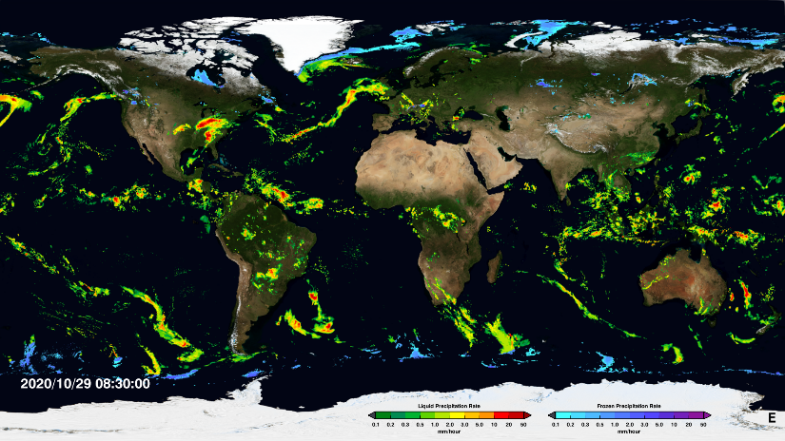
GPM Applications Webinar
GPM Precipitation: Data Information and Access for Transport and Logistics Applications
Andrea Portier
NASA GSFC- SSAI
andrea.m.portier@nasa.gov
Amita Mehta
NASA GSFC-UMBC-JCET
amita.v.mehta@nasa.gov
5 November 2020

Slide 2
Webinar Objectives
Become familiar with GPM resources and learn how to access GPM data
Description of GPM’s IMERG data record, data access, analysis, and visualization
Learn to access IMERG data and assess extreme precipitation events for transportation and logistical applications
GPM Applications Webinar: 5 November 2020
Part of the 2020 GPM-ACCP Transportation and Logistics Workshop

Slide 3
Outline
A recap of the Transportation and Logistics Workshop activities
GPM Applications efforts
An overview of the GPM webpage, GPM data resources, and past training material
Andrea Portier (20-30 minutes)
Information about access, analyze, and visualize IMERG data using NASA web-tools
IMERG case study for transportation and logistical applications
Amita Mehta (60-80 minutes)
GPM Applications Webinar: 5 November 2020
Part of the 2020 GPM-ACCP Transportation and Logistics Workshop

Slide 4
Workshop Recap
Day 1
Nov 2nd
Introductory session on the GPM Mission
Overview NASA Decadal Survey ACCP Mission Study
Day 2
Nov 4th
Transportation- Aviation Panel and Discussion
Transportation-Roads, Railways and Maritime Management Panel and Discussion
Day 3
Nov 5th
Morning GPM Training
Logistics and Supply Chain Panel and Discussion
ACCP Applications Overview
Keynote Presentation: Randy Bass (FAA)
Q&A
Breakout Sessions
Breakout Sessions
Report out from breakouts and workshop conclusion
GPM Applications Webinar: 5 November 2020
Part of the GPM-ACCP Transportation and Logistics Workshop

Slide 5
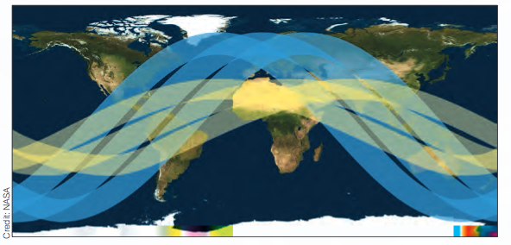
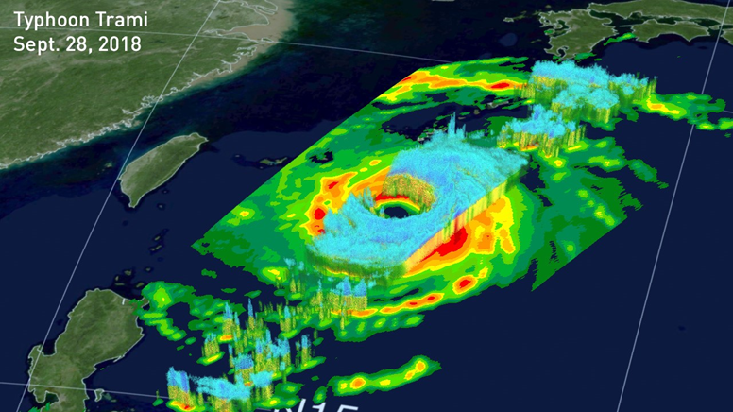
Overview: Global Precipitation Measurement (GPM) Mission
https://gpm.nasa.gov/
Core satellite launched Feb 27, 2014
Non-polar, low-inclination orbit
Altitude: 407 km
TRMM to GPM
TRMM was designed to measure heavy to moderate rainfall in the tropics and subtropics
GPM can measure everything from light rain to heavy rain and falling snow
Sensors:
GMI (GPM Microwave Imager)
DPR (Dual Precipitation Radar)
An consortium of international satellites contribute measurements to GPM mission
GPM has a revisit time of 2-4 hrs. over land
GPM
TRMM
GPM Applications Webinar: 5 November 2020
Part of the GPM-ACCP Transportation and Logistics Workshop
Notes:
*The GPM Core Observatory orbits Earth at an inclination of 65 degrees, which enables it to cut across the orbits of other microwave radiometers and sample the latitudes where nearly all precipitation occurs. A non-sun-synchronous orbit that takes it around Earth roughly 16 times per day allows it to sample precipitation at different times of the day. Data is transmitted continuously to ground systems on Earth by the Tracking and Data Relay Satellite (TDRS) communications network.
DPR = provides 3D observations of precip structure, precip particle size distribution, precip intensity and distribution
GMI= provides observations of precip intensity and distribution

Slide 6
GPM Application Activities
Applications = innovative uses of mission data products in decision-making activities for societal benefit.
Mission Applications take a satellite's data products and expand them into areas where they can help inform policy or decisions.
*GPM precipitation products help advance societal applications by addressing the needs of end users and to support decision-making.
*GPM precipitation observations can be quickly and easily accessed via various data portals.
GPM Applications Webinar: 5 November 2020
Part of the GPM-ACCP Transportation and Logistics Workshop

Slide 7
GPM Societal Benefit Areas
Flooding
Landslides
Tropical Cyclones
Re-insurance
Wildfires
Disaster Response
Disasters and Risk Management
Energy infrastructure and management
Alternative energy development/ management
Energy Infrastructure and Management
Drought
Water resource management
Food security
Water resources, Agricultural Forecasting, and Food Security
Disease Tracking
Transportation
Development and Public Health
**Decision-making for transportation, logistics and supply chain management activities falls into many sectors
Numerical Weather Prediction
Climate variability and change
Land Surface Modeling
Weather, Climate, and Land Surface Modeling
Animal Migration
Ecological Management and Sustainability
Ecological Management
GPM Applications Webinar: 5 November 2020
Part of the GPM-ACCP Transportation and Logistics Workshop

Slide 8
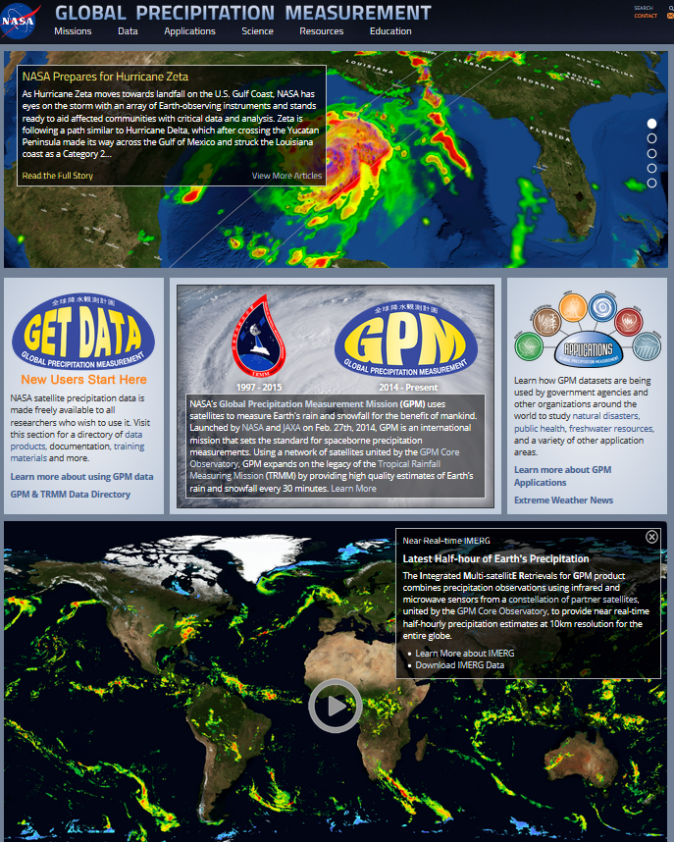
GPM Webpage and Data Resources
GPM Webpage: https://gpm.nasa.gov/
Mobile friendly layout
Handful of resources on the GPM Home page
Latest GPM coverage stories
Direct link to GPM Applications page
Latest Half-hour of Earth’s Precipitation
Posted Upcoming Events
Lastest @NASARain Tweets
Direct access to data resources and downloads
Let’s take a look…. A quick tour of the NASA GPM Page, https://gpm.nasa.gov/
GPM Applications Webinar: 5 November 2020
Part of the GPM-ACCP Transportation and Logistics Workshop

Slide 9
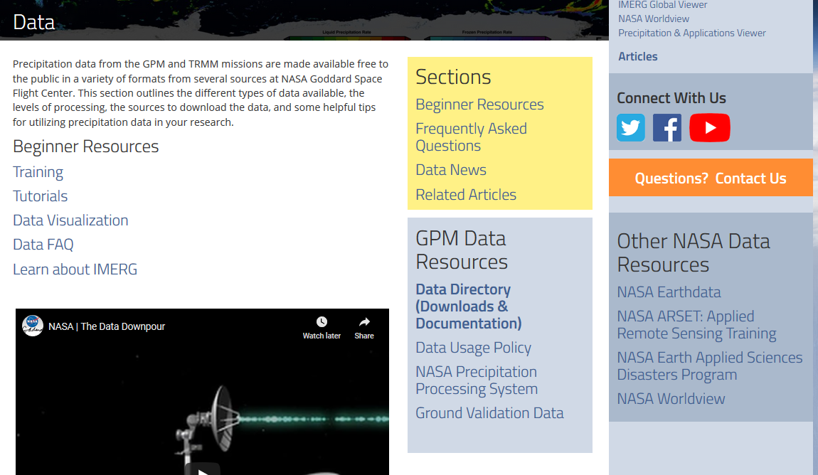
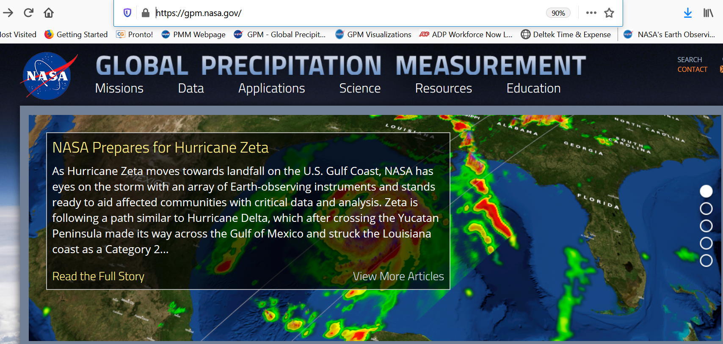
GPM Data Portal
https://gpm.nasa.gov/data
Multiple data access sources for GPM
Beginner resources: trainings, tutorials, data visualization, FAQ
Data directory (downloads), https://gpm.nasa.gov/data/directory
Link to other key NASA resources
GPM Applications Webinar: 5 November 2020
Part of the GPM-ACCP Transportation and Logistics Workshop

Slide 10
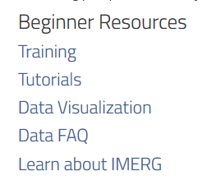
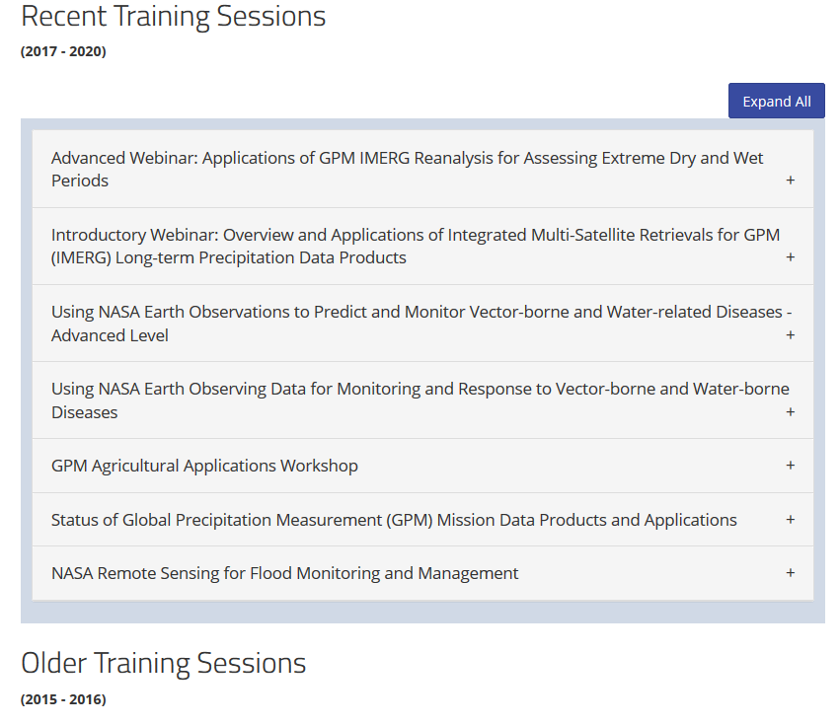
GPM Beginner Resources: Trainings
https://gpm.nasa.gov/data/training
GPM Applications Webinar: 5 November 2020
Part of the GPM-ACCP Transportation and Logistics Workshop

Slide 11
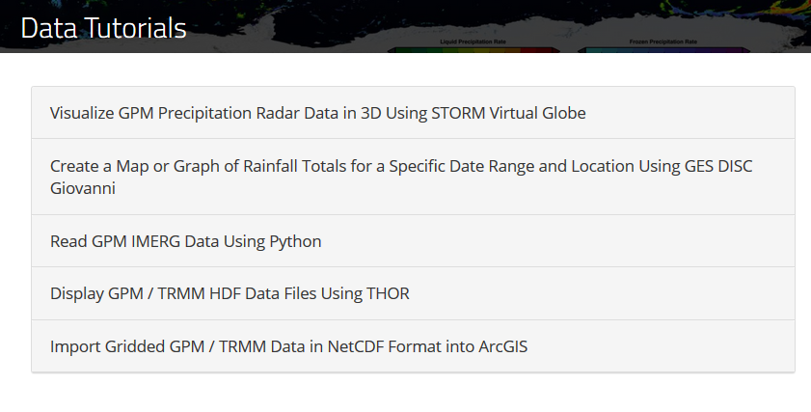
GPM Beginner Resources: Tutorials
https://gpm.nasa.gov/data/tutorials
GPM Applications Webinar: 5 November 2020
Part of the GPM-ACCP Transportation and Logistics Workshop

Slide 12
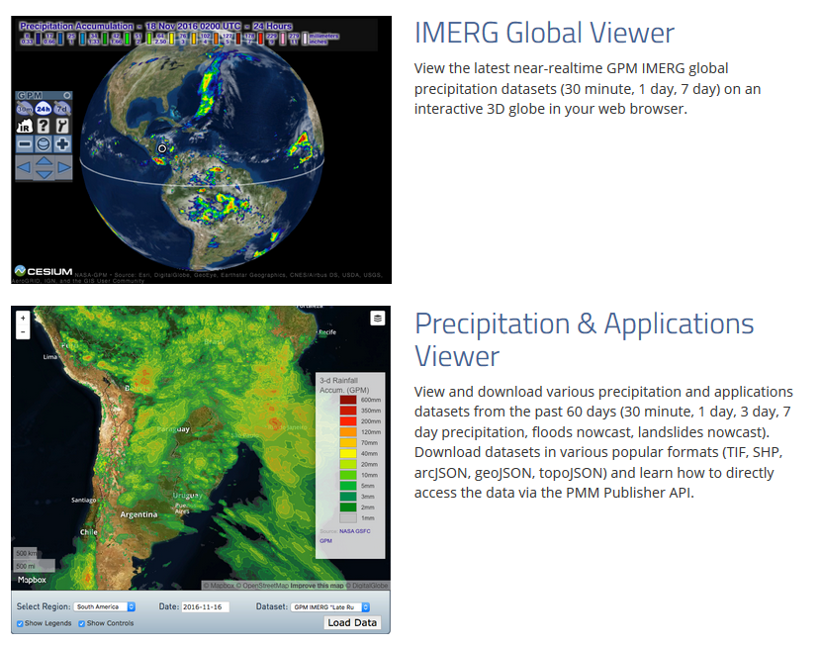
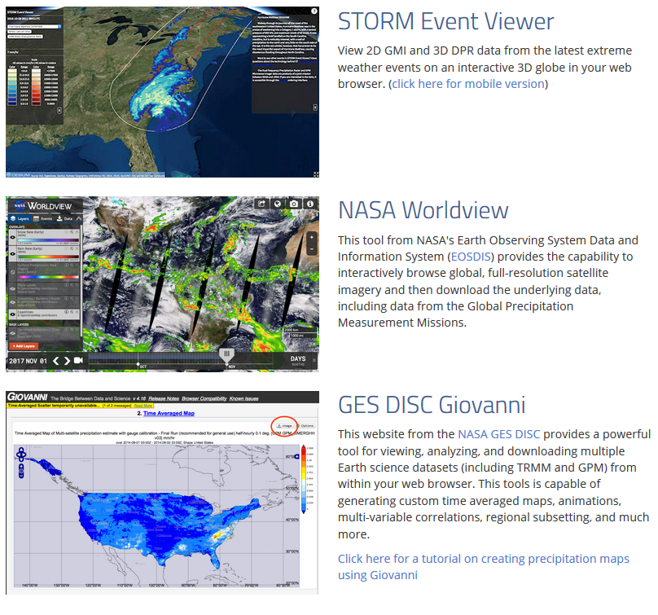
GPM Beginner Resources: Visualizations
Quick ways to view GPM data
IMERG Global Viewer: View the latest IMERG global precipitation accumulations on an interactive 3D globe
Precipitation & Applications Viewer: Download datasets in various popular formats (TIF, SHP, arcJSON, geoJSON, topoJSON) and learn how to directly access the data via the PMM Publisher API.
STORM Event Viewer: View latest extreme weather events on an interactive globe.
NASA Worldview: Browse global, full-resolution satellite imagery and then download the underlying data, including data from GPM.
GIOVANNI: view, analyze, and download multiple Earth science datasets (including GPM) from within your web browser.
https://gpm.nasa.gov/data/visualization
GPM Applications Webinar: 5 November 2020
Part of the GPM-ACCP Transportation and Logistics Workshop
Notes:
Precip and App. Viewer/ API = extract IMERG data and other applications products via an Applications Programming Interface (API), where users can directly pull data into their existing systems in a range of different formats and for several different accumulations: https://pmmpublisher.pps.eosdis.nasa.gov/swagger/index.html. The PMM Publisher API can be used to automatically retrieve precipitation and related applications datasets and associated metadata for further processing by your tool of choice.
Giovanni = For simple data analysis schemes, such as time averaging, data comparisons and correlation, and climatology calculations.

Slide 13
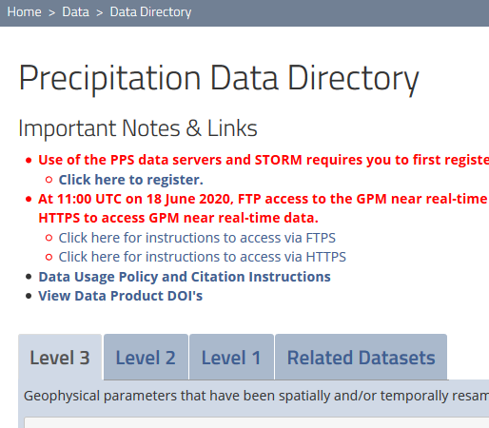
GPM Data Access
https://gpm.nasa.gov/data/directory
GPM Data Directory
Access to all 3 GPM product levels (raw data to gridded precip products)
Each product level provides information:
Description of product
Dates covered
Latency
Resolution
Technical documentation
GPM Applications Webinar: 5 November 2020
Part of the GPM-ACCP Transportation and Logistics Workshop
Notes:
Latency = how soon the data is available after the satellite collects the observations

Slide 14
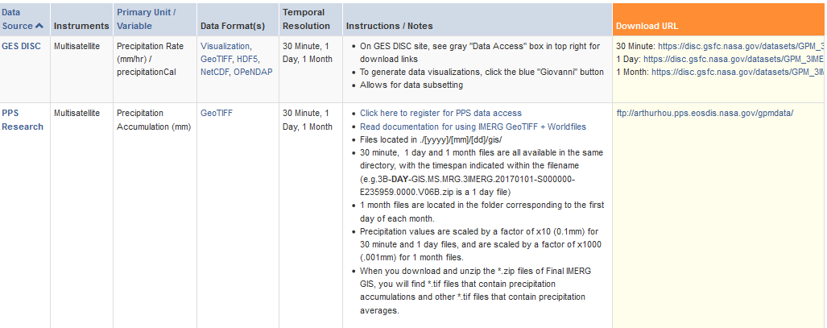
GPM Data Access
https://gpm.nasa.gov/data/directory
Multiple ways to view and analyze data
Each product provides:
Data source (GPM downloaded from two NASA primary data archive servers, GES DISC and PPS)
Option to download in format of your choice
Let’s take a look…. A quick tour of the GPM Directory page, https://gpm.nasa.gov/data/directory
GPM Applications Webinar: 5 November 2020
Part of the GPM-ACCP Transportation and Logistics Workshop

Slide 15
NASA ARSET: Applied Remote Sensing Training
https://arset.gsfc.nasa.gov /
Part of NASA’s Applied Sciences Capacity Building Program
Goal is to increase the use of Earth science in decision-making through training for:
policy makers
environmental managers
other professionals in the public and private sector
Online training topics include:
Fundamentals of remote sensing
Disasters: flooding, extreme precipitation events, disaster risk assessment
Health and Air Quality
Water Resources
Slide courtesy of NASA ARSET
GPM Applications Webinar: 5 November 2020
Part of the GPM-ACCP Transportation and Logistics Workshop

Slide 16
Webinar Objectives
Learn about GPM Data Products
Learn to access IMERG data and assess extreme precipitation events for transportation and logistical applications
GPM Applications Webinar: 5 November 2020
Part of the 2020 GPM-ACCP Transportation and Logistics Workshop

Slide 17
Outline
Information about access, analysis, and visualization of IMERG data using NASA web-tools
Integrated Multi-satellitE Retrievals for GPM (IMERG) case study for transportation and logistical applications
GPM Applications Webinar: 5 November 2020
Part of the 2020 GPM-ACCP Transportation and Logistics Workshop

Slide 18
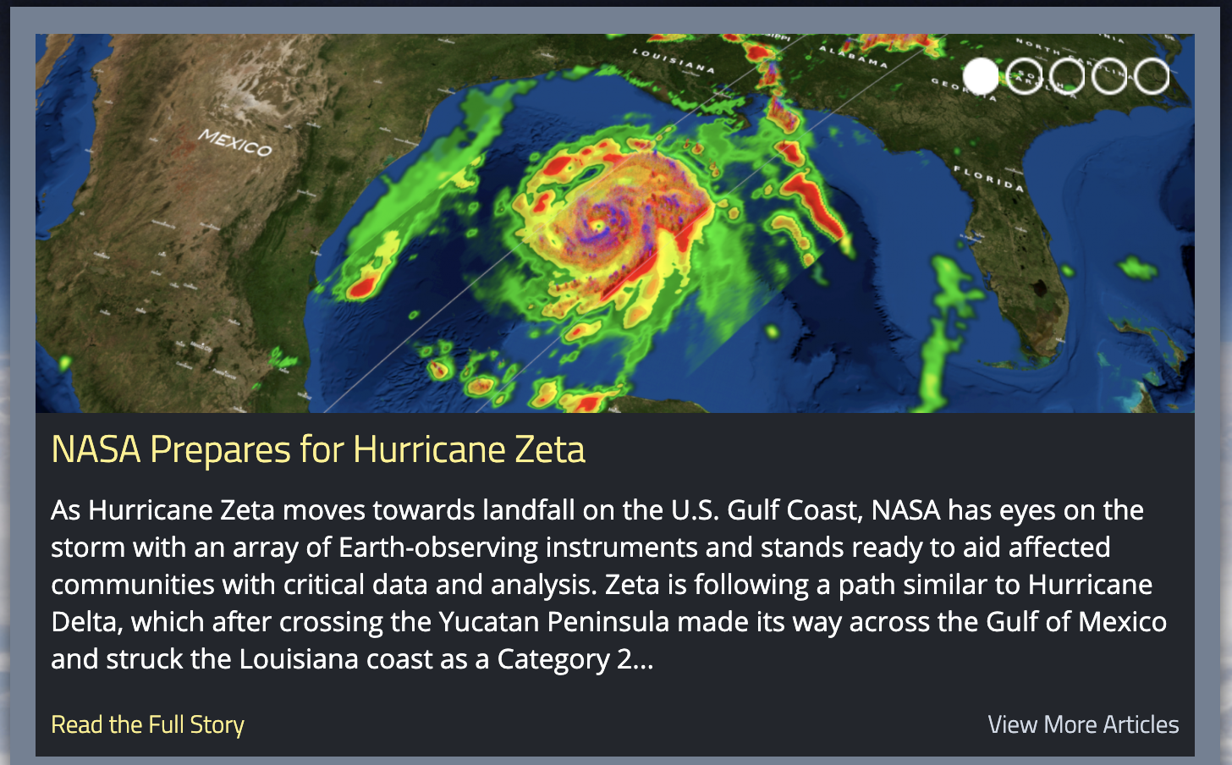
NASA ARSET: Applied Remote Sensing Training
https://arset.gsfc.nasa.gov /
https://appliedsciences.nasa.gov/join-mission/training/english/applications-gpm-imerg-reanalysis-assessing-extreme-dry-and-wet
GPM Applications Webinar: 5 November 2020
Part of the GPM-ACCP Transportation and Logistics Workshop

Slide 19
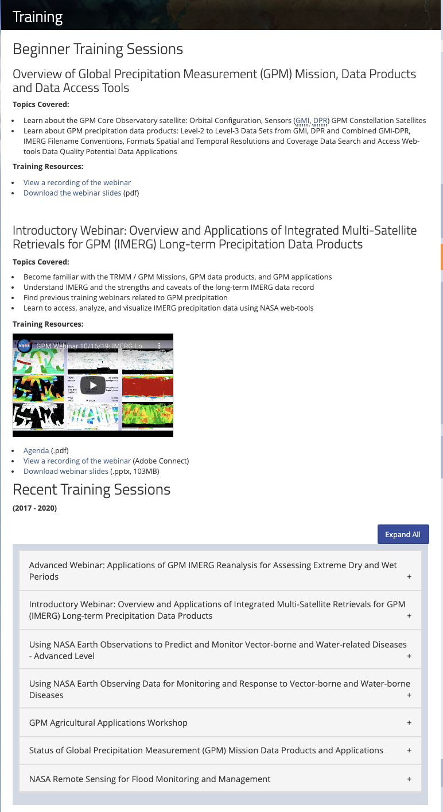
GPM Applications: Trainings
https://gpm.nasa.gov/data/training
Introductory Webinar: Overview and Applications of Integrated Multi-Satellite Retrievals for GPM (IMERG) Long-term Precipitation Data Products
GPM Applications Webinar: 5 November 2020
Part of the GPM-ACCP Transportation and Logistics Workshop

Slide 20
Data Processing Levels
https://gpm.nasa.gov/data/training
GPM Applications Webinar: 5 November 2020
Part of the GPM-ACCP Transportation and Logistics Workshop

Slide 21
Level-2 Data
https://gpm.nasa.gov/data/training
Three Algorithms and Products:
Dual Precipitation Radar
Microwave Radiometer
Combined Radar & Radiometer
GPM Applications Webinar: 5 November 2020
Part of the GPM-ACCP Transportation and Logistics Workshop

Slide 22
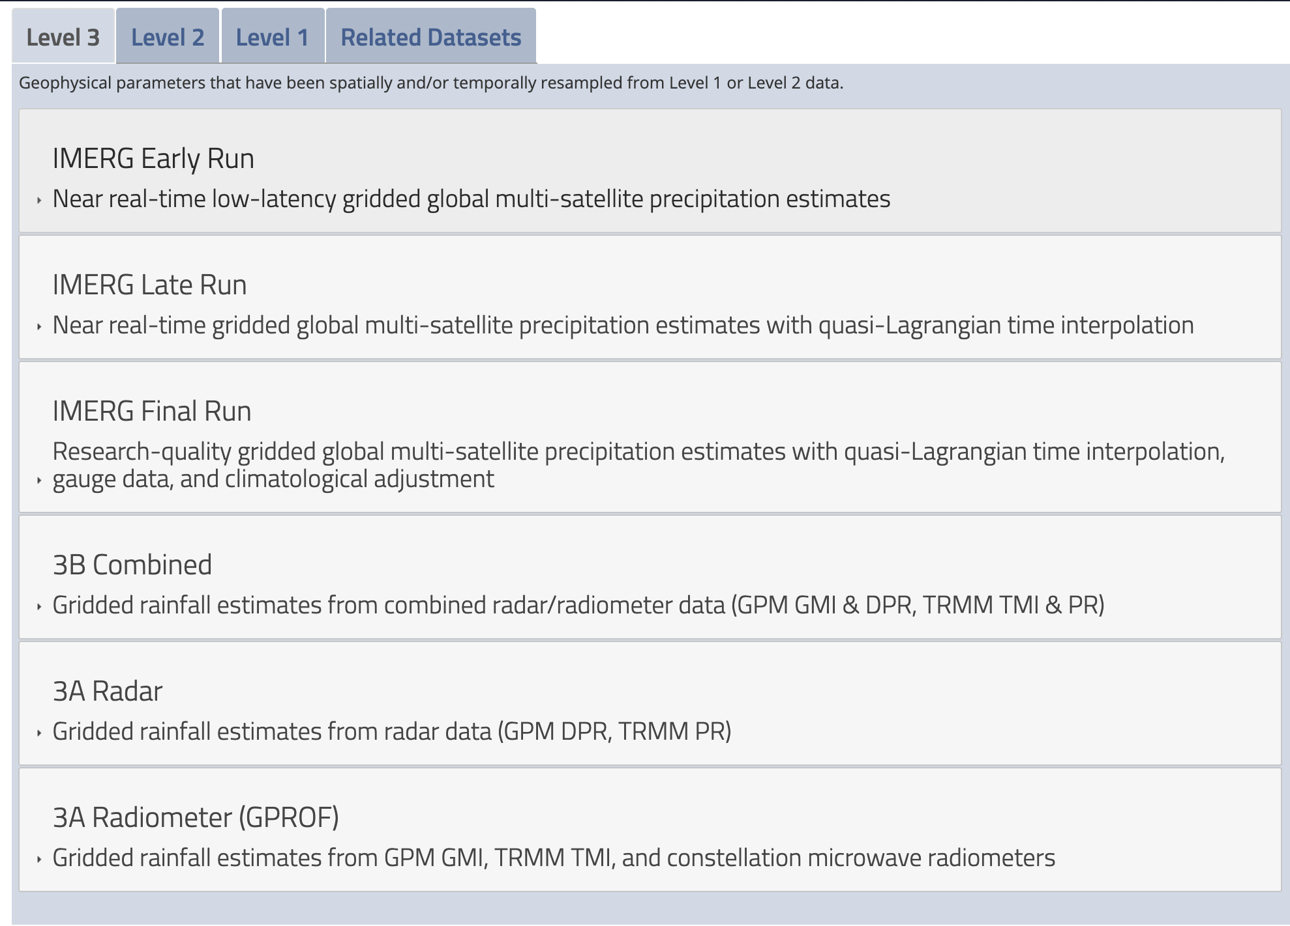
Level-3 Data
https://gpm.nasa.gov/data/training
Uniformly Gridded Products:
Radar, Radiometer, and Combined Level-3 data
IMERG: Multi-satellite Merged Algorithm and Data product
Long temporal coverage combined with TRMM data
Widely used for a variety of applications
GPM Applications Webinar: 5 November 2020
Part of the GPM-ACCP Transportation and Logistics Workshop

Slide 23
IMERG Version 6 Data
IMERG is a single integrated code system for near-real and post-real time
Multiple runs for different user requirements for latency and accuracy
“Early” – 4 hr. (flash flooding)
“Late” – 14 hr. (crop forecasting)
“Final” – 3 months (research)
Time intervals are half-hourly and monthly (final only)
0.1º global grid
Extends from June 2000 to present
Morphing of precipitation based on numerical models poleward of 60º N/S
Overall calibration is provided by TRMM and GPM Combined Radar-Radiometer Algorithm. TRMM June 2000-May 2014, GPM thereafter.
IMERG is adjusted to GPCP monthly climatology zonally to achieve a bias profile that is considered reasonable
From: Huffman (https://www.youtube.com/watch?v=OyPUp7SuEy4&feature=youtu.be)
GPM Applications Webinar: 5 November 2020
Part of the GPM-ACCP Transportation and Logistics Workshop

Slide 24
IMERG Data Access
https://gpm.nasa.gov/data/sources
PPS Near Real-time and Research Bulk Data Download
GES Disc
Giovanni Analysis and Visualization
PPS Storm Visualization
Worldview Visualization
GPM Applications Webinar: 5 November 2020
Part of the GPM-ACCP Transportation and Logistics Workshop

Slide 25
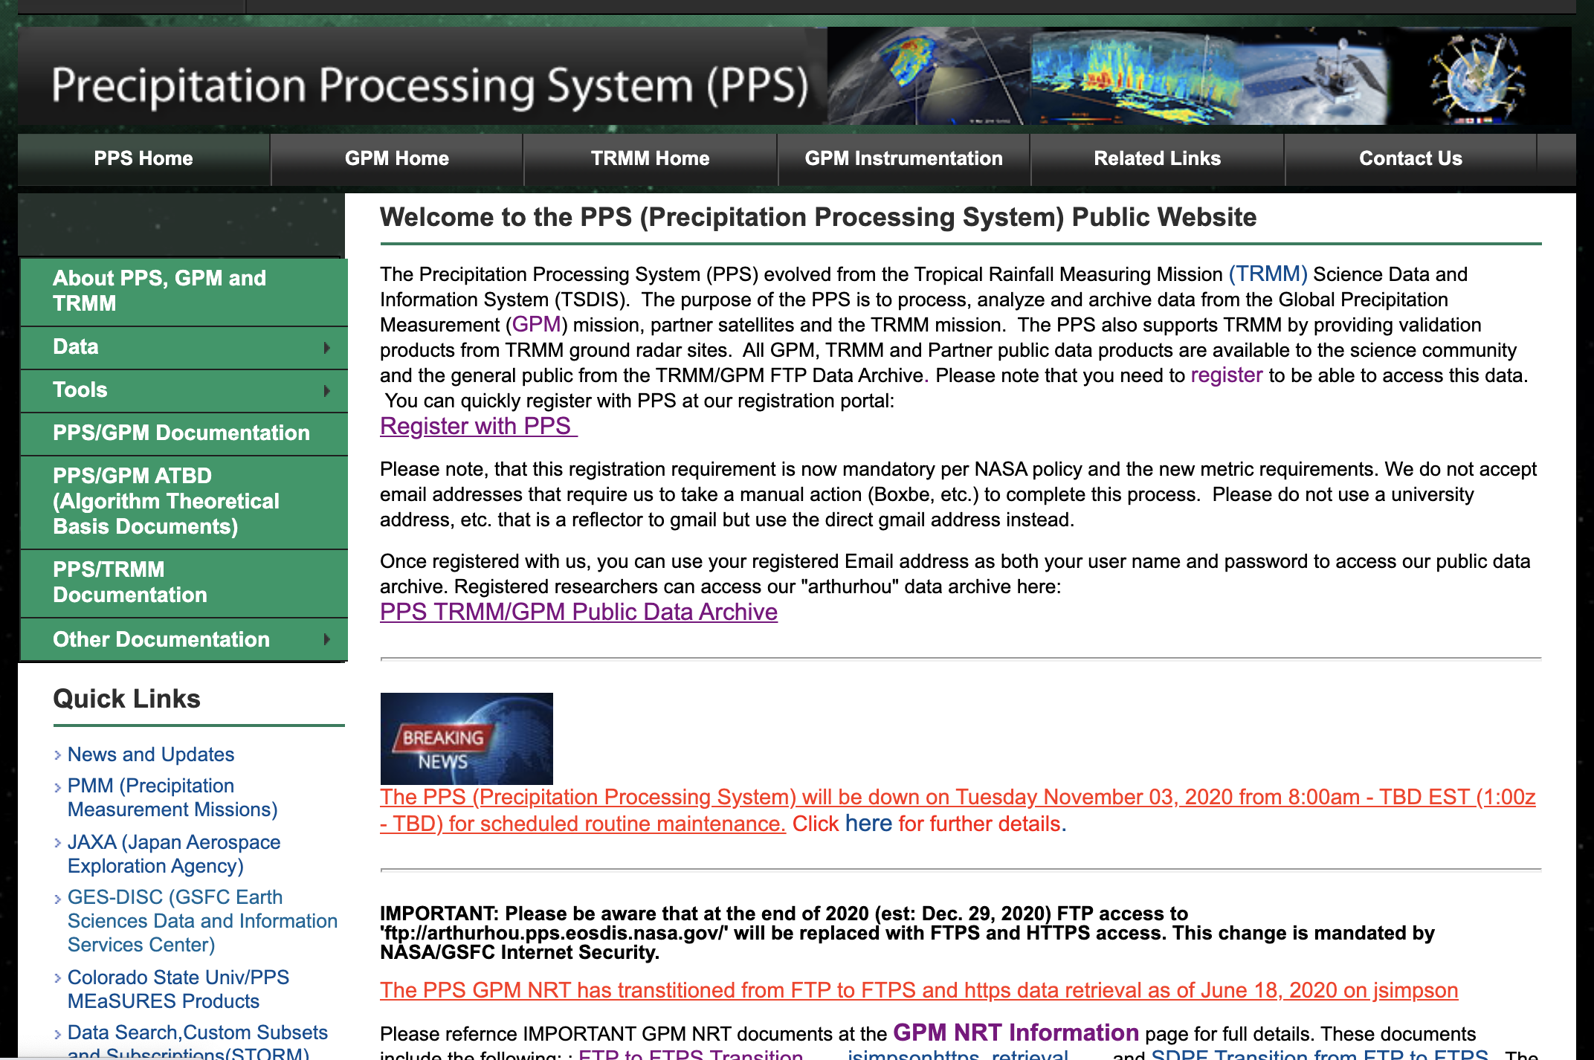
Demonstration: Precipitation Processing System
PPS Near Real-time and Research
GPM Applications Webinar: 5 November 2020
Part of the GPM-ACCP Transportation and Logistics Workshop

Slide 26
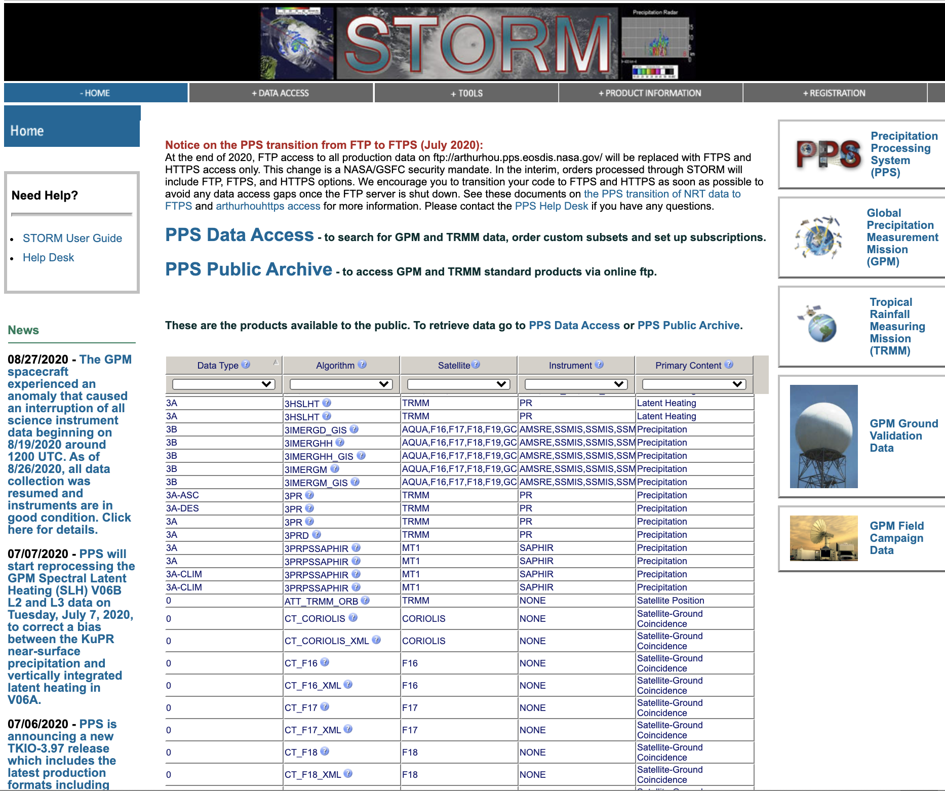
Demonstration: Precipitation Processing System
Science Team On-Line Request Module (STORM)
https://storm.pps.eosdis.nasa.gov/storm/
GPM Applications Webinar: 5 November 2020
Part of the GPM-ACCP Transportation and Logistics Workshop

Slide 27
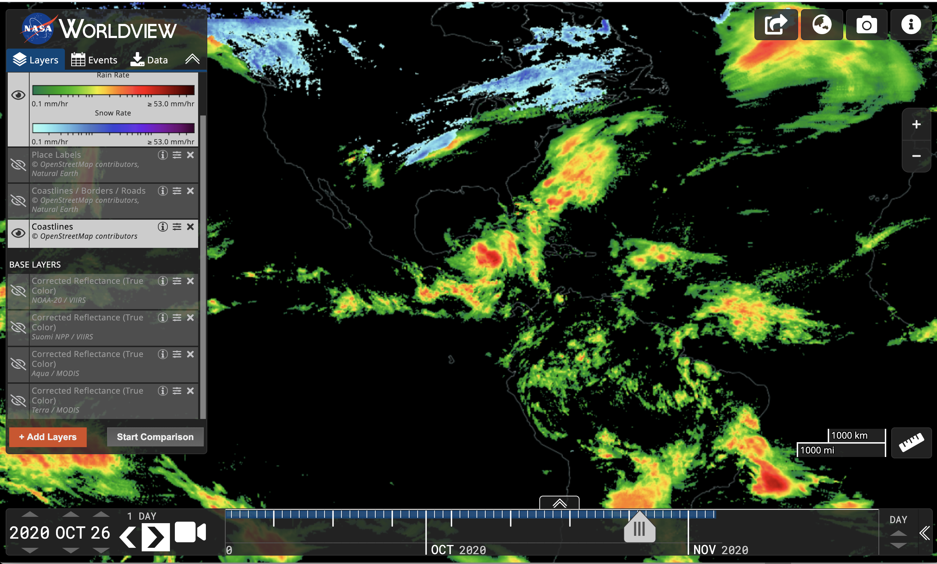
Demonstration: Worldview
https://worldview.earthdata.nasa.gov/
GPM Applications Webinar: 5 November 2020
Part of the GPM-ACCP Transportation and Logistics Workshop

Slide 28
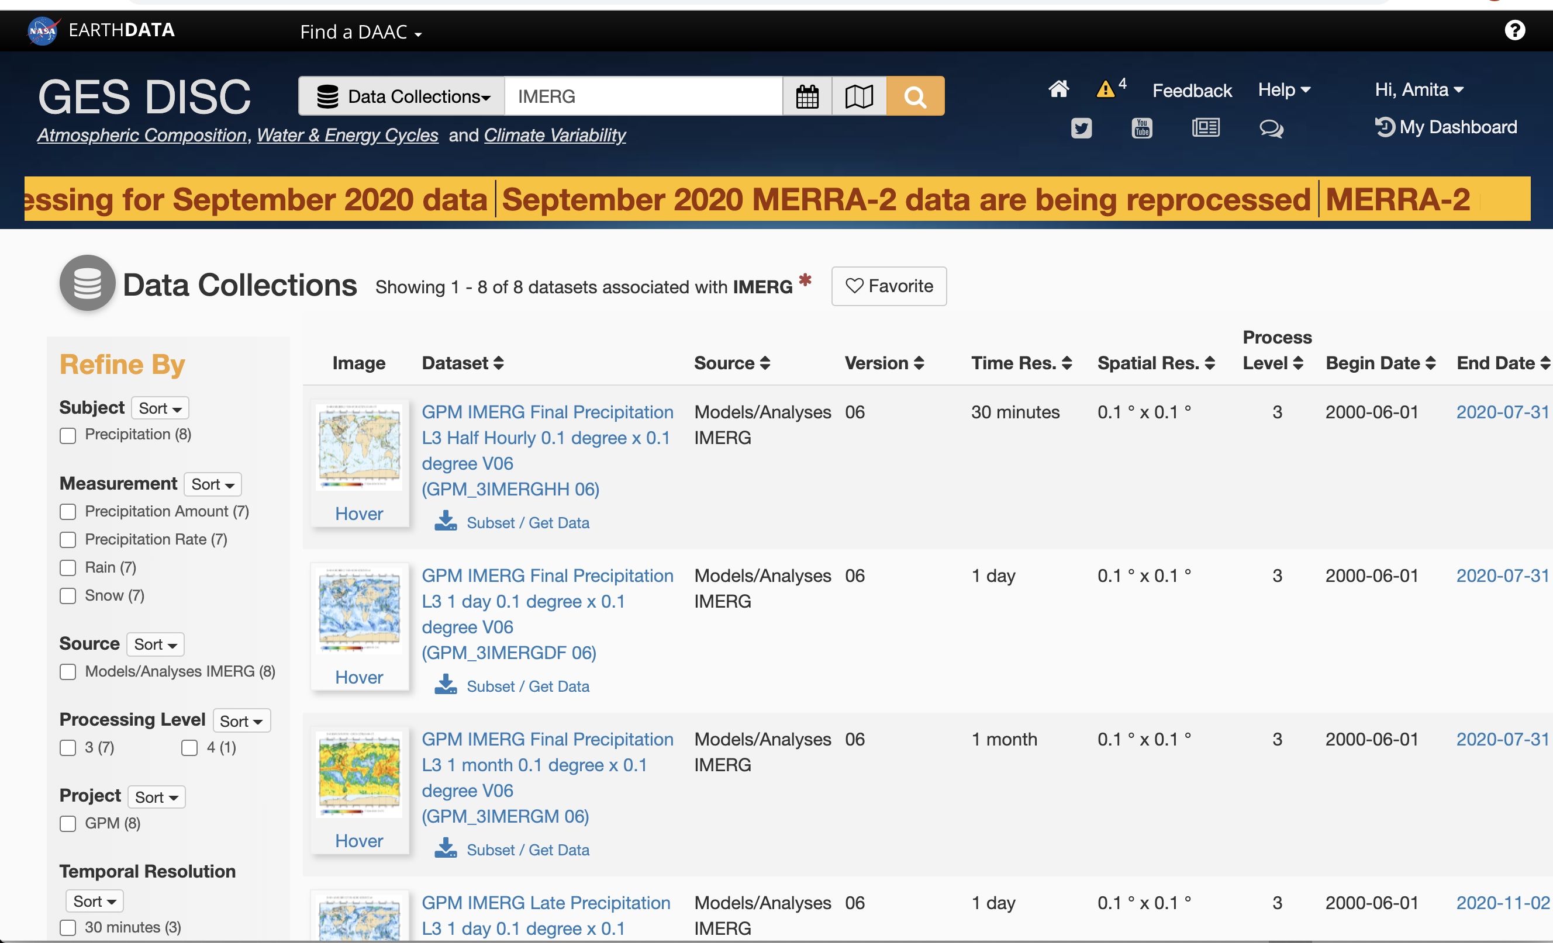
Demonstration: GES DISC
https://disc.gsfc.nasa.gov/
GPM Applications Webinar: 5 November 2020
Part of the GPM-ACCP Transportation and Logistics Workshop

Slide 29
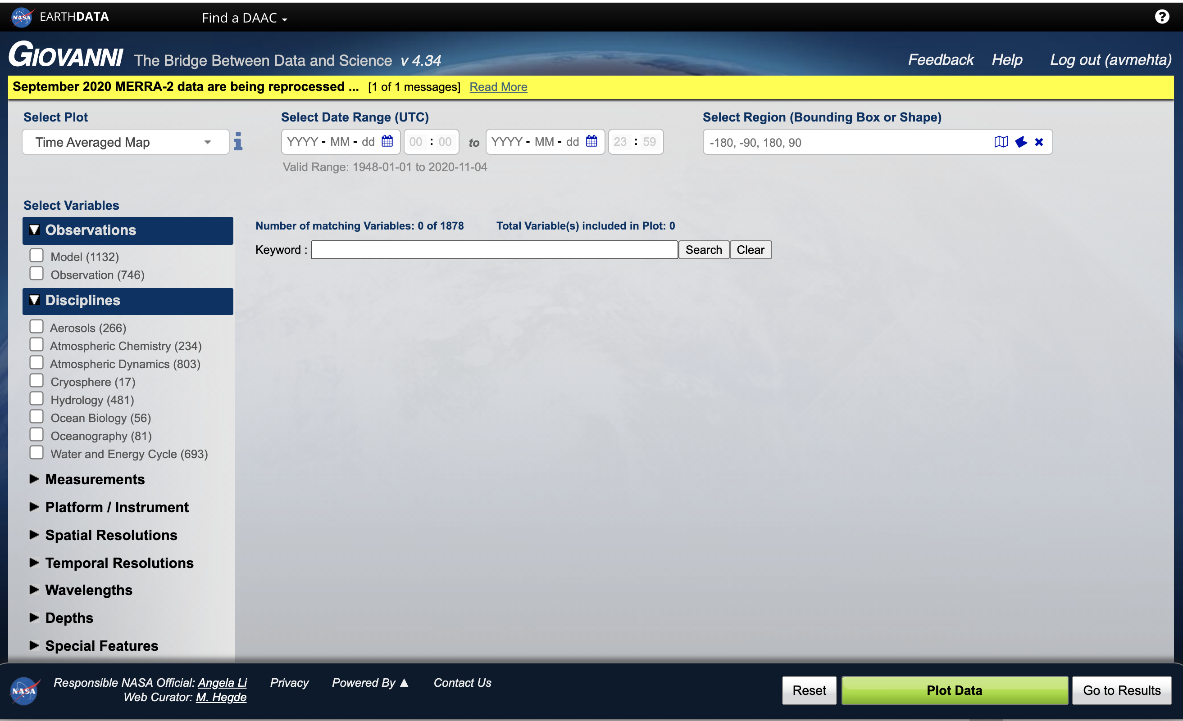
Demonstration: Giovanni
https://giovanni.gsfc.nasa.gov/giovanni/
GPM Applications Webinar: 5 November 2020
Part of the GPM-ACCP Transportation and Logistics Workshop

Slide 30
Monitoring Rain for Road Transportation Logistics
GPM Applications Webinar: 5 November 2020
Part of the GPM-ACCP Transportation and Logistics Workshop

Slide 31
Weather Impact on Traffic
https://ops.fhwa.dot.gov/weather/q1_roadimpact.htm

Slide 32
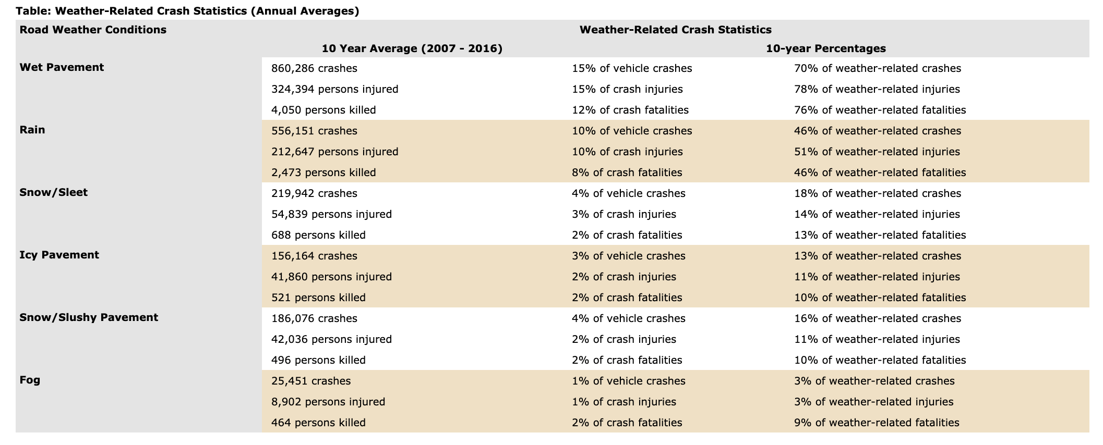
Weather Impact on Traffic Saftey
https://ops.fhwa.dot.gov/weather/q1_roadimpact.htm

Slide 33
Rain Impact on Traffic Flow
https://ops.fhwa.dot.gov/weather/q1_roadimpact.htm

Slide 34
Assess Rain Impact on Traffic/Road Conditions in your area of Interest using IMERG Data
Examine rainfall patterns – long term mean and variations.
Assess rainfall thresholds for past events of traffic delay and/or road closures related to heavy precipitation and flooding,
Monitor near real-time rainfall to decide potential for adverse impact traffic/road conditions.
Here we show how to use IMERG analysis using Giovanni and examine
rainfall intensity and statistics for a case study in North Carolina.
Note: Additional weather information, winds, temperatures, clouds, visibility, terrain, soil moisture, and road conditions should be included for systematic impact assessment and decision support for roadways and traffic management.

Slide 35
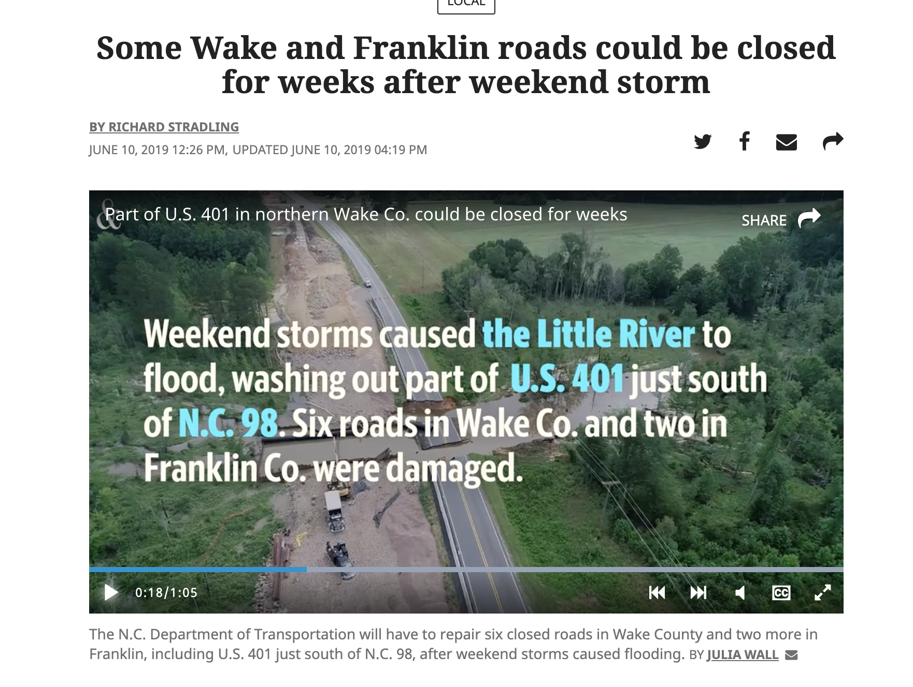
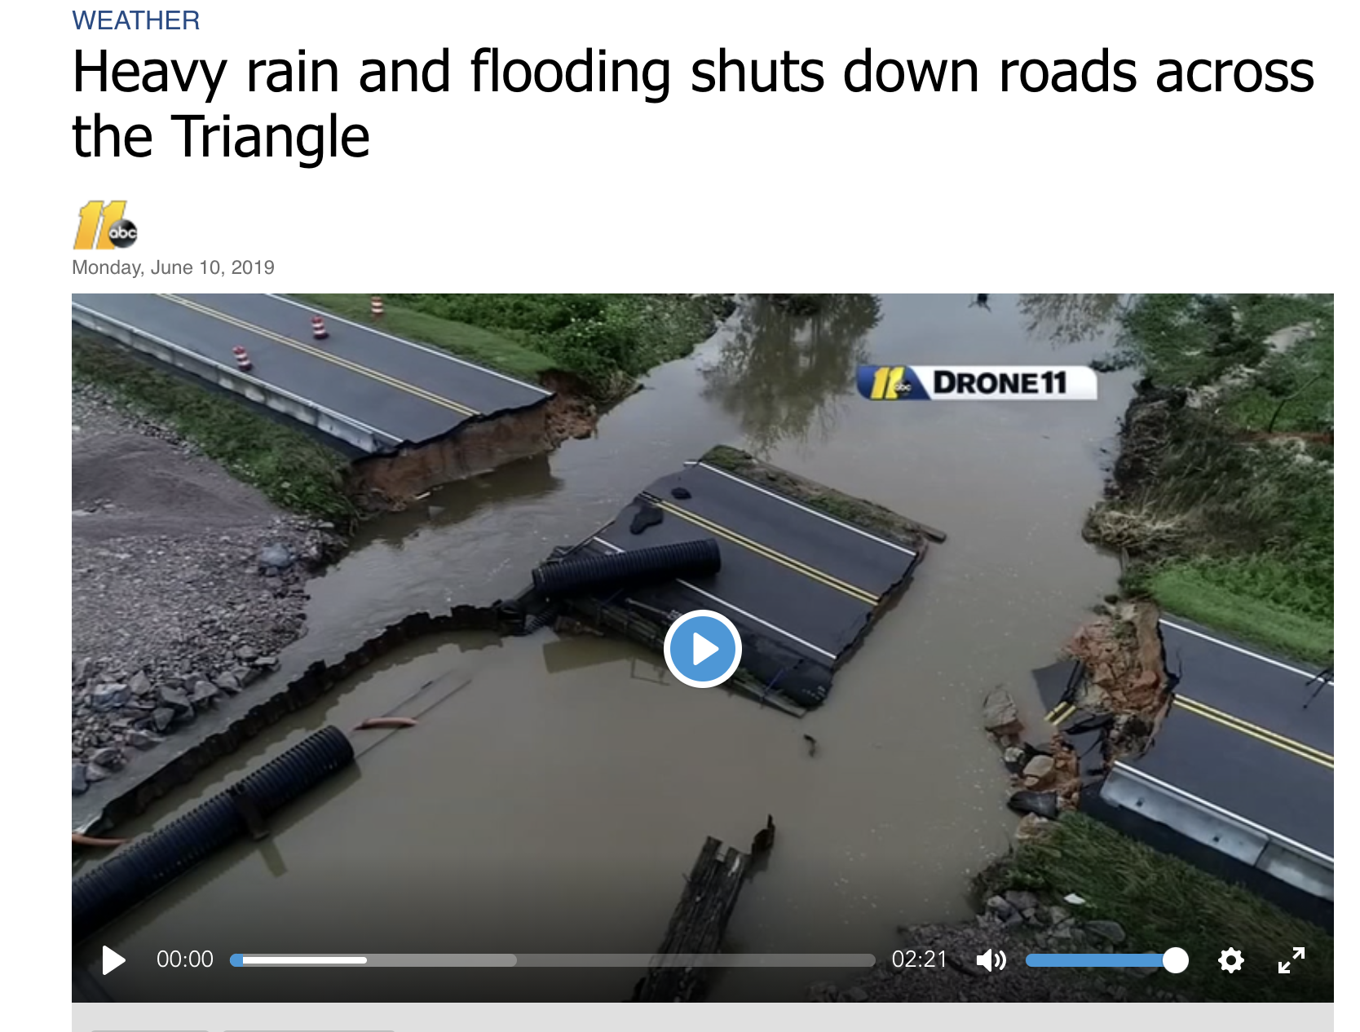
Case Study: Heavy Rain and Wake and Franklin County Road Closure
https://www.newsobserver.com/news/local/article231382168.html
https://abc11.com/weather-radar-the-wral/5338332/

Slide 36
Example of IMERG analysis using Giovanni, QGIS, and Excel for Wake County North Carolina
Spatial and temporal Selection
Calculate and download 20-year daily mean rainfall for the region of interest (ROI) (map and time series) for June
Examine daily rainfall anomalies (departure from mean) for June 2000 to 2020
Identify 80 to 90 percentile value for rainfall to gauge threshold of rainfall for the ROI for likely flooding and impact on roads
Examine rainfall over the ROI for June 2019 when the heavy rains flooded roads that resulted in road closure.
Next: Giovanni Demonstration

Slide 37
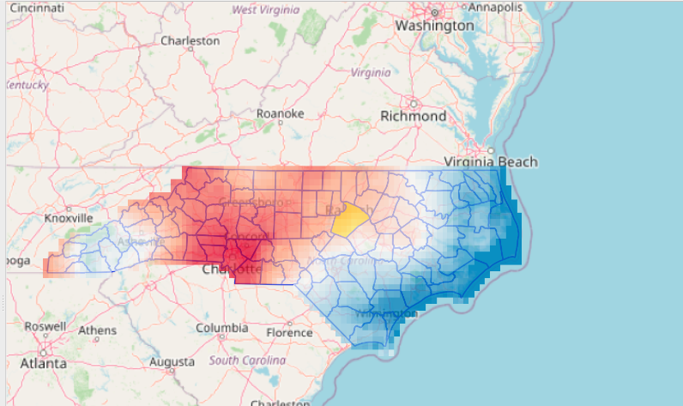
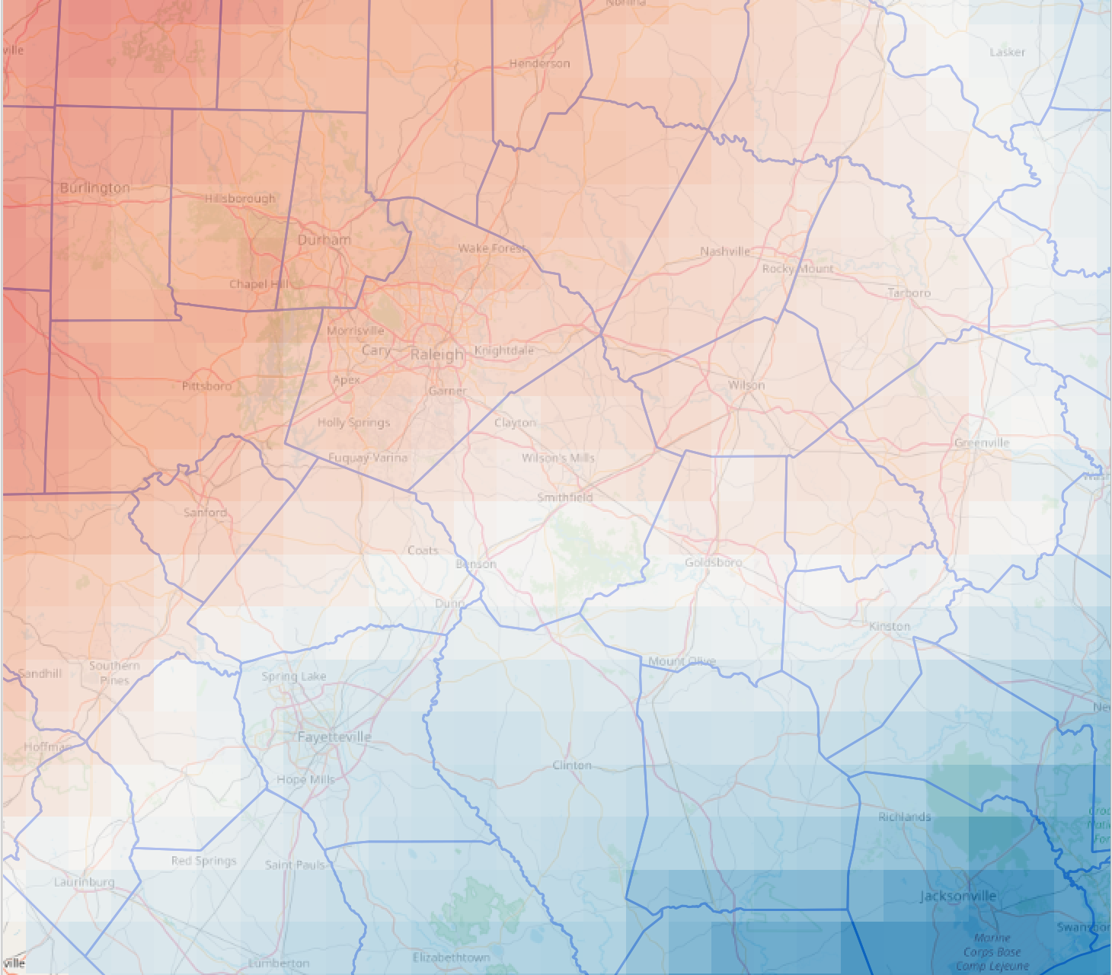
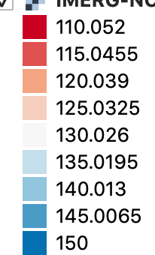
June Mean Precipitation (2000 – 2020) in North Carolina
mm/month

Slide 38
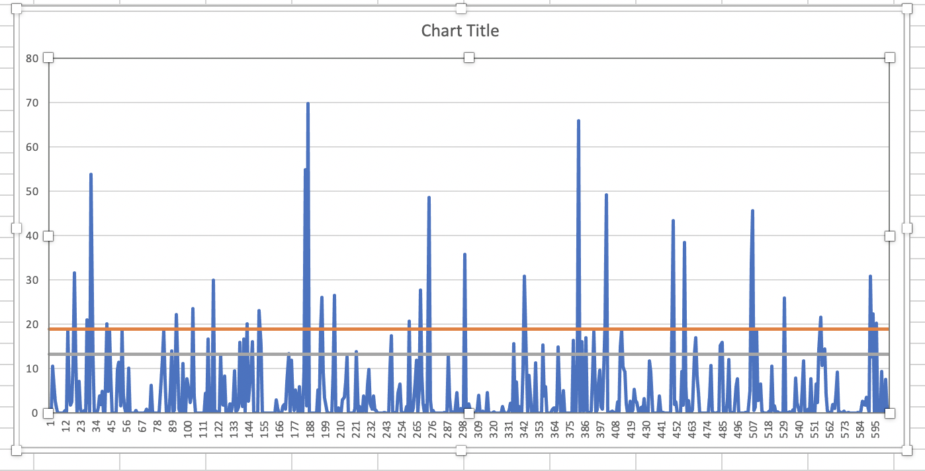
Time Series of June Precipitation for Central Wake County
2000 - 2020
90. and 95. percentile precipitation values
Mm/Day

Slide 39
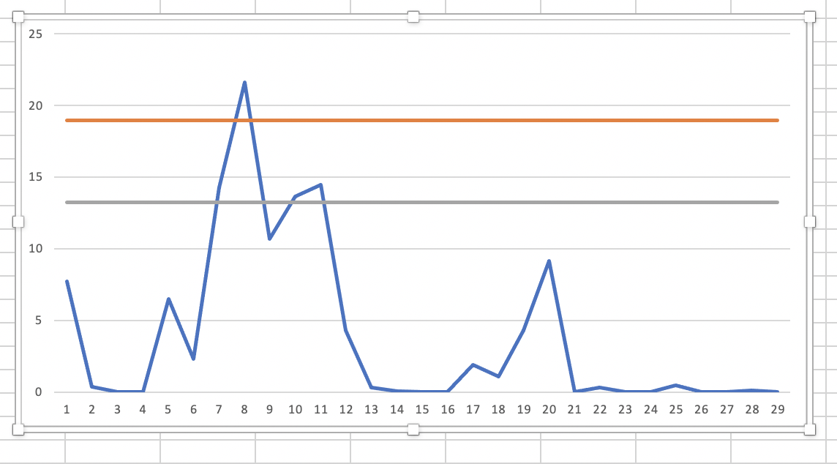
Time Series of June Precipitation for Central Wake County
2019
90. and 95. percentile precipitation values

Slide 40
Summary
Overview of GPM Precipitation data products and data access via a variety of web-based tools was provided.
IMERG Rainfall analysis using Giovanni was demonstrated for a heavy rain and road closure event that occurred in June 2019 in North Carolina.
Despite 0.1 degree spatial resolution of IMERG, availability of long-term, spatially continuous, consistently derived, half-houlry rainfall data are very useful for a variety of applications and can be used to aid decisions for transportation management.
GPM rainfall data are open source and online resources, tutorials, and training are available.
Additional data such as soil moisture, land cover, terrain height from NASA satellites are also available.

Slide 41
Thank You

