Slide 1


The Spatial and Temporal Aspects of Precipitation Applied to Transportation Applications
James E. Mitchell, Ph.D.
IT Statewide Project Officer-GIS
presented at the
NASA GPM-ACCP Transportation and Logistics Workshop
Virtual Conference – November 2, 4, 5; 2020
Notes:
Presentation by James E. Mitchell, Ph. D. at the 2020 NASA GPM-ACCP Transportation and Logistics Workshop, a virtual conference, in November, 2020

Slide 2
Uses of Precipitation Data by State Transportation Agencies
Road and Bridge Design
  Static/Historical/Archival
  Identify “Design Storm”
  Calculate “Probable Maximum Precipitation Event”
Operations
  Near-Real Time/Short-term Forecast
  511 Traveler Information Roadway Conditions
Safety
  Static/Historical/Archival
Notes:
State transportation agencies use precipitation data in many ways. Some require near-real-time data. Others typically use historical data.

Slide 3
Model Components q = f(x, y, z, p, t) + €
Where:
q | = | Output
f() | = | Model of “known” relationship(s) between inputs and outputs
x, y, z | = | Input Watershed Characteristics
p | = | Incident Precipitation
t | = | Input Time Dimension
€ | = | Error – Unexplained behavior and Intrinsic variability
Notes:
Models are abstractions of reality that relate data inputs to outcomes. Although often overlooked, “intrinsic variability” is a characteristic of many models, it is often disregarded, as “error” rather than a characteristic of the system being modeled.

Slide 4
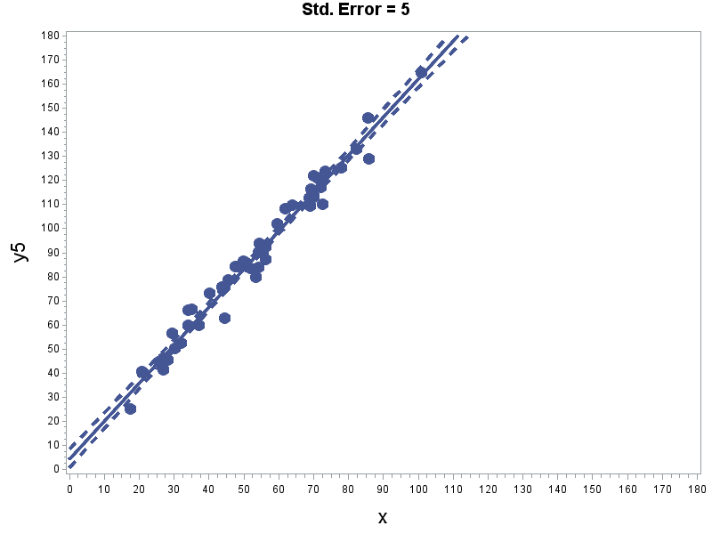
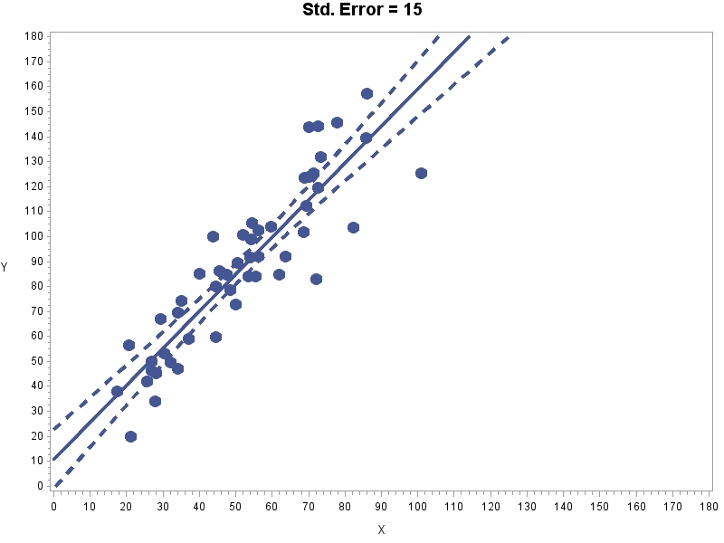
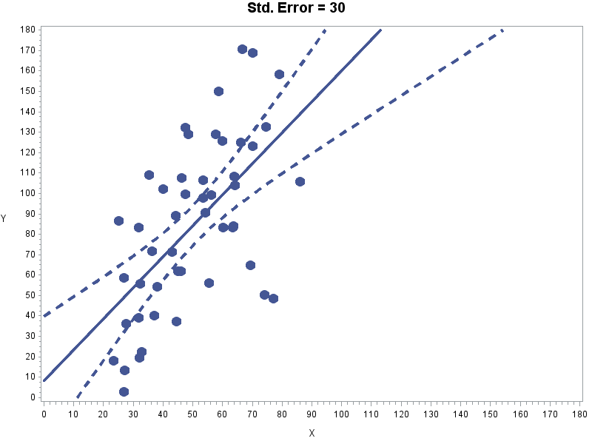
Intrinsic Variability is a
Watershed Characteristic
Same mode (slope and intercept), different uncertainty (variance).
Model variability is a characteristic of the watershed,
Fundamental hhydrology is consistent across basins.
Spatial patterns of basin characteristics modify response.
Notes:
This example displays the same model with three different magnitudes of “intrinsic variability.”

Slide 5
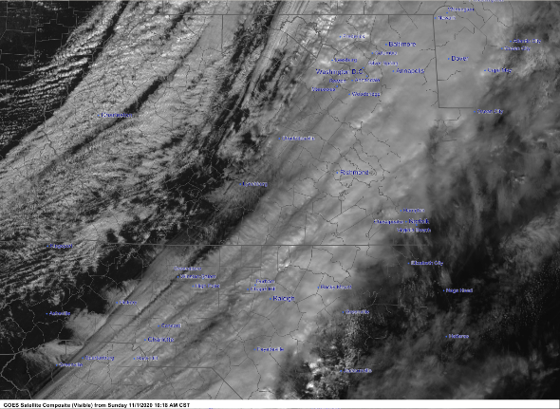
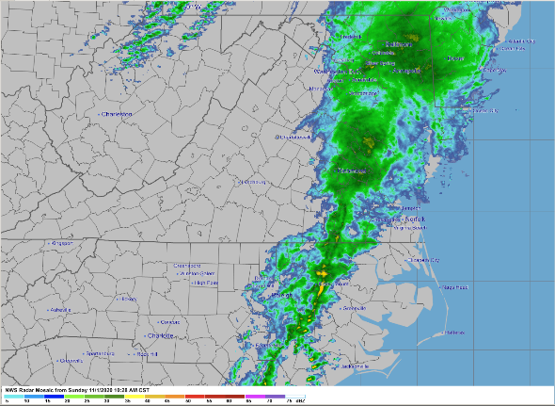
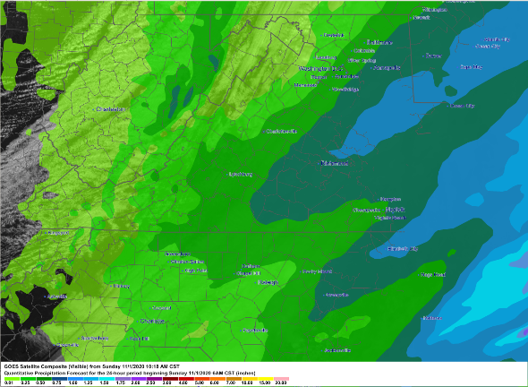
Nature of Precipitation Events
A
What You See and What You Get
A - GOES Satellite Image
B - Doppler Radar Image
C - NWS Precipitation Forecast
B
Precipitation occurs as saltatory events that track across the landscape, along paths that follow frontal boundaries, tropical cyclones, and other weather phenomena. They are discontinuous, anisotropic, and inhomogeneous. Figures A and B show these characteristics for November 1, 2020:10:40 AM CST . Figure C displays a typical National Weather Service forecast for that same time. The NWS forecast uses a contouring algorithm to represent precipitation. However, contouring assumes relatively well-behaved, smooth, continuous surface and does not represent surfaces with discontinuities, very well.
C
Notes:
Precipitation is a saltatory, discontinuous natural phenomenon; that moves across the landscape. It is difficult to capture the spatial and temporal variability (characteristics) in a model.

Slide 6
Issues of Spatial Scale
Sampling
  Areal Density of Sample Locations
  Pattern of Rainfall (size of storm, movement across basin)
Analysis and Visualization
  Interpolating Between Sample Locations
  Maintaining Discontinuities
Notes:
Spatial scale is an important factor in data collection and modeling. To accurately capture spatial variability, the data must be sampled at a finer spatial scale.

Slide 7
Issues of Temporal Scale
Sampling
  Frequency of Sample (annual, monthly, daily, hourly…)
  Cumulative or Instantaneous
  Intensity of Rainfall Events (Volume/Time)
  Duration of Rainfall Events
  Latency, Time Between Events, “Training”
Notes:
How data are sampled in the time domain is important to ensure that all incident precipitation are accounted for in the model. Time steps between samples as well as, whether the data are sampled in a cumulative for instantaneous fashion impact, directly, on how the model can be used.

Slide 8
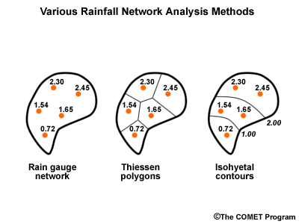
Traditional Methods to Estimate Precipitation on a Watershed
Notes:
Traditional methods used to estimate precipitation over a watershed rely on point samples [rain gauges), whose measurements are weighted, (A) arithmetically, (B) by Thiessen polygon areas, or (C) through weighted interpolation (contouring).

Slide 9
Spatial Scale - Fixed Watershed
Different Sized Data Grids
Grid size = 20 (n = 6), Grid size = 10 (n = 17), Grid size = 5 (n = 52)
Notes:
Example of he number of “sampling points” provided by rasters of a different scales on a watershed. The finer the grid size, the me intrinsic variability can be captured.

Slide 10
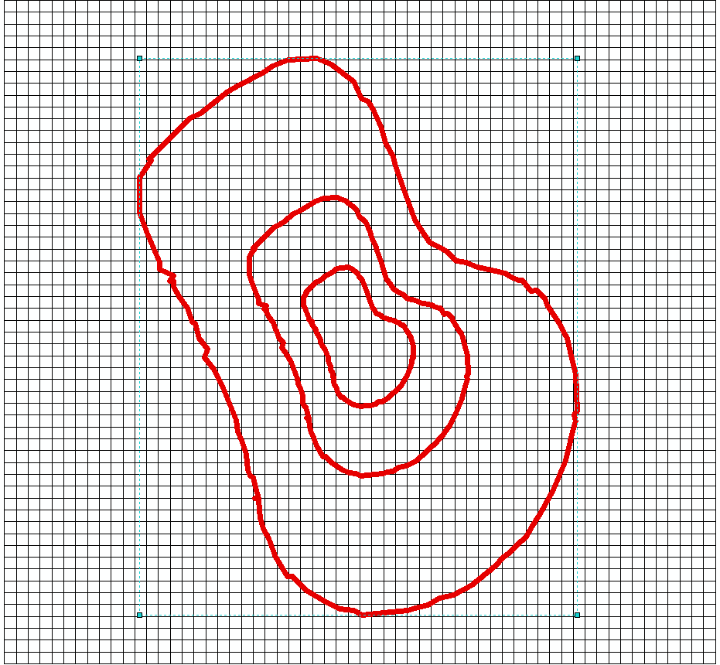
Spatial Scale - Fixed Data Grid
Different Sized Watersheds
Grid size = 5; Watershed sizes: A, 2A, 4A
Notes:
A generic watershed of the same shape, but of different sizes. At some point, the relative size of the precipitation events, the sampling grid, and the watershed reach a point where it is not possible to adequately capture the variability of the precipitation event, over the watershed.

Slide 11
Conclusions
Both Spatial and Temporal Domains are Important to Determine:
  Volume of Precipitation
  Intensity of Precipitation
Relative Scale Between the Data Sample, Rainfall Pattern, and Watershed matters
Operational Applications in Transportation Require:
  Near-Real-Time for 511 Traveler Information
  Short-term Forecasts for:
    Roadway Condition – Roadway Safety
    Potential Flooding, Landslides, Infrastructure Integrity
Information Needs to be Delivered Through Fast and Efficient, Geospatial Web Services
Notes:
Whether satellite precipitation data products can be used in operational transportation applications will depend on the specific application and the method of delivery of that information.

Slide 12

For More Information
Contact
James E. Mitchell, Ph. D.
Louisiana Office of Technology Services - GIS
jim.mitchell@la.gov 225-379-1881
Notes:
For more information, please contact me.

