Slide 1
Overview of GPM Ground Validation Walter A. Petersen, NASA GSFC/Wallops Flight Facility walt.petersen@nasa.gov
Outline
GPM GV Science Framework
Direct Validation (NMQ, VN)
Physical Validation (Field Efforts)
Integrated Validation (IFloodS)
Summary
Acknowledgement: Matt Schwaller
NASA GSFC and GPM Flight Project

Slide 2
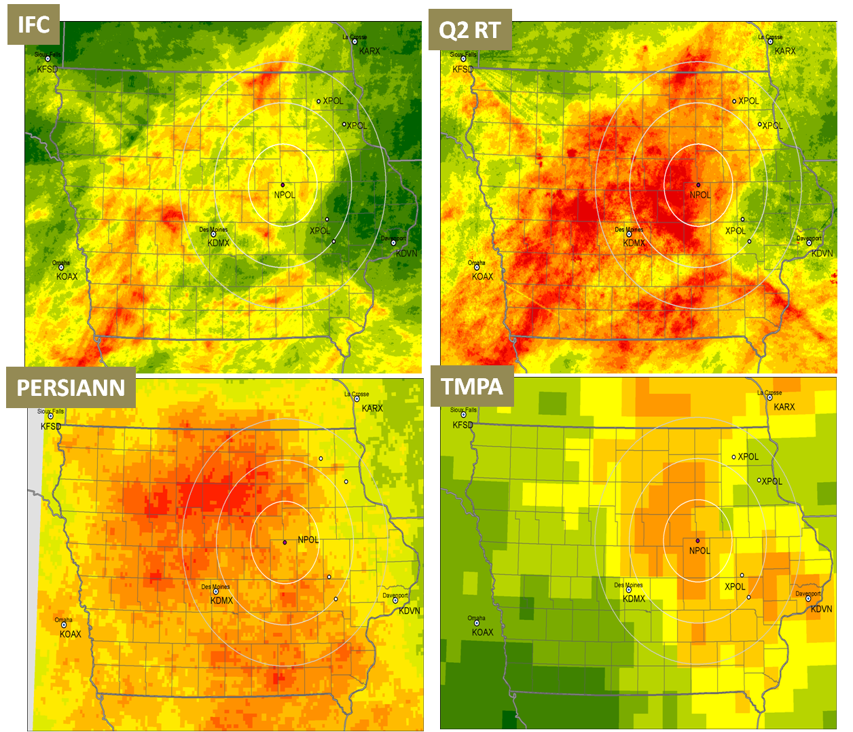
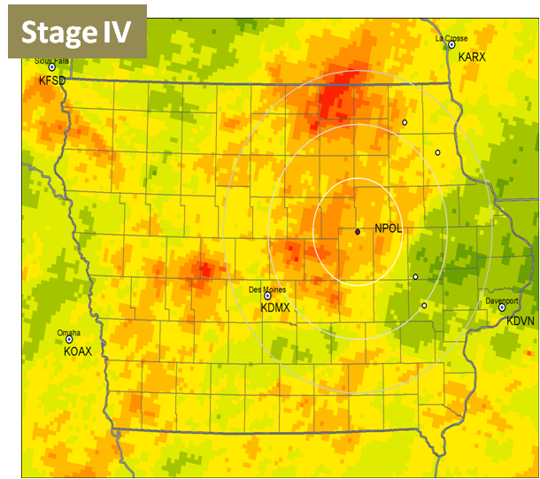
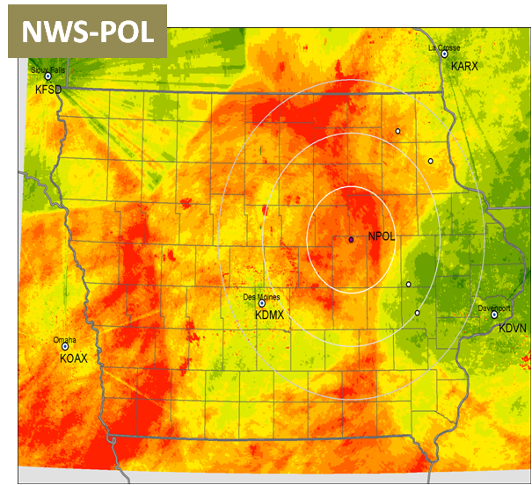
Comparison of Quasi-Real Time Products for April-June 2013 over Iowa
Courtesy; W. Krajewski, U. Iowa/Iowa Flood Center
A bit of work to be done!
What are the uncertainties here and why are they there?
How do we reduce them to get convergence of estimates?
What are the impacts to applications such as flood prediction?

Slide 3
Role of GPM Ground Validation
Refine algorithm assumptions & parameters - Characterize uncertainties in satellite retrievals & GV measurements
“Truth” is estimated through the convergence of satellite and ground-based estimates
Pre-launch algorithm development & post-launch product evaluation
Three complementary approaches:
Direct statistical validation (surface):
- Leveraging operational networks to identify and resolve first-order discrepancies between satellite and ground-based precipitation estimates
Physical process validation (vertical column):
- Cloud system and microphysical studies geared toward testing and refinement of physically-based retrieval algorithms
Integrated hydrologic validation/applications (4-dimensional):
- Identify space-time scales at which satellite precipitation data are useful to water budget studies and hydrological applications; characterization of model and observation errors

Slide 4
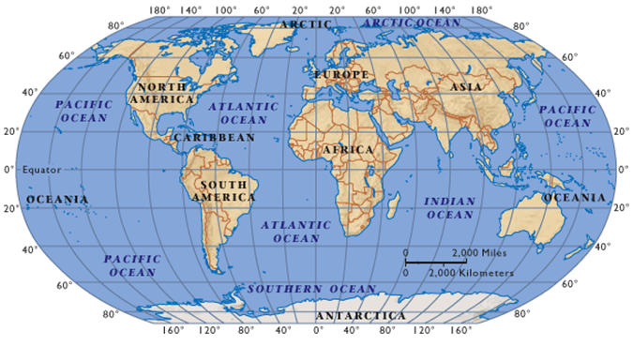
GPM Ground Validation
CONUS/NOAA NMQ, NASA VN (Radar, Gauges)
GV: A Global Effort
NASA WFF: Radar, disdrometers, gauges
Finland: UH/FMI radars, gauges (LPVEX 2010; Snow 2013- )
EC Canada (T1-2 Radars/Gauge)
(GCPEX;2012 CSPICE, 2013- )
EU gauges, radars, disdrometers, HSAF GV
EU HyMEX (2012- )
U. Washington
OLYMPEX; 2015/16
S. Korea (KMA) Gauges, Radars
Middleton Island
Radar
Japan (JAXA): Radars, gauges, disdrometers
U. Iowa/Flood Center
IFloodS; 2013
DOE ARM SGP
MC3E;2011
Duke U., NOAA
IPHEX; 2014
Kwajalein
KPOL Radar,
gauges, disdrometers
Melbourne FL (Radar/Gauges)
Brazil
Radar, gauge, disdrometer
(CHUVA; 2010-14 )
Ethiopia
Blue Nile
Gauges
Australia
Operational/Research Radars/Gauges, Ship
Argentina
Operational Radars/Gauges
Megha -Tropiques GV (France: Radar, gauge, disdrometer)
Israel Operational Gauge/Radar network
Notes:
Mention in context of 3 approaches
Direct Val efforts in U.S . Focused on NMQ (gridded continental) and VN (individual radar),
Physical val and integrated Val. via campaigns coming and completed
Cross-approach sites: WFF (NPOL, D3R with supporting dense gauge and disdrometer; CSU-CHILL and FRONT, ARM-SGP,

Slide 5
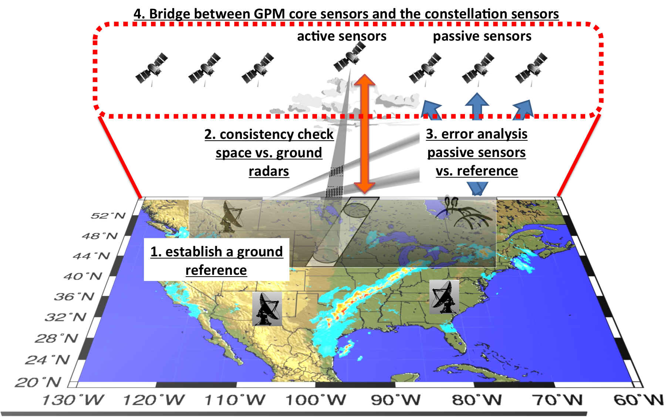
Direct GV: CONUS Focus Using NMQ/MRMS
Courtesy: P. Kierstetter, Y. Hong, J.J. Gourley

Slide 6
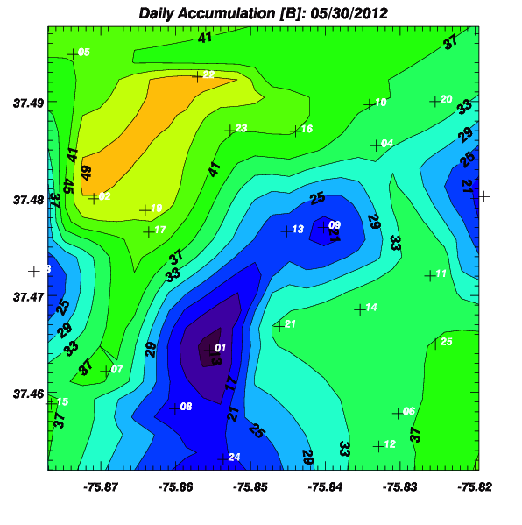
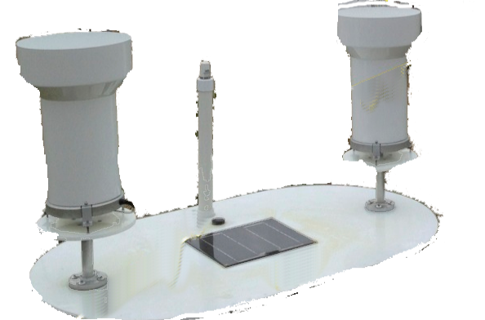
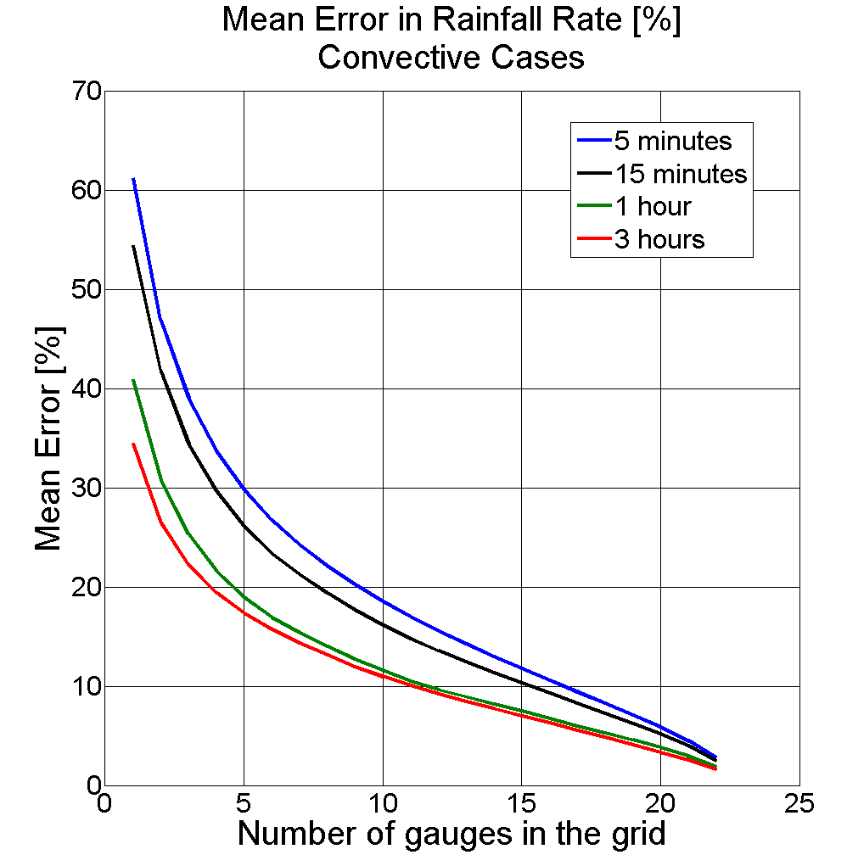
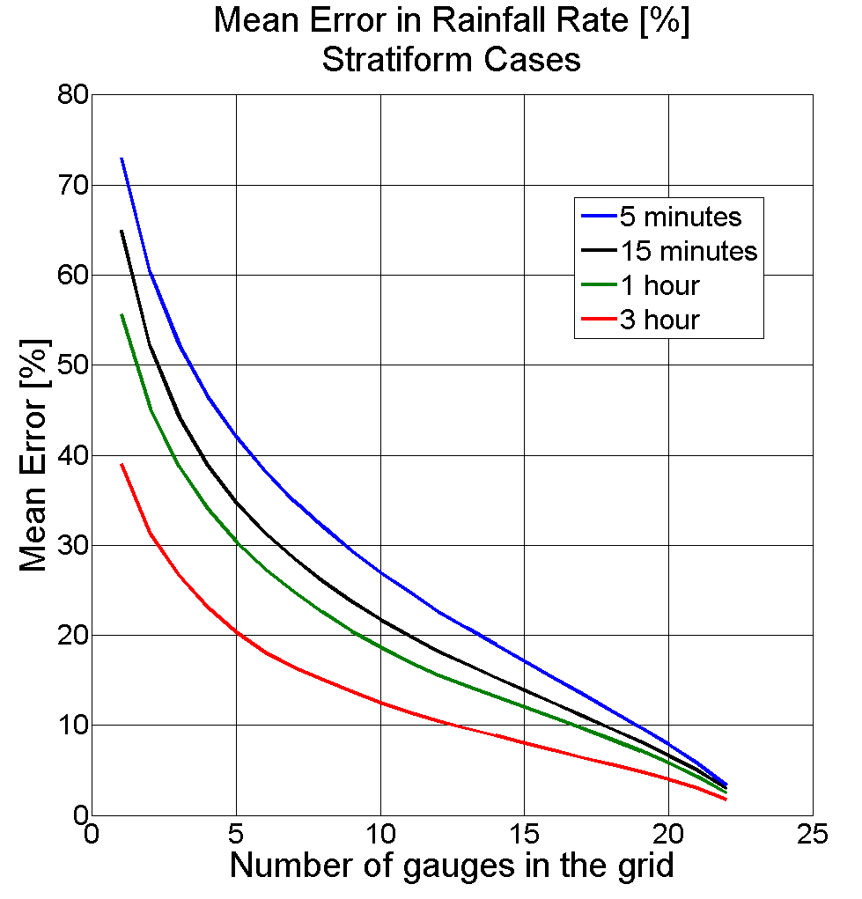
Why not just use gauges? Area estimation and “representativeness”
5 km
GPM
DPR Pixel
May 30, 2013
Daily Accumulation
Max: 50 mm
Min: 13 mm
~400% variability across a 5 km pixel for a daily total!
5 km
GPM Dense gauge Network
Gauges for tuning and/or validating? Implications for uncertainty
Estimating area-mean at relevant footprints and errors < 10-20% takes a large number of gauges! Not practical.

Slide 7
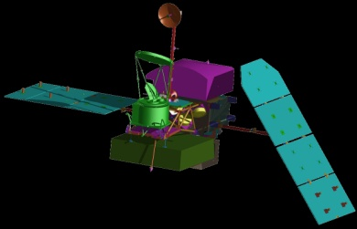
Measurements are required at a multitude of scales
Radars function as the “BRIDGE” between scales
Gauge Network
ΔX O[0.1 to 10 km]
Radar
(volume)
Gauge (point)
Satellite
ΔX[4 km - 50 km]
Scanning radiometer/radar
O[0.1 to 4 km]
ΔX
Research Operational
Scanning Precip Radar (variable δt)
Synergistic and adaptive 4-D use of relevant platforms
long term, “heart beat”, statistical sampling (national radar network)
Ability to “probe” at high space-time res. (research radars)
Reference ground measurements (gauge networks)

Slide 8
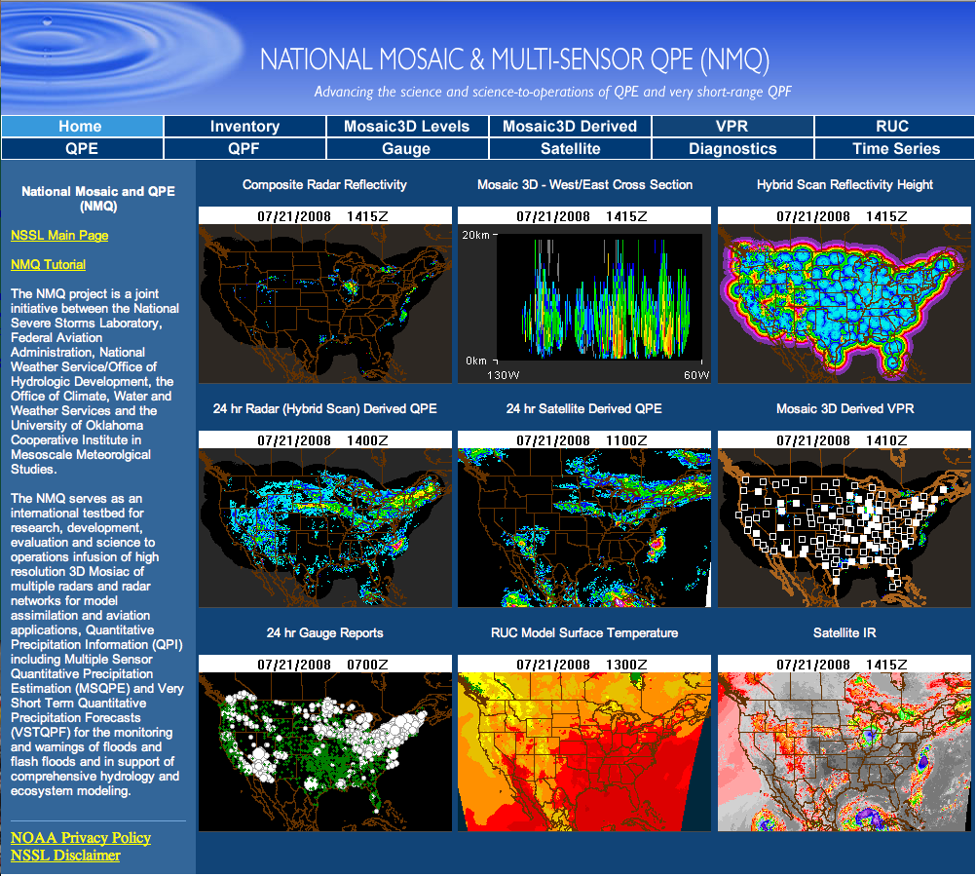
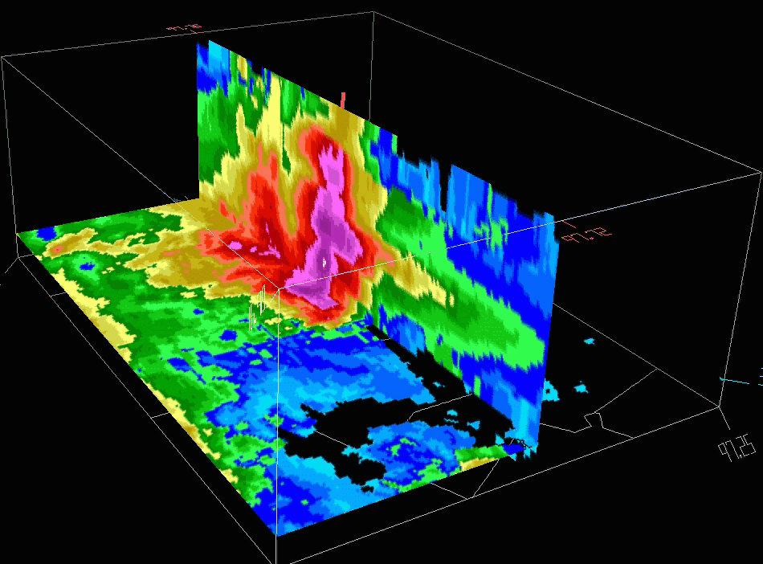
Q2 provides 3D reflectivity mosaics and QPE products over CONUS at 1-km²/5 min resolution
NASA GPM GV and NOAA/OU Collaboration for Direct GV Using Operational NOAA NMQ-Q2…
Real-time platform to develop, test, and assess advanced techniques in quality control, data integration and precipitation estimation.
http://nmq.ou.edu/legacy2005.html
Courtesy P. Kierstetter, U. Oklahoma
Notes:
The NMQ system combines information from all ground-based radars comprising the NEXRAD network, mosaics reflectivity data onto a common 3D grid and estimates surface rainfall accumulations.
The uniqueness of the NMQ system lies in its resolution at 1-km² horizontal resolution and 5 min.

Slide 9
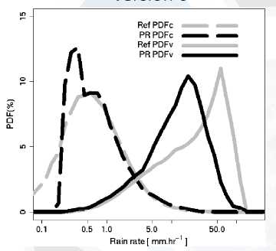
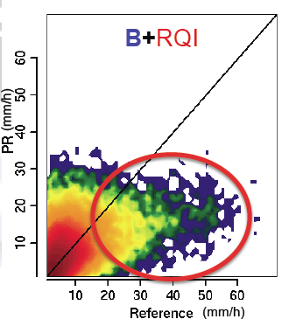
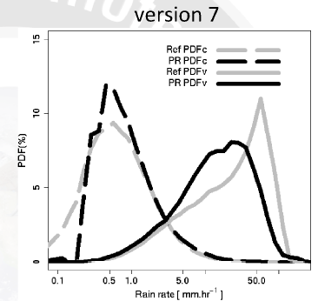
GPM Direct Validation Tool Development with NOAA NMQ Group
(OU/NSSL: Kirstetter, Hong, Gourley,; PMM: Morris, Wolff, Petersen, Schwaller)
System Prototype:
Reference Q2 matched to PR
Compare March-May 2011
Example: Test TRMM PR Retrieval Version Changes
V7.0 improved bias and correlation
Slight shift of V7.0 rain volume PDF toward heavier rain (right direction)
Ongoing Work
Error by rain type, topography, scan angle, NUBF etc.
Error analysis for TMI (2A12)
CONUS-wide Level II (orbit)/Level III (hourly accum) products being transferred to NASA WFF GV Servers
Operational server /web site
Transition to MRMS/Q3

Slide 10
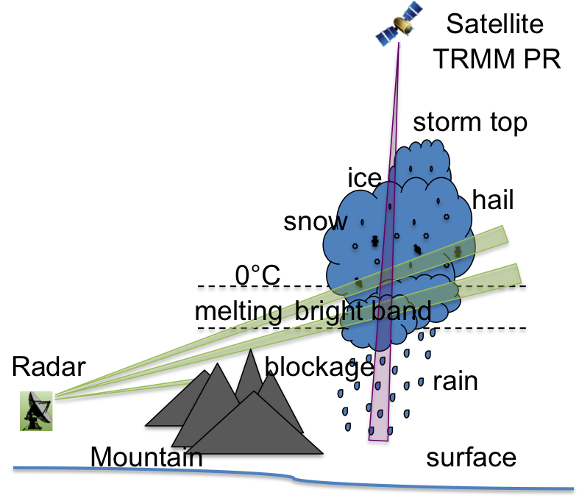
Synergy of Satellite Validation as QPE Application/Utility Correcting low level radar Vertical Profile of Reflectivity: (VPR)
TRMM
Determine the representative VPR from TRMM (GPM) and apply it to ground radar for near surface QPE
Ku-Band VPR
Physical model
Empirical model
VPR
S-Band VPR
Range correction
Ground Radar
Representative AVPR
Enhanced QPE
Corrected by
Courtesy B. Wen, U. Oklahoma

Slide 11
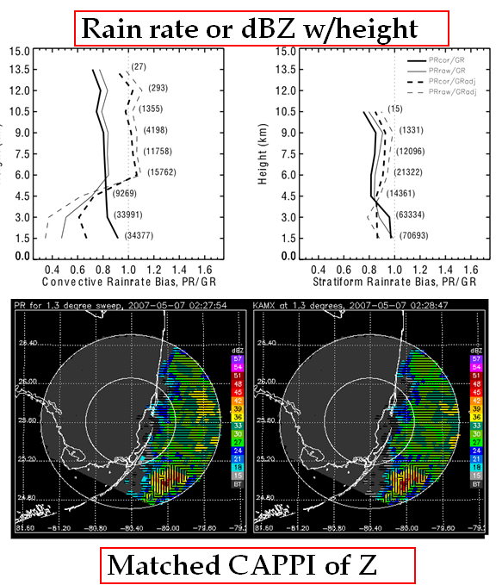
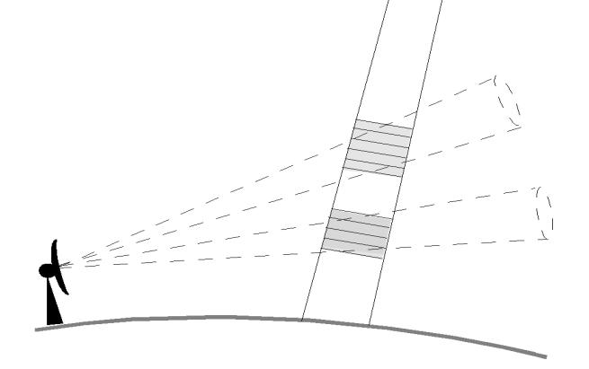
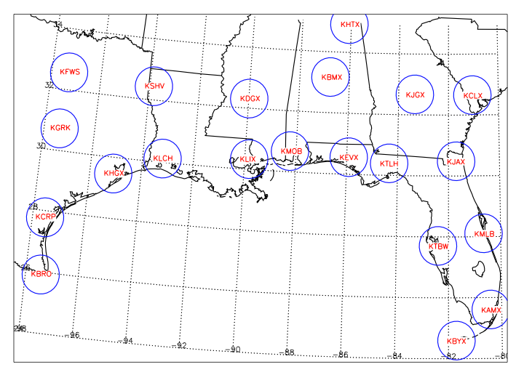
GPM Direct Validation: Developing our Tools
Pixels: GPM Project Office Validation Network (VN) Software
Reflectivity: Geometrically matches ground, spaceborne radar (statistics); prototype for 21 radars in SE U.S. (TRMM matching since 2007)
Radiometer: TMI 2A12 Rain rate profile
Products:
Horizontal and vertical cross-section comparisons of Z, R, dual-pol (e.g., HID)
Volume statistics on rain rate (2A25, 2A12) reflectivity……
Scalable and radar-platform adaptive tool: Also in use by GPM partners in Korea, Taiwan, Australia, Europe
Arthur Y. Hou
NASA Goddard Space Flight Center

Slide 12
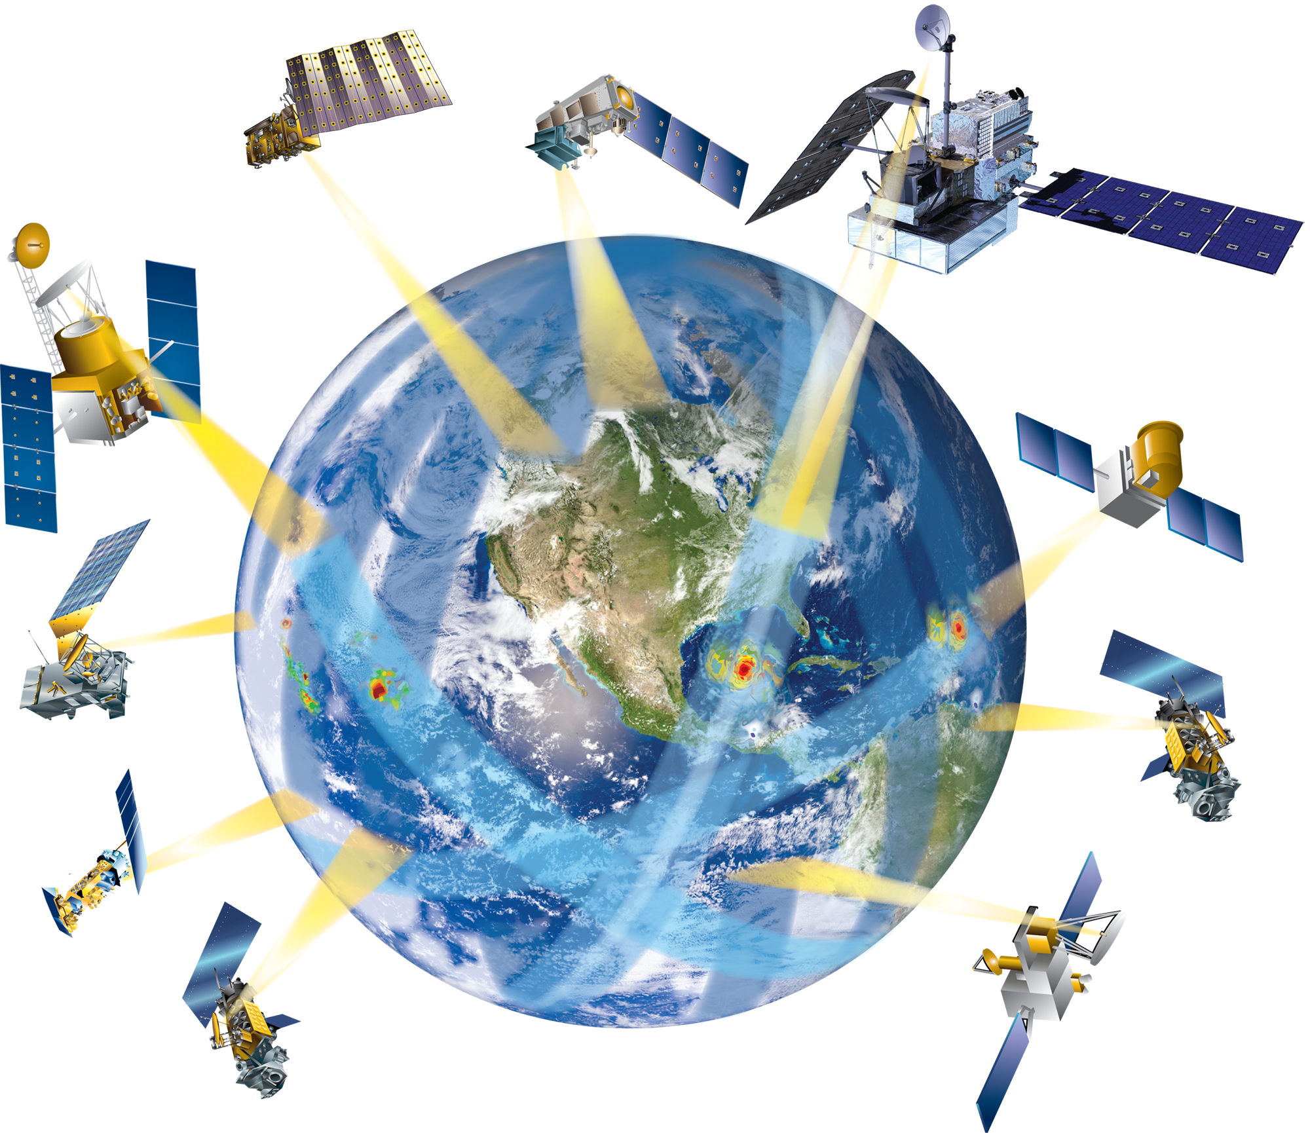
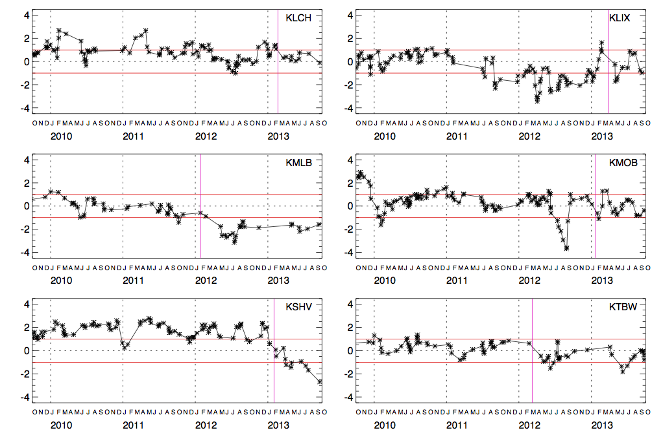
Validation Network Database Mining: GR bias trends vs. PR
GPM
Stratiform rain, above 0°C level, 100% “beam fill”, Ku-adjusted GR
KLCH
KLIX
NPOL and D3R in Iowa
KMLB
KMOB
KSHV
KTBW
Dual-pol transition
Notes:
Significant “cooling” of the GR in Melbourne and Shrieveport radars. Long term differences in the +/- 1 to 2 dBZ range for comparisons of GR and PR.

Slide 13
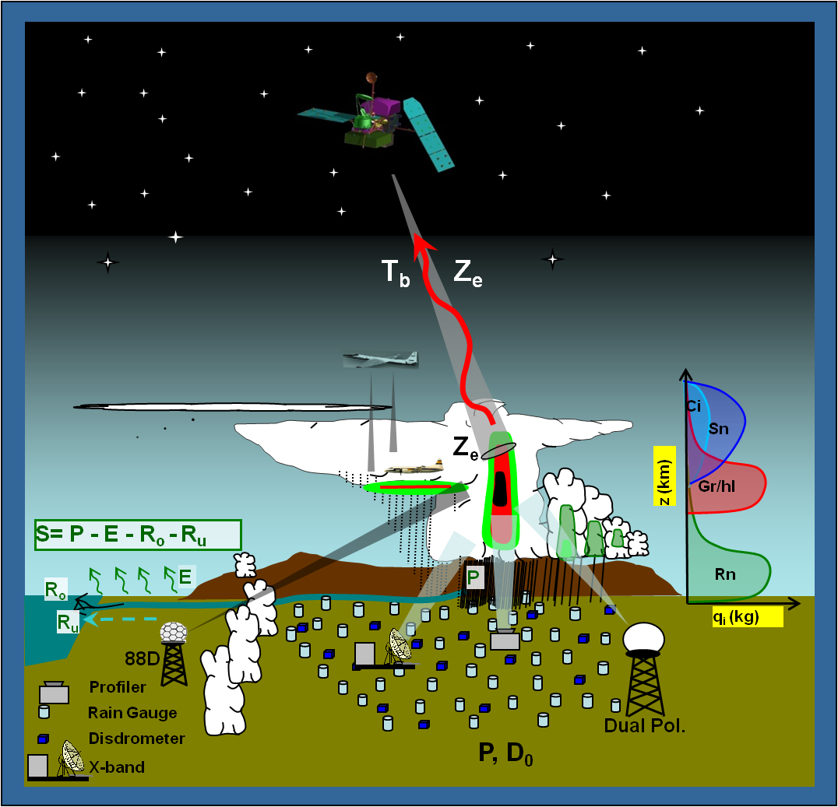
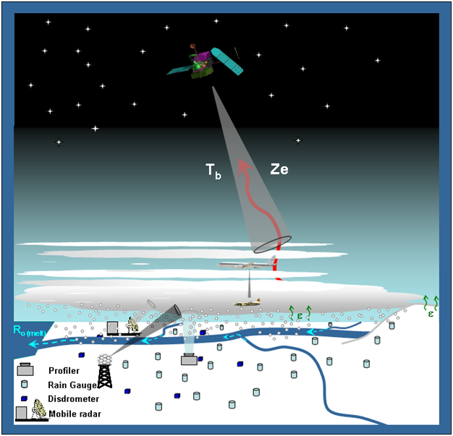
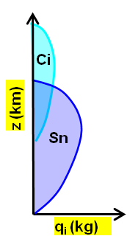
GPM Ground Validation
Getting the Physics Right: GPM Physical Validation
Warm season
Rain
Cold season Snow/ice
Fundamental to any application, GPM must produce accurate precipitation estimates over a broad range of warm and cold season conditions- difficult proposition!
GPM Ground Validation field measurements are conducted to test and improve satellite-based remote sensing and estimation of precipitation.

Slide 14
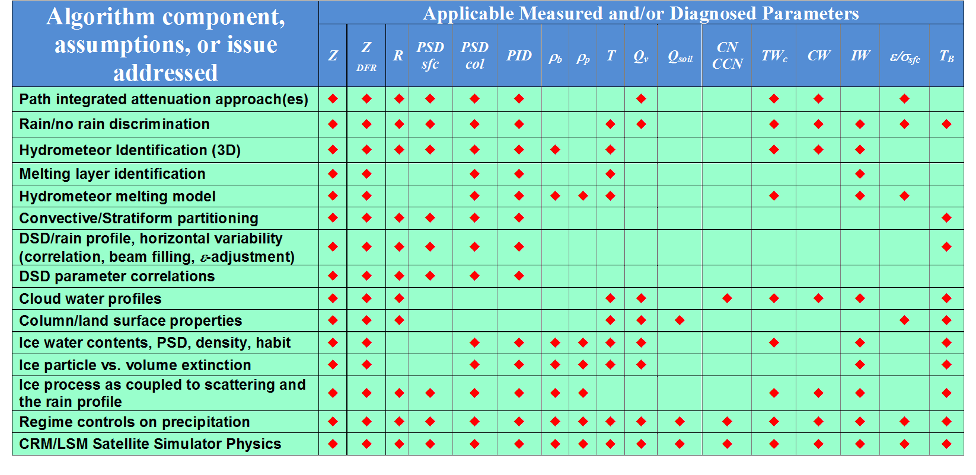
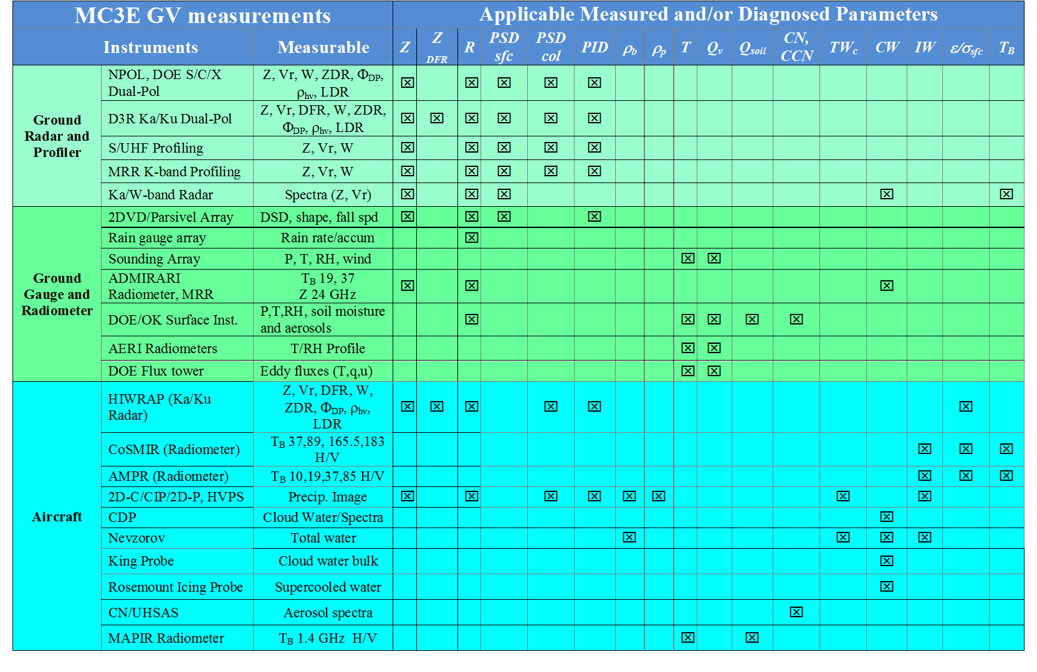
Field Campaigns and Algorithm Needs: “Traceability”
Improving algorithm physics / testing assumptions requires observations of relevant parameters
The required observations drive instrument selection and deployments
walt.petersen@nasa.gov
Notes:
The field campaigns we conduct are designed for traceability to algorithm needs. That is, there are specific physical assumptions , approximations or methods made in the algorithms that require testing at the very least and a perhaps significant modification at the worst- these are tied to measurement of certain parameters. The measurements in turn are tied to certain instruments that must be deployed- hence a field effort. The traceability gives us a means to generate a “score card” after the field campaign and analysis of results is complete.

Slide 15
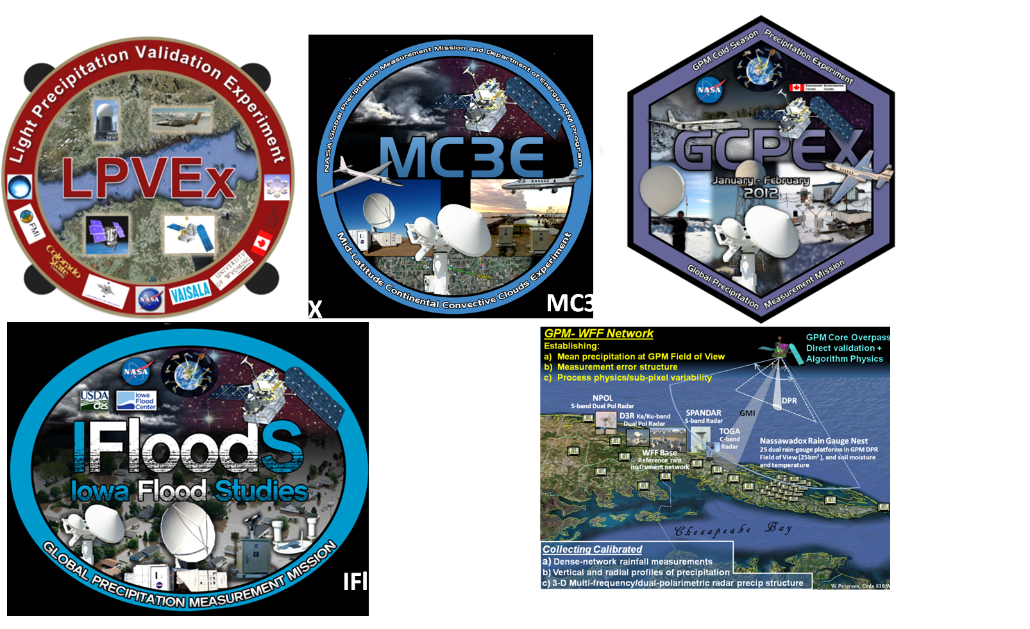
GPM Ground Validation
Physical Process Validation: Field Campaigns
“Cloud system and microphysical studies geared toward testing and refinement of physically-based retrieval algorithms”
C3VP

Slide 16
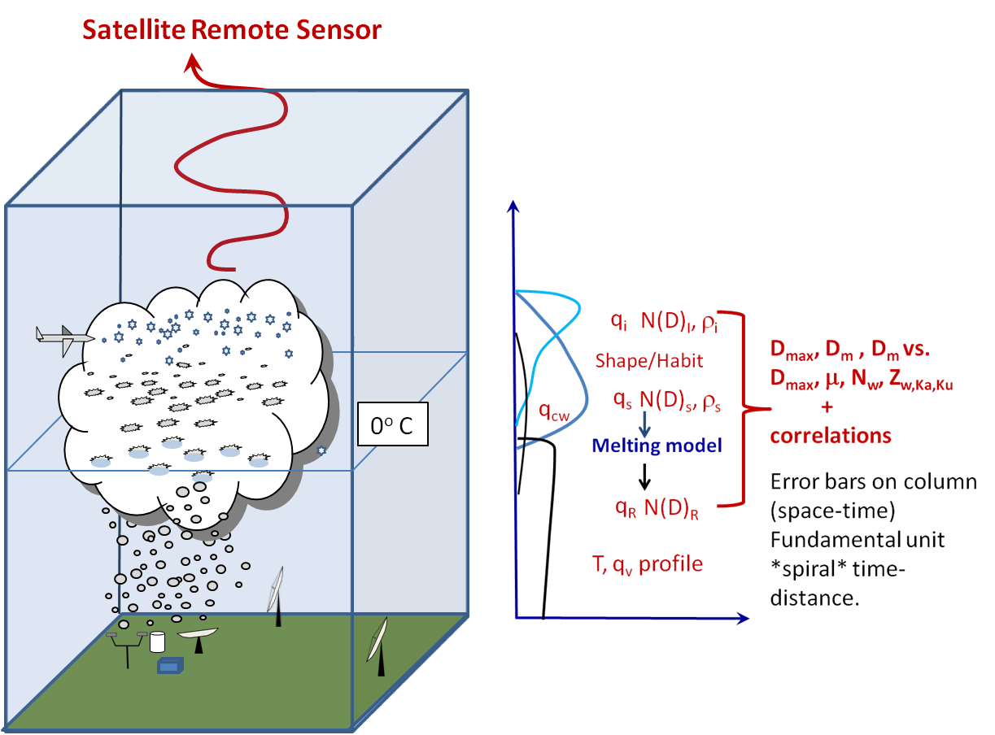
Science Approach to Data Collection
“Building the Column”
Connecting the physical “dots” for precipitation process ground to cloud top, coupled to GPM satellite simulator measurements.
Example “Dream Scenario” from MC3E
Satellite view: High Altitude ER-2 (“satellite simulator”; HIWRAP, CoSMIR, AMPR)
Column: UND Citation Microphysics
3-D Domain: Multi-frequency/polarimetric radar
Ground reference: Dense networks of disdrometers (DSD) and rain gauge measurements

Slide 17
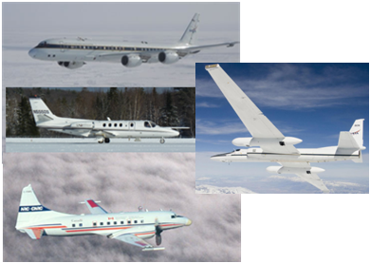
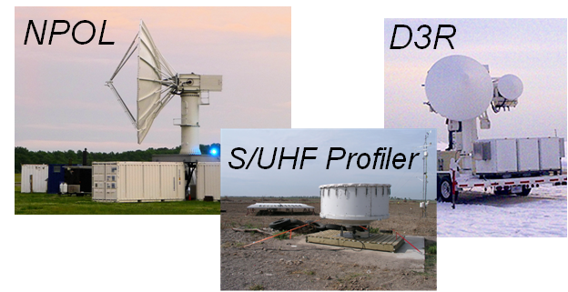
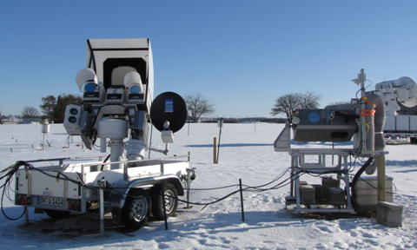
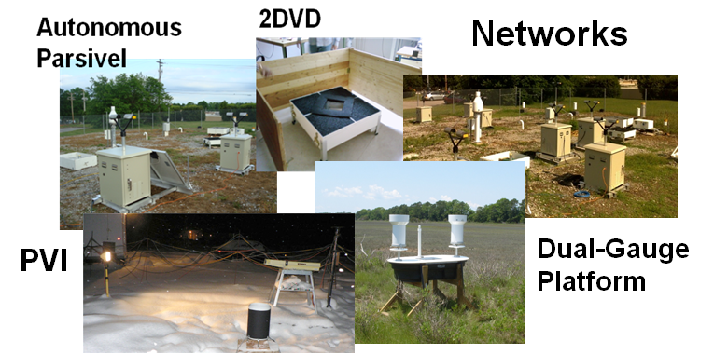
High Altitude to Ground: Instruments
Airborne
View from the top- Satellite “simulators”
CoSMIR, AMPR Radiometers
HIWRAP, APR-2, Ka-Ku Radars
Column microphysics
Cloud Microphysics Suite (e.g., 2D-C/P/S, CIP,CPI,CDP, HVPS-3, Nevzorov, King)
Ground: Dual-pol/Dual-Freq. Radar
Column precipitation microphysics, rates, DSD
Scanning: W, Ka, Ku, X, C, S
E.g., NPOL, D3R, King City, X/C-SAPR
Profiling: W, K, X-band, S/UHF
Radiometer (ADMIRARI/DPR)
Column TB, Water Path
ADMIRARI (10-37 GHz), DPR (89-150GHz)
Precipitation Rates / DSD
Connect/Reference column to surface
Disdrometers (2DVD,Parsivel, JW))
MetOne rain gauges, dual-gauge
All weather hot-plates
OTT Pluvio² weighing gauges
Precipitation Video Imager
ADMIRARI
DPR
Notes:
Continue on top-down approach- instruments match this philosophy from both a particle and integrated remote sensing perspective.

Slide 18
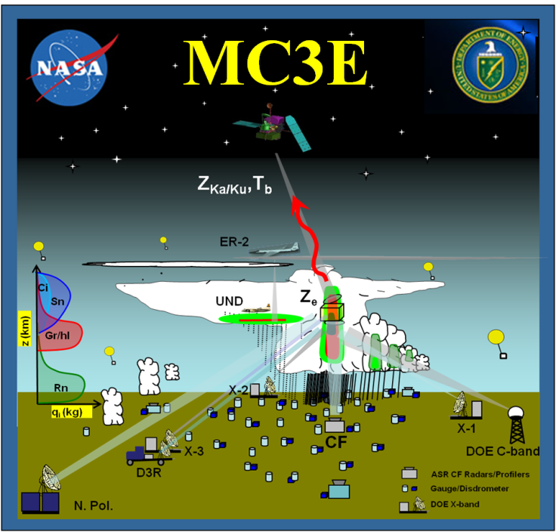
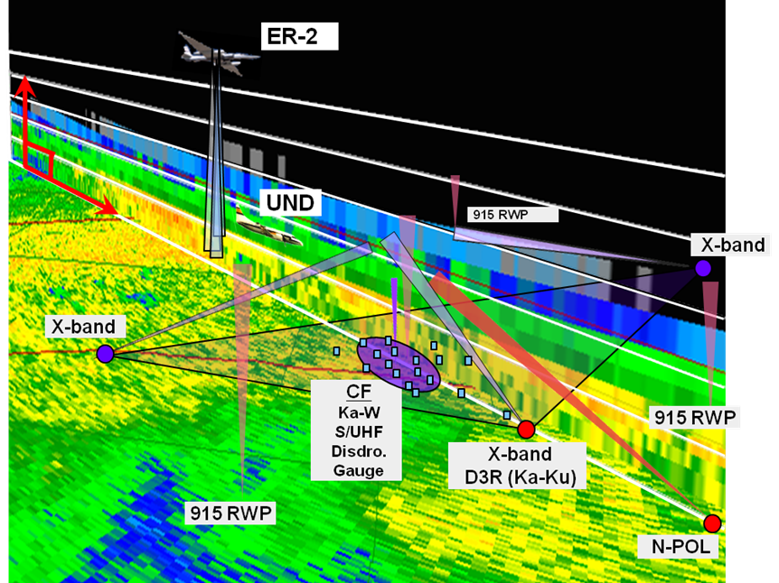
Mid-latitude Continental Convective Clouds Experiment
April 22 – June 6, 2011
Location: DOE-ARM SGP Central Facility, N. Oklahoma and NE Colorado (CSU CHILL)
Overarching Objectives:
GPM: Improved physically-based rainfall retrieval algorithms over mid-latitude land surfaces
DOE: Improved simulation of convective cloud properties (initiation, dynamics, microphysics)
Sampling Strategy:
ER-2 (satellite “proxy”; HIWRAP, CoSMIR, AMPR) stacked over UND-Citation (in situ microphysics)
Coincident and targeted ground-based multi-frequency/dual-pol radar (S/C/X/Ku-Ka/W), profiler, disdrometer/gauges
Column precipitation physics for a variety of precipitation types
The “Dream Scenario”
Notes:
Start some data examples (select)- not all inclusive- too much to show…………..

Slide 19
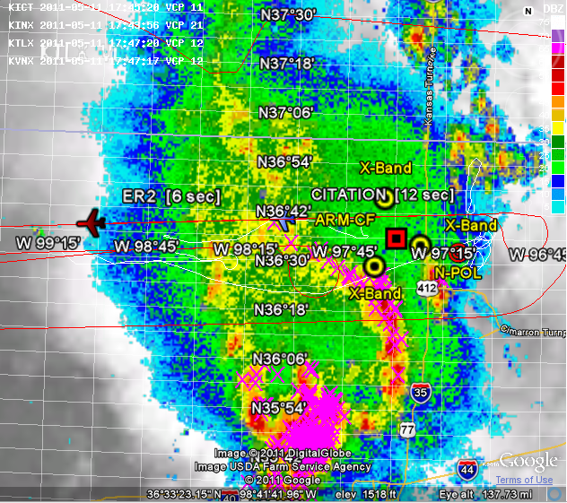
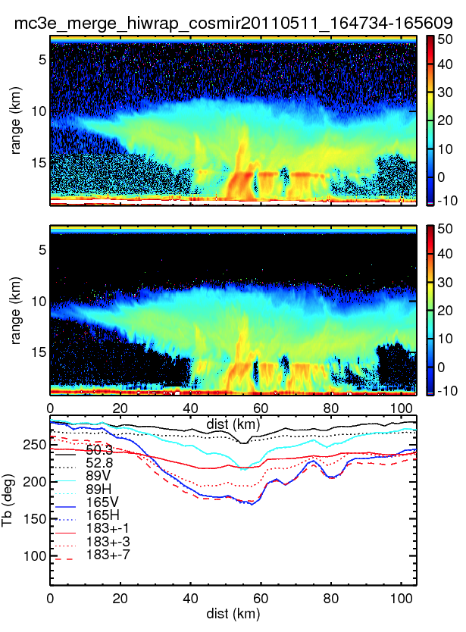
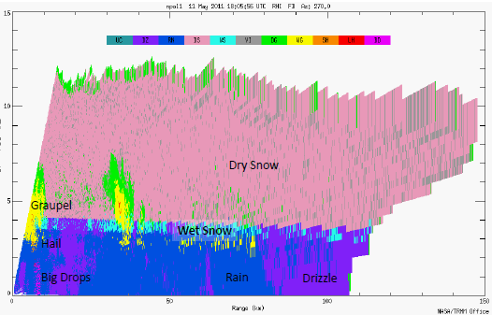
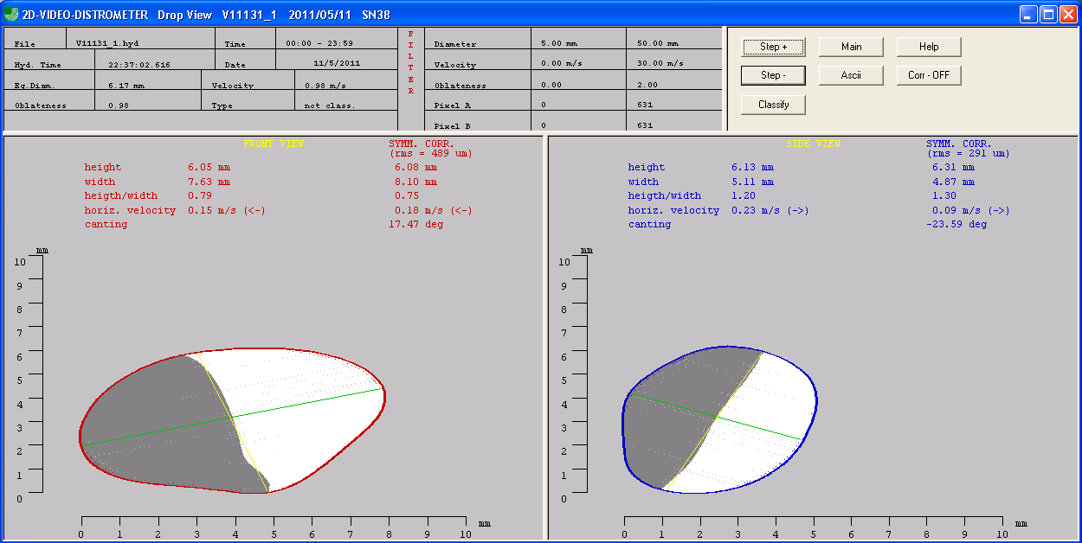
Example Operations and Observations: 11 May 2011
“Lumpy” mixed stratiform-convective sampling……………
1743 UTC
HIWRAP
CoSMIR
AMPR
Ka-Ku and
10-183 GHz
TB’s
NPOL
large-drop microphysics and drop size distributions
2DVD
Regime physics and D_{max}?
8mm
6 mm
Notes:
Relative to the 20 May case- this is really for folks undertaking studies like Bill et al.- this is also a good case- mixed/lumpy stratiform, and can be well connected to ground observations.

Slide 20
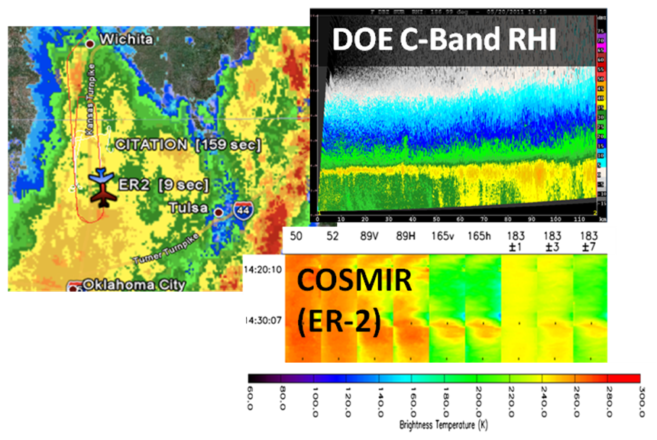
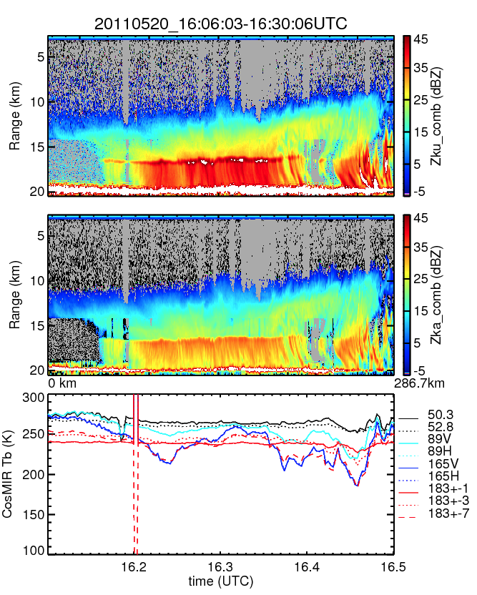
Example Operations and Observations
“Dream Scenario” Event: May 20
Early: Citation-ER-2 “Dream Scenario” stacks over/near SGP
A little later: ER-2- Only
(HIWRAP, COSMIR, AMPR)
Variety:
Early sampling focused on stratiform
Later sampling- ER-2 on deep convective line with trailing stratiform well east of Central Facility.
CoSMIR
300
280
260
240
220
AMPR
Notes:
Initial focus case of several for MC3E- good airborne stacked sampling over robust surface measurement- read bullets

Slide 21
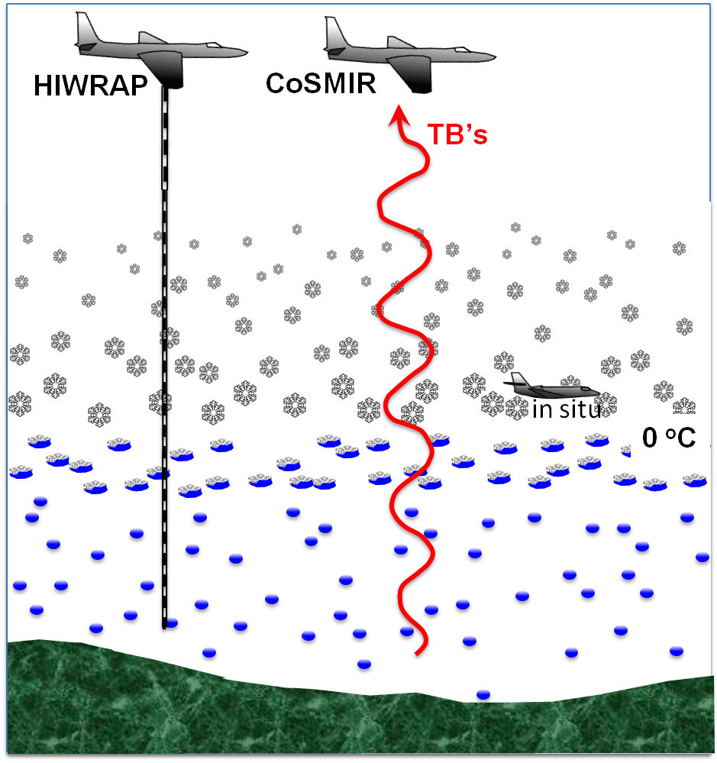
Evaluating Combined Algorithm Ice Physics Using HIWRAP and CoSMIR in MC3E (courtesy W. Olson et al.)
Assign scattering model.
• Retrieve precip profile
(PSD’s) using HIWRAP.
Compute consistent
microwave scattering
properties in profile.
• Simulate upwelling
brightness temperatures
at 89, 165.5 GHz.
• Compare to CoSMIR obs.
Note: brightness temps
aren’t sensitive to variations
of surface emission and
liquid precip if light rain is
present => scattering
signatures discriminate
snow particle models.
Notes:
20 May case study by Olson et al. for combined algorithm assumptions related to ice scattering and water content retrievals.
This is pretty basic, but it illustrates how we are testing the snow particle models using HIWRAP and CoSMIR. The main point is that if light rain is present, then at higher microwave frequencies (greater than or equal to 89 GHz), the microwave emission from the earth’s surface and the rain layer are pretty much constant; i.e., the rain layer strongly absorbs microwaves at these frequencies, and variations of the rain water content don’t have a significant impact on
the upwelling brightness temperatures at these frequencies. Therefore, the observed changes in 89 and 165.5 GHz brightness temperatures are primarily due to scattering by snow particles; and how you deal with those relative to particle assumptions on scattering makes a huge difference- Emphasize Bill’s talk for the result!
Olson, Grecu, Johnson, Kuo, Heymsfield…………

Slide 22
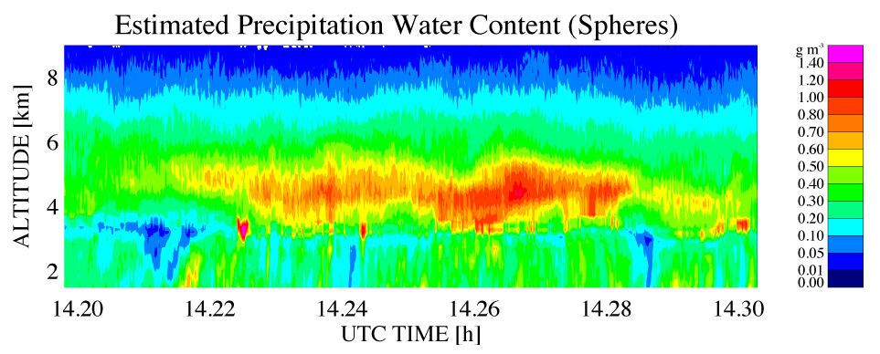
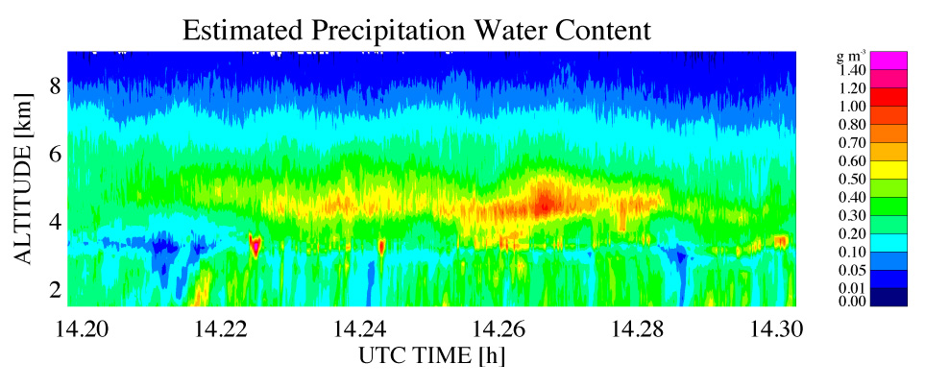
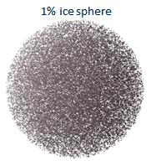
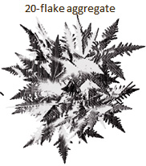
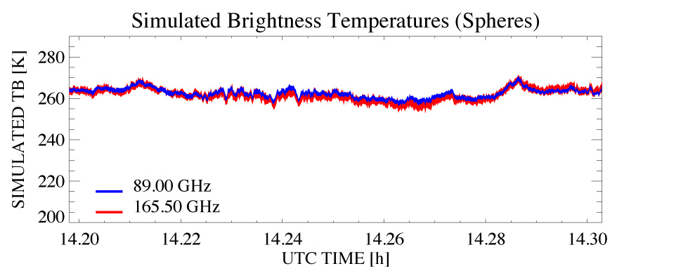
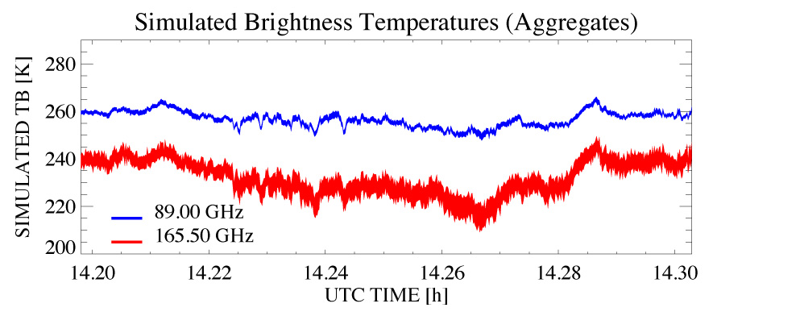
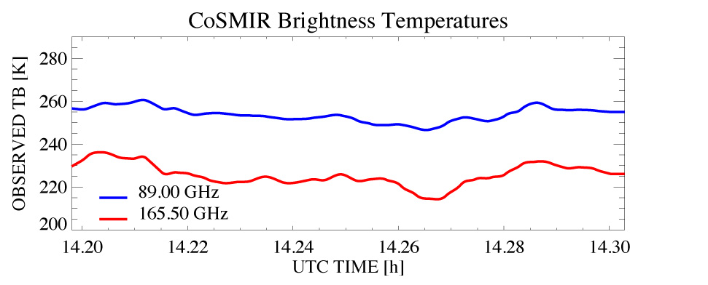
Radar Retrieval and Simulation of TB’s Using Spherical/Aggregate Ice
(Aggregates)
ρ = 0.1 g cm⁻³ spheres
Kuo aggregates
ρ = 0.1 g cm⁻³ spheres
Kuo aggregates
Olson et al.
Notes:
Continuing from the last slide:
The Kuo aggregates lead to radar retrievals/simulations in better agreement with the observed TB’s. I won’t go into the details here, but the increased scattering and reduced proportion of forward scatter (asymmetry parameter) of aggregates are factors.
Changing the density of the spheres doesn’t greatly improve their agreement with observed TB’s. Residual discrepancies of the aggregate model could be due to density vs. size relation represented by Kuo’s aggregates, smaller ice particles (weakly reflective, but could have impact on bulk scattering and TB’s). Details of the melting layer (spheres currently used) generally have a smaller impact, but this could change a bit when we introduce Ben’s melting aggregate model. We will also look at simulations of CoSMIR data at oblique (53 degrees) view, for which scattering effects are enhanced. Ultimately, retrieved water contents and PSD’s will be compared to Citation microphysics data for rough validation.

Slide 23
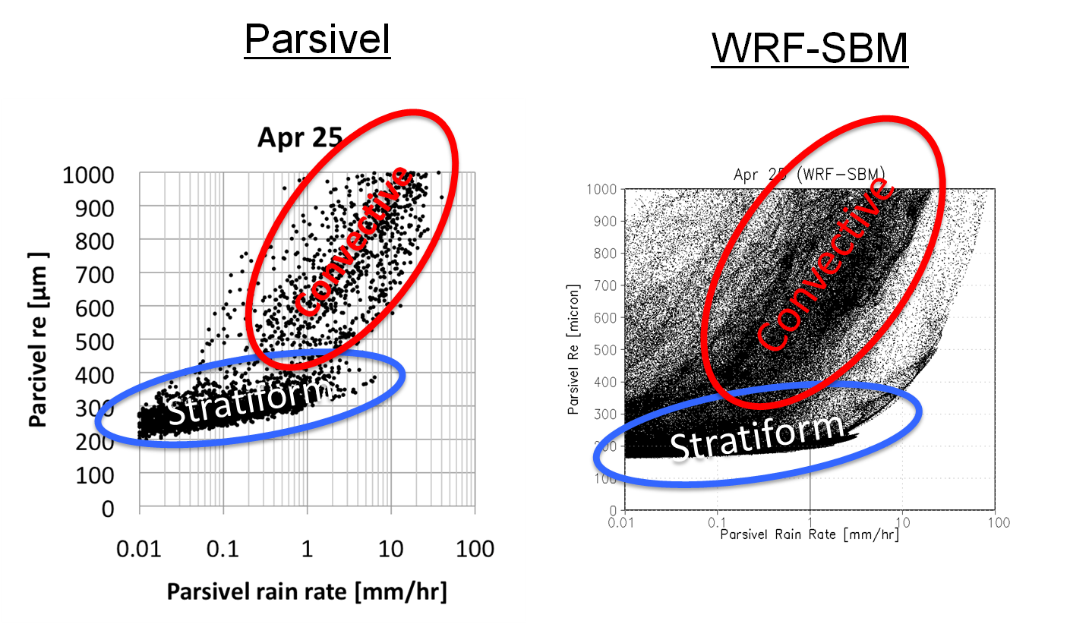
DSD Data Use: Satellite Simulator (WRF-SBM) Validation
MC3E April 25th MCS Case: DSD network observations vs. WRF-SBM
Approximate agreement- increases confidence in model simulation(at least in liquid phase).
T. Matsui

Slide 24
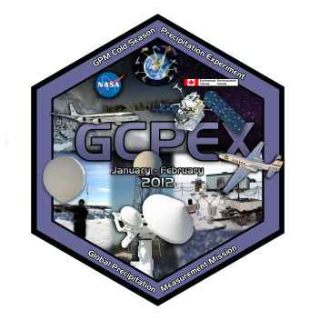
Global Precipitation Measurement Mission (GPM)
Cold Season Precipitation Experiment (GCPEX)
1/17/12 – 2/29/12 Egbert, Ontario, Canada
Observations to Improve GPM Satellite Methods for Detecting and Measuring Falling Snow
“Top down” Approach
DC-8 “satellite” instrument view
UND Citation aircraft: in cloud snow particle measurements
Ground-based remote sensing – snow and snowpack at surface
From the Top ( NASA DC-8) APR-2 and CoSMIR
NASA Snow Video Imager
Ground: NASA/EC Disdrometers, gauges, and Micro Rain Radars
Ground-based Remote Sensing: EC King City Radar
NASA D3R Radar, McGill Verti-X, W-band
In-situ microphysics:
UND Citation, NRC C-580
EC Snowpack Survey

Slide 25
: Example of Collective Measurements 1/30-31 Case

Slide 26
Integrated GV
“ ……provide a physical means for better understanding the strengths and limitations of the satellite products, while propagating that understanding in an end-to-end fashion into assessments and forecasts that rely solely on satellite products……”
How can GPM four-dimensional QPE and associated uncertainties be effectively used within the framework of global water and energy cycle applications including climate and weather prediction?
How can GPM four-dimensional QPE and associated uncertainties be effectively used in hydrometeorological applications such as soil moisture estimation, decision support for flood forecasting, and water resource management?
Characterization of uncertainties in satellite and ground-based (radar, dense gauge networks) rainfall estimates over a broad range of space/time scales
Characterization of uncertainties in hydrologic models and understanding propagation of input uncertainties into model forecasts
Assessing performance of satellite rainfall products in hydrologic applications over a range of space-time scales
Using data from synergistic missions (e.g. SMOS, SMAP, GRACE) to refine hydrologic model parameters and improve predictions driven by GPM input data

Slide 27
NASA GPM Iowa Flood Studies (IFloodS)
Integrated Validation of Satellite-Estimated Rainfall
April – June 2013, Central-Eastern Iowa
Objectives:
Assess uncertainty in satellite estimates of rainfall
Identify sources of and means to reduce uncertainties
Assess and improve use(s) for flood prediction
Ground Estimate
Iowa
Iowa flooding 2008
Merged Satellite Estimate
W. Petersen, 610.W

Slide 28
IFloodS: Instrument Network Design
Participants and Regional Collaborators
NASA GPM, Iowa Flood Center, U. Iowa, ARS/NASA SMAP, NOAA-NWS North-Central RFC w/USGS, Iowa State U.

Slide 29
The NASA Polarimetric Radar (NPOL)
And Dual-Frequency (Ka-Ku) Dual Polarimetric Dopper Radar
Deployed with D3R in Traer, Iowa (2013; IFLoodS)
Photo: W. Krajewski

Slide 30
Rainfall: Dual-Rain Gauge Networks
Ground State: Soil Moisture and Temperature
Dual-gauges ensure measurement consistency
Networks provide a reference for radars
Soil probes connect precipitation to ground hydrology and energy balance
W. Petersen, 610.W

Slide 31
Precipitation Particle Measurements
Parsivel Disdrometer
Micro Rain Radar
2D Video Disdrometer
Reference for polarimetric radar estimates
W. Petersen, 610.W

Slide 32
Rapid PPI Rain Scans: Rain mapping
Initial hybrid dual-pol rain estimator (DROPS)
Rapid Updates (< 3 min)
IFloodS field-level rain rate estimates:
1-minute Parsivel-2 vs. NPOL rain rates
Petersen, 2013, 6th GV Workshop, Rome

Slide 33
Role of Physics? Process to Product
NPOL Cross-sections of Precip Microphysics

Slide 34
IFloodS Satellite Platforms and Related Dataset Archive
Individual Satellite Platforms (Raw and GPROF) [Via Kummerow, CSU CIRA]
SSM/I (F15),
SSMI/S (F16,17,18)
NOAA 16 (AMSU-A/B)
NOAA 18, 19 (AMSU-A/MHS)
GCOM-W1 (AMSR-2)
CloudSat
TRMM TMI
METOP(A, B) (AMSU A, MHS)
Suomi-NPP (ATMS)
GOES (+ rapid scan)
Gridded Multi-Platform Rain Rate Products (G. Huffman*)
TMPA-RT / Production (Post FC) (0.25º, 3 hour) / IMERG Test product (Post FC)
CMORPH (0.07º, 0.5 hour)
GSMAP (0.25º, 1 hour)
PERSIANN (0.04º, 0.5 hour)
HydroEstimator
Other :
SMOS (Hornbuckle, Iowa State)
South Fork ARS/SMAP Gauge/Flux network (22 dual-gauge sites with soil Q/T, 2 flux towers)
WSR-88D Level II dual-pol data (GHRC)
WSR-88D Level III dual-pol rain rates (Jim Smith, Princeton)
Q2/NMQ , and Level II orbit and Level III hourly .01º gridded, gauge-adj. rain rates with RQI
IFC archived precipitation products (HydroNEXRAD, Q2-RT, gauges etc.)
GPROF (orbit level)

Slide 35
Hydrologic Measurements (Krajewski et al.)
Leveraging of Iowa Flood Center, Regional Partner/Collaborative Datasets
(Many IFC assets in place in several basins of interest)
Modeling (Christa P. Lidard)
Coupled Modeling: NASA Unified-WRF Real-Time Support (GSFC/MSFC)
Land Surface/Hydrologic Modeling:
GFMS Real-Time TRMM-based Flood Potential Modeling (Adler/ESSIC/GSFC)
North American Land Data Assimilation System (NLDAS)

Slide 36
Preliminary comparisons between rainfall products
20 May 2013
Gross similarities, but also very significant differences relative to the reference (NPOL). What are the impacts on flood prediction?
NASA NPOL (Dual-Pol)
NOAA Satellite (Hydro Est.)
NASA Satellite (3B42RT)
IFloodS Approach:
Create benchmark ground-instrument rain maps with estimated uncertainties (dual-pol radar composites validated against gauge/disdrometer networks)
Propagate benchmark and current version satellite estimates through runoff models
Examine sensitivities to estimator type, scale, physics etc. (physical val.)
Run different versions/products (e.g., GPROF-2014, IMERG) against original benchmark(s).

Slide 37
Preliminary Benchmarking with GV Field Obs IFC/CHRS Modeling Efforts
Basin Average Precipitation Statistics (unconditional)
 | Stage IV | PERSIANN-CCS
RMSE [mm] | 0.682 | 0.900
CORR | 0.783 | 0.713
BIAS | 0.080 | 0.235
Krajewski et al., 2013 6th International GPM GV Workshop
Notes:
Comparison of precipitation products using the IFloodS Interpolated rain gauge data as a reference. For the lower basin, both PERSIANN-CCS and Stage IV precipitation have similar correlation values using the rain gauges as the reference, but Stage IV precipitation has a much higher correlation with the gauges in the upper basin than PERSIANN-CCS. The correlation values are taken from within the IFloodS experiment time period (Apr 24th – June 24th 2013).
Also included is a table of basin average precipitation statistics for the same time period, again, using the interpolated rain gauge data as a reference.

Slide 38
IFC/CHRS Modeling Efforts
 | IFloodS Rain Gauges | Stage IV | PERSIANN-CCS
RMSE [m^3/s] | 60.7 | 85.7 | 166.5
CORR | 0.87 | 0.72 | 0.63
BIAS | 0.18 | 0.25 | 0.43
Krajewski et al., 2013 6th International GPM GV Workshop
Notes:
38
These are the hydrographs from running HL-RDHM forced by StageIV rainfall, PERSIANN-CCS and interpolated IFloodS Rain Gauge data. The blue line is the observed hydrograph at the Garber stream gauge. This is run during the IFloodS experiment time frame when all precipitation products were available (Apr 24th – June 24th 2013). Dotted lines represent the stages of flooding at this location according to the National Weather Service.

Slide 39
Summary
GPM GV Three Approaches:
Direct statistical validation:
Primary CONUS: NMQ/MRMS precipitation rates; Validation Network (VN) Processing
Datasets from numerous other locations- KMA, HSAF, NIMROD, EC, Finland…….etc.
Physical validation:
Several air/ground-based datasets collected for warm, cool, frozen precipitation regimes; analysis ongoing with slow progress, but some progress……….
Integrated Hydrologic Validation:
IFloodS an initial attempt on the regional scale; clear examples of challenges as pertains to both ground and satellite product precipitation estimate “convergence”…..
Upcoming campaigns and EOPs:
GPM IPHEX/NOAA HMT-SEPS, North Carolina (2014); OLYMPEX (2015/16)
HSAF, GFMS etc. for “larger scale” system approaches………….
Challenge: Coordinating manageable inter-mission, inter-agency, international efforts- ESPECIALLY TRUE FOR INTEGRATED “APPLICATIONS”

