Slide 1
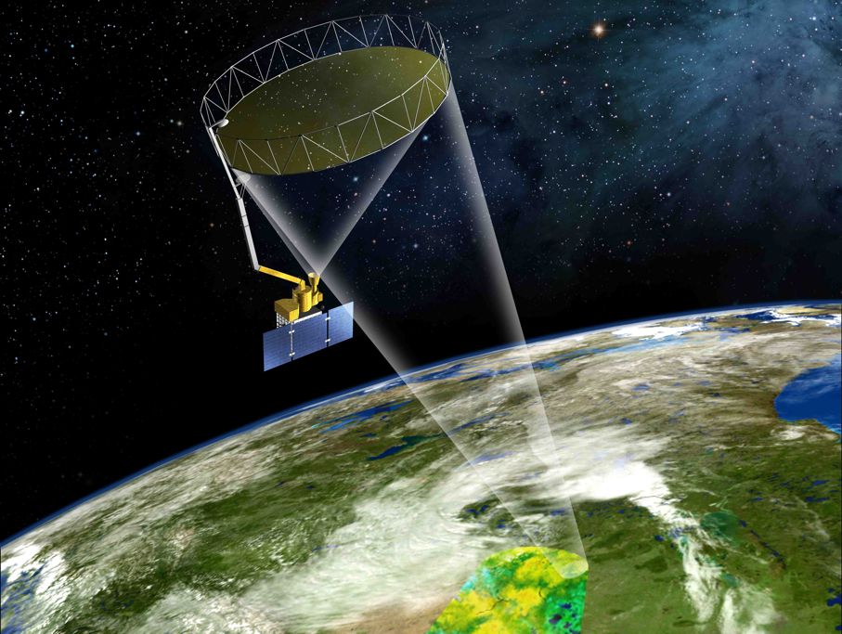

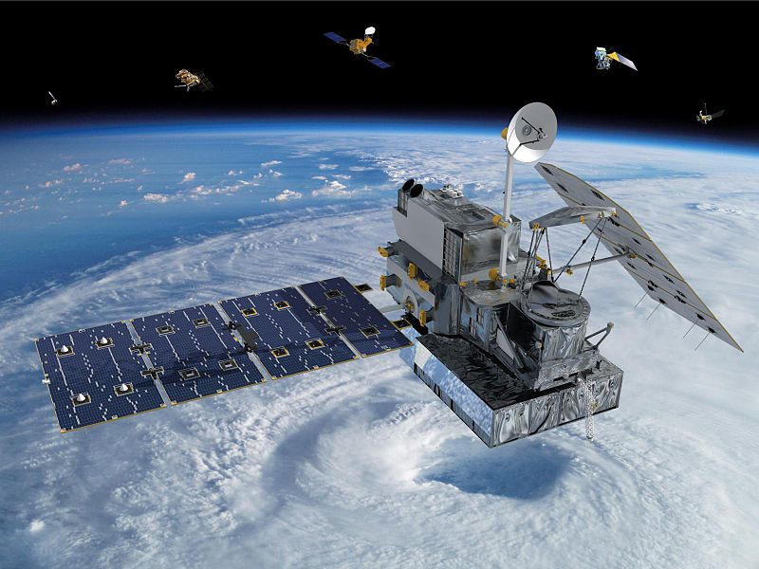
NASA SMAP-GPM Joint Mission Teacher
Workshop
NASA Goddard Space Flight Center
Wednesday, June 26, 2013
Workshop Team: Dorian Janney and Dalia Kirschbaum (GPM), Brian Campbell (SMAP),
Izolda Trakhtenberg (Soil Lady)

Slide 2
Global Precipitation Measurement (GPM) Mission
Launching Early 2014

Slide 3
Soil Moisture Active Passive (SMAP) Mission
Launching Fall 2014

Slide 4
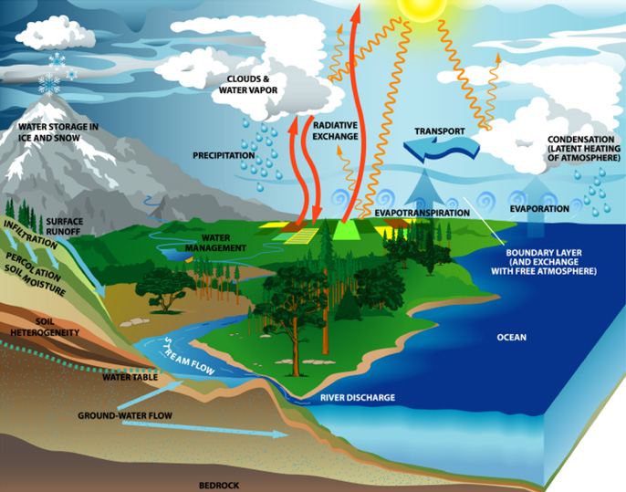

Slide 5
At the SMAP-GPM Joint Mission Teacher Workshop we will:
Increase middle school teachers’ knowledge about NASA Earth science content
Share hands-on activities and resources that increase the awareness of the importance of studying soil and precipitation
Identify the correlation between precipitation and soil moisture in our Earth System
Identify the correlation of the soil characteristics, soil water content and soil moisture
Align Earth science presented in workshop to the Next Generation Science Standards (NGSS)

Slide 6
USEFUL LINKS
SMAP Mission:
Main URL: http://smap.jpl.nasa.gov
Facebook: http://www.facebook.com/NASA.SMAP
Twitter: http://twitter.com/NASA_SMAP
Soil Science Education Home Page
http://soil.gsfc.nasa.gov/
Soil Climate Analysis Network
http://www.wcc.nrcs.usda.gov/scan/
NRCS Soils Website
http://soils.usda.gov/
Soil Lady
http://soillady.com
GPM Mission:
Main URL: http://pmm.nasa.gov/GPM
Facebook: https://www.facebook.com/NASA.Rain?fref=ts
Twitter: https://twitter.com/NASA_Rain
GPM Education:
http://pmm.nasa.gov/education/
NASA Headquarters GPM Page:
http://www.nasa.gov/mission_pages/GPM/main/
IFloodS Campaign:
http://earthobservatory.nasa.gov/blogs/fromthefield/category/iowa-flood-studies/

Slide 7
CONTACT INFORMATION
Brian Campbell, SMAP Education Lead, Brian.A.Campbell@NASA.gov
Dorian Janney, GPM Education Lead, Dorian.W.Janney@NASA.gov
Izolda Trakhtenberg, The Soil Lady, Izolda@gmail.com

