Slide 1
Water for Wheaties?
This presentation is a part of the “Water for Wheaties?” lesson plan for third grade students.
It was developed by the GPM Education and Outreach Team.
This lesson plan highlights the was in which NASA Earth observing satellite data is being used to improve life here on Earth.
Notes:
Introduce ourselves

Slide 2
Engage
Make a list of the things that you had to eat yesterday.
Put a star by the things that were grown by farmers.
Share your list with your partner and circle foods that have ingredients which were grown by farmers.
"Food" by Anthony Acosta D.Sc is licensed under CC BY-NC-SA 2.0

Slide 3
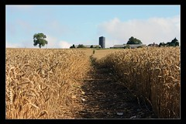
Engage
What do farmers need to grow crops?
"North Downs 01" by Matthew-Millen is licensed under CC BY-NC-ND 2.0

Slide 4
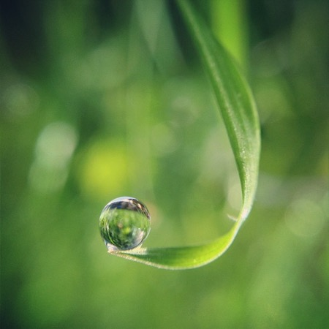
Engage
As you probably figured out, water is essential for farming.
Let’s begin by learning a little bit about Earth’s freshwater resources.
Earth is known as the “water planet”
How much of Earth’s surface is covered by water?
Water droplet on leaf
"Archive: The Blue Marble" by NASA's Marshall Space Flight Center
Notes:
The Globe activities can be found here: https://gpm.nasa.gov/education/interactive/earths-water-globe-activity

Slide 5
“Show Me the Water”
Notes:
The video can be found at this link: https://pmm.nasa.gov/education/videos/show-me-water. It is 02:49 in length. You might want to download it ahead of time to ensure it plays smoothly.

Slide 6
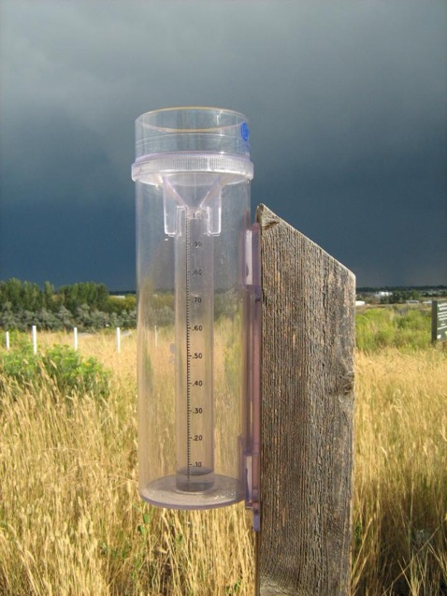
Engage
About how much freshwater is used by farmers in the U.S. to irrigate their crops?
About how much freshwater is used by farmers in developing countries to irrigate their crops?
What is the difference between needing to “irrigate” crops versus letting them get their water directly from precipitation?
Measuring precipitation before a storm.
Notes:
You may want to have students define what “irrigate” means. According to the Cambridge Dictionary, “irrigate” means ”to supply land with water so that crops and plants will grow.” (https://dictionary.cambridge.org/us/dictionary/english/irrigate). Discuss the difference between needing to irrigate crops versus letting the precipitation water the crops as it falls.

Slide 7
Engage
Read the article “Precious Freshness”.
Why are freshwater resources limited?
Why don’t regions all over the world have equal access to freshwater resources?
How are freshwater resources used around the world?
Gathering water
Notes:
If you click on the image, it will open up the page where you can find the article, “Precious Freshness”. https://pmm.nasa.gov/education/articles/precious-freshness You can have students read this with a paper copy or together using the online version.

Slide 8
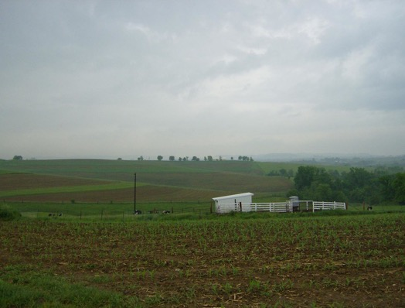
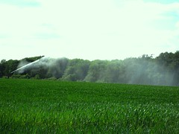
Explore
How do farmers water their crops?
"IA_Farm_1" by Zonie_Zambonie is licensed under CC BY 2.0 "IMG_0779 EDIT" by Rowley Taylor is licensed under CC BY-NC-ND 2.0
Precipitation will
water crops, but it has
to be falling where the crops are and long enough to water them effectively.
If there is no precipitation, farmers need to irrigate their crops by spraying or flooding their fields with freshwater.

Slide 9
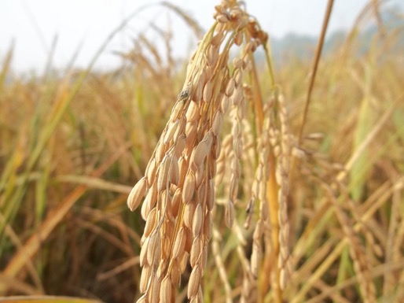
Explore
The last time you ate pizza, a tortilla, a bagel, wheat bread, pasta, crackers, and many other food products, you were probably enjoying wheat.
Wheat is a very important crop all over the world!
"Wheat / Farm / Field" by Farhan Ahmad.me is licensed under CC BY 2.0
"Pizza" by cgurholt is licensed under CC BY-NC 2.0

Slide 10
Explain
Now you will work in one of four “Expert Groups” to become a specialist in one of the following topics. You will learn about two main wheat growing regions in the world, and comparing and contrasting their weather and climate.
Growing Wheat
Weather and Climate in Sargodha, Pakistan
Weather and Climate in Gypsum, Kansas
Pakistan’s Freshwater Resources

Slide 11
Explain
Locations of Two Wheat Growing Regions in
Kansas and Pakistan
Developed using Google Maps

Slide 12
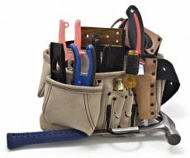
Explain
Expert Groups
As you read your article and then discuss it with your team, use the notetaking organizer to take notes and have when you meet with your Project Team.
Project Teams will have a specialist from each expert group. They will share in what they learned about their topic and will work with NASA data to help predict when farmers might need to use freshwater resources to irrigate their crops.

Slide 13
Explain
In your expert groups, be looking for the information that answers the following questions:
How much freshwater does wheat need to grow?
When is the wheat growing season in Pakistan?
When is the wheat growing season in Kansas?
How do farmers water their wheat crops in these two locations?
Are there any problems having enough freshwater in either of these locations?
Notes:
Stop the slides at this point, and have the students work together in their Expert Groups. Wait until they have finished working in their Expert Groups to resume the slides.

Slide 14
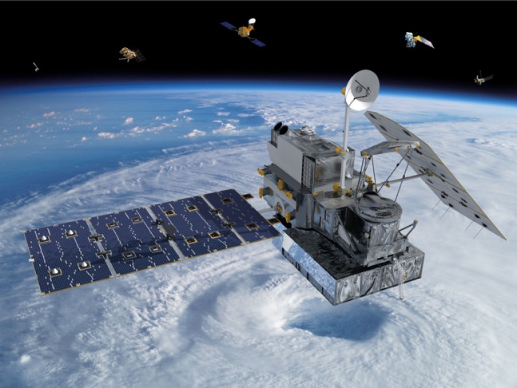
Explain
In your Project Teams, you will be analyzing data from NASA’s Global Precipitation Measurement mission.
Let’s learn a little bit about this satellite and how and why it measures precipitation from space.
The GPM Core Satellite/ Image credit: NASA

Slide 15
Explain
Notes:
You can download the video, “For Good Measure” here: https://pmm.nasa.gov/education/videos/for-good-measure It is 2 minutes long. You may want to download it and have it ready to play to avoid having any delays.

Slide 16
Explain
In your Project Teams, you are going to look at GPM data for the two wheat growing regions that the Expert Groups explored.
This data will be a bit confusing at first, but you will work together to unpack it.
As a Project Team, you will use this data to answer some questions about the data and to figure out whether or not the wheat farmers would need to irrigate their crops during their growing season.

Slide 17
Explain
Locations of Two Wheat Growing Regions in
Kansas and Pakistan
Developed using Google Maps

Slide 18
Explain
This data shows how much precipitation has fallen over
Gypsum, Kansas between 2000 and 2019.
Notes:
The students will probably need some guided assistance to unpack this data. The My NASA Data “Data Literacy Cubes” have cubes which specifically focus on unpacking data from graphs: HTTPs://pmm.nasa.gov/education/videos/for-good-measure This slide could be used to assist Project Teams with unpacking the data as needed. There is more information and resources related to these cubes here: https://mynasadata.larc.nasa.gov/data-literacy-cubes-graphs-maps-and-data-tables

Slide 19
Explain
This data shows how much precipitation has fallen over Sargodha, Pakistan between 2000 and 2019.

Slide 20
Explain
Each Project Team will be responsible for answering the questions below:
How does the amount of precipitation that falls during wheat growing season in each of these two locations impact the usage of freshwater resources?
What are some suggestions for how to reduce the amount of freshwater needed to irrigate wheat crops?

Slide 21
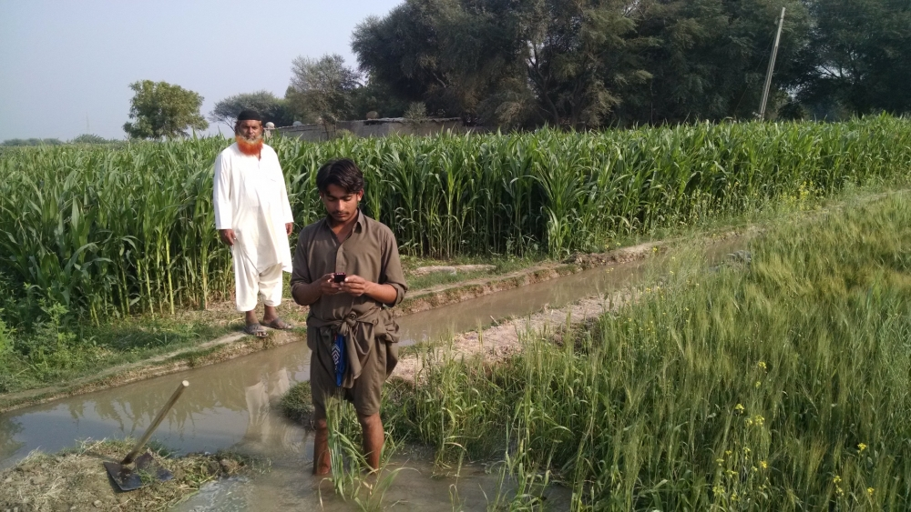
Explain
What do you think the wheat farmers in Pakistan are doing in the picture below?

Slide 22
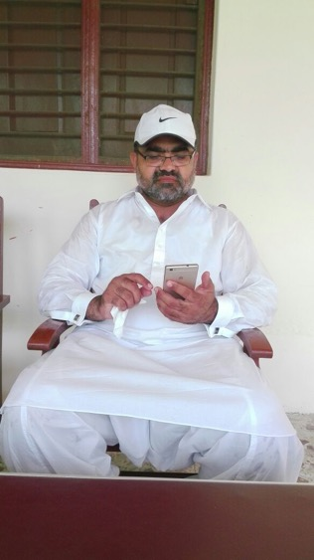
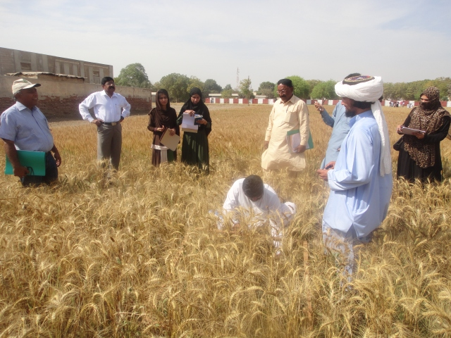
Explain
Take a look at these pictures and brainstorm about
how the farmers are using technology to assist them in
reducing the amount of freshwater resources they need
to irrigate their wheat crop.
Images credits: Faisal Hossain of University of Washington and PCRWR of Pakistan.

Slide 23
Explain
Meet Faisal Hossain!
Notes:
Click on the picture to open the video of Faisal introducing himself to the students. The video is 02:29 long. https://www.youtube.com/watch?v=zlMrxpr6Uko&feature=youtu.be

Slide 24
Explain
Faisal Hossain is a Professor of Civil and Environmental Engineering. He has developed a way to help take data from NASA’s Earth observing satellites and use it to help wheat farmers in Pakistan reduce the amount of freshwater resources they use.
Read the “Interview with Faisal Hossain” to find out about his career and how he uses his position to improve life around the world.
Notes:
https://gpm.nasa.gov/education/sites/default/files/lesson_plan_files/water-for-wheaties/AG_3_Interview%20with%20Faisal%20Hossain.pdf

Slide 25
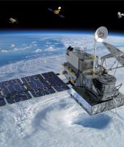
Explain
As you read the interview, try to find the answers to these questions:
What kinds of things does he do for his job?
How does he help wheat farmers know when to use freshwater resources to irrigate the wheat crops?
How could someone get a job like his?
How does he use NASA data to help him do his work?

Slide 26
Explain
If you could ask Faisal Hossain questions about his career or the work he does, what are some questions you would have?

Slide 27
Guiding Farmers with NASA Satellites
Notes:
This video, “Guiding Farmers with NASA Satellites”, (4:04), explains the complex reasons for the shortage of freshwater resources in Pakistan. Faisal Hossain is featured as he describes how he NASA and other data to assist farmers in using their cell phones to receive messages so they can irrigate less and rely on using precipitation when possible

Slide 28
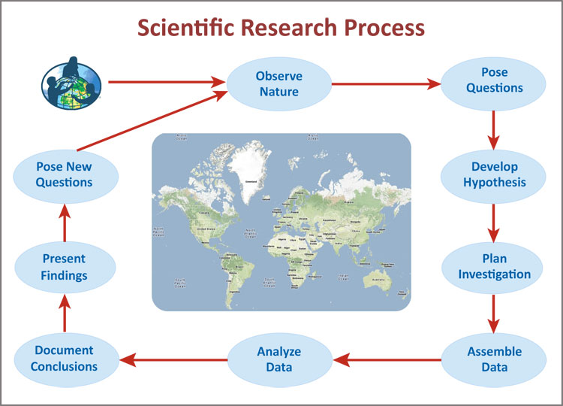
Evaluate
An important part of everyone’s job is to be able to communicate their findings to others. Scientists and engineers need to do this regularly to share what they have learned and to learn from each other.

Slide 29
Evaluate
Your task is to select a method to use that will share what you learned about growing wheat, freshwater resources, the impact of weather and climate on growing wheat, and the impact of not having enough freshwater to meet the needs of the population. You will also explain how NASA data and technologies are being used to help reduce the use of freshwater.
Your teacher will discuss the various options for you to use to communicate your results to others.

Slide 30
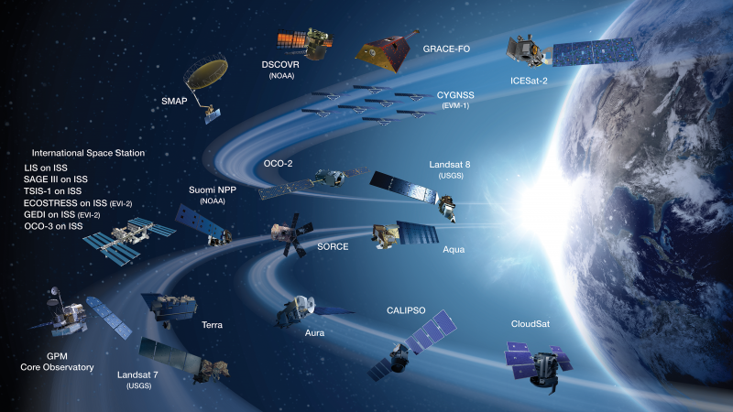
Extend
You might be surprised to know that NASA has many Earth observing satellites that give us a lot of meaningful information about our home planet.
NASA’s Earth observing satellites
Image credit: NASA
Notes:
This is a short video (1:52) that explains why NASA studies Earth from space. https://www.youtube.com/watch?v=f9F7yDjSdNA&feature=youtu.be

Slide 31
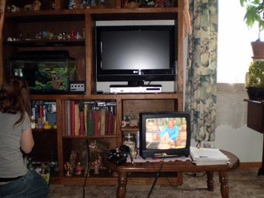
Extend
You might wonder how a satellite above Earth is able to measure things that are on Earth. That is actually a great question, and it involved something called “remote sensing”.
Think about when you use a television remote. You use it to point it at your television and it turns it on! Like magic! It actually uses light energy to move from the remote to the sensor on your television.
"irony" by michelebandgeek is licensed under CC BY-NC-SA 2.0
Tv Remote" by charles.cla is licensed under CC BY-NC 4.0
Notes:
This is a short video (1:52) that explains why NASA studies Earth from space. https://www.youtube.com/watch?v=f9F7yDjSdNA&feature=youtu.be

Slide 32
Extend
“Getting the Big Picture”
Notes:
This is a short video entitled “Getting the Big Picture”. It discusses why we need remote sensing to study Earth. It is 02:39 minutes long. You might want to have it downloaded and ready to play ahead of time to improve the problems with lag time. https://pmm.nasa.gov/education/videos/water-falls-getting-big-picture

Slide 33
From Satellites to Your Backyard
Find out how much precipitation GPM measured for your backyard! By following these directions in this activity, you can get the data for anywhere in the world.

Slide 34
Meet Iker Llabres
Notes:
Another use of NASA data is to help small businesses and small farmers to be able to have insurance in case they are impacted by too much or too little water. In this short video (02:44), students meet Iker Llabres who explains a little bit about his STEM-related career and how and why he uses NASA’s GPM data to help determine if individuals should receive payments. They could also read the written interview here.

Slide 35
NASA Satellites Help Farmers in Central America’s Dry Corridor
Notes:
Here is the link to the video in English: https://youtu.be/WH-tzUVk9eE, and here is the link to the video in Spanish: https://youtu.be/tp61G0KQRoo The videos are 02:47 long. You can learn more about this story at this website: https://gpm.nasa.gov/applications/nasa-satellites-help-farmers-central-americas-dry-corridor

Slide 36
Extend
Would you like to find out how you can help to save our precious fresh water resources in your daily life?
Notes:
This picture has a link to the EPA’s “WaterSense” website with activities and information for students and teachers. https://www.epa.gov/watersense/watersense-kids

Slide 37
Extend
Read this article, “Earth’s Water Delivery: No Passport Required” to learn more about our precious freshwater resources and how they are distributed around the world.
Notes:
This is a “one-pager” which has a reading to be informed article about

Slide 38
Credits and Resources
This work has been completed by the GPM Outreach Team. You can learn more about the GPM mission here.
Special thanks to Faisal Hossain and the “Pakistan Council of Research in Water Resources” (http://www.pcrwr.gov.pk) for contributing to this work.
You can learn more about Faisal Hossain and the work he is doing here.
Here is a “Scientists as Storytellers” story about Faisal Hossain.
See more about the work being done by SASWE (Sustainability, Satellites, Water, and Environment)
Here is a story from NASA’s Earth Observatory about the research and efforts that formed the basis of this lesson plan.

