Slide 1

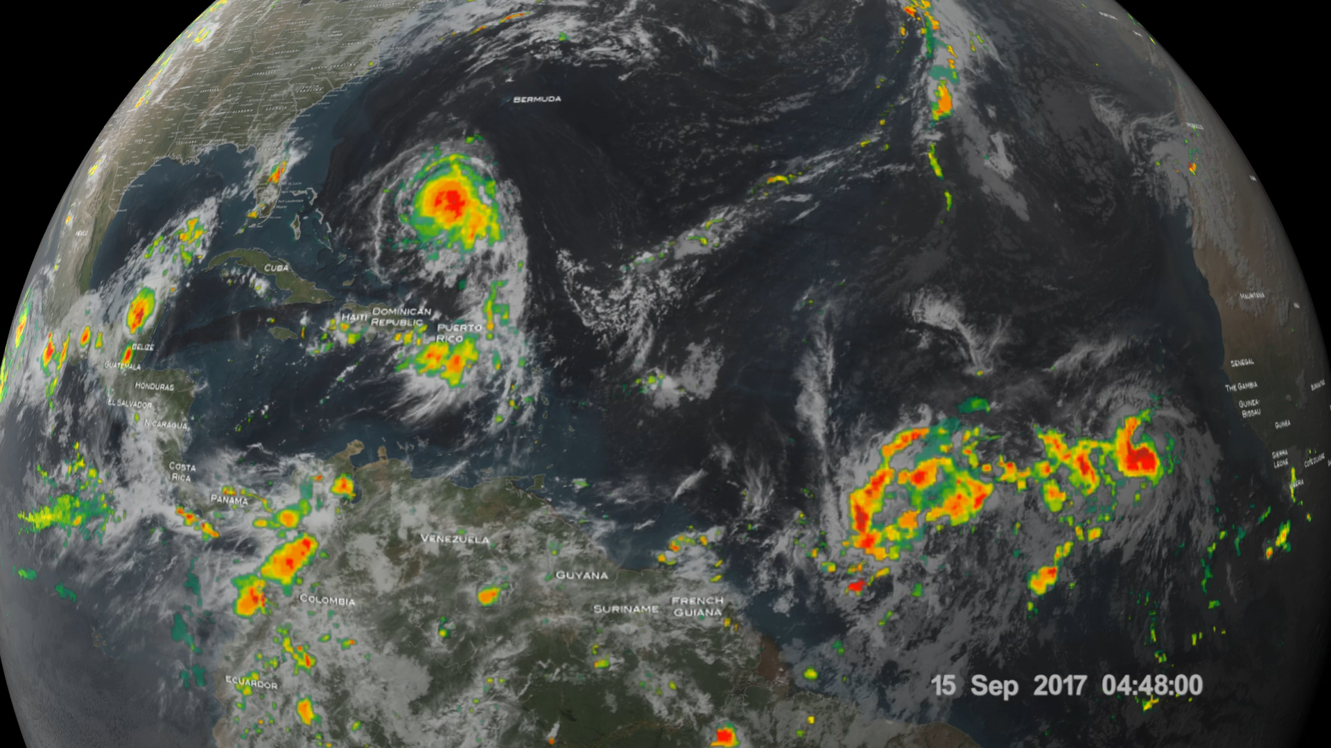
GPM Sees Hurricanes Maria and Jose
GPM passed over both Hurricane Maria and Hurricane Jose on September 18th, 2017, capturing rainfall distribution for the two major storms churning in the Atlantic and Caribbean basins. The visualization shows an image of Hurricane Jose as the storm was moving due north at 9 mph well off shore from the coast of North Carolina. The GPM image estimated areas of very heavy rain on the order of 75 mm/hr (~3 inches per hour). The GPM CO satellite also had an excellent view of Hurricane Maria when it passed almost directly above the hurricane on September 17, 2017 at 1001 PM AST (September 18, 2017 0201 UTC). GPM's Microwave Imager (GMI) and Dual-Frequency Precipitation Radar (DPR) showed that Maria had well defined bands of precipitation
rotating around the eye of the tropical cyclone. GPM's radar (DPR Ku band) found rain falling at a rate of over 6.44 inches (163.7 mm) per hour in one of these extremely powerful storms northeast of Maria's eye. Intense thunderstorms were found towering to above 9.7 miles (15.7 km). This kind of chimney cloud is also called a "hot tower" (as it releases a huge quantity of latent heat by condensation). These tall thunderstorms in the eye wall are often a sign that a tropical cyclone is becoming more powerful. Maria rapidly intensified following this view to a Category 5 storm on September 19th.
Credit: NASA SVS

