Slide 1
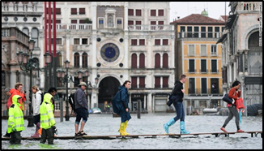
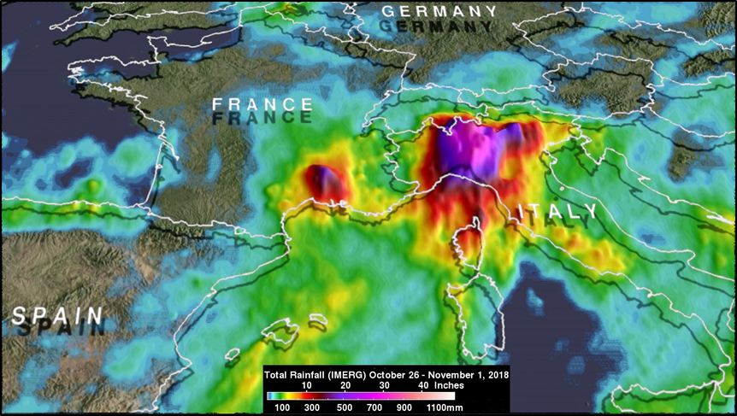
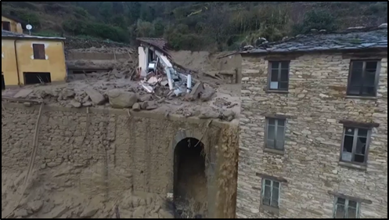
Adding up the Rain in Italy using GPM IMERG
Torrential rainfall from a strong low-pressure system moving through southern Europe drenched Italy triggering landslides, flooding throughout Venice, infrastructure damage to historic buildings, and several deaths in late October and early November, 2018. GPM IMERG estimates captured this rainfall accumulation between October 26 and November 1, 2018. IMERG data revealed that the most extreme rainfall in southern Europe was concentrated in northern Italy. IMERG
indicated that storms inundated that area with
rainfall totals often greater than 508 mm
(20 inches).
People cross the flooded St. Mark's Square on a raised walkway Monday. Credit: Miguel Medina (Getty Images) via CNN.
Heavy rains have caused landslides in the region of Liguria (NW Italy). Credit: BBC News.
Total rainfall (IMERG) from Oct. 26-Nov. 1, 2018 in Italy. Credit: Image Credit: Hal Pierce (SSAI/NASA GSFC).

