Slide 1
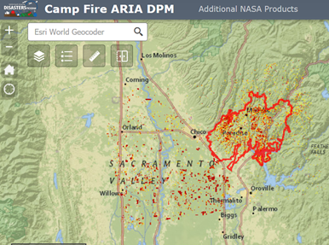
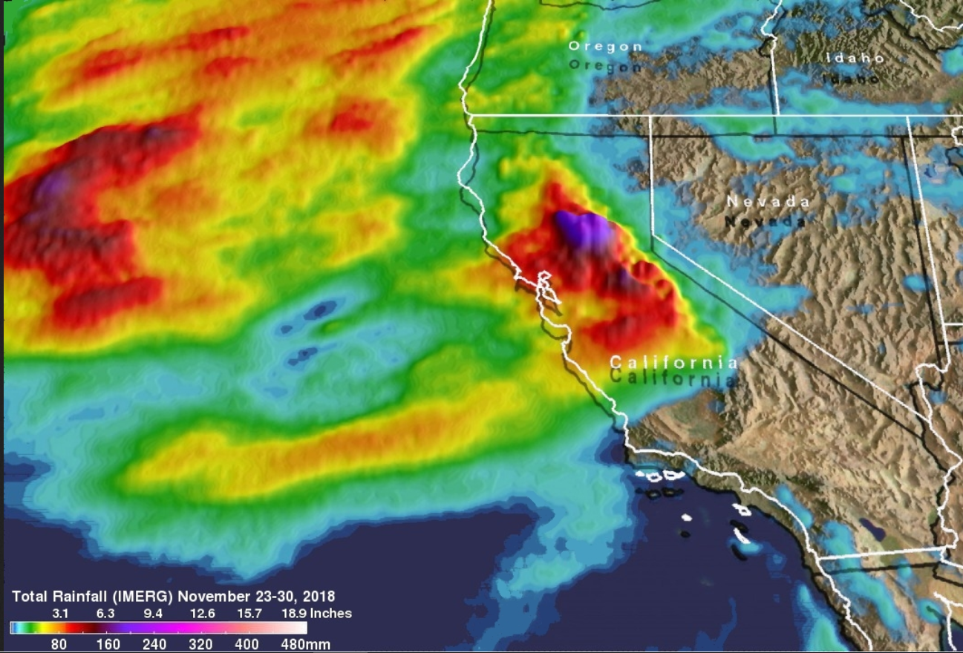
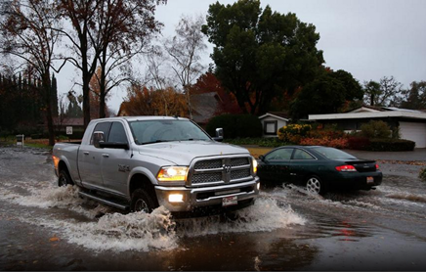
GPM Captures Rainfall in California Wildfire Areas
Heavy precipitation hit areas of California that were recently devastated by deadly wildfires during the last week of November 2018. Flooding triggered by the heavy rain resulted in evacuations in burn scarred areas such as Butte County where the deadly Camp Fire hit. Flash floods, debris flows and mudslides were observed in areas where the wildfires stripped away vegetation. GPM IMERG estimates captured this rainfall accumulation from
November 23-30, 2018. IMERG data revealed that
the most extreme rainfall was concentrated in
central-northern California. IMERG indicated that
parts of Northern California received upwards of
7.8 inches (200 mm) of rain.
Red line delineating affected area of the Camp Fire. Image captured from NASA Disasters Mapping Portal, https://maps.disasters.nasa.gov/arcgis/apps/MapSeries/index.html?appid=8014e6c744a945baa8700797ccffccf6.
(Right)Total rainfall (IMERG) from Nov. 23-30, 2018 in California. Image Credit: Hal Pierce (SSAI/NASA GSFC).
Flooded street in Chico, California (near Camp Fire area) on Thursday, Nov. 29, 2018. Image Credit: AP Photo/Rich Pedroncelli) via The Weather Channel.

