Slide 1
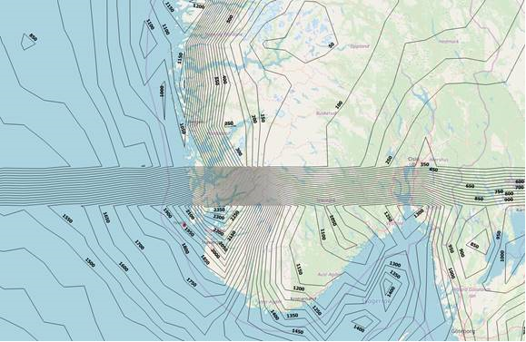
GPM IMERG Data Used for Wind Energy
Individual components of wind turbines, especially the rotor blades, are expected to have an operational life span of 20 years while facing environmental extremes such as precipitation. These extremes can lead to corrosion on the leading edges of the blades and reduce the overall efficiency of converting wind into energy. To understand how weather impacts wind turbine blades throughout the world, LM Wind Power (a supplier of wind turbine blades worldwide) is using GPM IMERG data to develop contour precipitation maps and determine average precipitation at existing and potential wind turbine
site locations. This information will
help LM Wind Power gather information on blade reliability and performance to satisfy their customers.
(Above) Map of average precipitation in the North Sea and western Norway depicted by black contour lines using GPM IMERG data. **Abrupt precipitation change → GPM end user was missing details and will revise.
Image credits: (Central) Laurids Andersen
LM Wind Power, www.lmwindpower.com.

