Slide 1
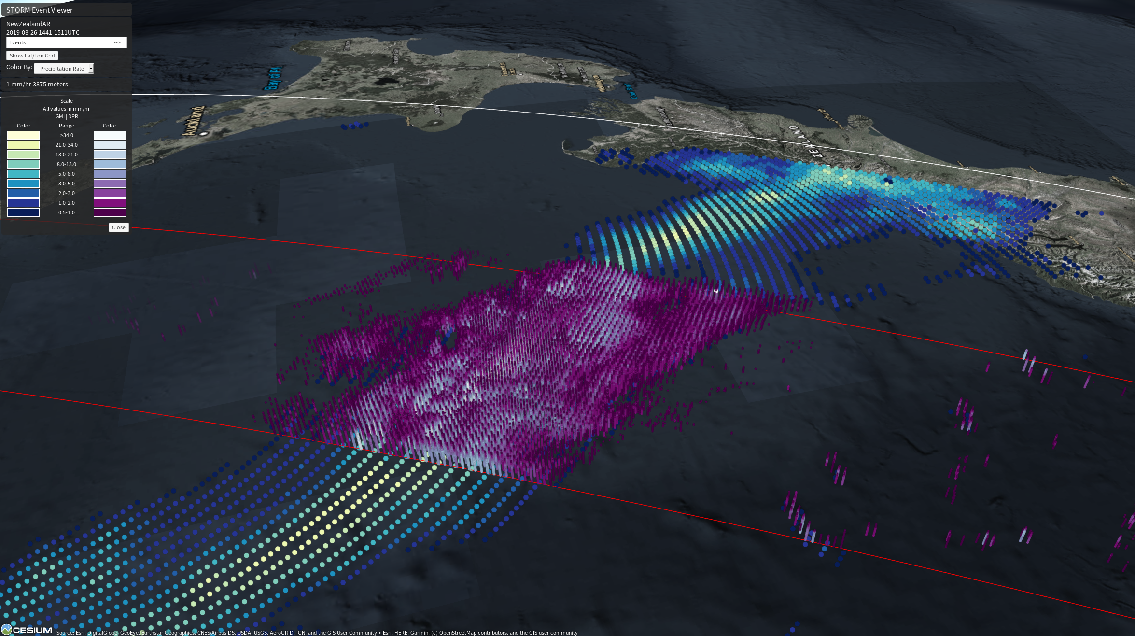
GPM Captures New Zealand Atmospheric River Event
On Tuesday, March 26, 2019 Westland, New Zealand declared a state of emergency after an atmospheric river event brought torrential rains causing flooding, record river levels, and closed roads, and prompting evacuations throughout the region.
GPM's GMI/ DPR provides a view of the atmospheric river event hitting NZ’s South Island on March 26, 2019. Visualization was produced using Event Viewer. Credit: Matt Lammers and Owen Kelley (NASA GSFC).
N
GPM IMERG accumulation over Westland, New Zealand from March 23- 27, 2019. (Left) IMERG Storm-total accumulation (mm). (Right) Three-hour storm accumulation (mm). Visualization Credit: Matt Lammers and Owen Kelley (NASA GSFC).
GPM’s GMI and DPR captured the moisture tendril impinging upon the South Island (left). The moisture source was TC Trevor, which eventually meandered over the Australian outback, where a trough pulled moisture southward across the Tasman Sea and over to New Zealand. Rainfall accumulation estimates using GPM IMERG revealed areas on the South Island receiving greater than 500 mm (~20 inches) of rain (above).

