Slide 1
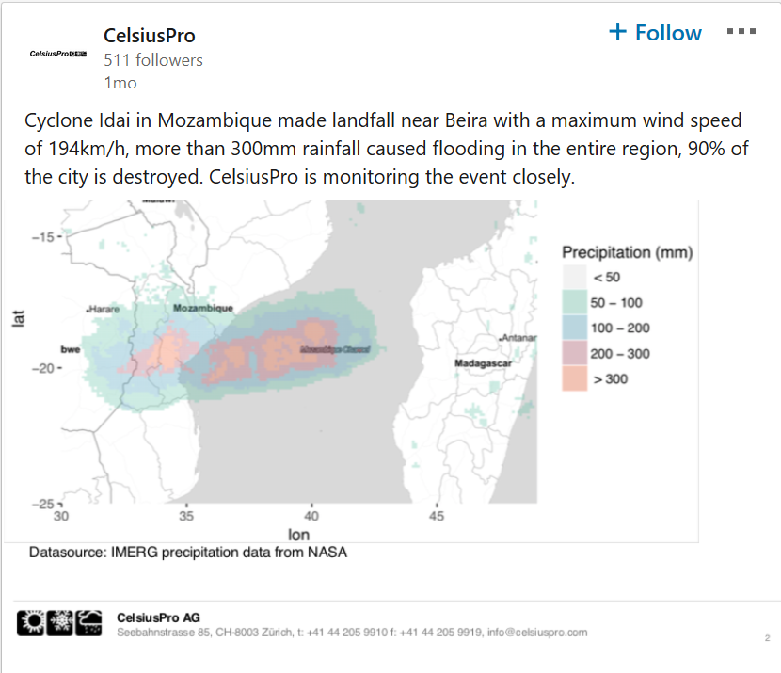
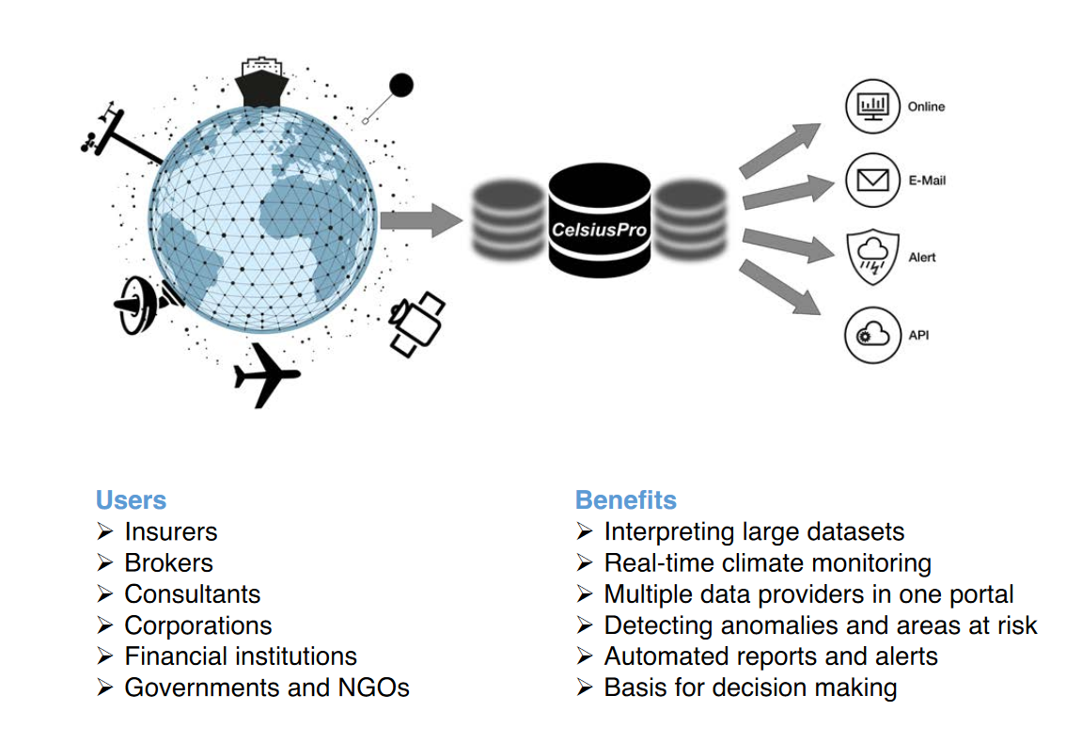
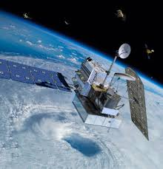
GPM Supports CelsiusPro Products
CelsiusPro, a Swiss Insurtech company, provides global insurance digitalization solutions for insurers throughout the world with a focus on weather, agriculture and parametric disaster products. Their parametric insurance solutions are based on data provided by third-party agencies such as official weather stations or satellites such as the GPM CO. Specifically, CelsiusPro (1) uses GPM precipitation data (TMPA and IMERG) to develop rainfall index products for their clients and (2) provides an online data platform, Environmental Monitoring System (EMS) 2.0, that allows their clients to access and visualize a range of environmental data including IMERG to mange their risks and opportunities.
CelsiusPro’s flow chart depicting how EMS 2.0 allows analysts, risk managers and claims officers to access, analyze, visualize and download climate, vegetation from different providers on one single platform. Automated reports can be customized to visually summarize the data and provide a global risk overview.
GPM
On LinkedIn, CelsiusPro posted the accumulated rainfall that was observed from Tropical Storm Idai using IMERG data. This post is one of many that CelsiusPro uses to communicate how they use environmental data to assess disasters. Image credits: CelsiusPro via LinkedIn post.
Credit (text and image): https://www.celsiuspro.com/solutions/

