Slide 1
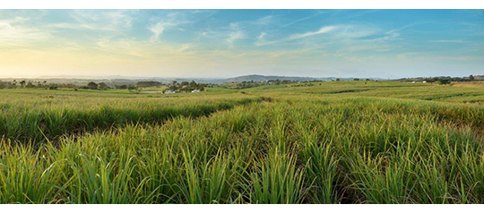
GPM used for Agricultural Forecasting in Africa
VanderSat, a Dutch satellite data analysis service company, is using NASA’s satellites (GPM and SMAP) and other satellites to develop precipitation, vegetation and temperature products for the agriculture sector. Working with over 5,000 registered users including insurers, agriculture companies, governments, and the Red Cross, VanderSat produces products for agricultural forecasting, predicting the weather, and performing predictive analysis.
NASA’s rainfall and soil moisture data enables VanderSat within the Partners for Water Program to collaborate with Tongaat Hulett, a large sugar cane company, to improve the water use efficiency and water productivity in a large scale open irrigation system of the Tongaat Hulett Xinavane Sugar Estate, Mozambique. Using satellite data, researchers can determine the different water fluxes (evaporation) and states (soil moisture) within the plantation. This information is then used by local operators to determine when to irrigate the fields.
http://www.tongaat.co.za/
“With our high resolution satellite products based on microwave observations including GPM-GMI we are able to manage water resources in a water stressed area more efficiently. The sugarcane plantation in southern Mozambique is a clear example of a significant water user along the Incomati riverbank. By boosting their water efficiency using valuable satellite information about soil moisture, and evaporation, sustainable expansion is possible and surrounding local farmers can meet their water needs” -Richard de Jeu, VanderSat Founder

