Slide 1
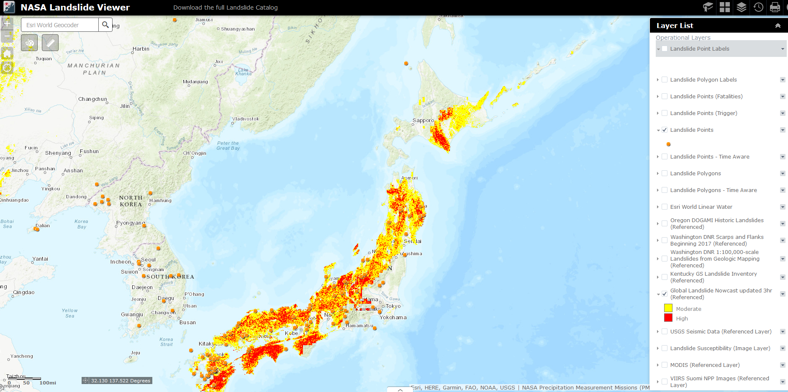
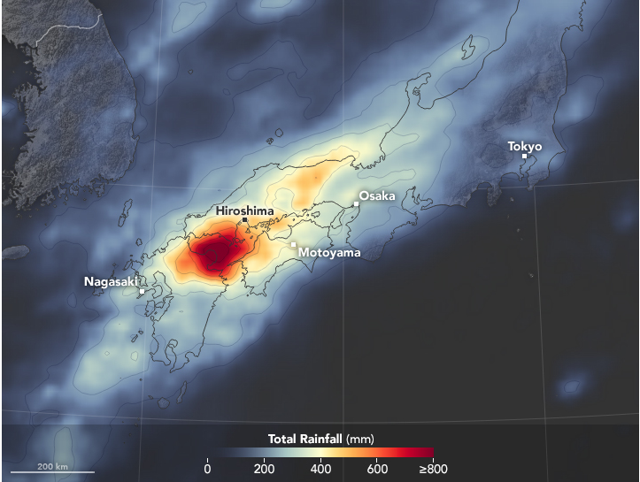
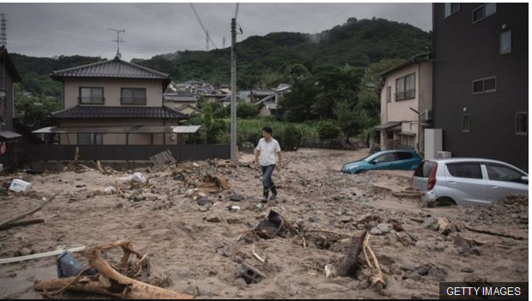
Aftermath of Typhoon Prapiroon across Japan
At least 155 people have died in floods and landslides triggered by Typhoon Prapiroon in Japan. GPM IMERG estimates showed upwards of 20.2 inches (512 mm) of rain in areas across the country from July 2 to July 9, 2018 (below). These heavy rains led the Japanese Meteorological Survey to issue landslide warnings for southern Japan that affected millions of people.
NASA Landslide Viewer showing “nowcast” of landslides in Japan on July 10, 2018. Landslide Viewer: (https://science.gsfc.nasa.gov/600/citizen-science/landslides/index.html)
NASA’s Landslide Viewer tool enables the public and researchers to pinpoint potential landslide activity in near real-time. Areas that are highly susceptible to landslides from Prapiroon are seen throughout southern Japan (above). The tool is based on a model that considers susceptibility with GPM rainfall.
Landslide on Sunday, July 8, 2018 in Hiroshima (Getty Images).
Total rainfall (IMERG) from July 2 to July 9, 2018 in Japan (above). Image Credit: Joshua Stevens, NASA Earth Observatory.

