Slide 1
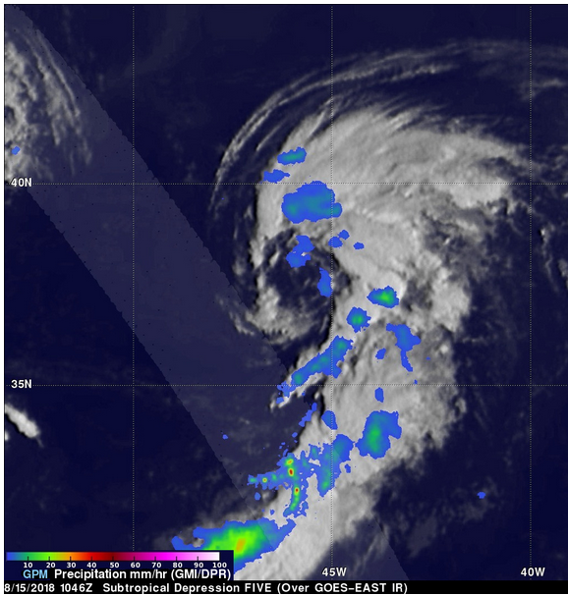
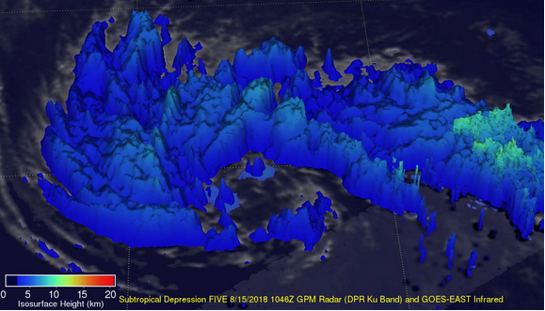
GPM Catches Subtropical Storm in Early Development
On the early morning of August 15, 2018, the GPM Core Observatory (CO) passed above the western side of the newly formed Subtropical Depression Five over the central Atlantic Ocean before intensifying into Subtropical Storm Ernesto later that afternoon. GPM's two instruments, GMI and DPR, were used to capture the location and intensity of rainfall, revealing most of the rainfall within the depression was outside the middle of the low level center of circulation. GPM’s DPR observed intense storms in a large feeder band on the southern side with rainfall rates over 4 inches (101 mm) per hour and found that storm top estimates reached above 6.8 miles (11km) (see below).
GPM's GMI/ DPR provides a view of John’s precipitation, showing intense storms near the center on 08/06/2018. Credit: Hal Pierce (SSAI/NASA GSFC), top left and Kel Elkins (USRA/ NASA GSFC SVS), bottom right.
N
GPM's GMI/ DPR provides a view of the storm’s precipitation on 08/15/2018 (above), credit: Hal Pierce (SSAI/NASA GSFC). Capturing Ernesto’s precipitation rates using GPM IMERG data on 08/16/2018 (left), credit: NASA GSFC SVS.
The National Hurricane Center (NHC) predicts that subtropical storm Ernesto has already reached its peak intensity as it moves northeastward over cooler ocean waters. Ernesto is expected to maintain intensity due to its fast forward speed over the North Atlantic as it approaches Ireland and the United Kingdom late Saturday.
The yellow arrow highlights the storm’s top heights measured by GPM’s DPR (above). Credit: Hal Pierce (SSAI/NASA GSFC).

