Slide 1
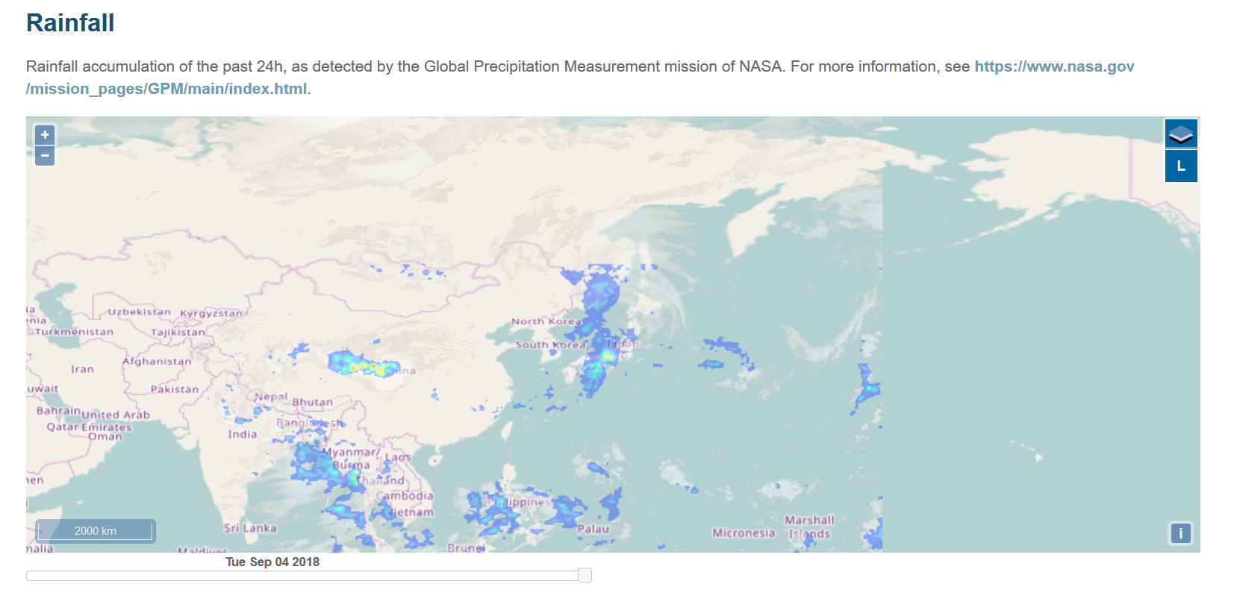
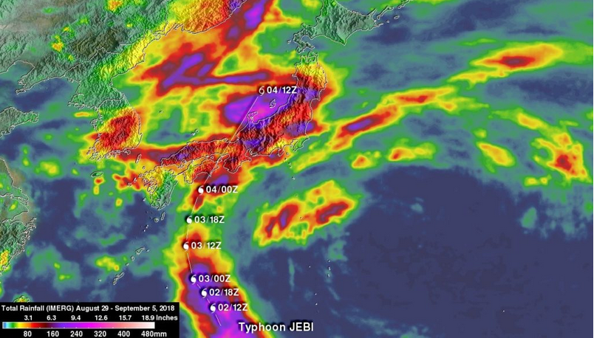
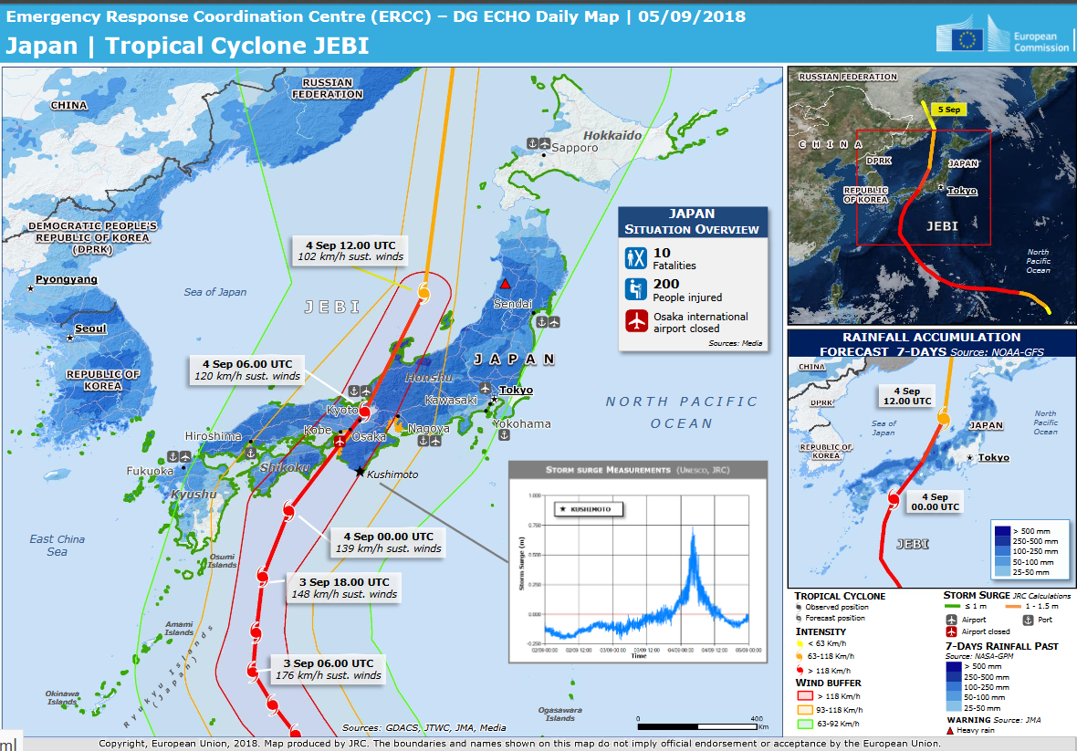
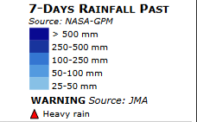
GPM helps track Jebi’s Staggering Rainfall Totals
Typhoon Jebi brought torrential rain and strong winds across southern Japan, causing major flooding, landslides, airport closures, and overturn cars within the first week of September 2018. At least 11 fatalities and over 300 injuries were reported due to the storm’s intensity. The GPM Core Observatory captured Jebi before making landfall and continued to capture the storm as it brought heavy rain to the country. GPM IMERG data was used to make rainfall estimates over Japan and the surrounding region for the 1-week period from August 29 to Sept. 5. More than 4 inches of rain covered main island of Honshu and Shikoku in the south.
Link to GPM
GDACS Disaster Alert Map crediting GPM for rainfall totals for Typhoon Jebi (above). Credit: http://www.gdacs.org/Cyclones/report.
Total rainfall (IMERG) from 8/29 to 9/05, 2018 in Japan (left). Credit: Hal Pierce (SSAI/NASA GSFC).
Hawaiian Islands
The EU’s ERCC and the GDACS used GPM rainfall estimates to communicate real-time rainfall information to multiple relief organizations and the government of Japan. This information is being used to prepare and plan for proper disaster response and relief throughout the country for Typhoon Jebi.
ECHO Daily Map for Jebi on 09/05/2018 using data from
GPM. Credit: https://erccportal.jrc.ec.europa.eu/Maps/Daily-maps

