Slide 1
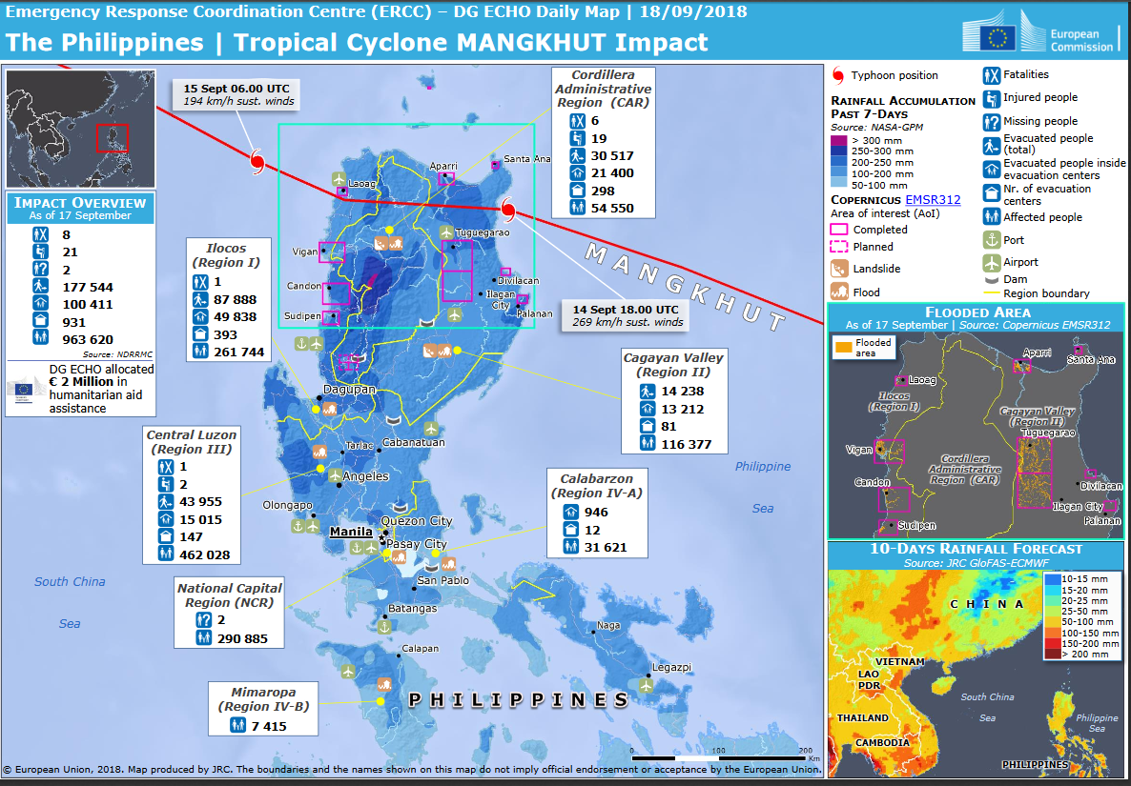
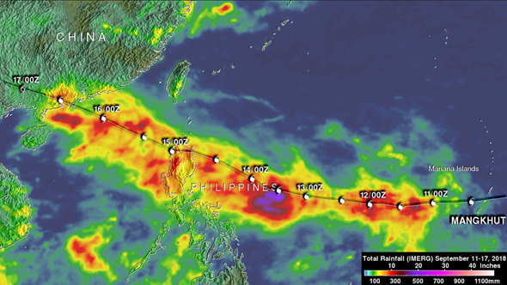
Adding Up Typhoon Mangkhut’s Rainfall with GPM
From September 14-17, 2018, Typhoon Mangkhut brought torrential rains and strong winds across the Philippines, mainland China, and Hong Kong. Over 175,000 people were evacuated from their homes in the Philippines alone. GPM IMERG data was used to show accumulated rainfall as the storm traced across the Philippines and made landfall in China. More than 4 inches of rain stretched from Manila to the northern tip of Luzon triggering landslides and flooding. The New York Times even highlights the storm's intensity with GPM data before making landfall.
GDACS Emergency Response Map for Mangkhut on 09/18/2018 using data from GPM. Credit: https://erccportal.jrc.ec.europa.eu/Maps/Daily-maps
The Global Disaster Alert and Coordination System (GDACS) used GPM IMERG data to distribute information about the storm’s impact across the countries. In turn, GDACS’ data was used by several relief organizations to provide humanitarian aid where needed.
Total rainfall (IMERG) from 9/11 to 9/17, 2018 for Typhoon Mangkhut. Credit: Hal Pierce (SSAI/NASA GSFC).

