Slide 1

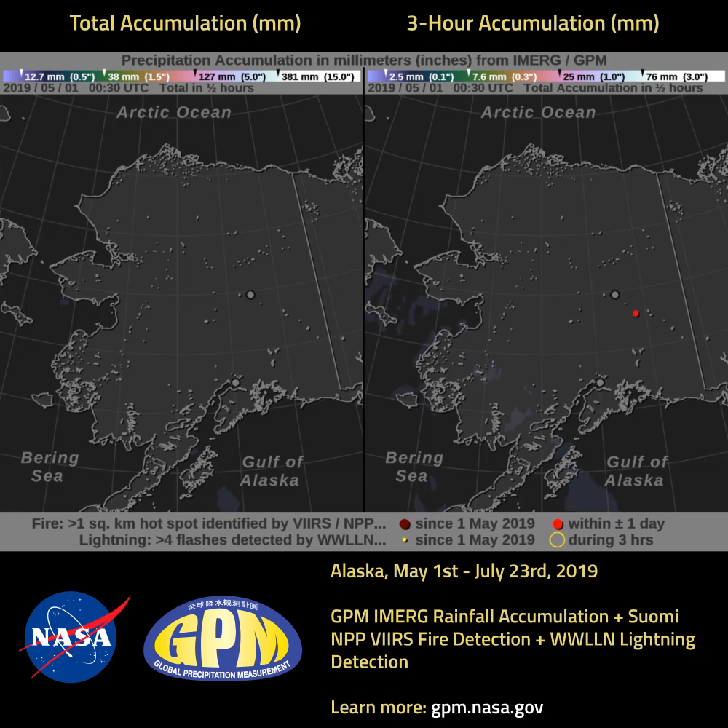
Rain Patterns Captured by GPM During the 2019 Alaska Wildfires
Wildfires occur in Alaska each summer, but July 2019 is shaping up to be a particularly active month. Few rain gauges exist in the large tracts of Alaskan wilderness, but wildfires unchecked can spread to populated areas within the state. Satellite-based precipitation estimates are particularly valuable here because of precipitation's relationship to wildfire hazard.
The movie shows GPM IMERG precipitation estimates for May 1- July 18, 2019. The total accumulation since May 1 is shown in mm (in.) on the left half, while the accumulation during a 3-hour period is shown on the right half. The locations of likely fires are shown in red, based on thermal anomalies observed by the VIIRS instrument on the Suomi NPP polar-orbiting satellite. The VIIRS "hot spot" data has a resolution of approximately 0.25 square km and is based on IR brightness temperature. Locations of lightning strikes are shown in yellow, as detected by the network of ground sensors that make up the World Wide Lightning Location Network. A flash is detected when five or more WWLLN stations around the world detect a radio-frequency atmospheric signal from the same lightning flash. A gray circle along the southern coast or center of Alaska represents the cities of Anchorage or Fairbanks, respectively.
Visualization and text: Owen Kelley (NASA PPS) & Jacob Reed (Telophase / NASA GSFC)

