Slide 1
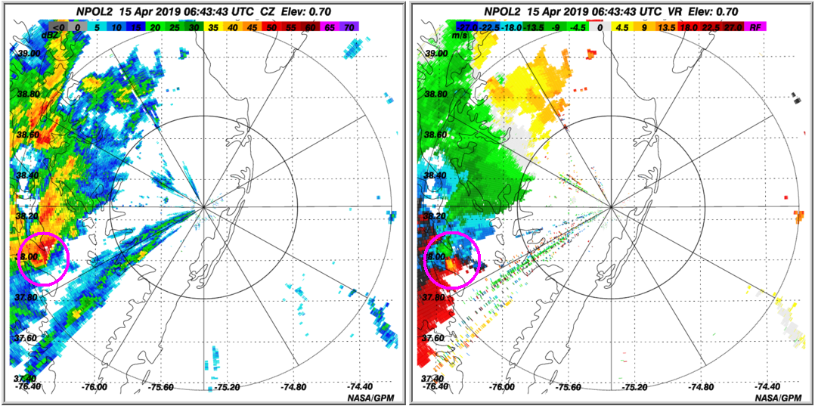
Perspectives from NASA’s NPOL Radar: Severe Weather on Delmarva (I)
Green/blue colors
show movement
toward NPOL, while
yellow/red colors
indicate movement
away from NPOL.
Together, this couplet
indicates rotation.
0643 UTC:
A strong cell was
detected near the
Chesapeake Bay.
The cell was moving
toward the Eastern
Shore.
NASA’s NPOL radar captured a severe thunderstorm with heavy rain and strong wind approaching the Maryland and Virginia Eastern Shore on April 15, 2019 between the hours of 2-4 am EDT. Cold dense air outflowing from the storm resulted in a burst of wind that induced rotation. NPOL detected wind moving toward and away from the radar with side-by-side difference greater than 50 mph. The storm weakened as it moved over the Chesapeake Bay possibly due to reduced friction over the water.
Text and Image Credits: David Marks (WFF/SSAI)
Scientific significance and societal relevance: *Ground radars such as the NASA S-Band Dual-Polarimetric Radar (NPOL) provide validation measurements that bridge the scale difference between satellite and point measurement instruments on the surface (e.g. rain gauges and disdrometers). The use of NPOL to validate GPM is critical to improve satellite-based precipitation rate retrieval algorithms. An accurate long-term record of global precipitation benefits society by providing critical information for climate change studies.

Slide 2
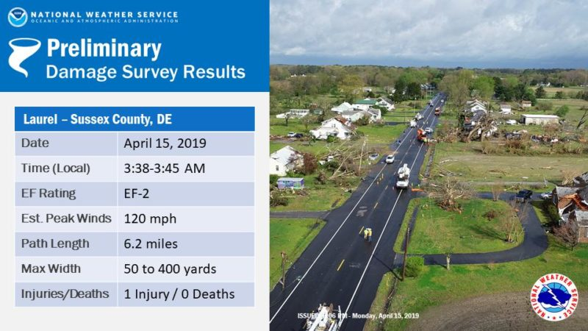
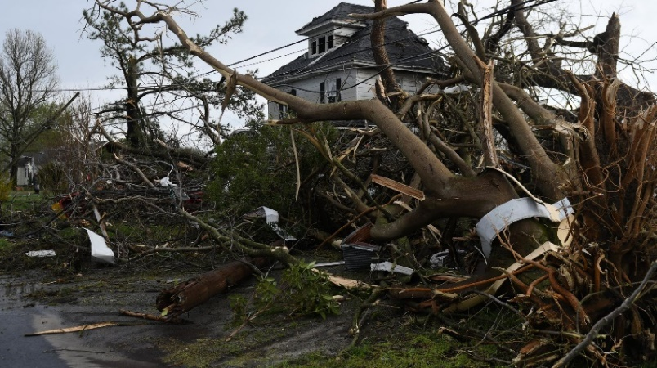
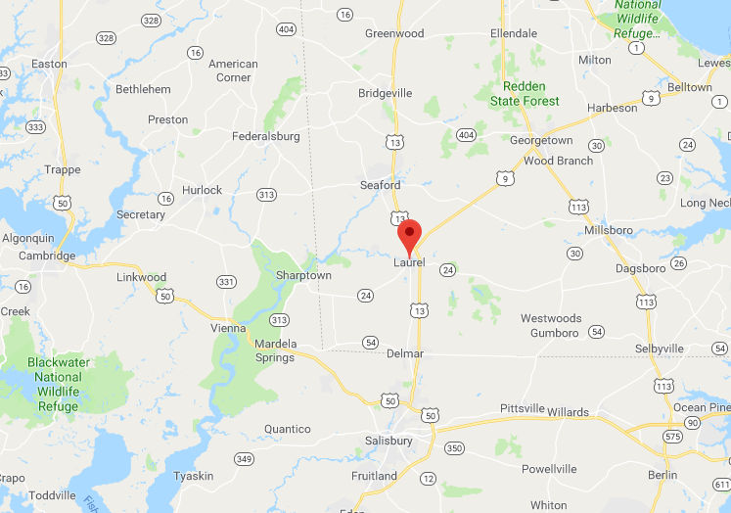
Perspectives from NASA’s NPOL Radar: Severe Weather on Delmarva (II)
0743 UTC:
NPOL detected tornadic
rotation near Laurel
and Seaford DE.
The cell dropped
a second tornado
near Harbeson DE
(21 miles NE).
Reflectivity showed circulation was wrapped in rain.
Mesocyclone and tornado vortex signature seen in velocity.
Reduced correlation was
an indication of lofted debris.
A severe thunderstorm spawned a tornado with estimated winds of 120 mph near Laurel and Seaford DE on April 15, 2019 with significant damage to trees and structures. NASA’s NPOL radar detected the tornadic wind rotation and the broader-scale rotation called a mesocyclone. A specialized radar field that shows statistical agreement within rain indicated a lower value that was consistent with lofted debris from the tornado.
Text and Image Credits: David Marks (WFF/SSAI)
Scientific significance and societal relevance: *Ground radars such as the NASA S-Band Dual-Polarimetric Radar (NPOL) provide validation measurements that bridge the scale difference between satellite and point measurement instruments on the surface (e.g. rain gauges and disdrometers). The use of NPOL to validate GPM is critical to improve satellite-based precipitation rate retrieval algorithms. An accurate long-term record of global precipitation benefits society by providing critical information for climate change studies.

Slide 3
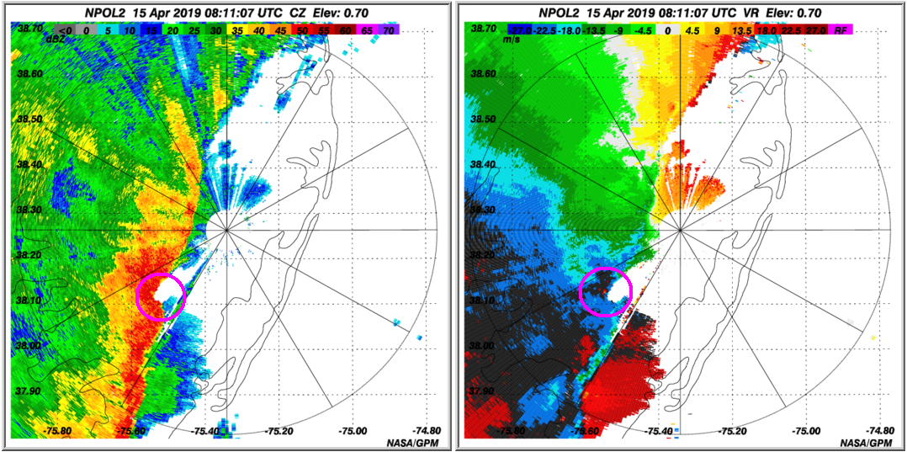
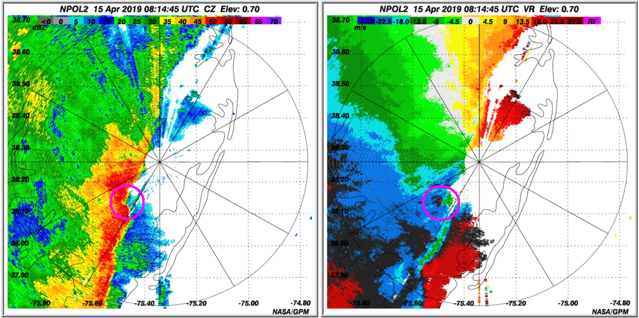
Perspectives from NASA’s NPOL Radar: Severe Weather on Delmarva (III)
0814 UTC:
Three minutes later, the bow echo rapidly advanced east, while the circulation center became more pronounced. A tornado could have occurred at any time, but did not form with this cell.
Reflectivity
Velocity
Reflectivity
Velocity
0811 UTC:
A bow echo indicated strong wind was detected by NASA’s
NPOL radar near Pocomoke City MD. A small shear-induced
circulation center had formed at the northern edge.
A severe thunderstorm near Pocomoke City, MD with strong winds greater than 50 mph was detected by NASA’s NPOL radar on April 15, 2019. The wind forced the leading edge of the storm to bow in an arc shape. A rotation feature formed on the northern edge of this bow as seen by red and blue colors side-by-side in wind velocity data. The rotation feature persisted for 15 minutes and had the potential to produce a tornado at any time.
Text and Image Credits: David Marks (WFF/SSAI)
Scientific significance and societal relevance: *Ground radars such as the NASA S-Band Dual-Polarimetric Radar (NPOL) provide validation measurements that bridge the scale difference between satellite and point measurement instruments on the surface (e.g. rain gauges and disdrometers). The use of NPOL to validate GPM is critical to improve satellite-based precipitation rate retrieval algorithms. An accurate long-term record of global precipitation benefits society by providing critical information for climate change studies.

