Slide 1
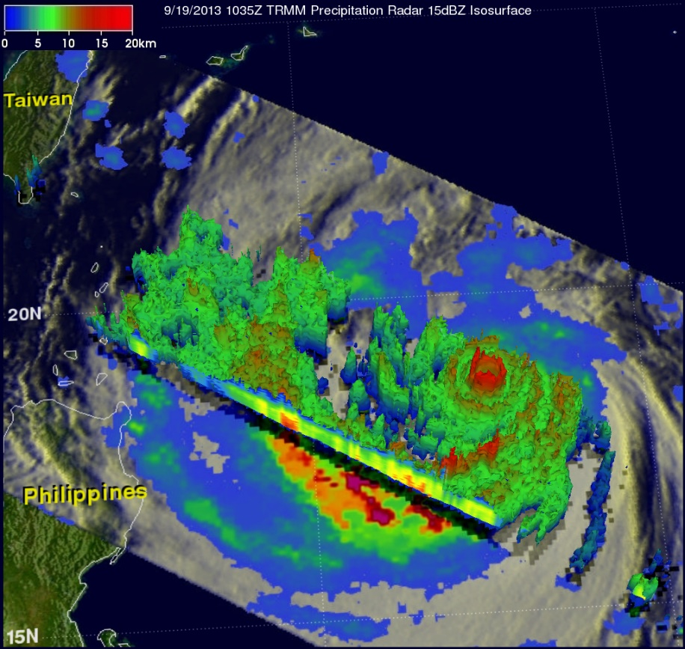
Comments on The Use of TRMM/GPM Observations at The Weather Company Peter P. Neilley Senior Vice President Global Forecasting Services The Weather Company

Slide 2
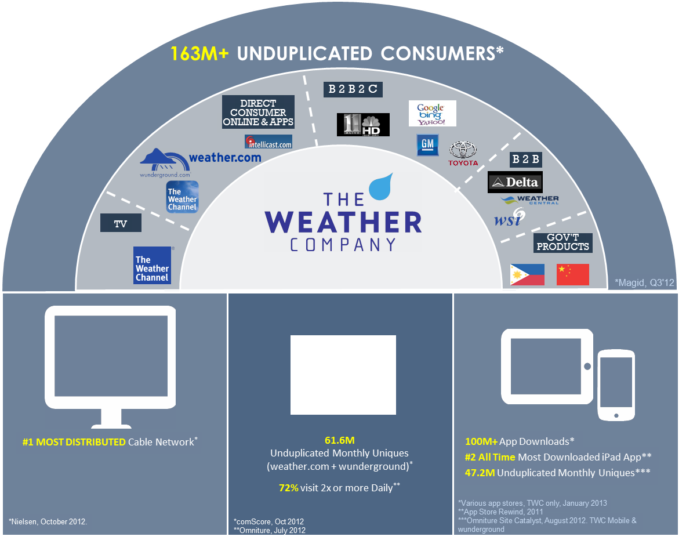
The Weather Company
The Weather Company is one of the world’s largest private weather companies. We provide services to a large number of consumers and broad spectrum businesses
Direct Consumer Portals
The Weather Channel
Weather.com
Weather Underground
Intellicast
Indirect Consumer Portals
Apple
Yahoo!
Google
Majority of US local TV broadcasters
B2B services
Aviation: 55,000 flights a day, 85% in US.
Energy: Forecasts and analytics to Energy Traders
Insurance and Reinsurance: Broad suite of weather svcs
Services to Governments and Agencies

Slide 3
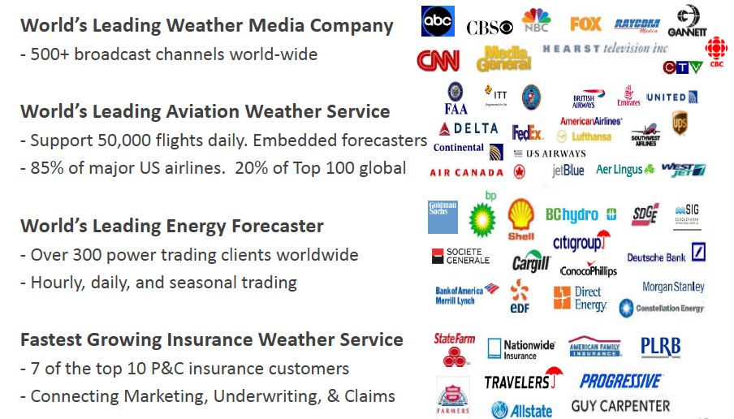
The Weather Company Global Reach

Slide 4
Forecasting at The Weather Company
We create our own global forecasts with emphasis on N.Amer and Europe.
We collect data from governments and partners to fuel our forecast generation
Standard WMO data
NWP data from global centers
Remotely sensed data (Radar, Satellite, profilers, etc)
Short-fuse government warnings
We augment the acquired data with our own proprietary content (global lightning, mesonets, A/C data)
We run our own NWP models (WRF-ARW, with 3D Var/Warm Cloud initialization) and climate models (CSM).
Humans can influence or augment the forecasts through an efficient editing enviroment.
We package the end result in useful and compelling ways.
Broad Input Data
We acquire weather and forecast data from governments and partners around the globe
Proprietary Data
We have our own sources for additional weather data, and we run our own NWP models
Forecast Engines
We have invested heavily in market specific analytical and statistical forecasting processes
Human Touch
Humans can improve, augment and enrichen the forecasts
Useful Products
We contain our forecasts in compelling ways in market specific products

Slide 5
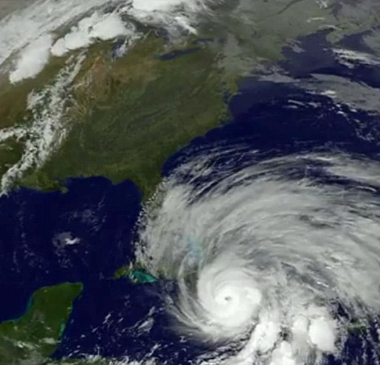
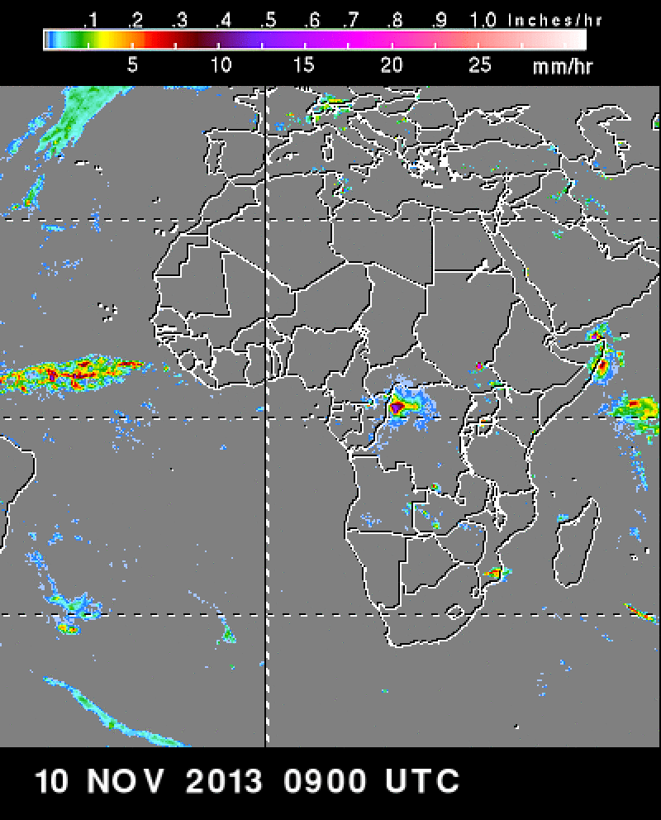
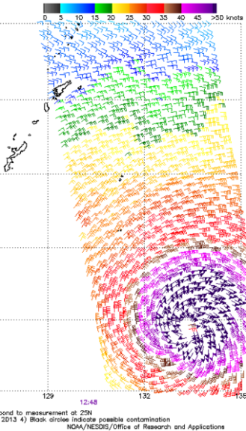
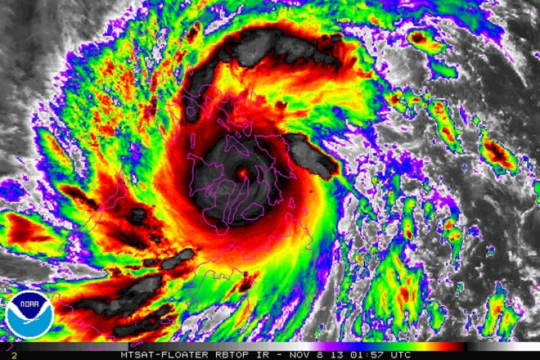
General Use of Satellite Data at TWC
In general, satellite data drives TWC content in the following expected ways:
Forecasting Situational Awareness: Location and evolution of important weather features, primarily using geostationary data.
Through Indirect Forecasting Applications: Assimilation of satellite imagery and derived products into NWP in our own models; Use of satellite-initialized models from government centers; Use in automated nowcasting systems.
“Story Telling”: Satellite imagery and derived products as a direct method to convey weather and forecasting stories and their impacts.

Slide 6
Use of POES Satellite Data at The Weather Company
POES data is used significantly less than GOES data at TWC
Forecasting Situational Awareness
High resolution imagery
Special-purpose instrumentation data and analysis (SST, volcanic ash, precipitation rates/accumulation, etc.)
Indirect Forecasting Applications
Use indirectly as incorporated into NWP models global modeling centers
No use in indirect (NWP, nowcasting, etc.) systems at TWC
Storytelling
Where content is unique (oceans, international)
As compelling graphics are pre-created and available.

Slide 7
Specific Use of TRMM at The Weather Company
TRMM data receives very limited systematic use within TWC.
It is used to support ad hoc interesting weather (mostly international) and climate stories.
Forecasting Situational Awareness
Rainfall rate/accumulation analyses for tropical systems either at sea or in sparse data regions.
Forecasting Applications
Indirect, through NCEP/ECMWF models
Storytelling
Where content is unique (oceans, international)
Where compelling pre-created graphics are available.
For post-analysis products/stories.
Significant event analyses / post-mortem.
Climate stories

Slide 8
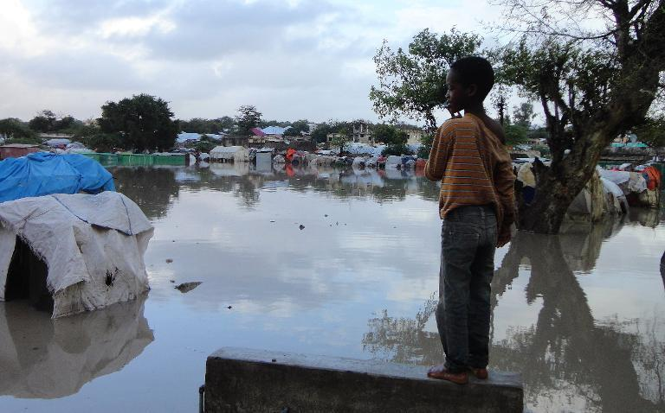
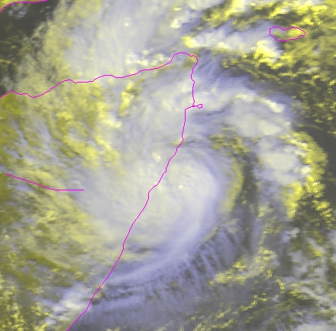
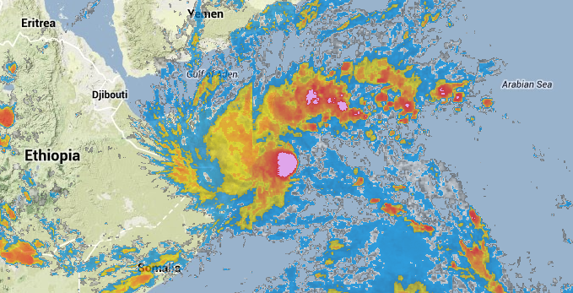
Tropical Storm 3A

Slide 9
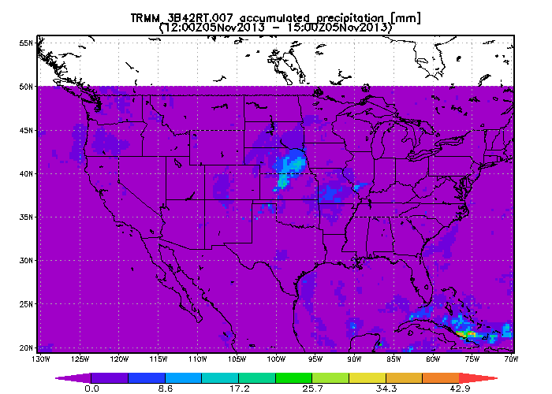
Why Limited TRMM Use at TWC?
Our US (and European) focus limits applicability of TRMM data compared to other sources.
Where rich ground-based radar data is available, TRMM adds limited value to the forecast process and story telling.
Coverage limited to tropical / subtropical band.
General limitations of polar orbiting data (timeliness, frequency, coverage) make real-time use difficult
One can not rely on having the data when you need it, particularly for rapidly evolving severe weather.
When compared to geostationary data, the unique information obtainable from TRMM is often not worth the trade-offs, particularly in the situational/story-telling applications
Less robust access infrastructure
Access to raw and analyzed TRMM products is not as robust compared to other weather or satellite platforms (e.g. compare to access to NWP data).
Ad hoc products
TRMM Accum. Precip Analysis
WSR-88D/Gauge Accum. Precip Analysis

Slide 10
Super Typhoon Haiyan
Rapid Scan IR from MT-Sat
Landfall image from TRMM/VIRS

Slide 11
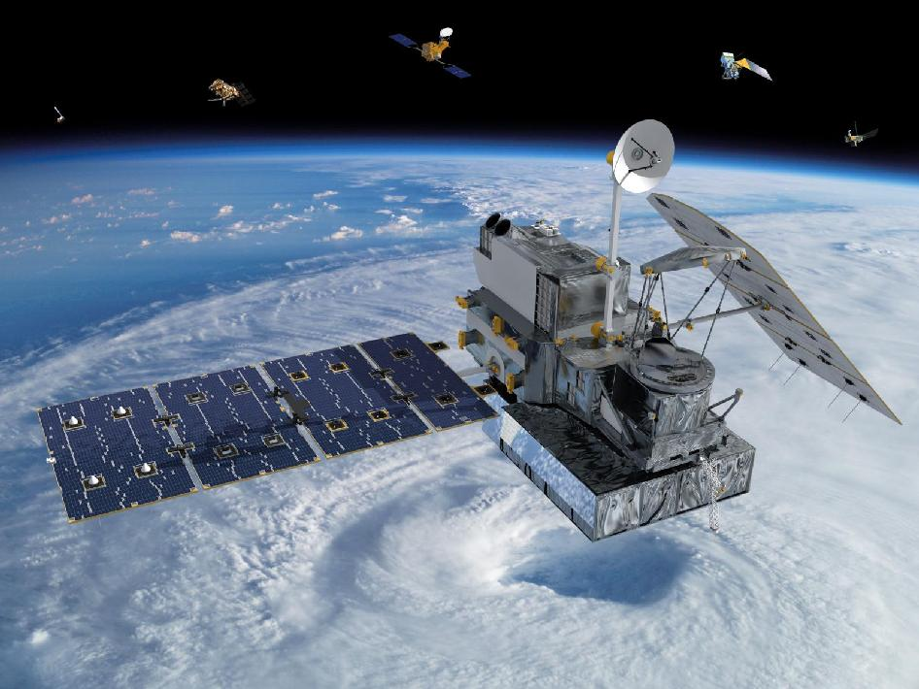
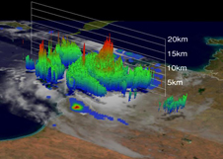
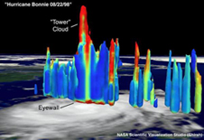
A Wish List for Increased use of GPM data at TWC
GPM will offer many new products than enhances the usability of the products for TWC use:
Broader latitudinal coverage
Extra tropical precipitation (snow, light precip)
Precipitation type identification
Particle discrimination / volcanic ash (?)
Even broader use at TWC likely would occur with these enhancements:
Solve the limitations of POES data ☺
Real-time, internet-based high-availability raw data streams.
Self-service portal to “research quality” data analysis and product/graphical generation.
Community available data-assimilation module(s) for WRF.
Relationships with TRMM/GPM core science organizations for better “use of opportunity”.

