Slide 1
Drought Monitoring and Precipitation Data
A U.S. Perspective on Current Uses, Needs, and Opportunities
Dr. Brian D. Wardlow
Director and Associate Professor
Center for Advanced Land Management Information Technologies (CALMIT)
And
Faculty Fellow
National Drought Mitigation Center (NDMC)
School of Natural Resources
University of Nebraska-Lincoln
2013 GPM Applications Workshop
College Park, Maryland
November 12-13, 2013

Slide 2
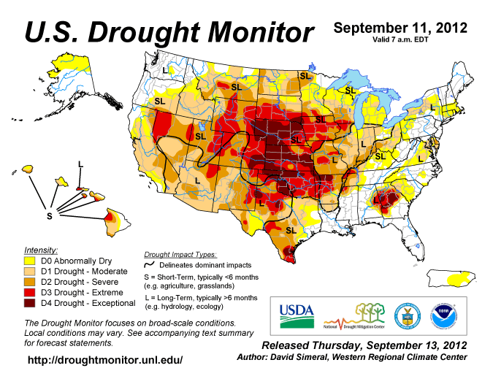
U.S. Drought Monitor (USDM)
Current State-of-the-Art Drought Monitoring Tool
Weekly map produced since 1999 by NOAA (CPC, NCDC, WRCC), USDA, and the NDMC.
Composite indicator of both ‘short’ (S) and ‘long’ (L) term drought conditions
Developed through the analysis of many indicators and indices (meteorological, climatological, hydrologic, and ecological) and input from ‘experts’ on the ground.
Widely used for drought-related decision making:
USDA Farm Service Agency (FSA)
Internal Revenue Service (IRS)
Congressional and White House briefings
Media (e.g., major newspapers and television)
Federal and state agencies /organizations
Precipitation data are critical input for USDM and other operational U.S. drought monitoring tools, but satellite-based precipitation data are not widely used.

Slide 3
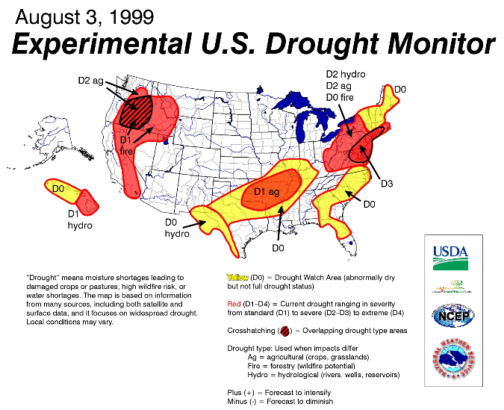
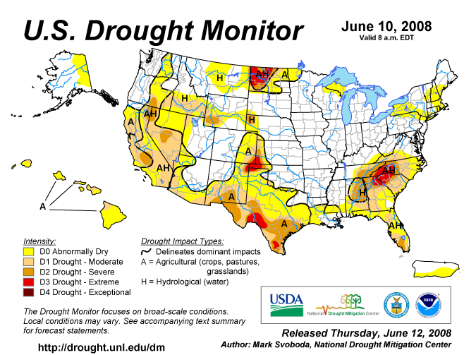
Evolution of the USDM
Since the first USDM map in 1999, the geographical depictions and specific classifications of drought (agricultural vs. hydrologic, short- vs. long-term) continue to improve as technology advances and new types of data inputs (including remote sensing) become available.

Slide 4
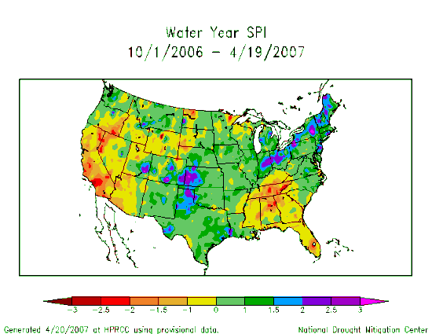
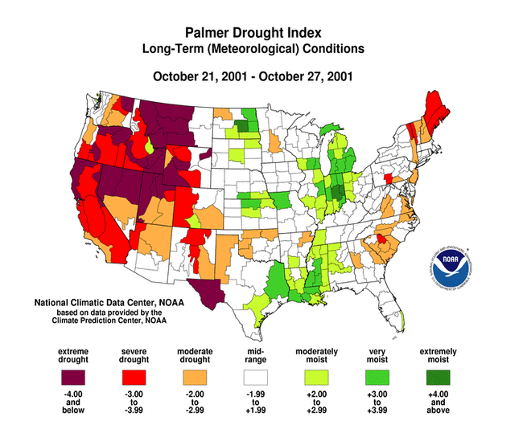
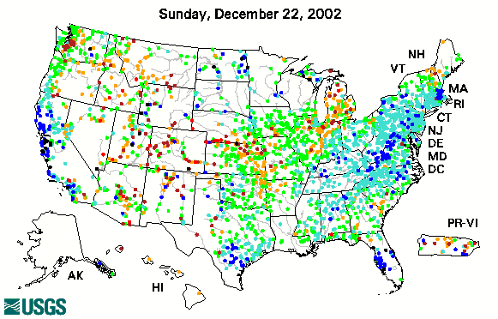
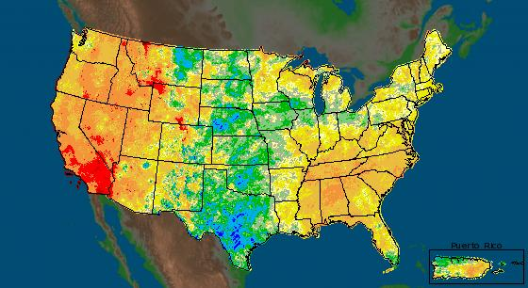
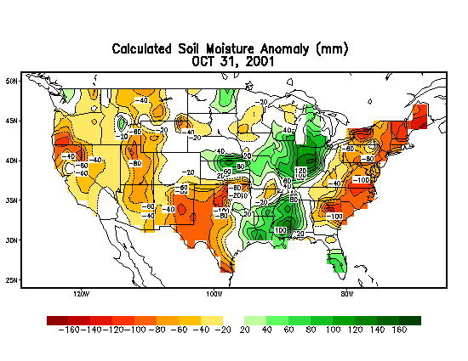
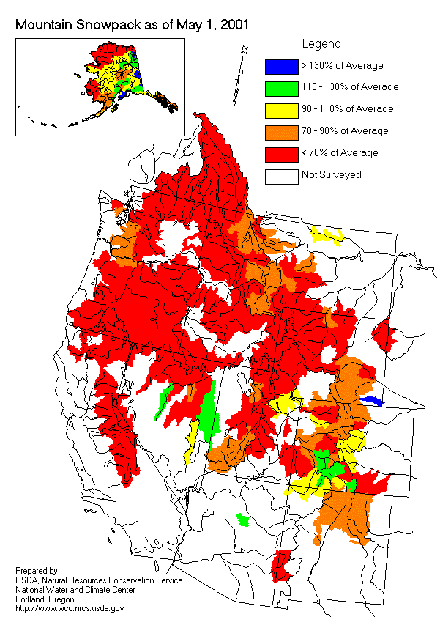
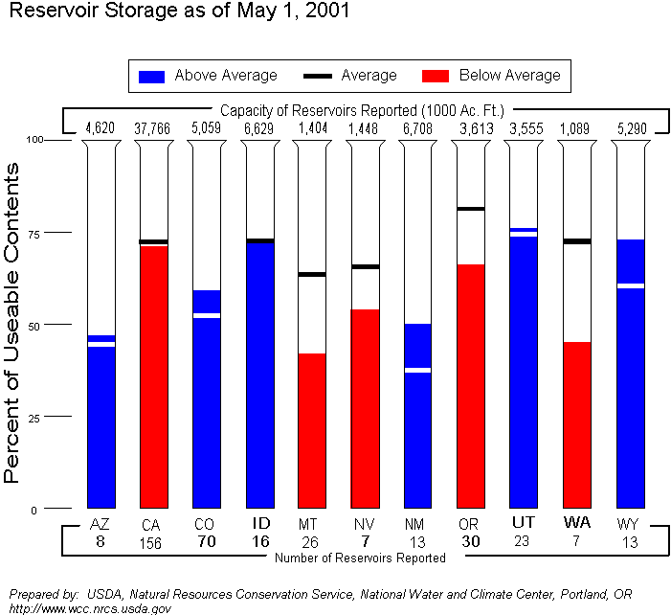
Examples of Inputs into the USDM
Key Drought Indicators:
- Palmer Drought Index
- SPI
- KBDI
Modeled Soil Moisture
- 7-Day Avg. Stream flow
- Precipitation Anomalies
Growing Season:
- Crop Moisture Index
- Satellite Veg. Health Index
Soil Moisture
Mesonet data
In The West:
- SWSI
- Reservoir levels
Snowpack (SNOTEL)
SWE
Stream flow
Expert Feedback from the Field
The USDM has traditionally relied upon station-based precipitation data that are spatially interpolated or aggregated into an anomaly or index product

Slide 5
Examples of Inputs into the USDM
Key Drought Indicators:
- Palmer Drought Index
- SPI
- KBDI
Modeled Soil Moisture
- 7-Day Avg. Stream flow
- Precipitation Anomalies
Growing Season:
- Crop Moisture Index
- Satellite Veg. Health Index
Soil Moisture
Mesonet data
In The West:
- SWSI
- Reservoir levels
Snowpack (SNOTEL)
SWE
Stream flow
Expert Feedback from the Field
Until recently, remote sensing products have had limited application in the USDM.
Recent Satellite Remote Sensing Products:
NWS Precipitation Analysis
Vegetation Drought Response Index (VegDRI)
Evaporative Stress Index (ESI)
GRACE Terrestrial Water Storage

Slide 6
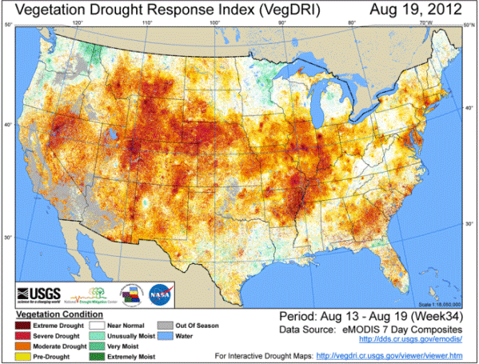
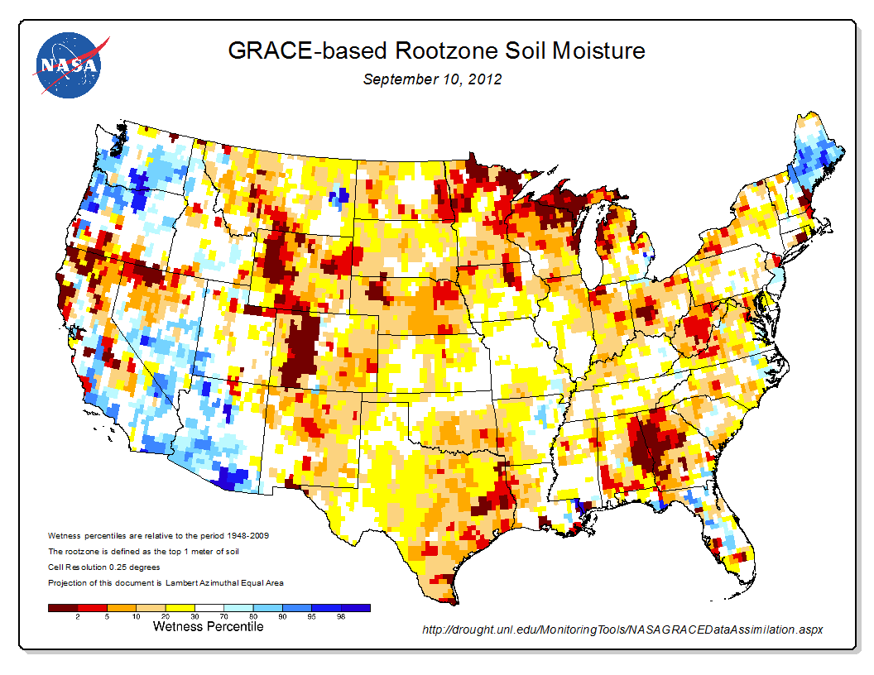
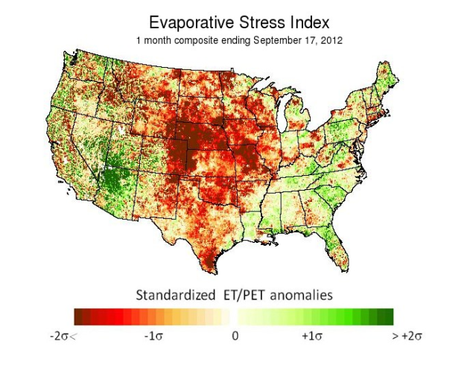
Satellite-Based Products for the USDM
vegdri.unl.edu/‎
http://drought.unl.edu/MonitoringTools/NASAGRACEDataAssimilation.aspx
vegdri.cr.usgs.gov/viewer/viewer.htm
hrsl.arsusda.gov/drought/index.php

Slide 7
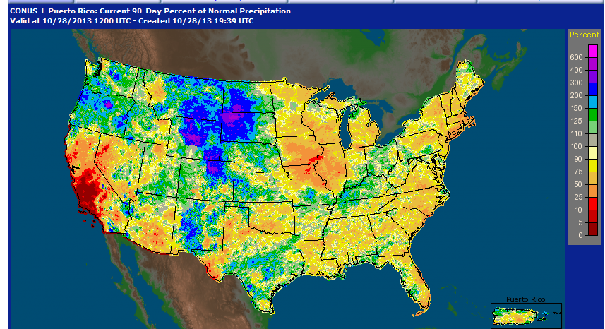
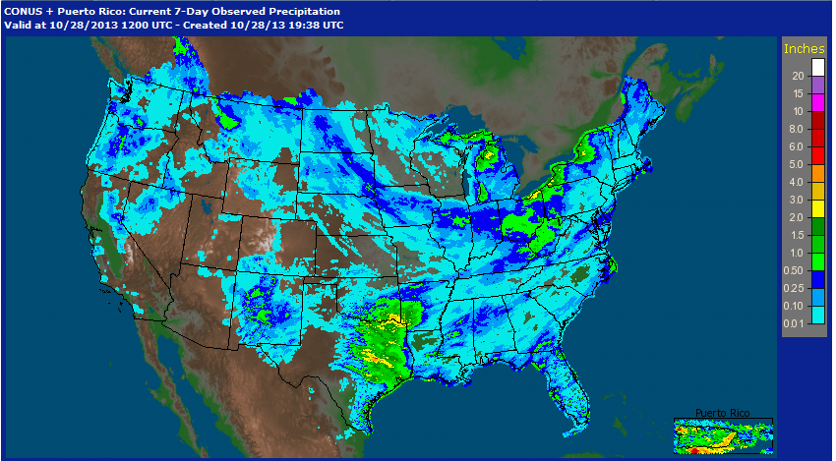
NWS Precipitation Analysis Products
The USDM routinely use 4-km precipitation products from the NWS River Forecast Centers (RFCs) produced using a ‘multi-sensor’ approach of precipitation estimates from WSR-88D NEXRAD observations and ground-based gauge measurements.
Daily and 7-day precipitation total – used to identify where and how much rainfall has recently been received.
Precipitation departure or percent of normal – for a long period (e.g., 60- to 90- days for snapshot of longer-term conditions (historical normals used from PRISM data).
http://water.weather.gov/precip/

Slide 8
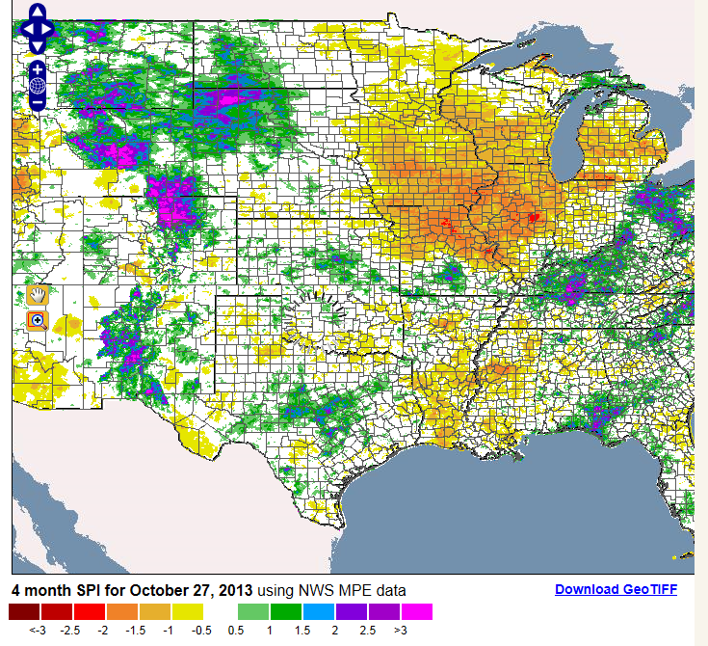
Gridded Standardized Precipitation Index (SPI) Data
Experimental product being considered by the USDM is 4-km gridded SPI data derived from the NWS Precipitation Analysis products and PRISM data produced at Texas A&M University.
SPI – Uses historical precipitation data to calculate probability of precipitation across multiple time scale (e.g., 1 to 12 months).
Routinely used index in USDM and many drought monitoring system globally.
Recognized as universal drought index by World Meteorological Organization (WMO) in 2009.
http://atmo.tamu.edu/osc/drought/

Slide 9
Final Thoughts
Why has the use of satellite-based precipitation been lacking in the U.S.?
No definitive answer
- Adequate spatial coverage over most of the U.S. through gauges and NEXRAD estimates (with exception of western part of the U.S.)
- Incorporation of satellite-based remote sensing tools has been
relatively slow (rapid increase in past 5-7years)
Operational needs for the USDM (lessoned learned from the development of recent remote sensing tools)
Near real-time (less than 24 hours from last observation)
Operational product delivery (e.g., every Monday morning)
Anomaly calculations (e.g., percent of normal, percentile, and/or drought index) over longer-historical record (e.g., 30 years)
Customized products (classification color scheme and data format)

Slide 10
Final Thoughts
Opportunities
Internationally, TRMM and GPM precipitation products (particularly anomalies) will be essential for drought monitoring in most regions/countries that often lack dense weather station networks.
USDM process is ‘flexible’ and can be adapted for new data inputs like the precipitation products from TRMM and GPM.
Other tools such as VegDRI, which rely on spatially interpolated precipitation grids from station data, could also benefit from long-term satellite-based precipitation data sets.
Concerns
Long-term data continuity maintain operational products into the future….. Will the product be here tomorrow ?

Slide 11
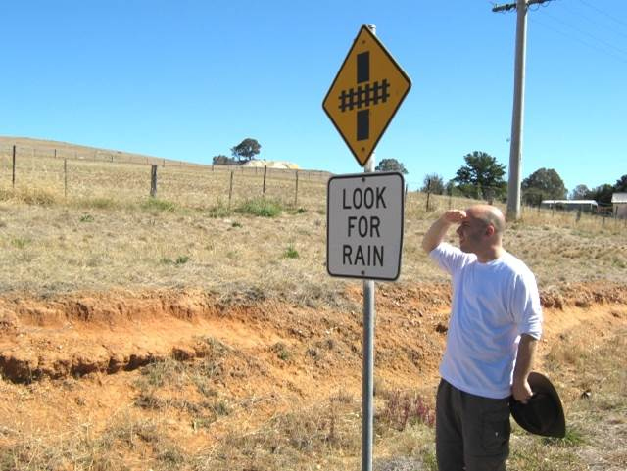
Thanks for your attention!
For questions or further information, please contact:
Brian Wardlow
bwardlow2@unl.edu
or
visit the National Drought Mitigation Center (NDMC) website
at drought.unl.edu/
Photo courtesy of Tom Pagano

