Slide 1
Still difficult questions to answer
NASA, FEWS NET and food security
Gary Eilerts
USAID Program Manager for FEWS NET
NASA GPM Workshop, June 10, 2015

Slide 2
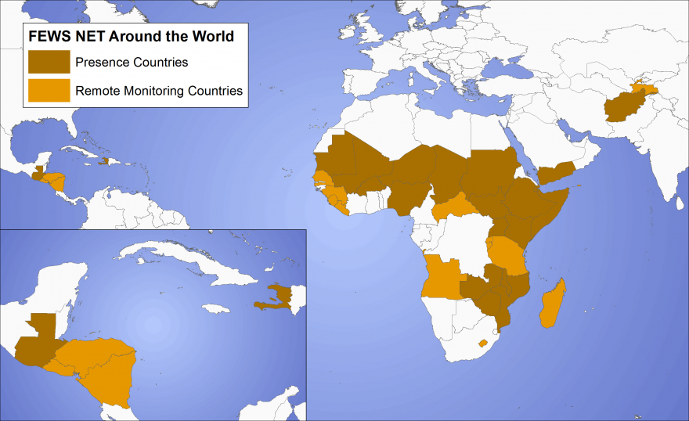
The Current FEWS NET world
The Purpose of FEWS NET
To prevent famine and mitigate food insecurity by providing decision makers with information that is accurate, credible, timely, and actionable.
To strengthen the ability of FEWS NET countries and regional organizations to provide timely early warning and vulnerability analysis.
Notes:
Over 25 years of food security early warning work (established in 1985 in response to FS crises in the Sahel)
Purpose
Monitor FS conditions in 36 countries (Africa, Central Asia and Central America and the Caribbean)
21 presence countries. In each presence country, usually have 2 main technical staff members. Staff are all local staff.
Also monitor 15 countries remotely, typically from a nearby country office.
In these RM countries, use a lighter version of FEWS NET’s traditional methodology and focus on identifying anomalies and scaling up monitoring if needed.

Slide 3
Why is FEWS NET at GPM workshop?
Two contracts
Four Inter-Agency Agreements
Notes:
Chemonics
Single award IQC
Current phase runs from December 2011 through December 2016
Prime contractor, Chemonics International
$200 million ceiling, currently funded at approximately $26mn/year
Operates 20+ country offices plus remote monitoring of 15 more countries
DC-based technical office of 18 people, lead by Chief of Party Bruce Isaacson
Mission buy-ins possible (buy-ins currently from Afghanistan, Malawi, Nigeria, DRC, South Sudan, Yemen, Zambia)
Kimetrica
Technical Support Contract - current phase runs from December 2011 through December 2016; Small business set-aside held by Kimetrica, LLC
Currently funded at approximately $1mn/year
Activities include:
Climate Resilience Study (Ethiopia)
Data warehouse development (market prices, nutrition, ag production)
Identify and test innovations in data collection for FEWS NET
USDA: Provides PASA staff to manage FEWS NET (Eilerts, Williams, McNabb and Scicchitano)
USGS: Agro-climatological data, climate change driver research, spatial modelling of risk, vulnerability and resilience factors
NOAA: Weather monitoring and forecasting, climate services support
NASA: Satellite datasets, implementing a water cycle and water availability monitoring system in FEWS countries

Slide 4
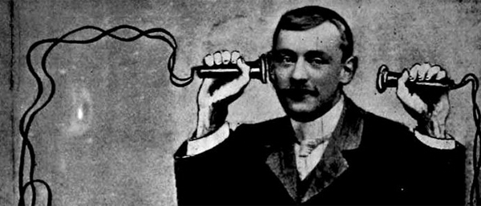
Old User vs Producer issue…
FEWS is a User of NASA products, and is making good use of them in a $2 billion food security activity.
Communication isn’t automatic
Needs are not always clear or known
Even when they are, an interpreter may be needed

Slide 5
Food security sector’s contribution
Roughly 40 years ago, “food security” was initially a construct of Amartya Sen. Everyone still accepts his definition of it ….
It became a “science” founded on a concept, raised on data, answering questions too important to wait for perfect answers, and oriented to delivering a high public good. Decision-makers liked (needed) it.
Notes:
Based upon a long-accepted concept of Amartya Sen

Slide 6
Food security: mission creep?
Food and nutrition security?
Chronic food insecurity (underlying problems)?
Resilience and development in the most difficult places?
Is food security really water security?
Isn’t food and water insecurity really a problem of unresolved conflict?

Slide 7
What are the stakes in play?
Food for Peace allocates between $1.5 – 2.5 billion of food aid and cash per year
Global needs are greater than that.
Who should get it, and who not, for what?
How does FFP make those decisions?

Slide 8
Are we a product, or a tool?
FEWS is increasingly being asked to monitor and analyze populations affected by too much or too little drought, poverty, conflict, water, ebola, coffee-rust, etc.. Those shocks, and responses to them, are not adequately defined by a food security lens.
FEWS is an (interim?) response to a broader decision-making need, as yet un-formalized, for a trustworthy capability, to ask and answer important human “well-being” questions, using quickly assembled evidence, and a transparent method, to deliver response-useful information.

Slide 9
Yes?, and yes?
Whatever it is, we’ve got more to work with…
30+ years of satellite imagery
More and more socio-economic data
Data and insights about people and their problems
What are some of the most interesting new products/tools?

Slide 10
Ask and answer important questions?
New “spreadsheets” to organize your data so that you can ask multiple new questions, and get quick answers back….
Getting beyond a 3-year “baseline”
Other people collecting and organizing your data

Slide 11
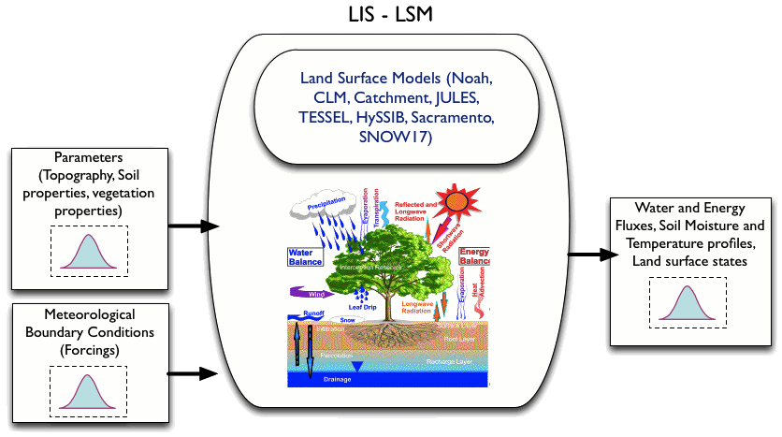
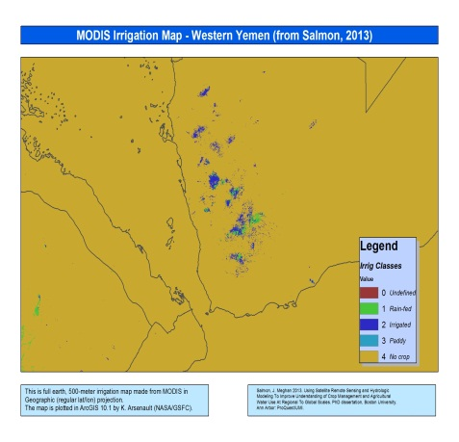
Example: FEWS LDAS (FLDAS)
A “spreadsheet” to organize your data so that you can ask multiple new questions, and get quick answers back….
MODIS Land Cover
MODIS LAI
Crop Map TBD
Irrigated Area Map
baseline water stress
inter-annual and seasonal variability in water availability
occurrence and severity of floods and droughts (SPI, SSWI, soil moisture percentiles)
groundwater stress
Land-Surface Models
Noah, VIC, WRSI
GDAS/MERRA + CHIRPS

Slide 12
Getting beyond a 3-year “baseline”

Slide 13
Example: Yemen grain imports
Source:
Commercially available shipping data received from automatic transponders on ships. Purchased from a web-site.
Our analysis in early May said we didn’t think Yemen could import mode than 350,000 MT per month, therefore, high chance of famine.
This information made the difference in FEWS NET’s analysis of “famine likely in Yemen”, to “not yet”.
MT needed per month

Slide 14
Formulate really new questions?
Water scarcity
The actual costs of risk and disaster
The benefits of alternate strategies

Slide 15
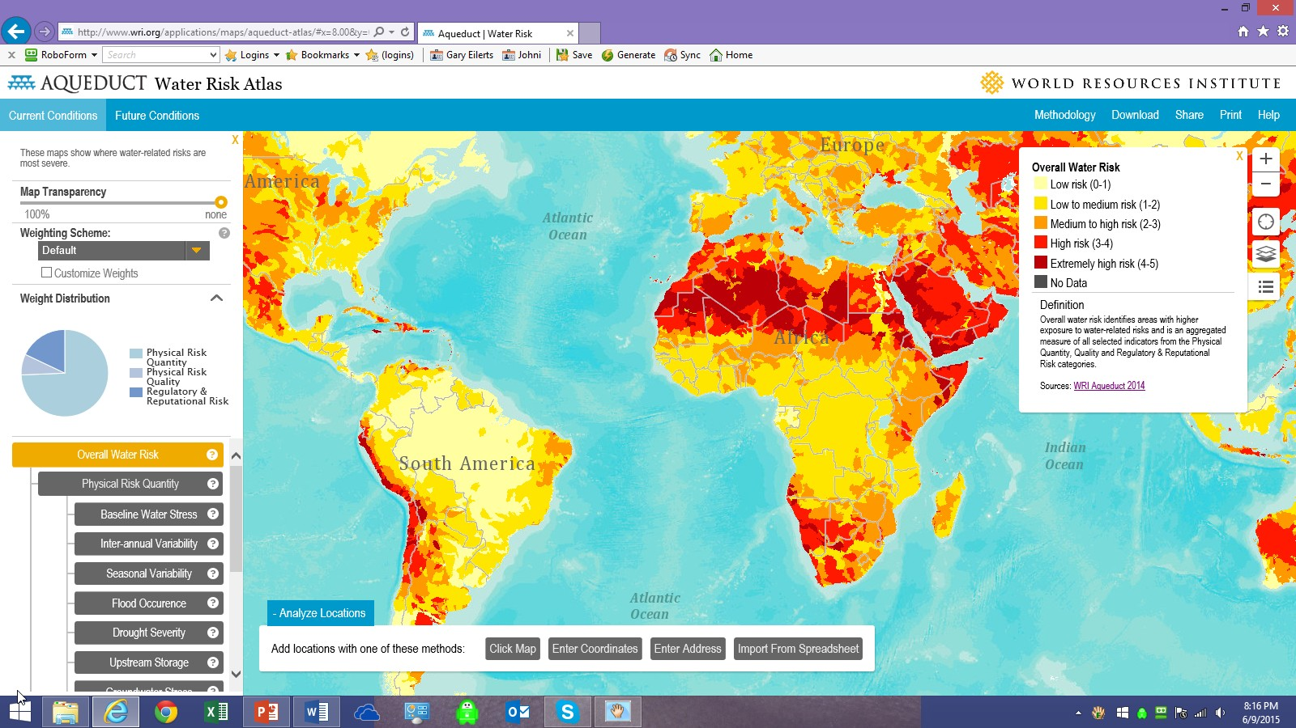
Example: water scarcity
Valiant efforts go into measuring water scarcity, even if a lack of measurements only let us understand the problem as it has been over many years.

Slide 16
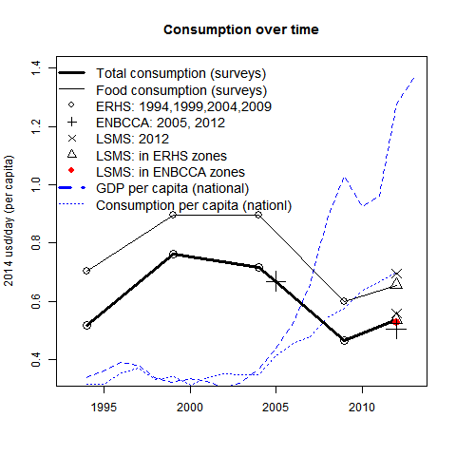
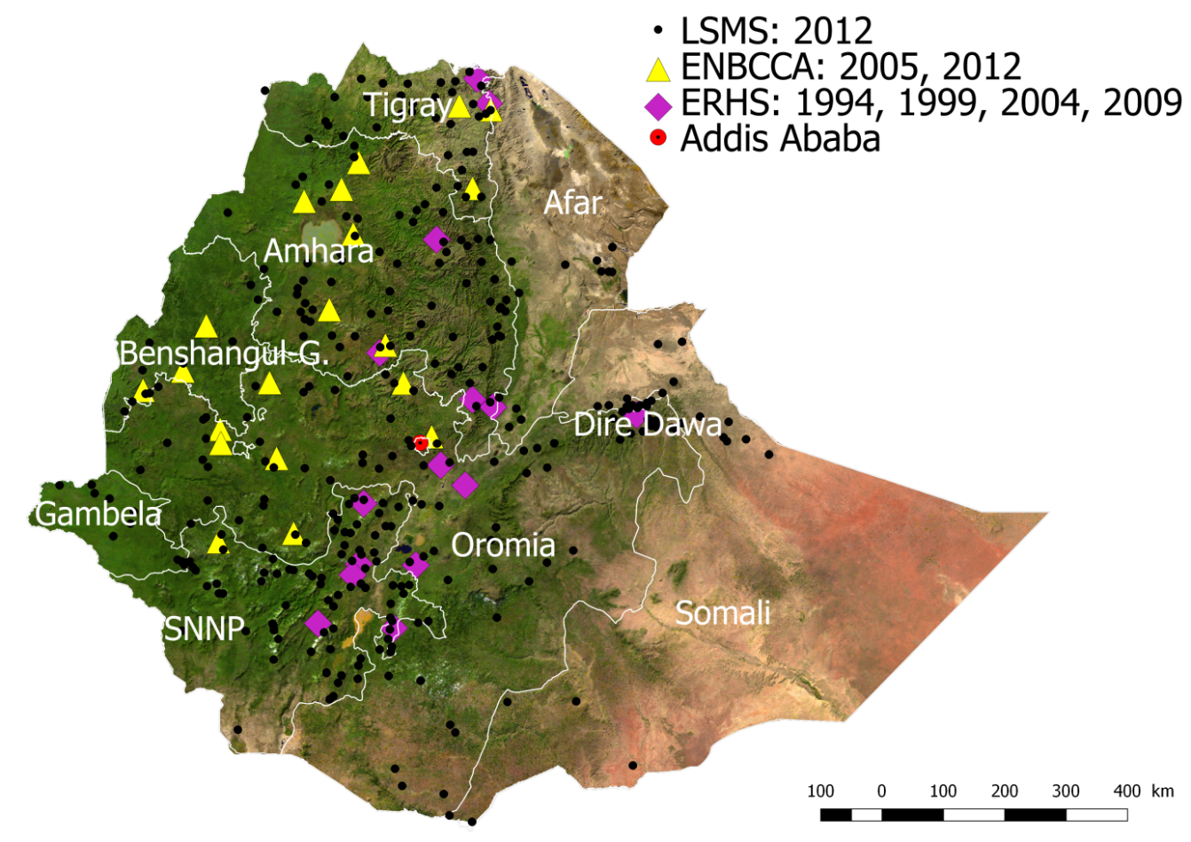
Example: Resilience study

Slide 17
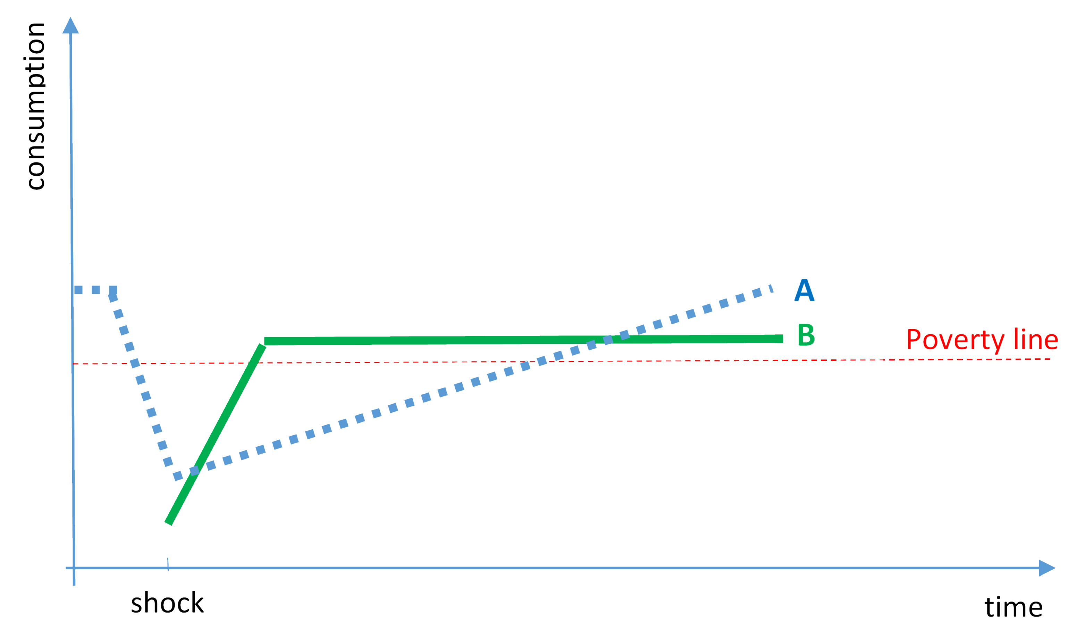
Example: Measuring vulnerability/resilience
Vulnerability
Vulnerability = how much income is lost due to weather/climate events
Resilience = how long it takes to return to previous income level
The value of good response: how much less vulnerability, and how much more resilience was conferred on households receiving food aid, or any other humanitarian intervention
Resilience

Slide 18
The newest multi-sectoral questions
Answering questions we never thought we could ask….
How much relief food are we giving to water-caused malnutrition?
How does soil moisture contribute to severity of ag drought
What is the cost in household income of a drought of “x” magnitude?
How does malnutrition vary with water availability?
Are food prices in “x” following local weather, or global markets?

Slide 19
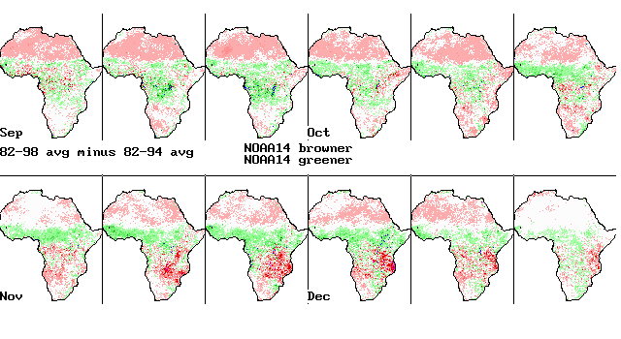
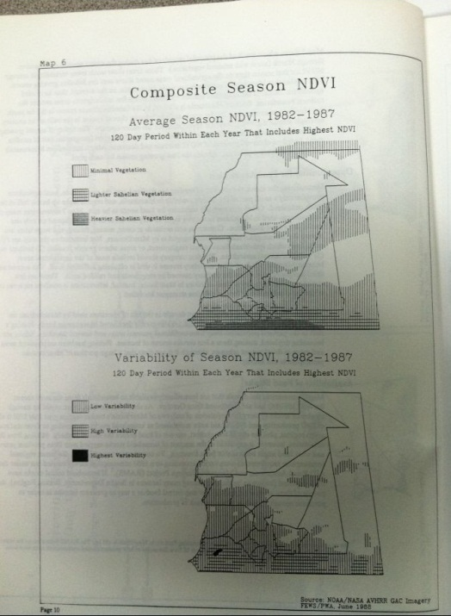
A tradition of innovation
The old frontier; things have changed
With these products of the late 80s, FEWS became known for its high-tech use of evidence.

Slide 20
Lingering thoughts
Need for more and better information and tools is still great
Innovation in response to revealed needs is essential
Communication is really difficult
Progress is being made
Keep up the good work!

