Slide 1
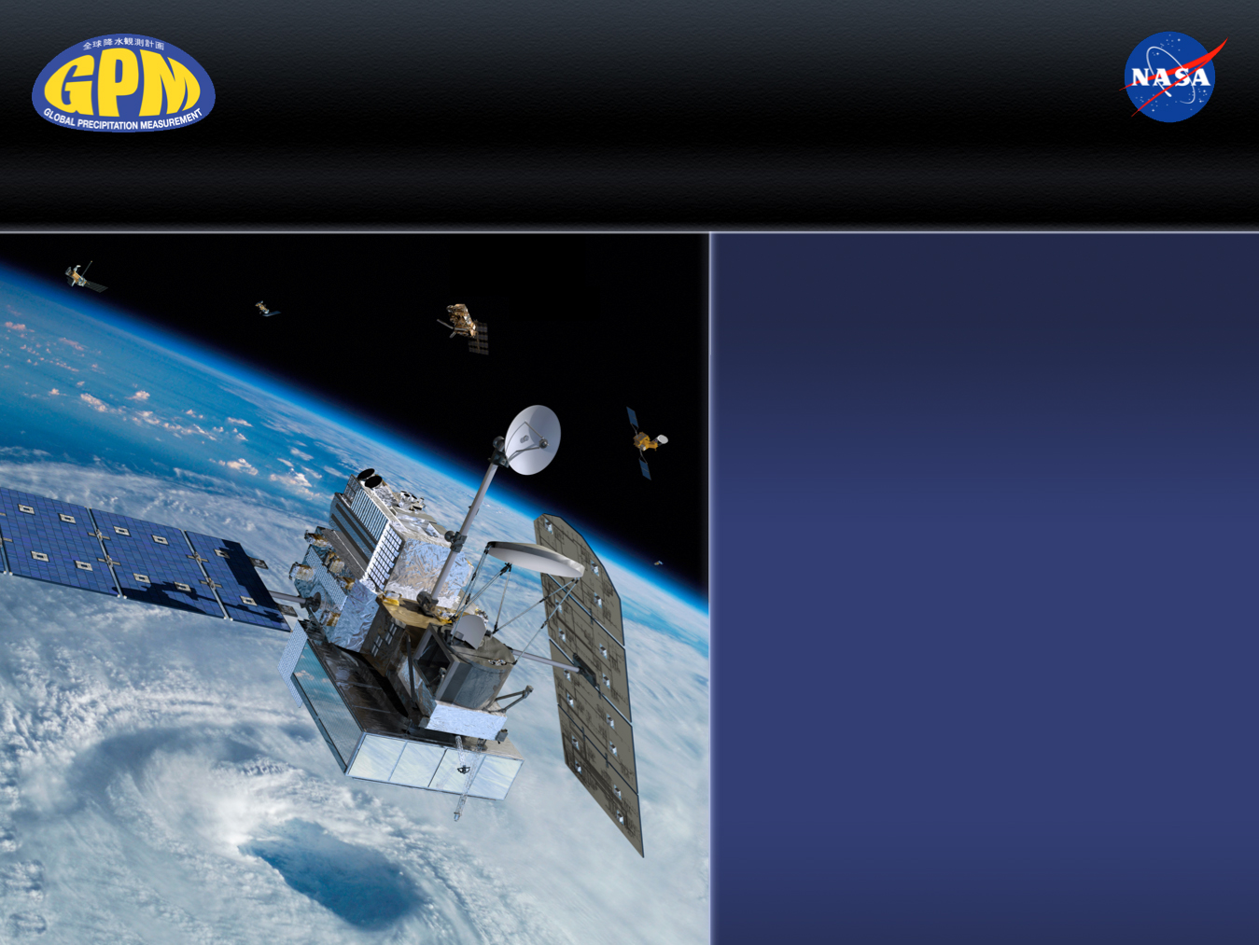
Global Precipitation Measurement (GPM) Mission Overview
Gail Skofronick Jackson
GPM Project Scientist
NASA Goddard Space Flight Center
Greenbelt, MD, USA
Gail.S.Jackson@nasa.gov
GPM Applications Workshop
9 June 2015
www.nasa.gov/gpm
Twitter: NASA_Rain
Facebook: NASA.Rain

Slide 2
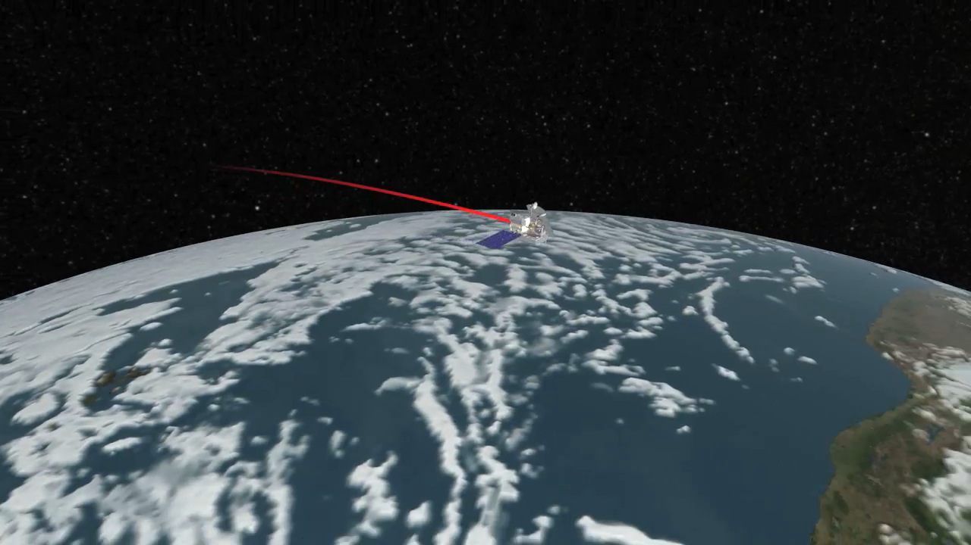
GPM Constellation in Action (Simulated Data)

Slide 3
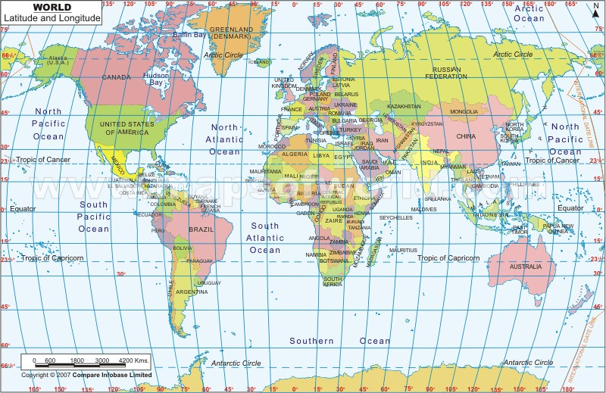
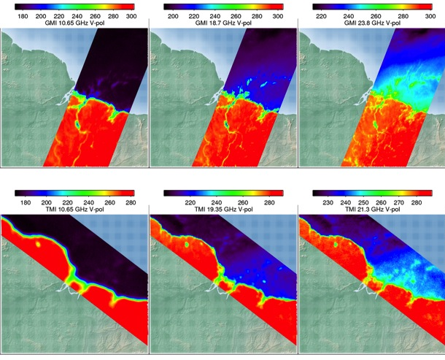

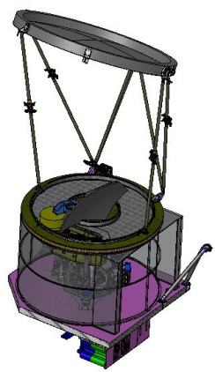

GPM Enhancements Compared to TRMM
Increased Earth Coverage
Advanced Instruments
  Dual Frequency Precipitation Radar
  Passive Radiometer (10-183 GHz)
Finer spatial resolution
Well designed
radiometer (unifies
partner
estimates)
Rainfall
Amazon
River
10V
GMI
26km
19V
GMI
15km
23V
GMI
12km
10V
TMI
48km
19V
TMI
24km
23V
TMI
22km

Slide 4
GPM Precipitation Products
GMI
Level 1: Calibrated TB; Level 2: precip rates; Level 3: accumulations
Constellation precipitation rates
DPR
Level 1: Calibrated powers; Level 2: Z & precip rates; Level 3: accum.
Latency: Near real time 3 hours
~5 km resolution
Combined
Level 2: Combined DPR & GMI; Level 3: accumulations
Greater constraints on estimates; database for GPROF
Latency: Near real time 1 hour
~15 km resolution
Ku, Ka, and Ku+Ka products
Name: GPROF
Name: DPR
Latency: Near real time 3 hours
~15 km resolution
Name: CMB
Multi-Satellite
Level 2: precip rates; Level 3: accumulations
Latency: Near real time 4 hours
~10 km res., every 30 minutes
Uses IR to fill between microwave for 30 min data
Name: IMERG
Name Features Latency Levels

Slide 5
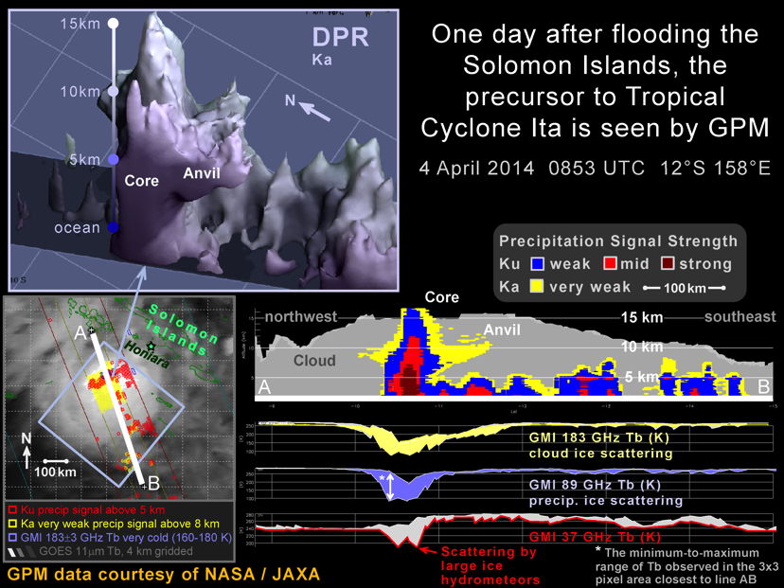
New Cyclone Observation Capabilities
Notes:
This image shows the power of the new capabilities on GPM. Namely the Ka radar frequency that is able to reveal the 3D structures of ice and light precipitation (because of its lower minimum detectable reflectivity down to 12 dBZ). Note the yellow anvil region coming out of the edges of the cyclone hot tower at the 10 km altitude. The GMI also has 166 and 183 GHz channels (that TRMM did not have). These channels are also sensitive to light rain and ice. One can see the depression in brightness temperatures in 183 GHz where the anvil ice exists. Note that 89 and 37 GHZ are sensitive to only the most intense precipitation areas. Also that 37 GHz warms when liquid precipitation is present. These GMI brightness temperature relationships are as expected over oceans.

Slide 6
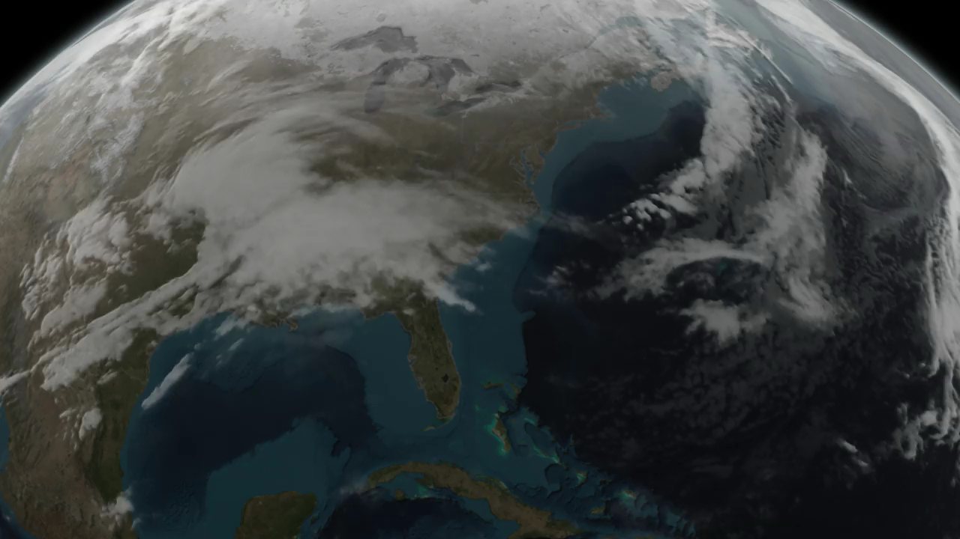
March 17, 2014 Snow Storm

Slide 7
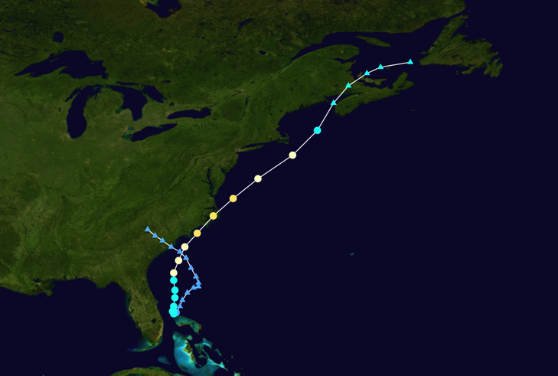
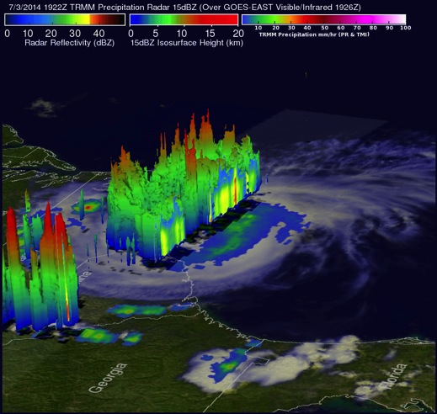
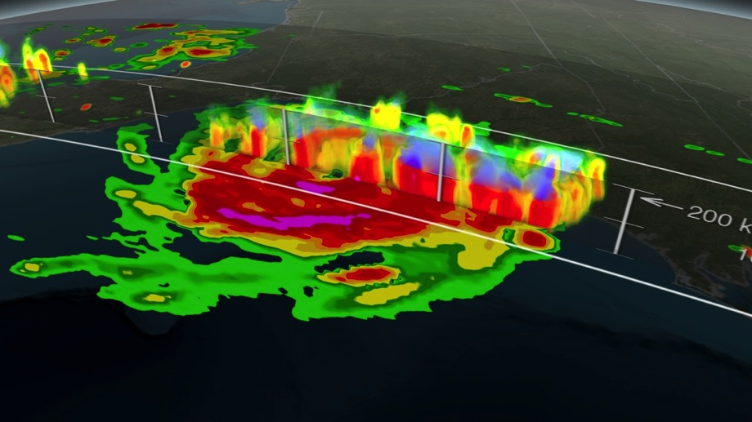


Observing Hurricane Arthur July 2014
GPM’s additional imaging extent (relative to TRMM)
Hurricane Arthur Track
TRMM: TMI/PR, July 3rd
Hurricane Arthur affected the East Coast of the U.S. from July 1-7th. TRMM and GPM viewed the storm multiple times throughout its lifecycle. GPM was able to view the storm as it progressed poleward
GPM: GMI/DPR, July 3rd
This slide dedicated to Arthur Hou
GPM Project Scientist 2005-2013
Notes:
Source of track data: http://en.wikipedia.org/wiki/Hurricane_Arthur#mediaviewer/File:Arthur_2014_track.png
Hurricane Arthur affected the East Coast of the US from July 1-7th, 2014
It was the first hurricane of the 2014 season and the earliest recorded hurricane to strike North Carolina
TRMM and GPM were able to view the storm multiple times throughout its lifecycle, the images above show Hurricane Arthur on July 3rd making landfall in North Carolina
Due to GPM’s 65 degree orbit, GPM is able to view storms such as Arthur as they progress poleward and observed precipitation that affected Maine and Canada.

Slide 8
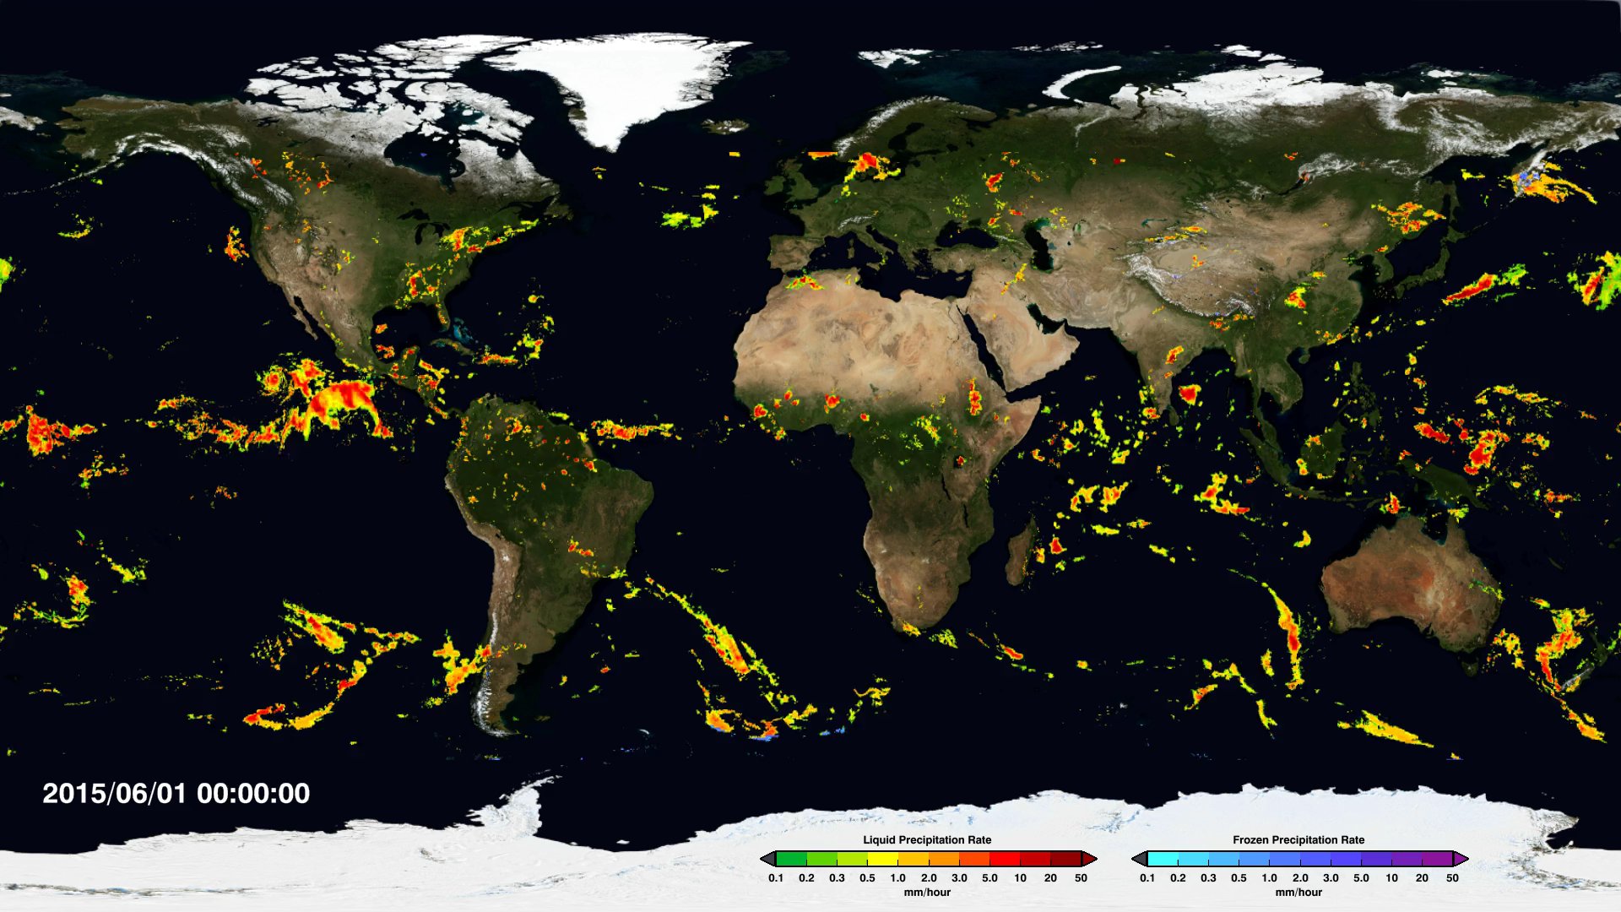


Multi-Satellite Precipitation Data (30 min, 10km by 10km)
IMERG: Integrated Multi-satellitE Retrievals for GPM 6/1-8

Slide 9
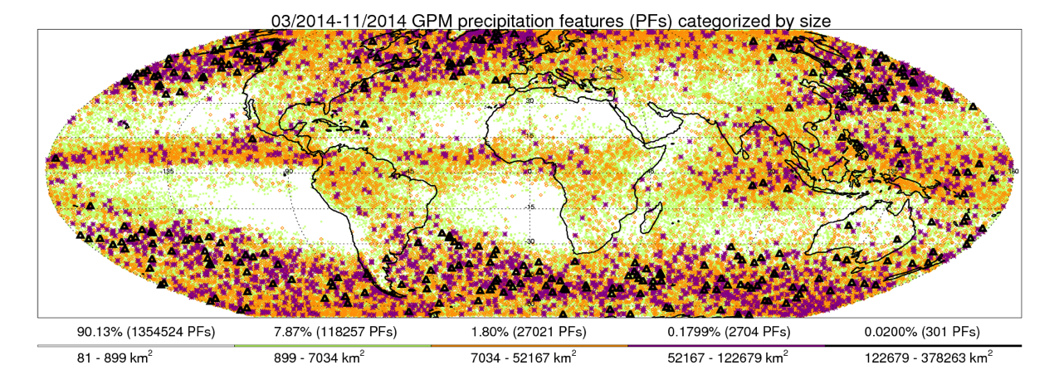
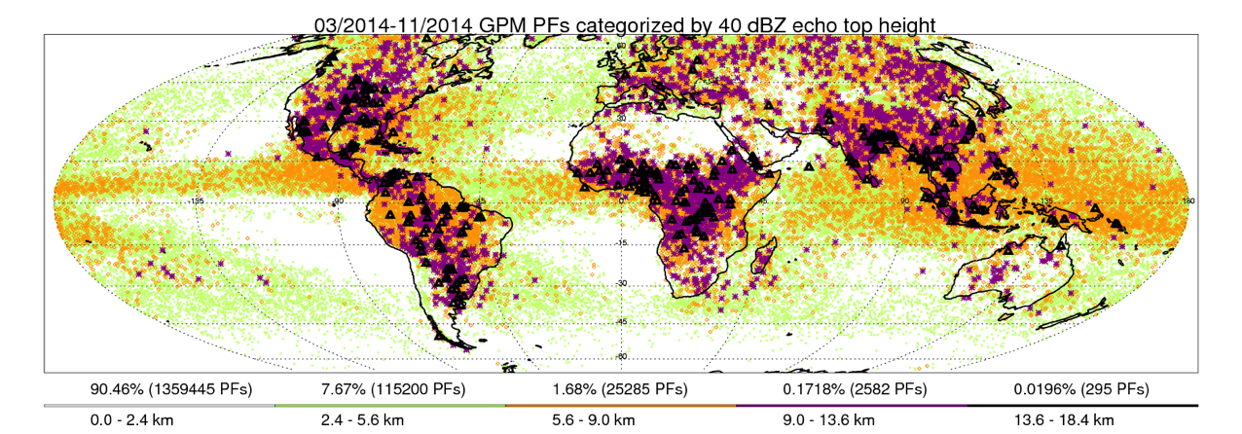
GPM’s Largest & Strongest Precipitation Systems
The most extensive precipitation systems are found over mid and high latitude ocean
Percent of Events
Size of events
The strongest storms such as hailstorms and lightning storms are dominant over land
Credit: Chuntao Liu, Texas A&M – Corpus Christi
Notes:
Precipitation systems categorized by their depths, intensities and sizes. Now we have more confidence to answer the questions of “where are the strongest, biggest, and deepest storms on Earth”.
PF stands for Precipitation Feature defined by grouping contiguous precipitating pixels. The plots show the locations of the most intense precipitation systems and strongest storms using the color code matching their rarity. The parameter limits for each category are indicated above each color bar. For example, of the 1.2 million PFs, only about 0.02% (269) have 40 dBZ echo reaching 13.8 km, another 0.02% have horizontal area greater than 120,511 km^2.

Slide 10
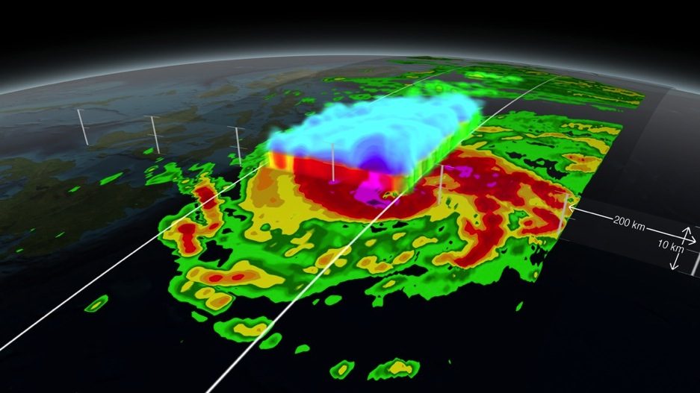
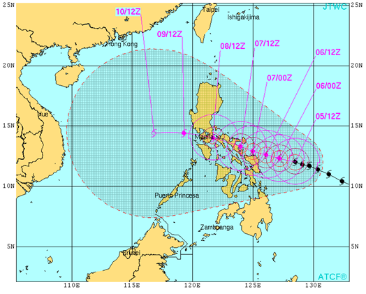
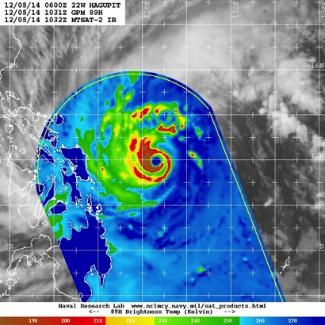
Applications: Eyewall Location Fixes for Cyclones
On December 5, 2014 the GPM Core Observatory flew over Typhoon Hagupit as it headed towards the Philippines. Visualization: http://svs.gsfc.nasa.gov/cgi-bin/details.cgi?aid=4248
Naval Research Lab is using GMI TB in their Automated Tropical Cyclone Forecasting System (ATCF) for improved track prediction (bottom right).
Total Views of GMI data on NRL page (June 2014-Feb 2015): 1,011,234 from 424K unique IP addresses
http://www.nrlmry.navy.mil/tc_pages/tc_home.html
Notes:
TB=Brightness Temperatures

Slide 11
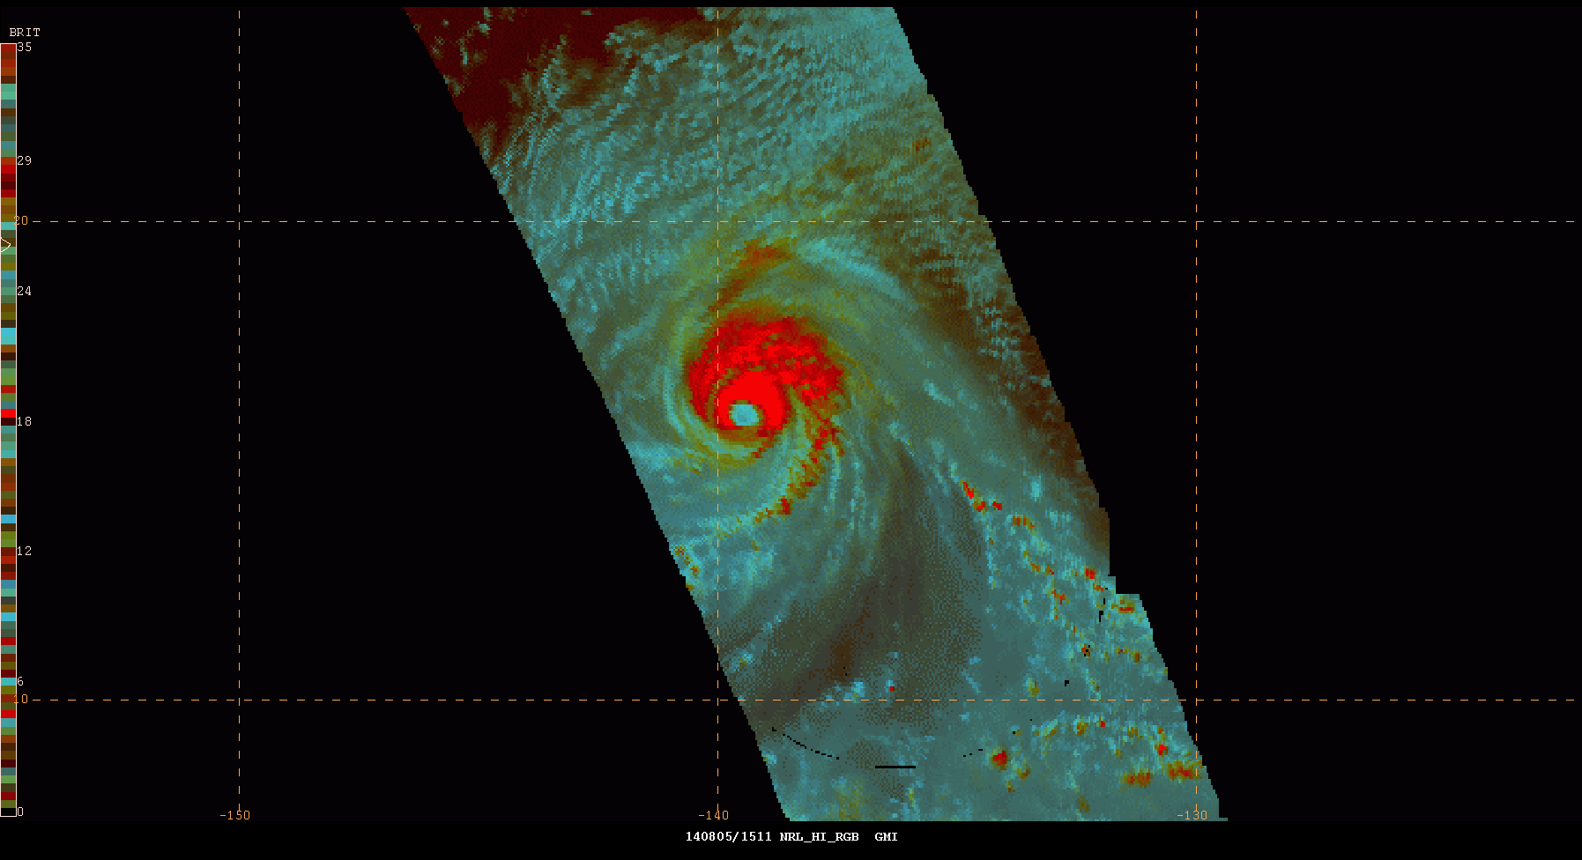
SPoRT Transitions NASA GPM Data to Forecasters
Cyan: Non-convective clouds
Red: Colder cloud tops associated with intense convection and precipitation
Used by forecasters to get a fix on the center of a tropical system
Hurricane Iselle as observed by the GPM Microwave Imager; screen capture from N-AWIPS Decision Support System used at NOAA NHC and WPC
Real-time processing and image by:
Frank LaFontaine (Raytheon)
Dr. Robert Atkinson (USRA)
Kevin McGrath (Jacobs)
SPoRT at NASA MSFC has transitioned real-time L1 GPM products to NOAA’s National Hurricane Center (NHC) and Weather Prediction Center (WPC)
Image shows combination of 3 channels (89 GHz) to from an RGB composite used by forecasters to locate the center and strongest convection of tropical systems
Notes:
The NASA Short-term Prediction Research and Transition (SPoRT) Center at Marshall Space Flight Center has been obtaining and processing L1 and L2 observations from the GPM Core and available Constellation satellites since last summer. We obtain the data from servers at Goddard, which serve the intercalibrated data products in near-real-time. SPoRT uses the L1 data to product multi-spectral composite imagery, which combines different channels to provide enhanced visualization of the imagery. In this example here, 3 channels are combined to form a composite that delineates the coldest cloud tops (in red) from other clouds (cyan). This imagery has been transitioned to the NOAA National Hurricane Center and Weather Prediction Center and is available for viewing by forecasters in their operational N-AWIPS decision support system (the image on this slide shows what the data looks like in N-AWIPS for Hurricane Iselle in August 2014). Forecasters have provided feedback on the product that this visualization and these data allow for easier pinpointing of the center of tropical systems and locating the areas of most intense convection.

Slide 12
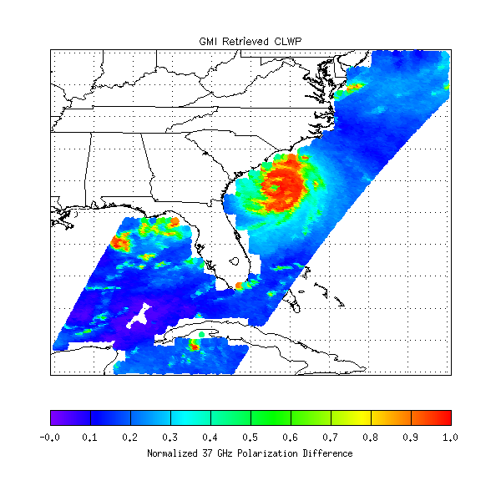
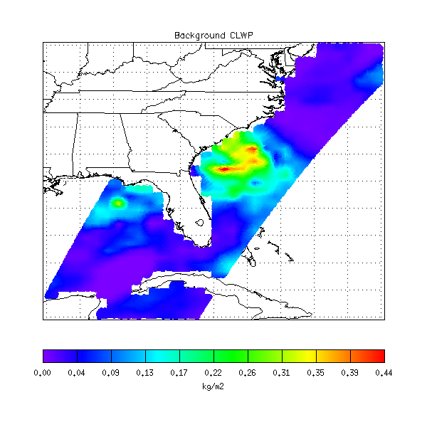
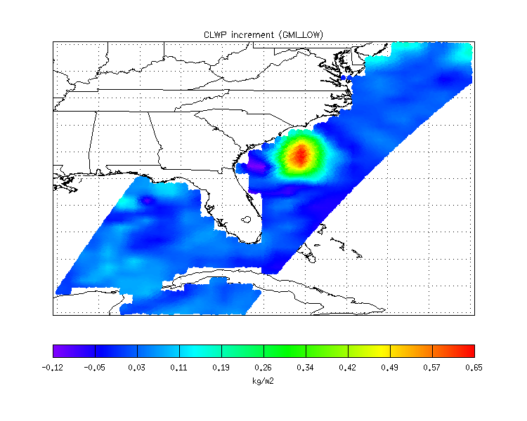
Improved Forecasting using GMI
GPM Microwave Imager Observations
Hurricane Arthur (3 July 2014)
GEOS-5 6hr Cloud Water Forecast
before assimilating GPM Microwave Imager data
GEOS-5 Cloud Analysis Increment
after assimilating GPM Microwave Imager data
The Global Modeling and Assimilation Office (GMAO/GSFC) is currently developing the all-sky radiance data assimilation system to using GMI radiance data in GEOS-5 to improve global cloud and precipitation analyses. This will contribute to improve near-real time weather forecasts including severe storms like hurricanes.
Figure Credit: Min-Jeong Kim, Jianjun Jin, Will McCarty, Ricardo Todling, and Ron Gelaro

Slide 13
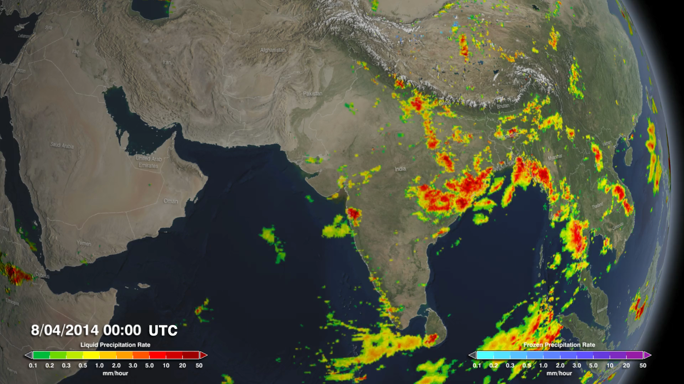

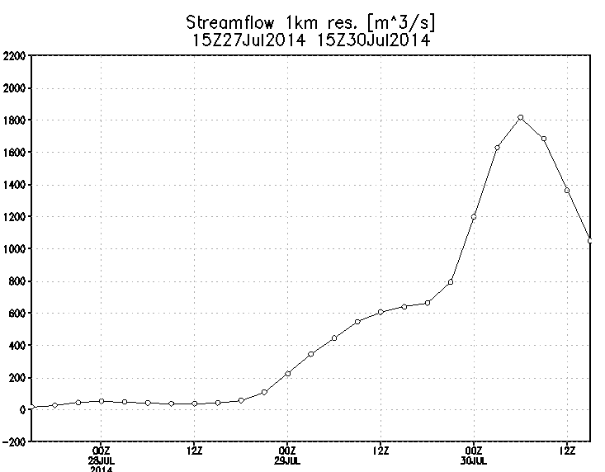
Flood and Landslide Modeling
A major landslide occurred in Malin caused 150 fatalities. GPM observed heavy monsoon rains were observed before, during and after the landslide
Peak in streamflow observed downstream from landslide following the event.
Adler/Wu U. of Maryland, flood.umd.edu

Slide 14
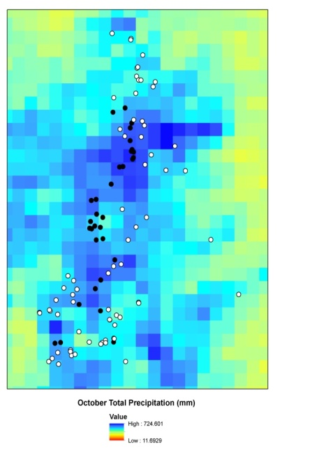
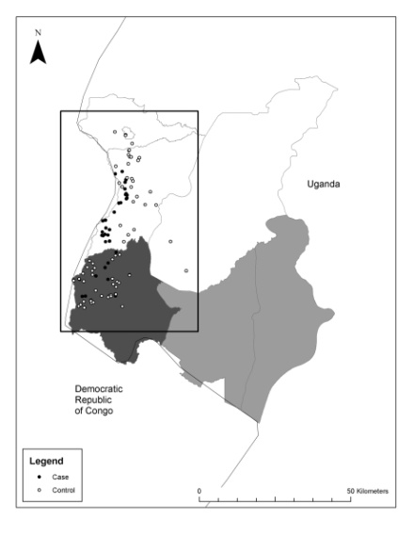
Disease Tracking
TRMM and GPM data have been used to estimate and trace the source areas of vector and river-borne diseases around the world.
Observed Plague Cases in Uganda
Cases are associated with wetter, cooler regions
Monaghan et al. 2012; MacMillan et al., 2012

Slide 15
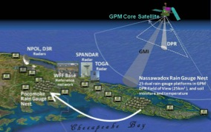
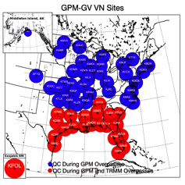





Ground Validation Activities
Direct Validation
A Global View of Precipitation with a Global Team
Wallops
Field campaigns for physical and hydrological validation
Notes:
Because the rain that falls in the US can be very different than the rain that falls in the rest of the world we need to verify precipitation globally. GPM has developed a global team for validation and science. NASA’s primary validation will be done in the US.

Slide 16
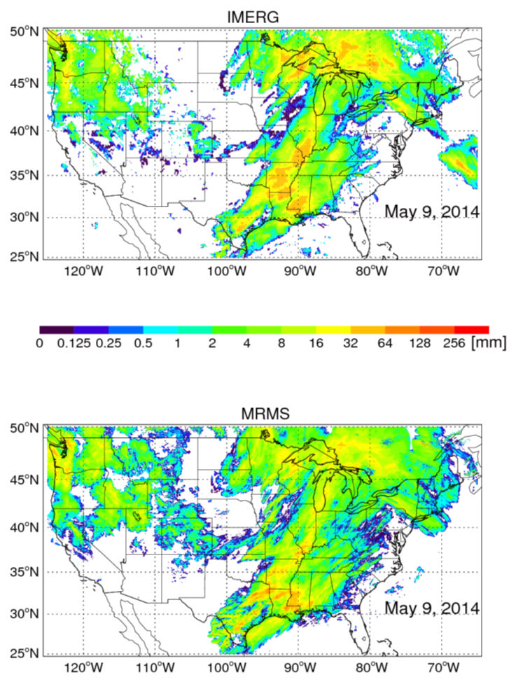
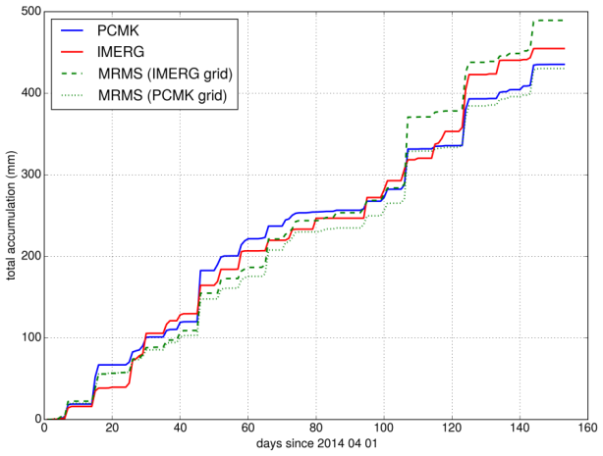
Ground Validation: IMERG Rain Accumulations
Continental-scale IMERG daily rain totals in reasonably good agreement with CONUS GV
Single grid-box comparisons over Wallops GV site in reasonable agreement
Daily accumulations 4/1 – 8/1 2014
IMERG, GV gauge, and MRMS daily accumulations

Slide 17

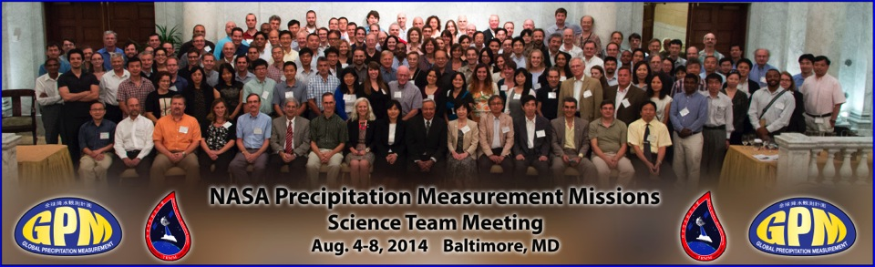
TRMM/GPM Science Team Meetings
The NASA GPM Science team has 56 NASA PI teams and 23 no-cost International PI teams
  Re-compete through ROSES in 2015
2014: Nearly 200 attendees (from 14 countries)
GPM Reference Article in BAMS May 2014: The Global Precipitation Measurement Mission by Arthur Y. Hou, et al.
Please send us reports of new science/applications with GPM data (1-2 page powerpoint summary slides)

Slide 18
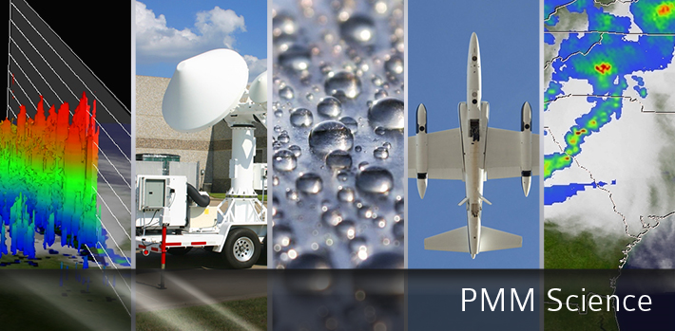
For more information on the TRMM and GPM Missions:
http://gpm.nasa.gov; http:/gpm.nasa.gov/education
www.nasa.gov/gpm; Movies at: http://svs.gsfc.nasa.gov/
Twitter: NASA_Rain (>12K followers) Facebook: NASA.Rain (>20K)
Notes:
Gail/Dalia

