Slide 1
Role of precipitation in creating environment for diarrheal disease pathogens
Antar Jutla
Assistant Professor,
Civil and Environmental Engineering,
West Virginia University, Morgantown.

Slide 2
How hydroclimate is related to Diarrhea?
Micro-Scale Environment
(processes within pathogens)
Macro-Scale Environment
(processes outside pathogens)
Diarrheal Diseases
Ambient Environment
(Population stress, Water security)
Our goal is to understand macro-environmental processes lead to disease outbreaks
Jutla et al., 2010 (JAWRA)
Notes:
diarrheal diseases can occur only under certain environmental conditions that
converge at appropriate scales
Our goal is to understand what macro-environmental processes lead to disease outbreaks

Slide 3
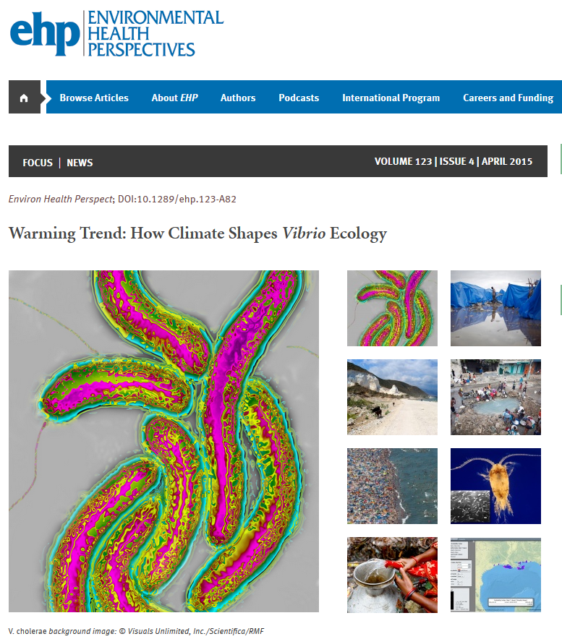
Cholera Paradigm
A perfect model for understanding diarrheal diseases

Slide 4
Cholera Model
Jutla et al., 2015 (AJTMH-Accepted)

Slide 5
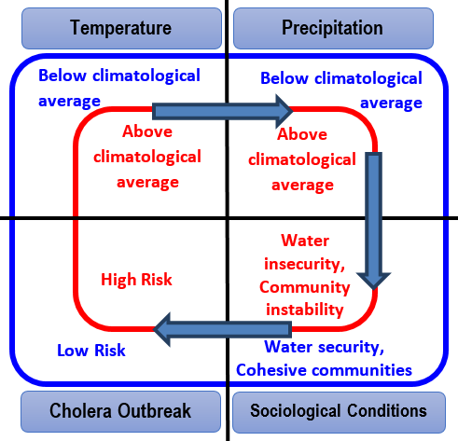
Predictive Epidemic Cholera Model

Slide 6
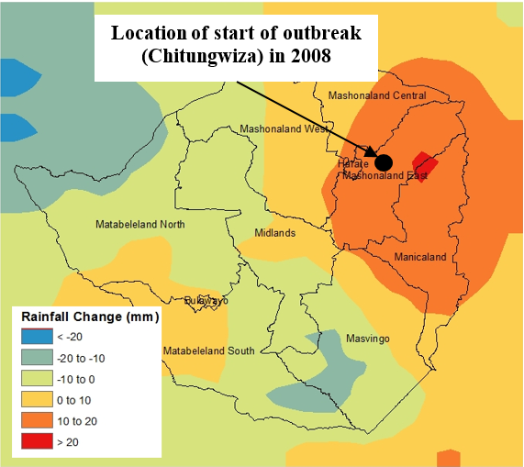
Predictive Epidemic Cholera Model

Slide 7
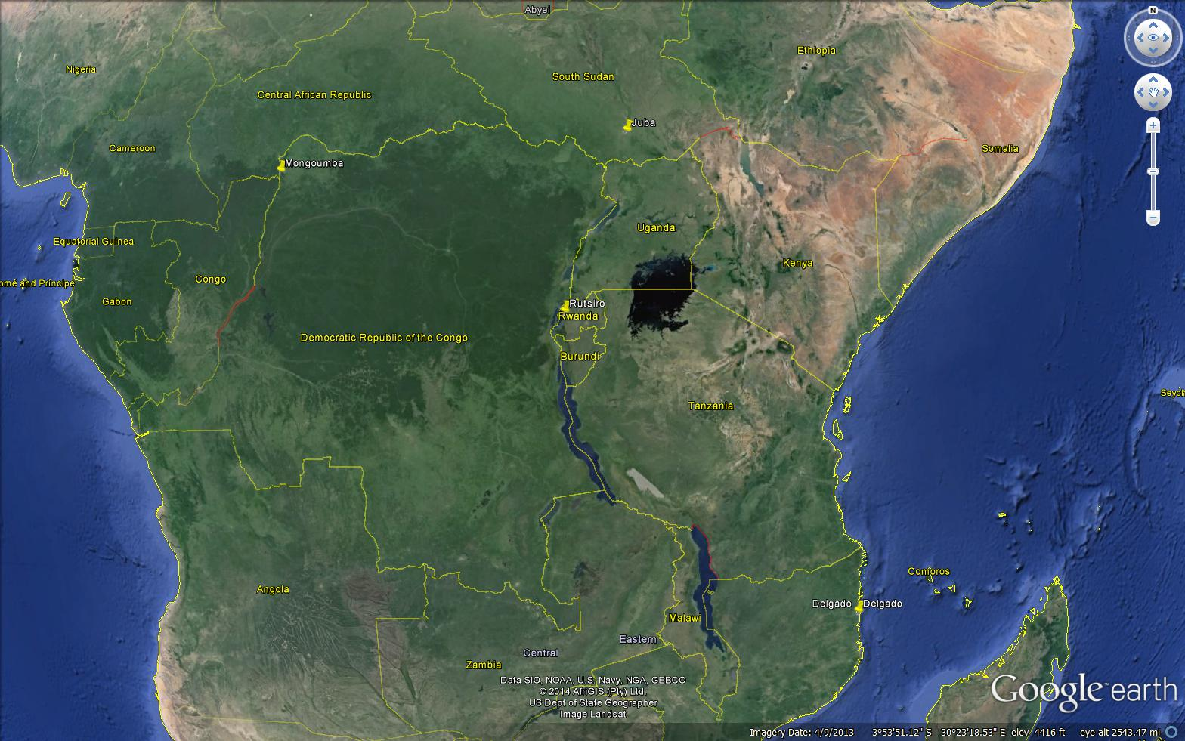
Predictive Epidemic Cholera Model
Notes:
Challenge is the continuous data availability and \unpredictability of disease outbreak in a region

Slide 8
Predictive Epidemic Cholera Model
Notes:
Challenge is the continuous data availability and \unpredictability of disease outbreak in a region

Slide 9
Predictive Epidemic Cholera Model
Notes:
Challenge is the continuous data availability and \unpredictability of disease outbreak in a region

Slide 10
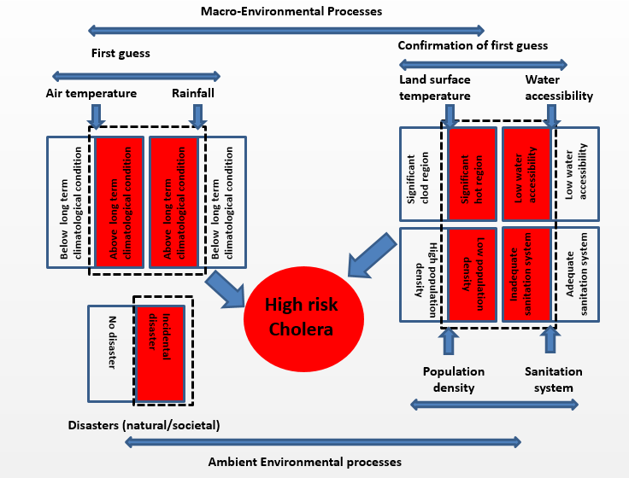

Slide 11
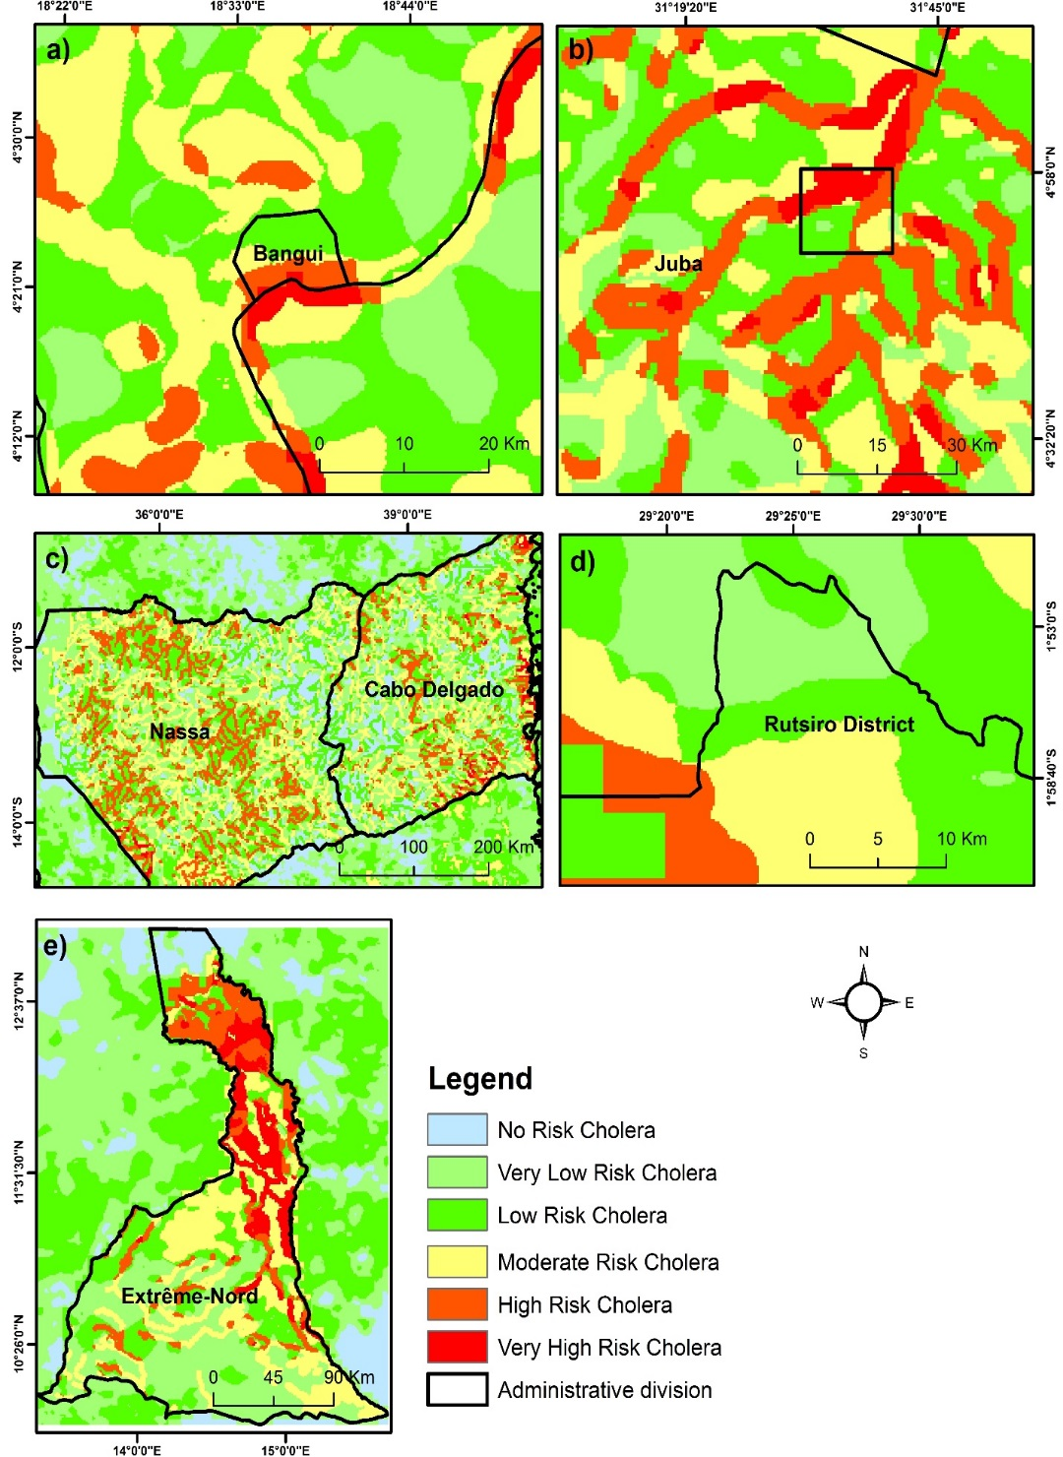
Predictive Epidemic Cholera Trigger Model

Slide 12
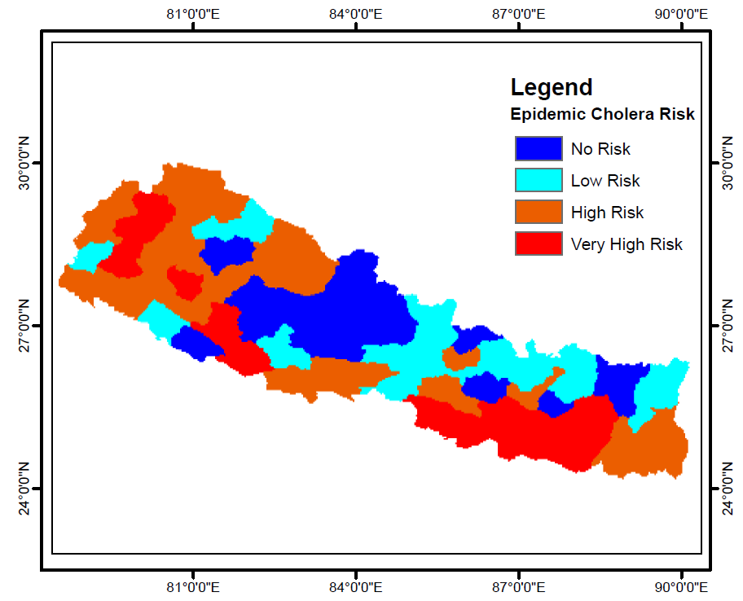
Risks of cholera (diarrhea) in Nepal 2015?

Slide 13
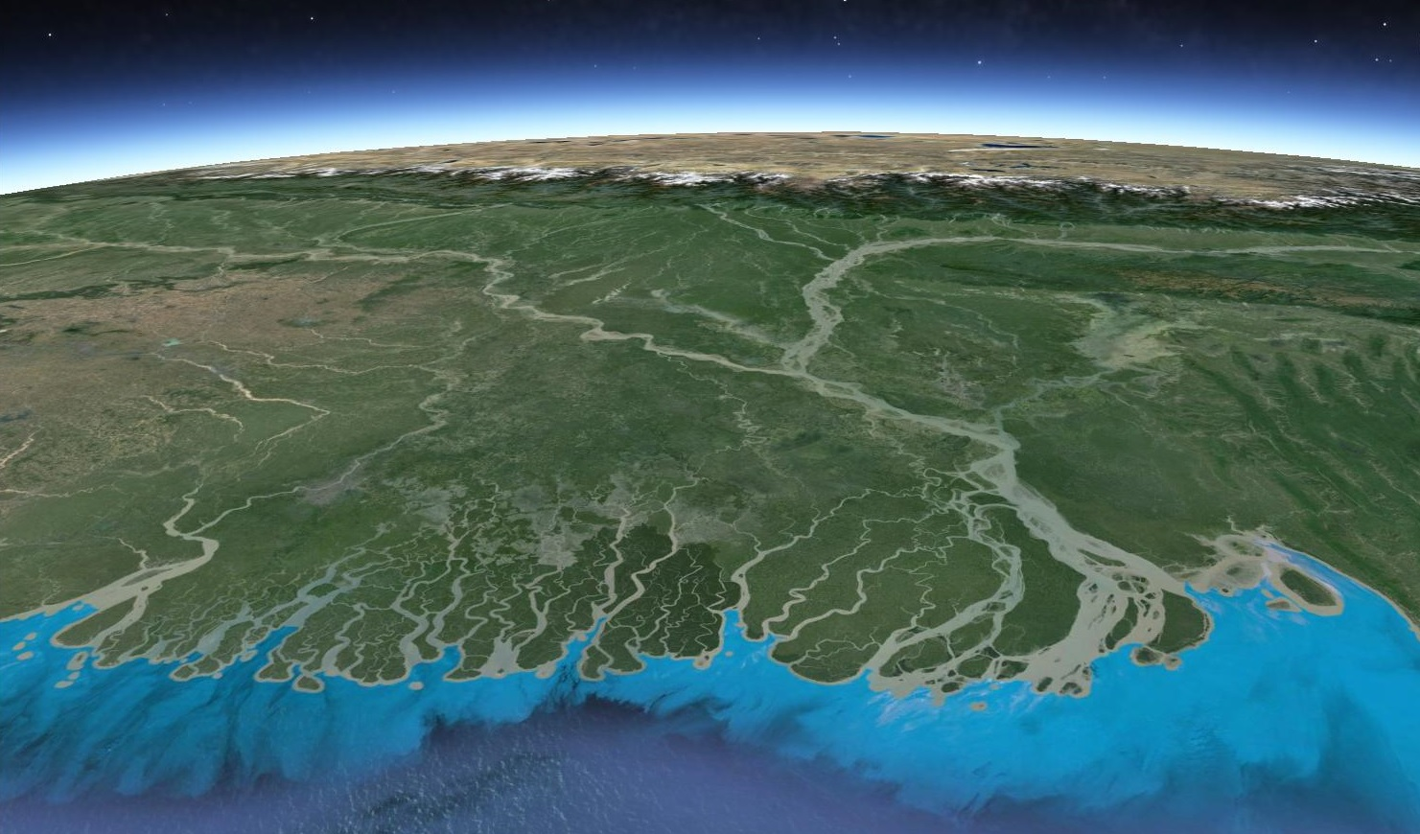
Predictive Endemic Cholera Model
Total Water Available in Basin
(Surface and Ground water)
GRACE satellite sensors
Water scarcity driven cholera
Water abundance driven cholera
5-6 month lead time
Ganges
Brahmaputra
Dhaka
Cholera outbreaks
2-3 month lead time
2-3 month lead time
Regional River Discharge
Seasonal bacteria intrusion due to low river discharge

Slide 14
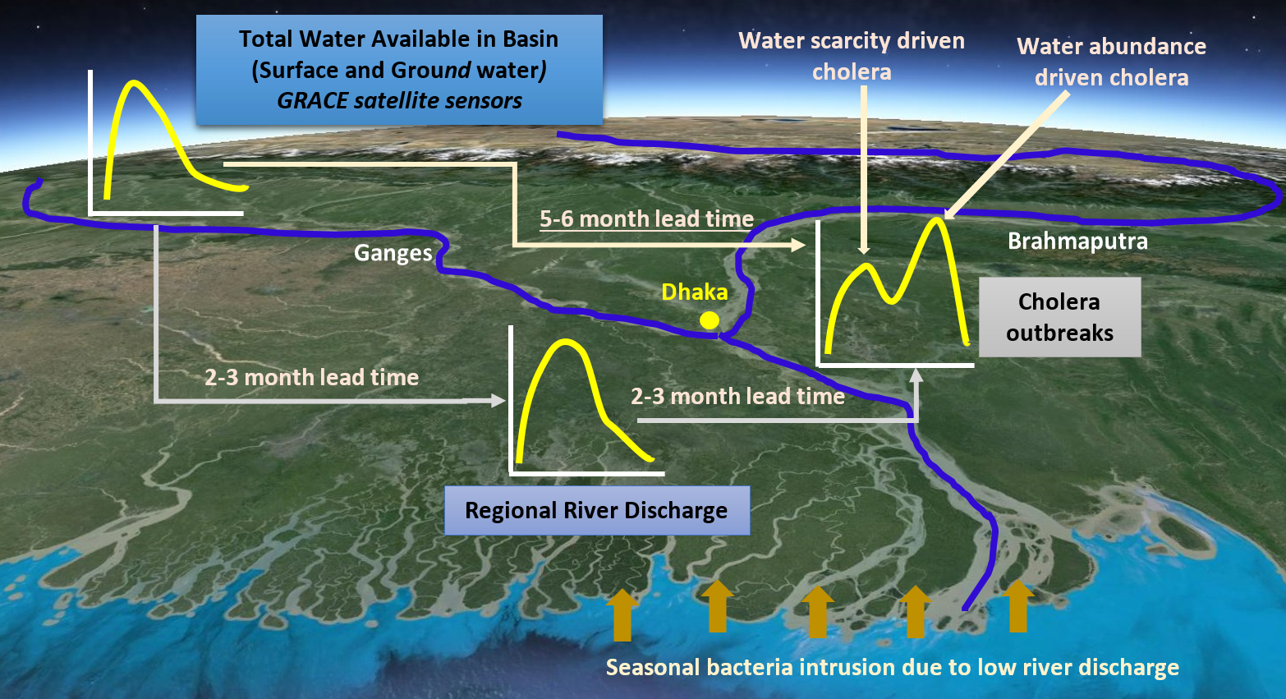
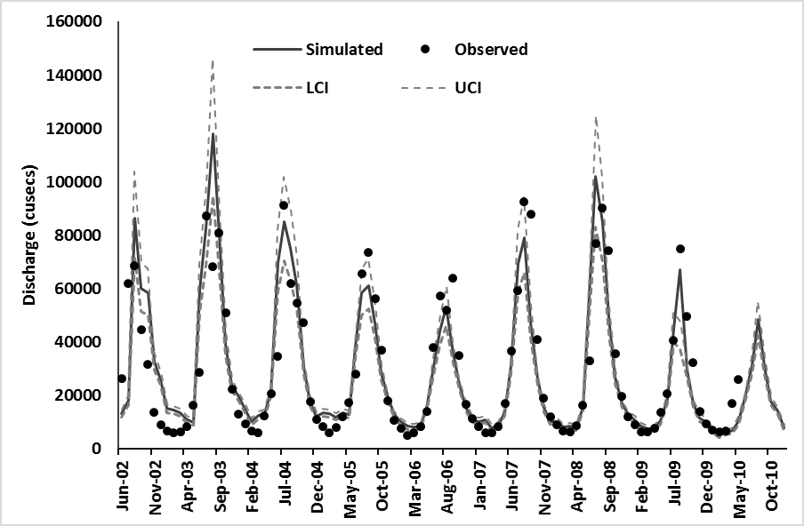
Predictive Endemic Cholera Model

Slide 15
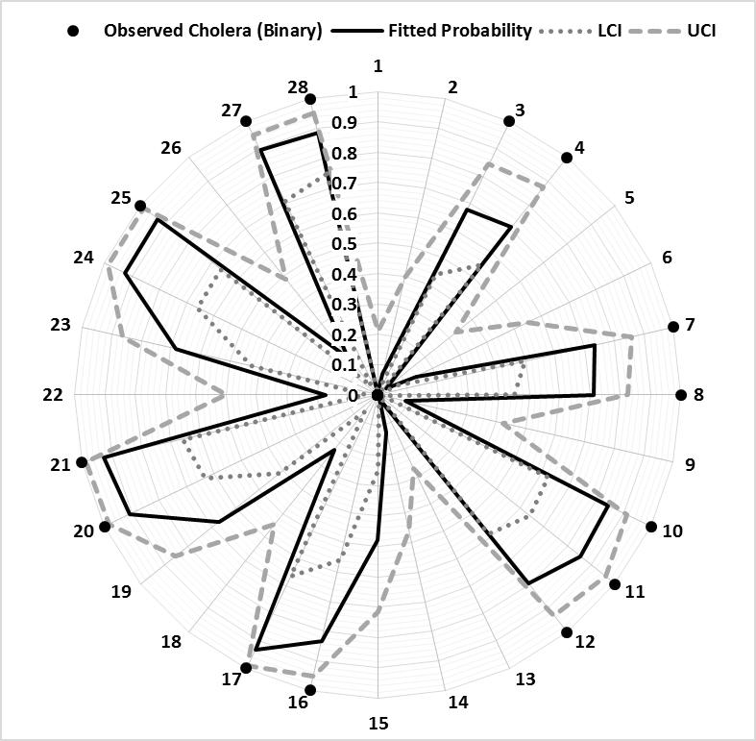
Predictive Endemic Cholera Model

Slide 16
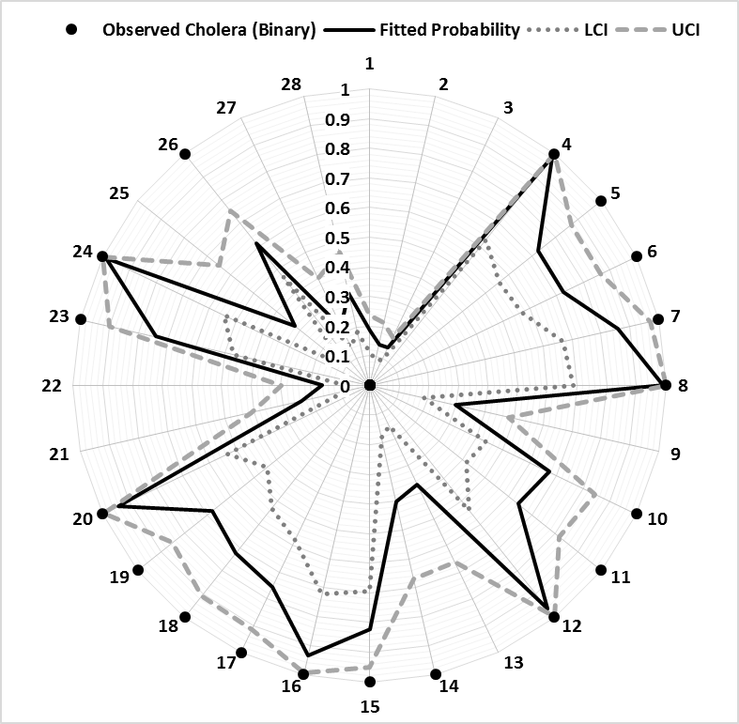
Predictive Endemic Cholera Model

Slide 17
Future Work
Field validation trials for microbiological water quality at multiple locations
Uncertainty in predictions, creating global database on disease
Other diarrheal pathogens (Norovirus, Shigella, Vibrio parahaemolyticus, Vibrio vulnificus)
Understand and synthesize scale issues for linking land surface models with disease transmission algorithms

Slide 18
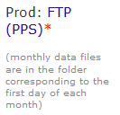
Where we need help?
Student webinars on available products-perhaps listserve type announcements.
Reduce latency time of IMERG data (or, availability of algorithms?)
Comparison of TRMM (3B43)and IMERG data, or atleast provide both dataset on same grid (or algorithms)
Uncertainty in IMERG data (especially on daily scales)
Restructuring data access for FTP
E.g., for obtaining IMERG on monthly scales, the file is located in day 1 folder of each month?

Slide 19
Collaborators
Rita Colwell, University of Maryland
Shafqat Akanda, University of Rhode Island
Helen Nyugen, University of Illinois-Urbana
Brad Sack, Johns Hopkins University
Juliet Iwelunmor, University of Illinois-Urbana
Munir Alam, ICDDRB
Mauro Colombo, UEM, Mozambique
Environment and Public Health Organization (ENPHO), Nepal
Saiful Islam, BUET, Bangladesh
This research is supported, in part, from a grant by NASA-Health and Air Quality Applications (NNX15AF71G)

Slide 20
Thank you

Slide 21
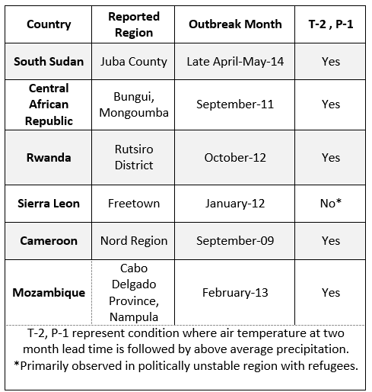

Slide 22
Publications
Jutla, A.S., Huq, A. and Colwell, R. 2015. Diagnostic approach for monitoring hydroclimatic conditions related to emergence of West Nile Virus in West Virginia. Frontiers Journal of Public Health. doi: 10.3389/fpubh.2015.00010.
Nasr-Azadani, F., Unnikrishnan, A., Akanda, A., Islam, S., Alam, M., Huq, A., Jutla, A., and Colwell, R. 2015. A framework for downscaling river discharge to assess the effects of climate change on endemic cholera. Climate Research. doi: 10.3354/cr01310
Akanda, A.S., Jutla, A.S. and Colwell, R. 2014. Global diarrhoea action plan needs integrated climate-based surveillance, The Lancet-Global Health, 2(2):69-70.
Luo, T., Jutla, A.S., and Islam, S. 2015. Evapotranspiration Estimation over Agricultural Plains using MODIS Data for All Sky Conditions, International Journal of Remote Sensing, doi: 10.1080/01431161.2015.1009648
Jutla, A.S., Whitcombe, E, Hasan, H., Haley, B., Akanda, A., Huq, A., Alam, M., Sack, B., Colwell, R. 2013. In Response: Environmental Factors Influencing Epidemic Cholera. American Journal of Tropical Medicine and Hygiene 89(6): 1231–1232.
Jutla, A.S., Whitcombe, E, Hasan, H., Haley, B., Akanda, A., Huq, A., Alam, M., Sack, B., Colwell, R. 2013. Environmental factors influencing epidemic cholera. American Journal of Tropical Medicine and Hygiene, 89(3):597-607.
Jutla, A.S., Akanda, A.S. and Islam, S. 2013 A framework for predicting endemic cholera using satellite derived environmental determinants. Environmental Modelling and Software, 47:148-158.
Jutla, A.S., Akanda, A.S., Huq, A., Faruque, A., Colwell, R. and Islam, S. 2013 A water marker monitored by satellites to predict endemic cholera, Remote Sensing Letters, 4(8):822-831.
Akanda, A.S., Jutla, A.S., Gute, D., Sack, R., Alam, M., Huq, A., Colwell, R., and Islam, S. 2013. Population vulnerability to biannual cholera outbreaks and associated macro-Scale drivers in Bengal Delta, American Journal of Tropical Medicine and Hygiene, 89(5):950-959..
Jutla, A.S., Akanda, A.S. and Islam, S. 2011. Satellite space-time variability of chlorophyll in Bay of Bengal: Connections to cholera outbreaks. Remote Sensing of Environment. 123:196-206
Akanda, A.S., Jutla, A.S., Gute, D.M., Evans, T. and Islam, S. 2011. Reinforcing cholera intervention through prediction aided prevention. Bulletin of the World Health Organization, 90(3):243-244.
Jutla, A.S., Akanda, A.S, Griffiths, J. Islam, S. and Colwell, R. 2011. Warming oceans, phytoplankton, and river discharge:Implications for cholera outbreaks. American Journal of Tropical Medicine and Hygiene. Doi:10.4269/ajtmh.2011.11-0181
Akanda, A.S., Jutla, A.S., Siddique, A.K., Alam, M., Sack, R., Huq, A., Colwell, R. and Islam, S. 2011. Hydroclimatic influences on seasonal and spatial cholera transmission cycles: Implications for public health intervention in the Bengal Delta, Water Resources Research, 47, W00H07, doi:10.1029/2010WR009914
Jutla, A.S., Akanda, A.S. and Islam, S. 2010. Tracking cholera in coastal regions using satellite observations. Journal of American Water Resources Association. 46(4):651-662. Doi: 10.1111/j.1752-1688.2010.00448.x.
Akanda, A. S., Jutla, A.S. and Islam, S. 2009. Dual peak cholera transmission in Bengal Delta: A hydroclimatological explanation, Geophysical Research Letters, 36, L19401, doi:10.1029/2009GL039312.

Slide 23
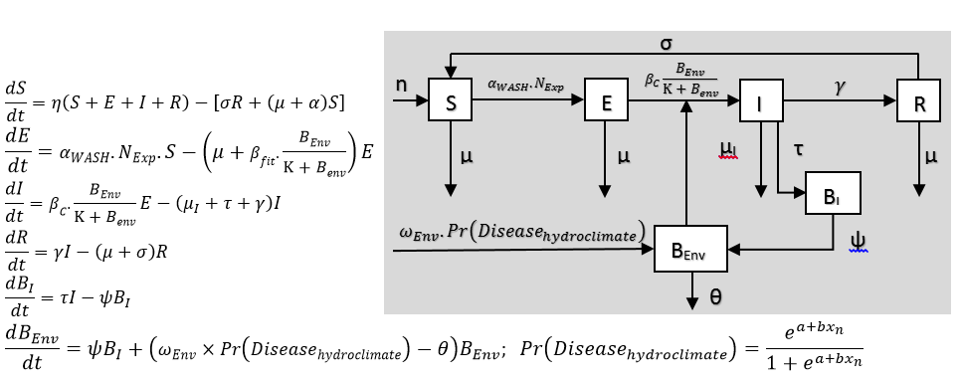
Predictive Epidemic Cholera Transmission Model

Slide 24
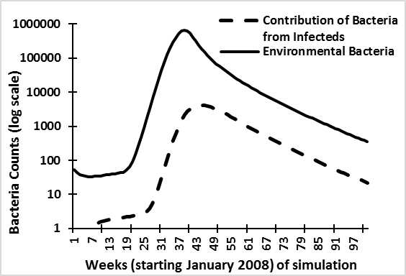
Predictive Epidemic Cholera Transmission Model
Four week difference

Slide 25
Epidemic cholera
New and unexpected regions, particularly in Asia and Africa, are likely to experience this form of diarrheal diseases

Slide 26
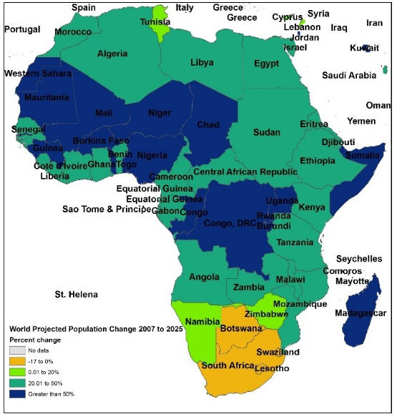
Epidemic Cholera under Changing Climate

Slide 27
