Slide 1
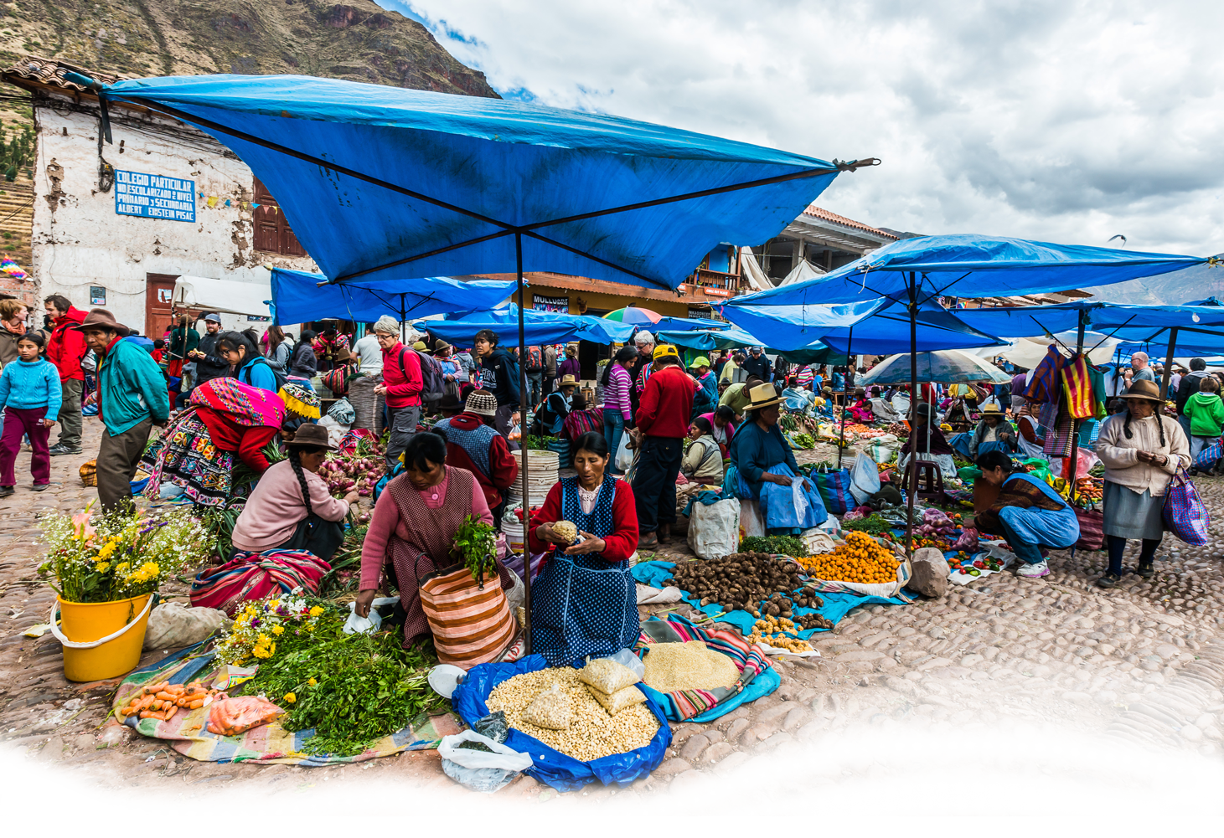
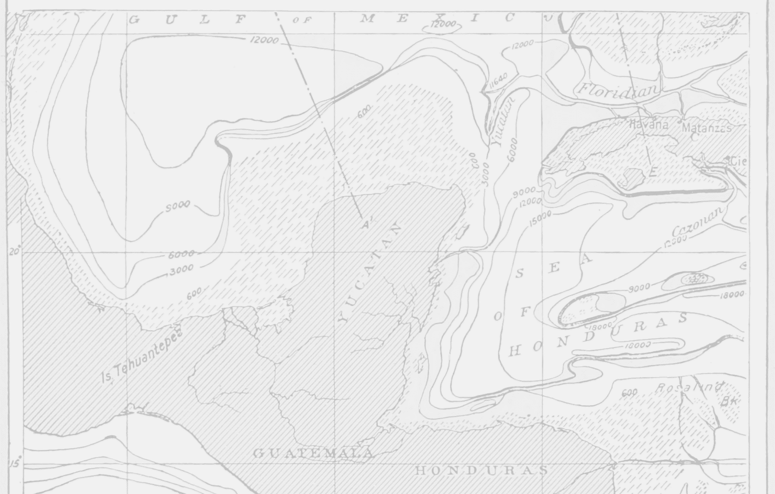
Presentation to the
2nd GPM Conference

Slide 2
Overview of MiCRO
Barbados domiciled specialty reinsurer founded in 2011 after Haiti earthquake
Focus on natural catastrophes and low income segments of population
Insured individuals in Haiti from 2011-2013 with mixed success; meso-insurance products from 2013-2015
Expanding into Central America (particularly Guatemala) with the goal to reach individuals
Acting in a project development and deal-making capacity earning fees; carrying risk will be born by Swiss Re for the time being

Slide 3
A World-Class Public Private Partnership
Management & Investors
Partners & Donors
Technical
Assistance
Others
Notes:
PARTNERSHIPS ARE KEY TO SUCCESS
MERCY CORPS (SOCIAL MISSION)
% Owned
Common A Shareholders Mercy Corps $110,000 59%
Fonkoze $75,000 41%
Total Common A
$185,000
Total Common B
0%
SWISS RE (TECHNICAL)
No ownership
Current challenge
Requires huge donor funding
Virtual team, limited resources to carry out any activities for MiCRO beyond specific project(s)
No income for operational costs
(ADD BARBADOS REGULATOR/MARSH/LEGAL COUNSEL)

Slide 4
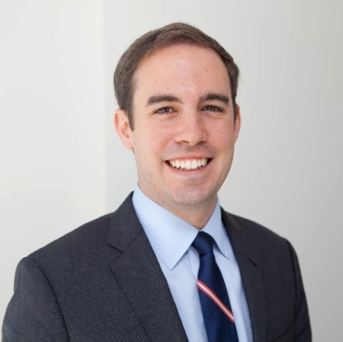
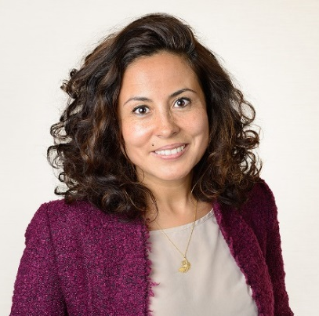
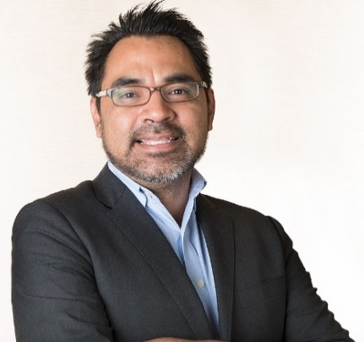
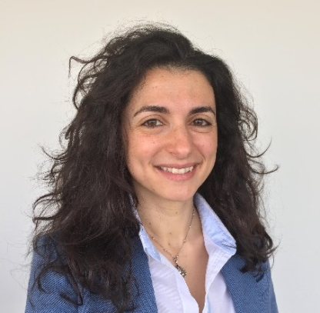
MiCRO’s Management Team
Chief Executive Officer
Carlos Boelsterli
Strategic Advisor
James Kurz
Legal & Regulatory Affairs
Andrea Camargo
Central America Operations
Josh Ling
The MiCRO team is comprised of experts in a range of disciplines. Additional experts and partners are engaged as needed.
Business Development
Leticia Gonçalves
Catastrophe Modeler
Edgar Uribe, PhD
Grants & Compliance
Nancy Sawaya

Slide 5
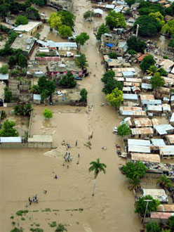
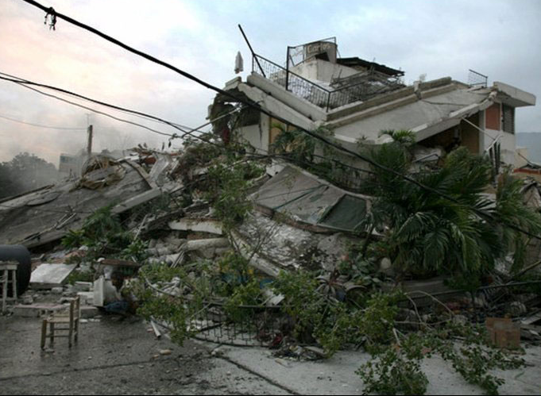
The Development Rationale
People build businesses, acquire assets, and improve their lives only to have their progress destroyed by disaster or weather. Lasting changes in poverty requires access to a safety net.

Slide 6
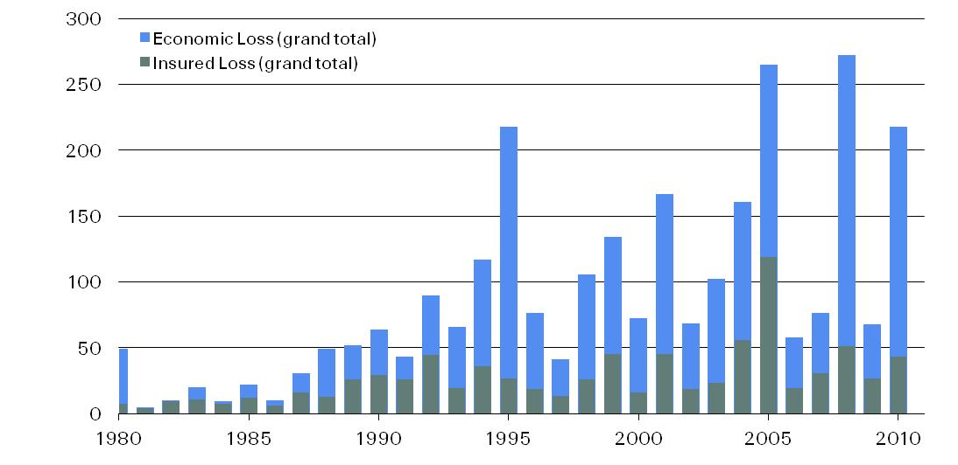
Massive Gap Between Economic and Insured Catastrophe Losses Worldwide
Natural catastrophe losses 1980-2010, in USD billion
Note: Loss amounts indexed to 2010 Source: Swiss Re sigma catastrophe database

Slide 7
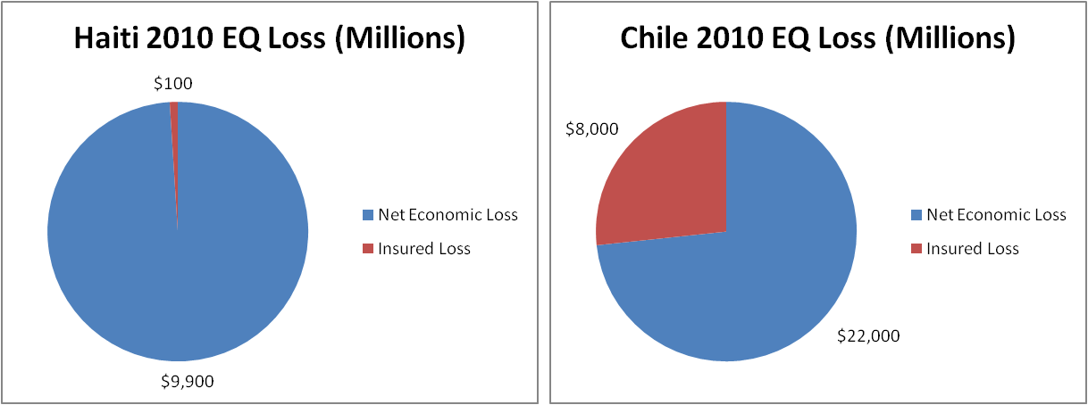
Example: Haiti vs. Chile
In Haiti, only 1% of all economic losses were insured, while in Chile nearly 37% were insured. Increased (re)insurance penetration contributed to the relative speed and robustness of Chile’s economic recovery versus Haiti’s.
Notes:
Haiti:
Total economic loss: $10B (2011, Swiss Re Sigma)
Of which insured: $100M (2011, Swiss Re Sigma)
Of which reinsured: % Unknown
2010 GDP: US$6.59B (2010, CIA Factbook)
Insured to Economic: 1%
Economic to GDP: 152%
Chile:
Total economic loss: $30B (2011, Swiss Re Sigma)
Of which insured: $8B (2011, Swiss Re Sigma)
Of which reinsured: ~99% (2011, Guy Carpenter internal research)
2010 GDP: US$199B (2010, CIA Factbook)
Insured to Economic: 27%
Economic to GDP: 15%

Slide 8
MiCRO’s Business Model
Primary Insurer
Aggregator (MFI, Coop, etc)

Slide 9
MiCRO’s Goals in Central America
Achieve sustainable scale (at least 80.000 active policyholders by 2017, 250.000 by 2019)
Focus on Guatemala, El Salvador, Honduras and Nicaragua
But there are constraints
Low income
Insurance ranks low in priority list of individuals
Distribution in remote areas
Language (especially in Guatemala)
Regulatory framework
Weather station networks of moderate quality and access to data

Slide 10
Building a “Minimum Viable Product” which Leads to a Real Breakthrough

Slide 11
Creating Products that Renew & Achieve Scale
MiCRO strives to move catastrophe microinsurance products from the left (unappealing) to the right (appealing)
Product
Unappealing
Inaccurate index products/low relevance payouts
Constraints:
Increasing…
Cost
Complexity
Infeasibility
Appealing
Full featured, accurate indemnity products (at a low price)
Application of latest modelling techniques
Research & development
Collaborative process with partners
Use of IT
Collaborative approach to Regulator
Client education
Value-added programming “brokerage”

Slide 12
Starting with the most important risks and expanding
Risk | When? | Commentary
Drought | MVP | Starting with satellite vegetation indexes Also would like to use local meteorlogical data but do not have permission yet
Torrential rainfall | MVP | Under review ☺
Earthquake (and possibly volcanic eruption) | MVP | ShakeMap provided by the USGS
Flooding | Future | Very complicated to model; should follow after excess rain coverage is designed
Extreme temperatures | Future | Temperatures are very local and an extremely dense weather station network will be required
Note: Due to the low weather station coverage and large climate variability in Guatemala (and most countries), we focus on remote sensing data or novel ways to combine both sets of data.

Slide 13
A Broader Interpretation of Insurable Interest
Natural disasters cause large amounts of direct and indirect damage, including business interruption
Most of our target clients opérate some kind of business that is likely to experience interruption under catastrophic circumstances
The loans, made for productive activities, will consistute the sum exposed to the disaster for the purposes of the insurance product
The trigger structure of the index will be highly localized
When a trigger is reached, it will be imputed that disaster has generated business interruption in the local región affected and therefore an insurance payout is due
Notes:
Como ejemplo de IC: interrupción de cadena de valor, de capacidad de pago de obligaciones, etc.

Slide 14
Lesson: The Importance of Value-Added Program
Insurance is not a known top priority of most smallholders and microentrepeneurs
Disaster risk reduction efforts by MiCRO can be directly beneficial to the client (as well as to MiCRO)
MiCRO’s partnerships with international donors and NGOs can direct resources to places where it is needed most
Additional services can be well aligned with public policies, incentivizing regulator interest in MiCRO’s products
Improves the selling proposition for MiCRO and it’s local partners

Slide 15
Lesson: The Critical Aspect of an Innovative, Enabling Environment
Evidence seems to suggest that traditional understandings of insurance limit the feasibility of viable microinsurance products for this market:
Index insurance – Lack of clarity about the feasibility under the current regulatory frameworks
Insurable interest – Acceptance of indirect damages as insurable interest
Proof of loss – Verification of losses is too expensive; correlations must be regarded as acceptable

Slide 16
Thank you! Questions?
James Kurz
MiCRO Strategic Advisor jkurz@microrisk.org

Slide 17
Product ideas that we’re studying now
Risk Coverage
Rain excess
Risk Coverage
Volcano
Risk Coverage
Drought
Risk Coverage
Earthquake
Risk Coverage
Hurricane
“Emergency Cash”
Savings-linked
Interest on account = potential premiums

