Slide 1
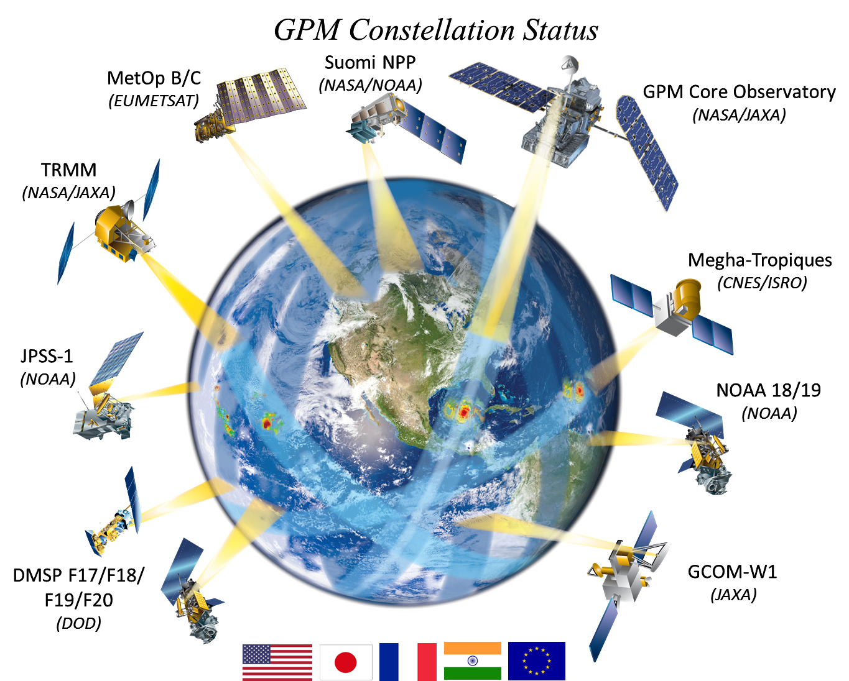
Achievements in Retrieving Precipitation with GPM
David Randel
Chris Kummerow
Sarah Ringerud
Colorado State University
June 9^{th,}, 10th ,2015
College Park, Md

Slide 2
GPM Algorithm Process
Ku, Ka – radars
Dual Frequency Ku/Ka radar
Combined Ku / GMI
Combined Ku / Ka / GMI
GMI & other Constellation
Radiometers
IMERG product set

Slide 3
GPM a-priori Database Creation
Combined Ku / GMI
Combined Ku / Ka / GMI
GMI Radiometer
13 Frequency Tbs Set
GMI/DPR
Empirical
GPROF Precipitation Retrieval

Slide 4
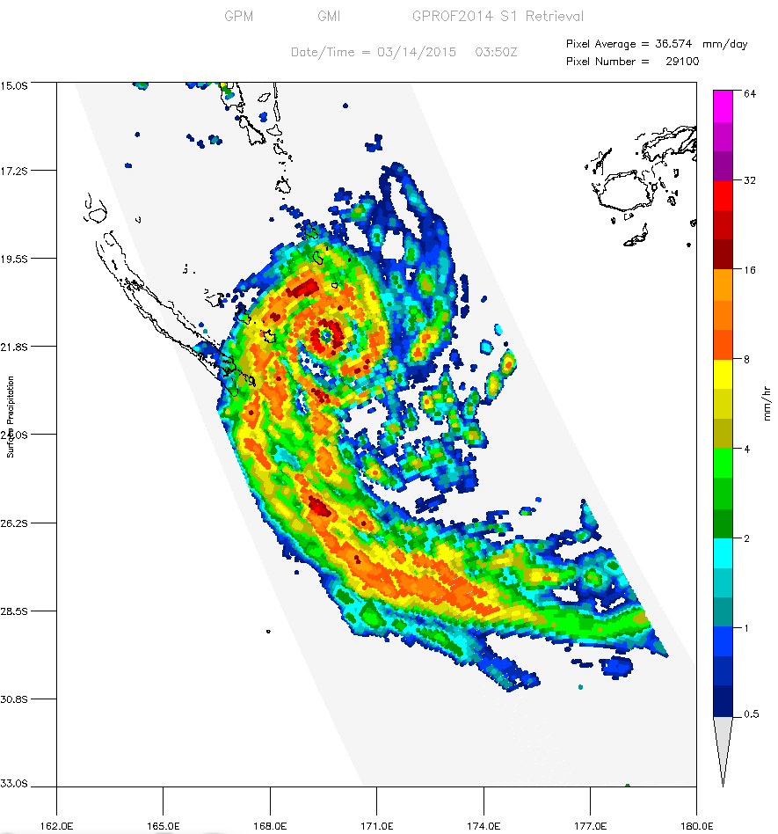
Hurricane Pam after striking Vanuatu
GMI Surface Precipitation March 14, 2015 03:50Z
GPROF2014 V2 from the first GMI/DPR database
Vanuatu

Slide 5
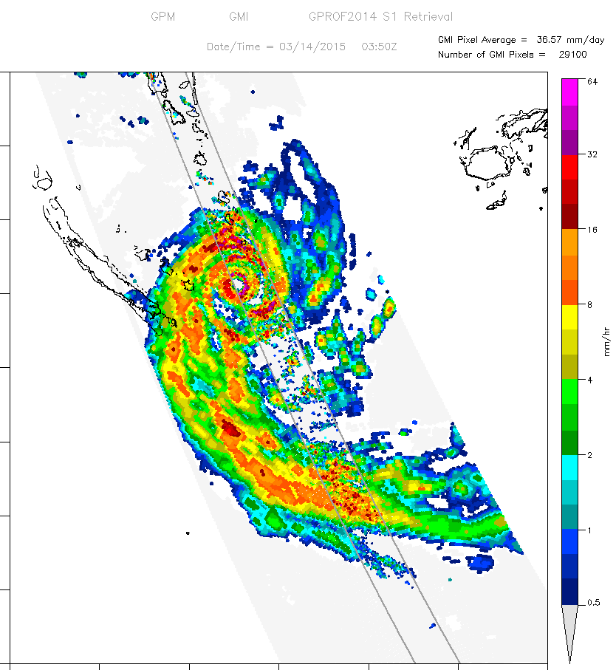
Hurricane Pam after striking Vanuatu
GMI Surface Precipitation March 14, 2015 03:50Z
GPROF2014 V2 from the first GMI/DPR database
Vanuatu

Slide 6
GPM a-priori Database Creation
Combined Ku / GMI
Combined Ku / Ka / GMI
GMI Radiometer
13 Frequency Tbs Set
GMI/DPR
Empirical
GPROF Precipitation Retrieval

Slide 7
GPM a-priori Database Creation
Combined Ku / GMI
Combined Ku / Ka / GMI
GMI Radiometer
13 Frequency Tbs Set
GMI/DPR
Empirical
TOA Forward Model Radiative
Transfer
GMI Database
SSMIS Database
GPROF Precipitation Retrieval
AMSR2 Database
MHS Database
ATMS/ Database

Slide 8
GPROF2014 – A Bayesian Algorithm
Database profiles with
same Tsfc and TPW
Tb database profile #1
GMI : ~ 500,000 /orbit
Tb observed
Tb database profile #2
~10 km
Tb database profile #3

Slide 9
GPROF a-priori Databases TRMM, GPM
TRMM 1999
PR / TMI Hydrometeor / Radiances (9 channels)
65,000,000 Over ocean only
GPM 2014 - 2015
DPR / GMI Hydrometeor / Radiance (13 channels)
240,000,000 All Surface types

Slide 10
GPM Retrieval Challenges
Produce consistent precipitation retrievals between sensors
Use the new channel frequencies to retrieval all precipitation types, over all surface types
Continue to solve the remaining Fundamental Problems

Slide 11
The GPM Constellation Sensors

Slide 12
Ocean Retrieval Comparison

Slide 13
Land Retrieval Comparison

Slide 14
GPM Retrieval Challenges
Produce consistent precipitation retrievals between sensors
Use the new channel frequencies to retrieval all precipitation types, over all surface types
Continue to solve the remaining Fundamental Problems

Slide 15
GPROF2010 – TRMM V7

Slide 16
GPROF2014 – A Bayesian Algorithm
GMI, SSMIS, AMSR2
SAPHIR, ATMS, MHS
SSM/S, TMI

Slide 17
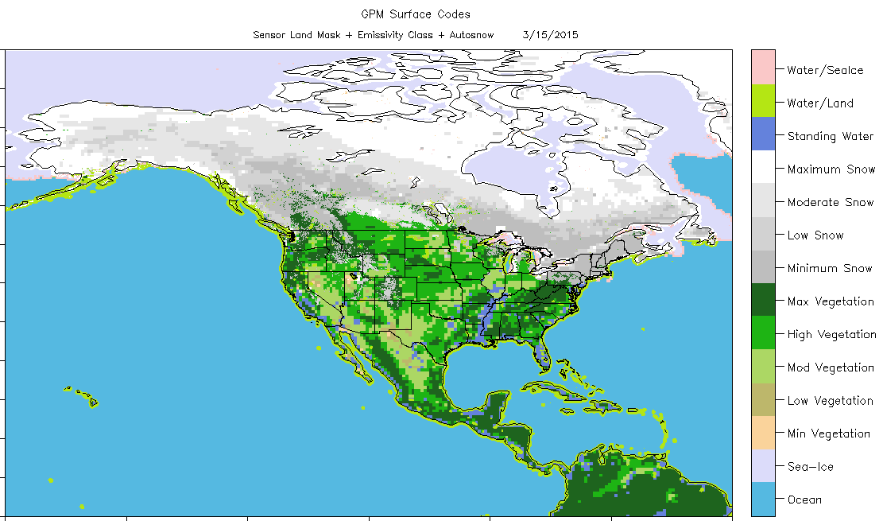
GPROF 2014 Surface Classification

Slide 18
GPROF 2014 Sensor Retrieval Differences

Slide 19
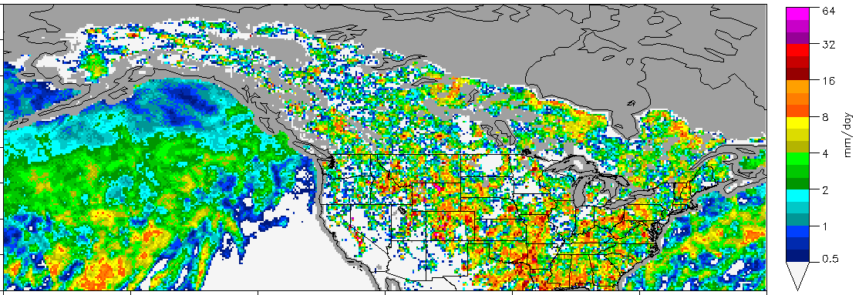
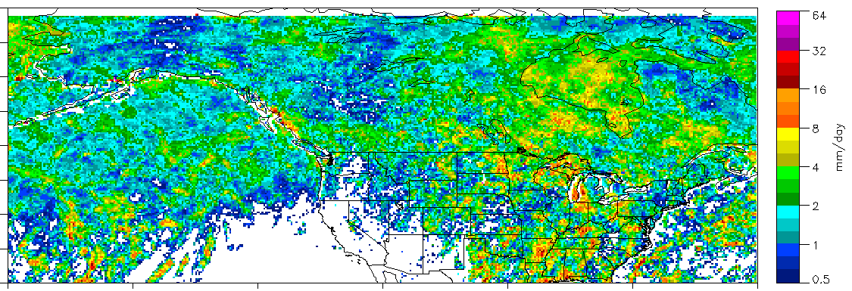
GPROF Retrieval Comparison - May, 2014
GPROF 2010 F17 (TRMM based)
GPROF 2014 V2 (GPM based) Database

Slide 20
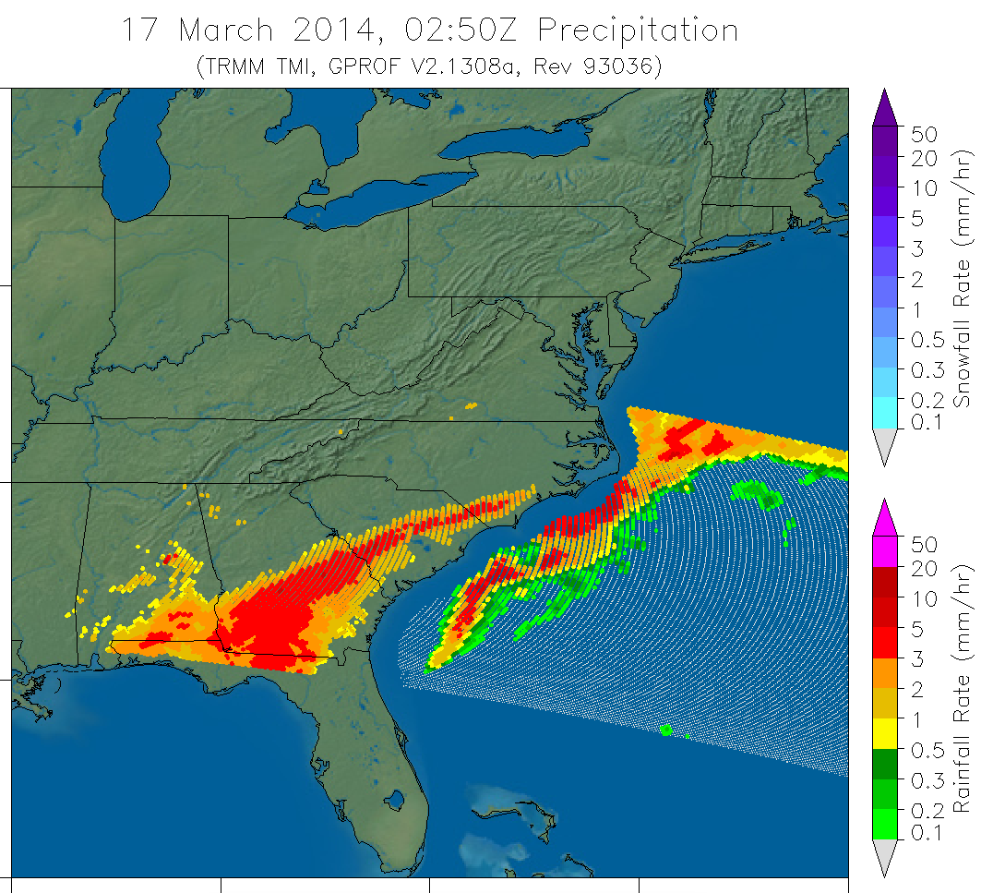
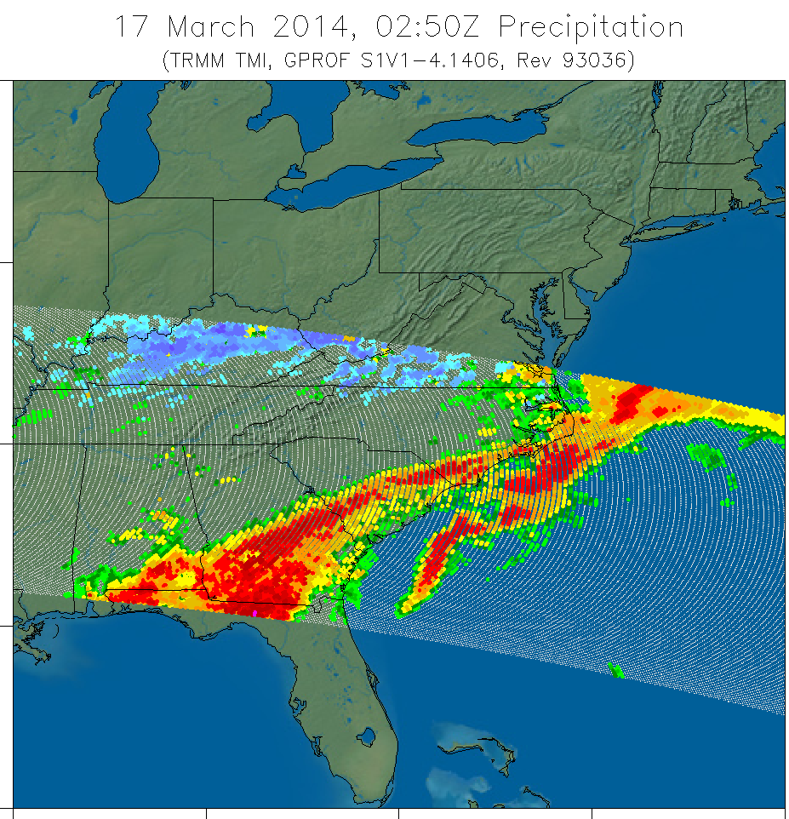
GPROF2010 vs GPROF2014

Slide 21
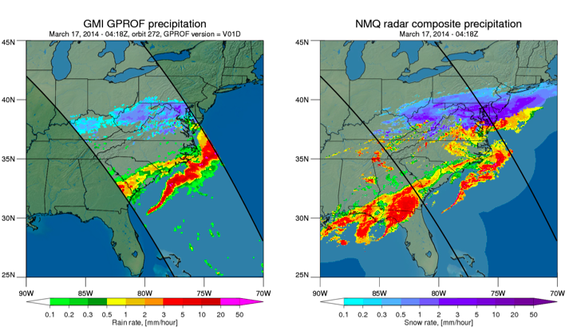
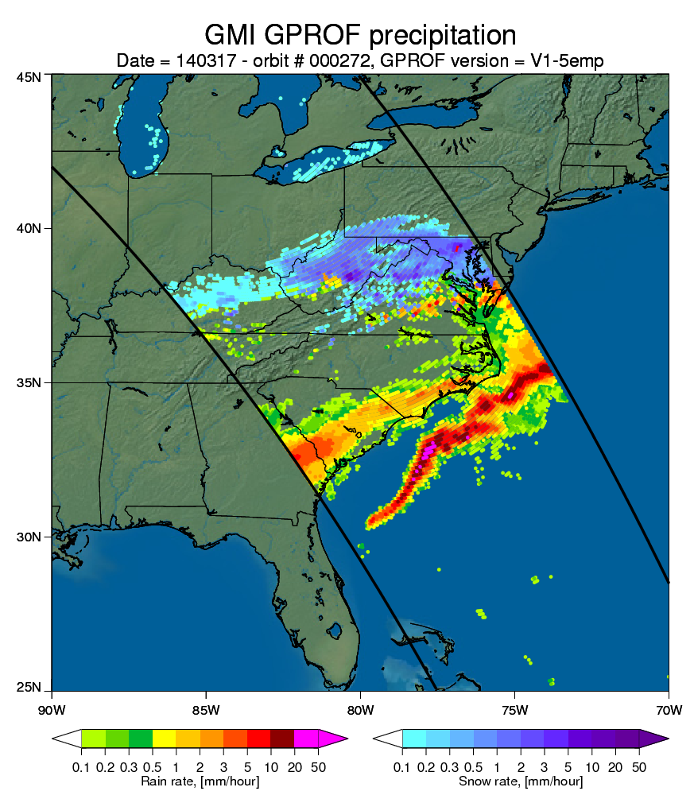
GPM Version Improvement
V1 (pre-launch)
NMQ
V2 (GMI/Combined)

Slide 22
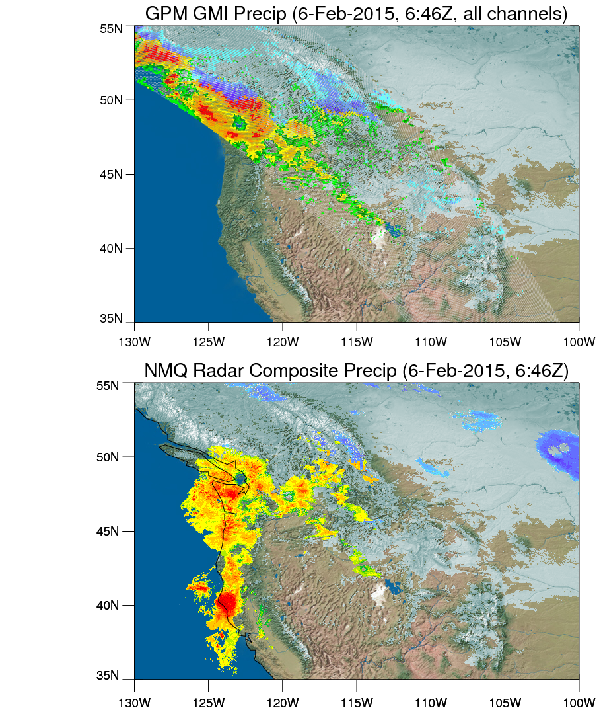
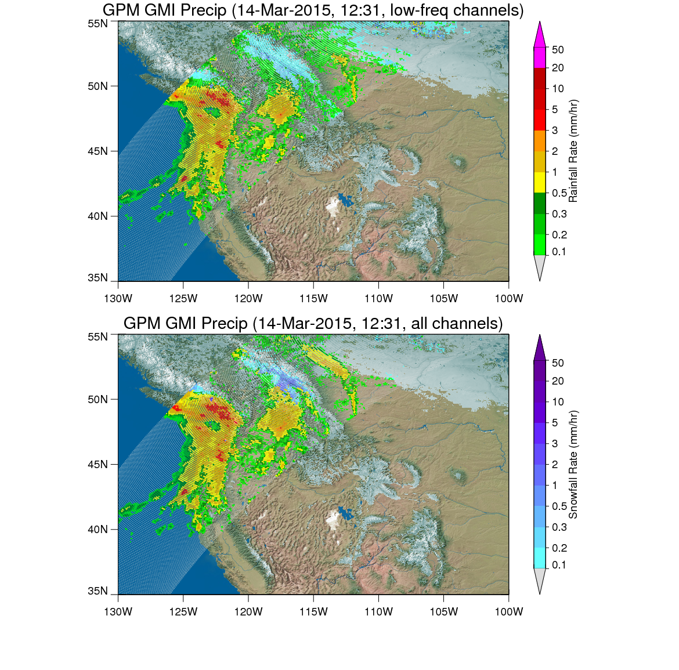
GMI Surface Precipitation V2

Slide 23
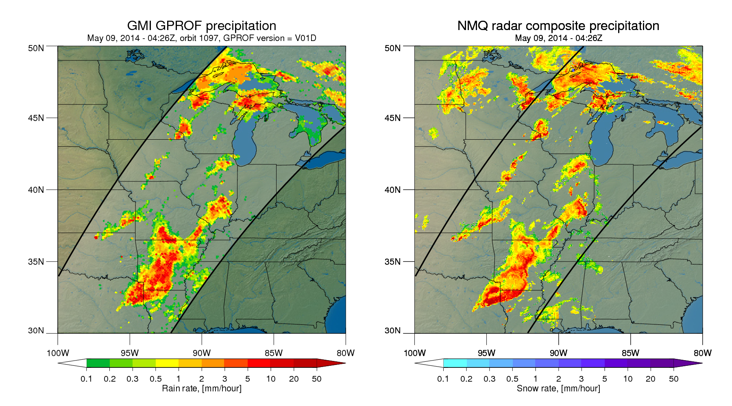
GMI – V1

Slide 24
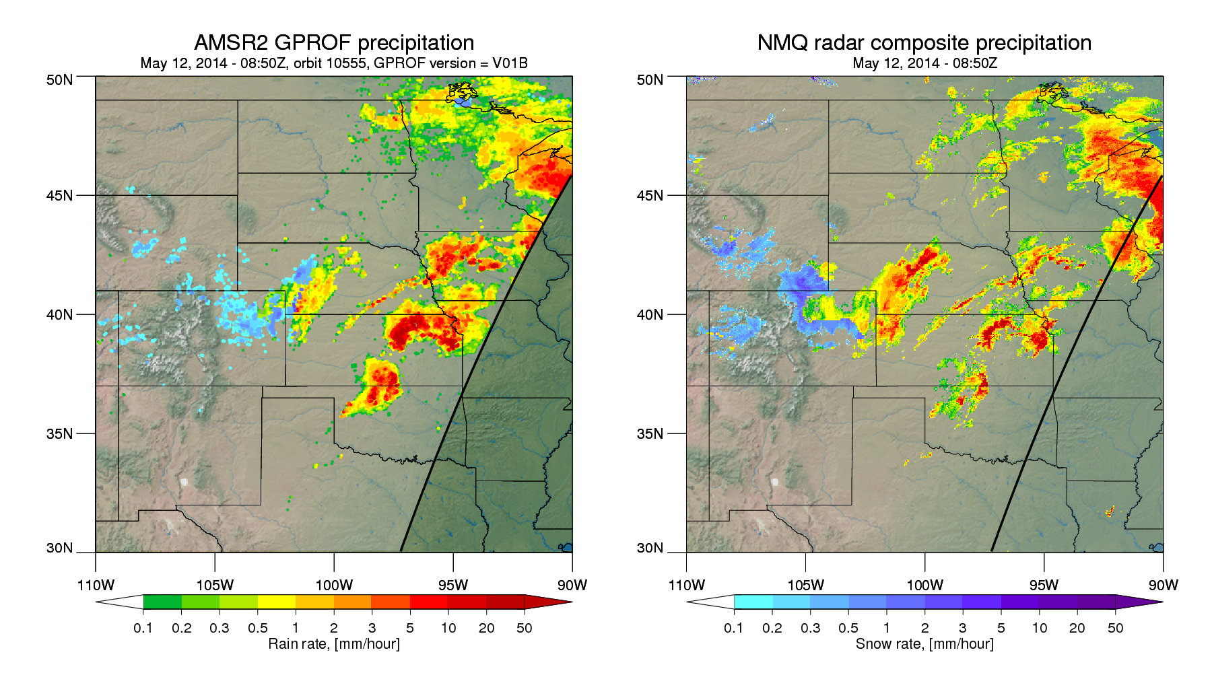
AMSR2 GPM V1

Slide 25
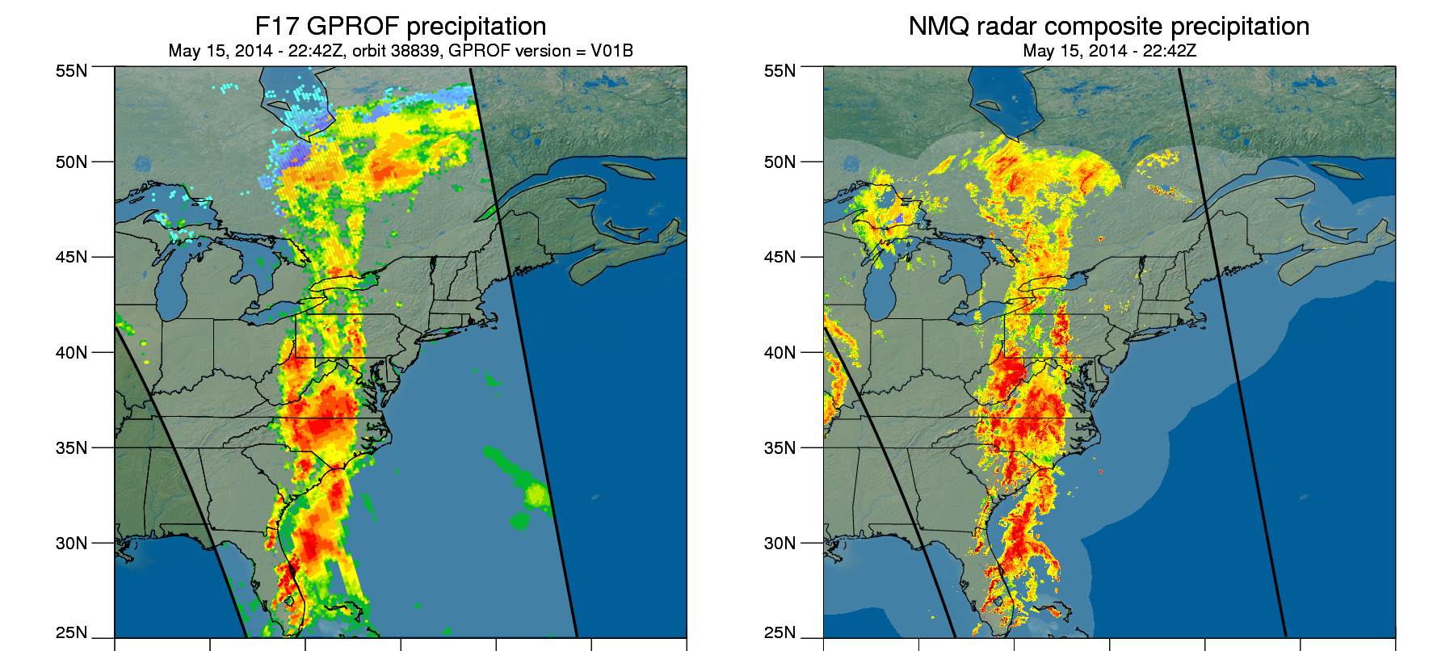
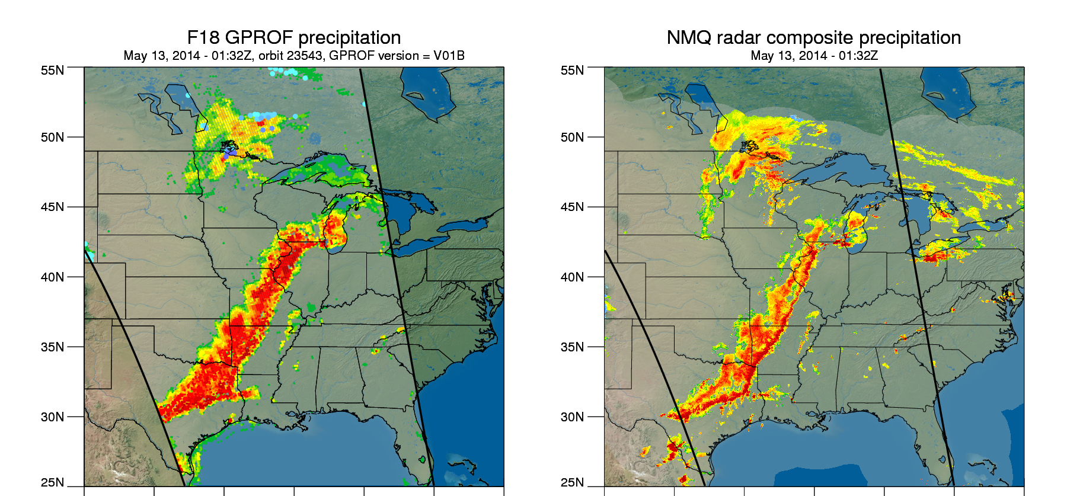
F17, F18 SSMIS – V1

Slide 26
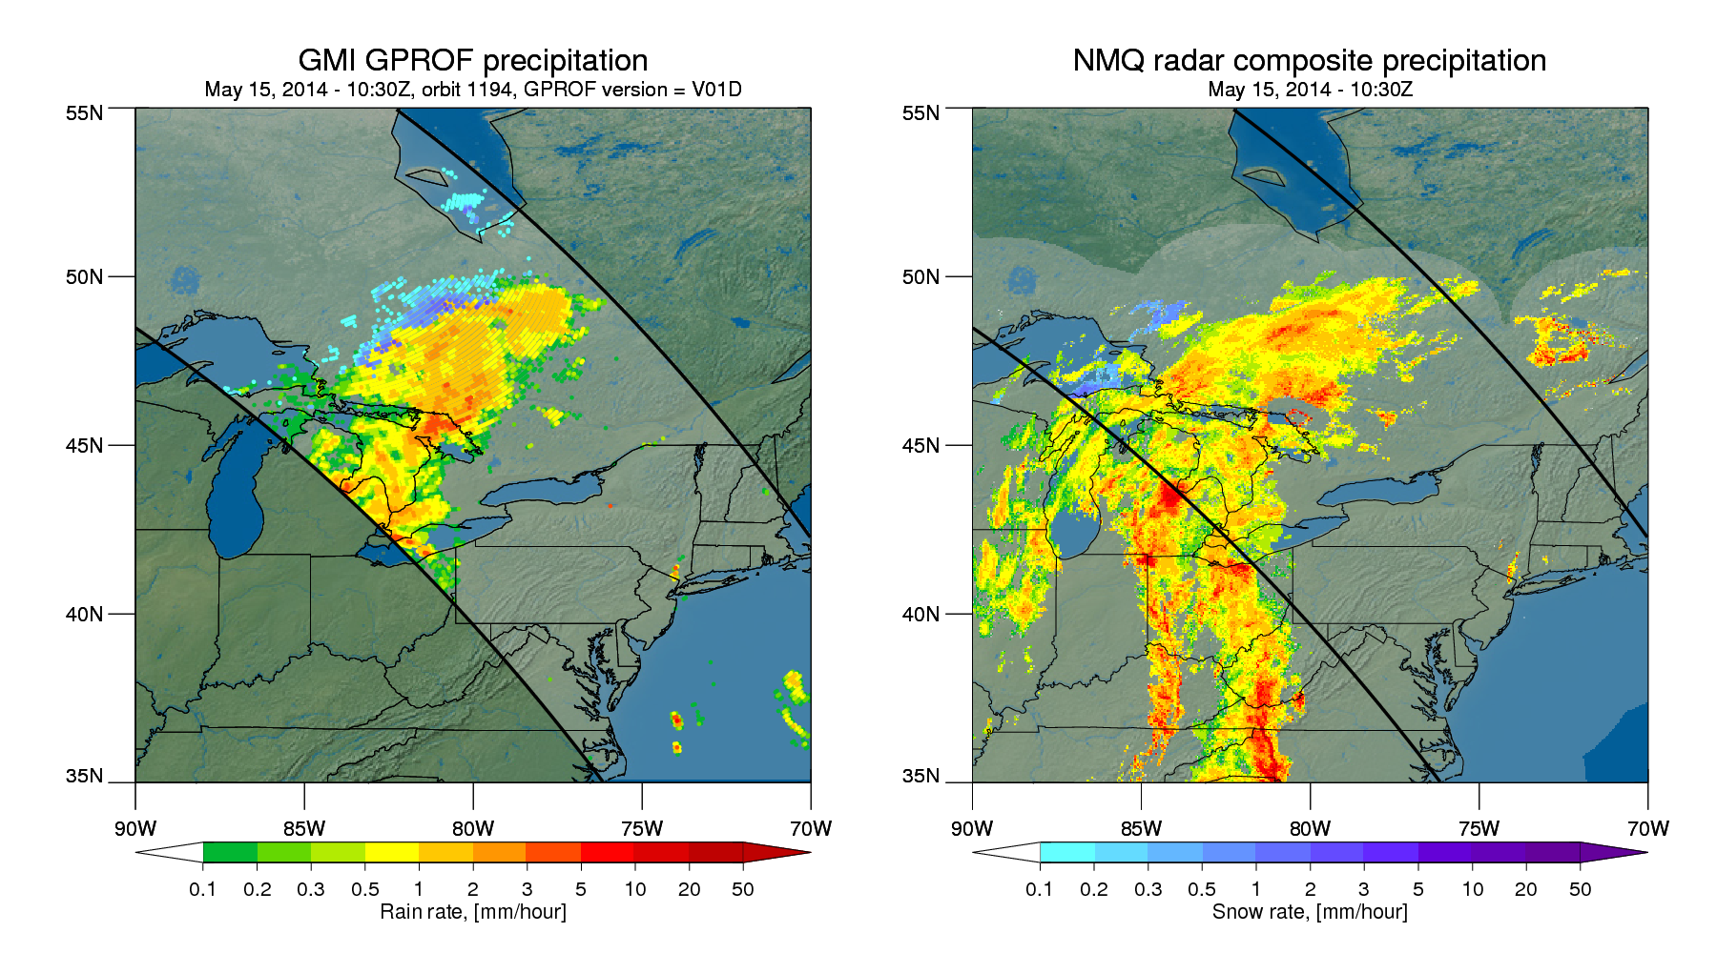
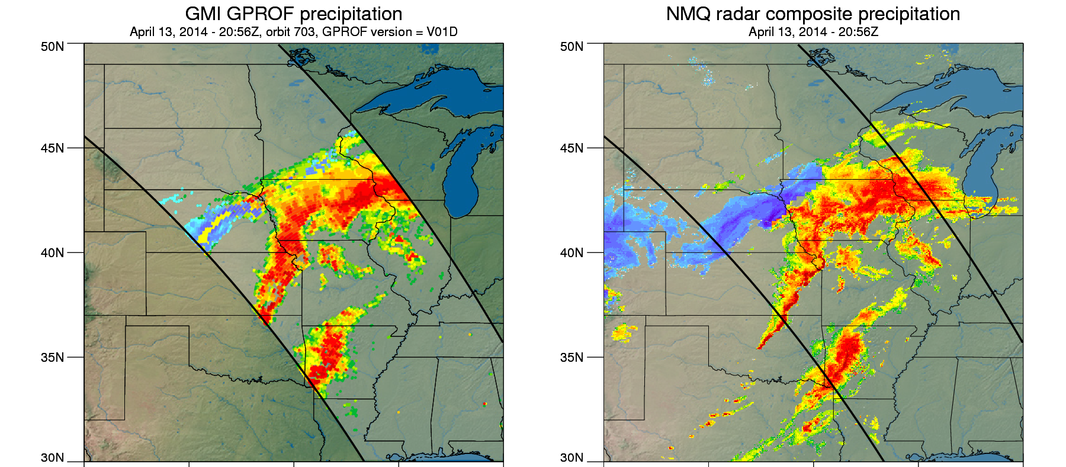
GMI – V1

Slide 27
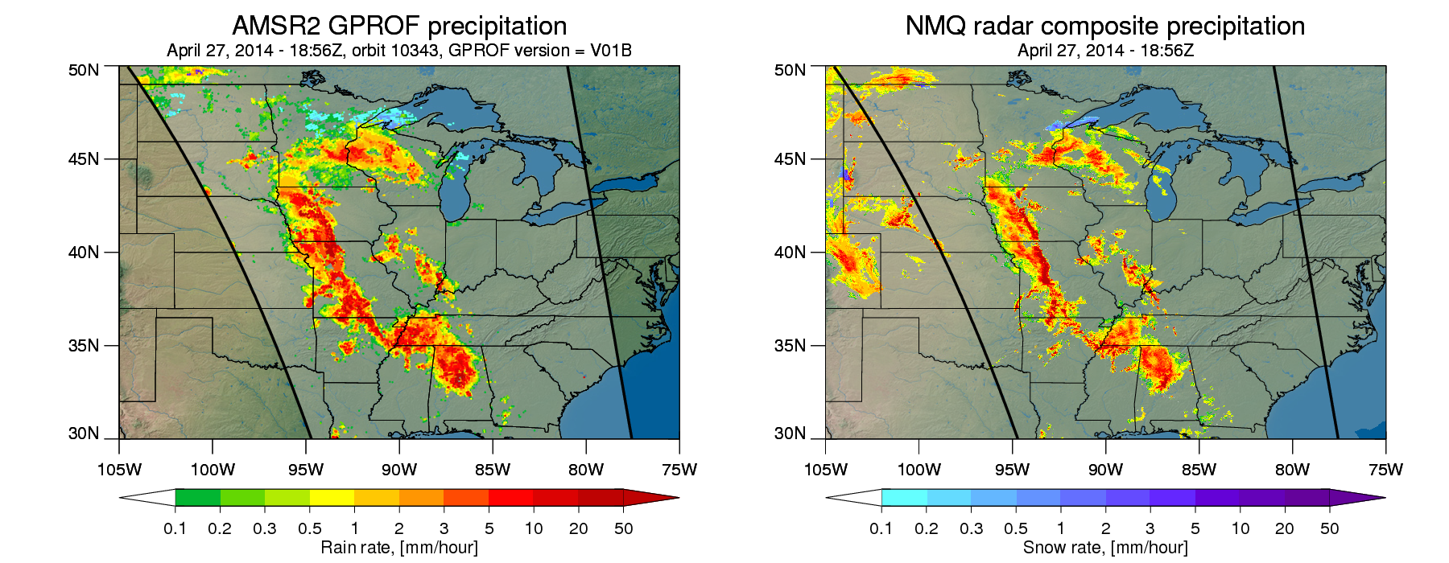
AMSR2 – GPM V1

Slide 28
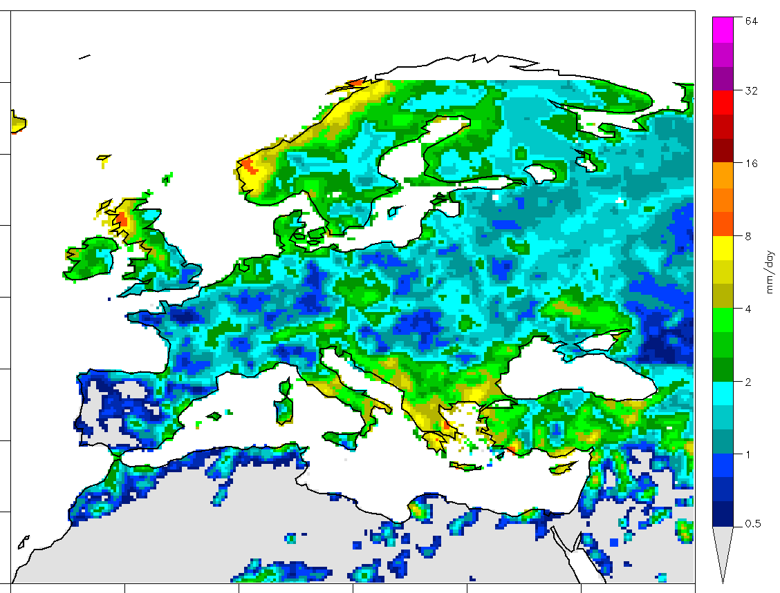
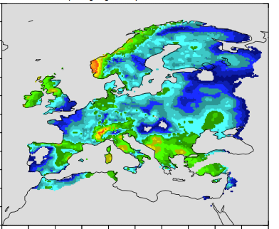
March 2015 Monthly Average
Surface Precipitation
GMI
Interpolated Gauge

Slide 29
GPROF 2014 Production
GPROF V1.4 = Prelaunch database. GPM data from core satellite not yet used to create a-priori databases. Small version updates fix software issues.
  GPROF V2.0 = being constructed now. Will be available after one year of GPM core satellite’s combined algorithm is available to create consistent a-priori databases.
Release Schedule
  GPROF Version 2.0, DPR/GMI based retrieval for all conical radiometers available - Early Fall 2015.
  Cross-track radiometers - Late Fall 2015.
  Vertical profiles of hydrometeors – Late Fall 2015.
  IMERG always ready to use new data!

Slide 30
Fundamental Problems in Development
(These take time to solve)
  Orographic precipitation
  Coastal areas (land/water boundaries)
  Extreme precipitation events – Bayesian database insufficiencies
  Better surface classification – emissivities
  Improve precipitation phase discrimination – from DPR

Slide 31
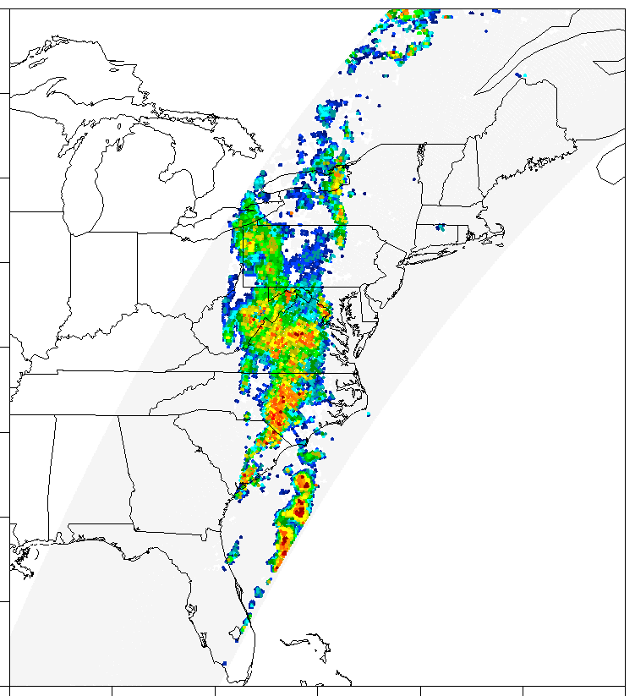
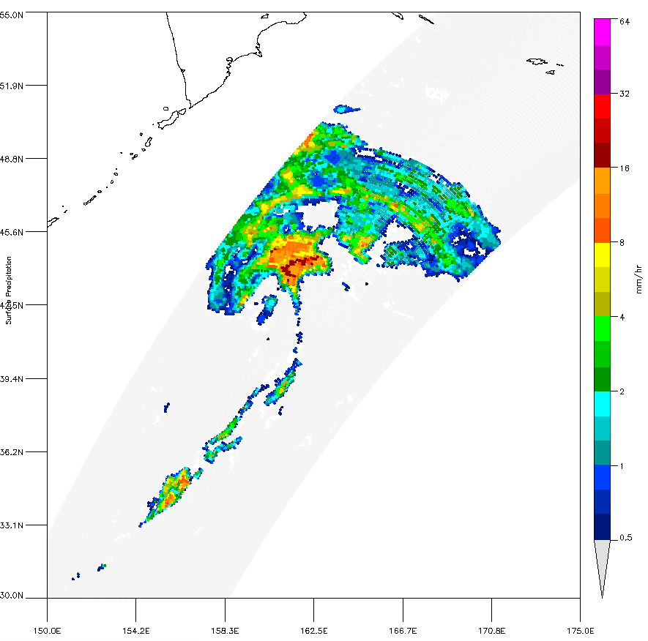
Surface Precip
GMI
Surface Precip
GMI
Kamchatka
64
32
16
8
4
2
1
0.5
May 16th, 2014
November 7th, 2014

Slide 32
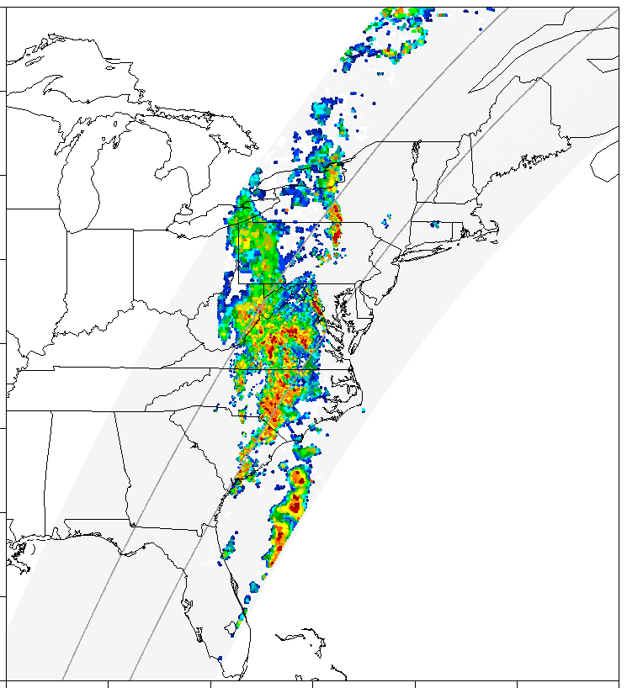
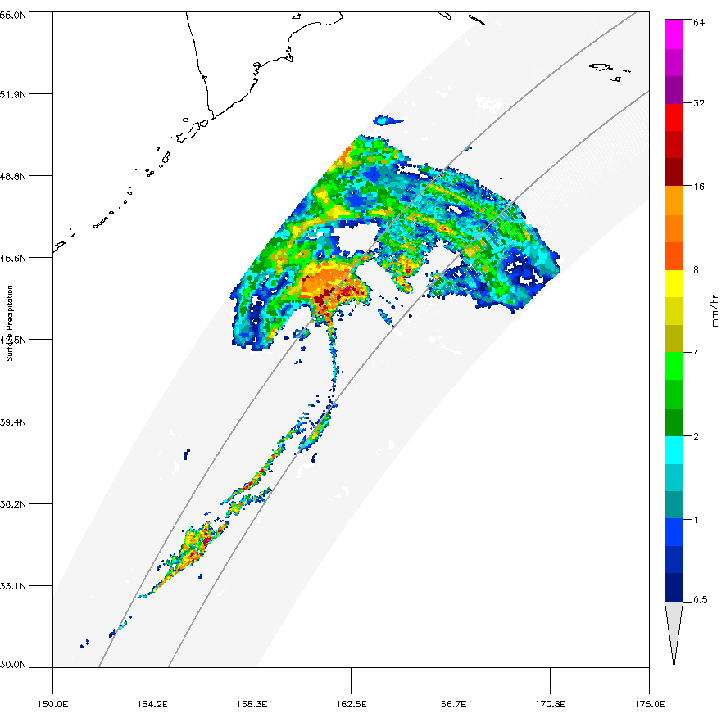
Surface Precip
GMI + Combined NS
Surface Precip
GMI + Combined MS
Kamchatka
64
32
16
8
4
2
1
0.5
May 16th, 2014
November 7th, 2014

Slide 33
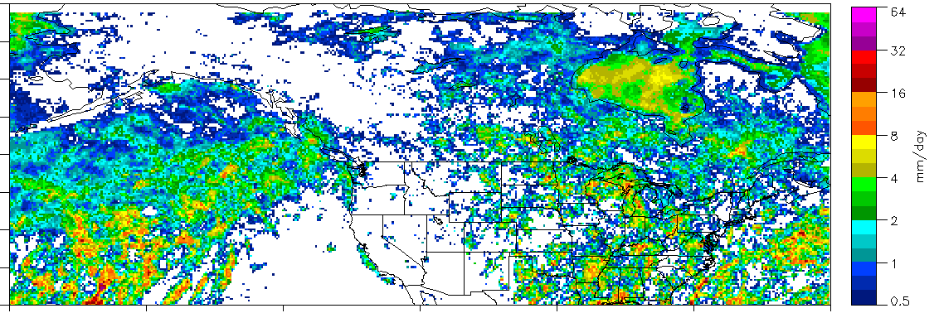
GMI GPROF2014 Retrieval - May, 2014
V1 (TRMM/NEXRAD based) Database
V2 (GPM based) Database

Slide 34
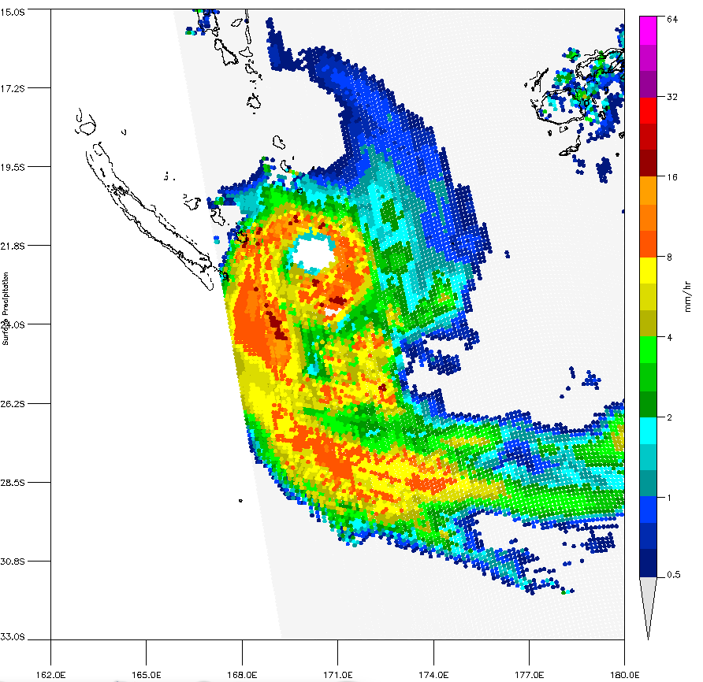
Hurricane Pam after striking Vanuatu
GMI Surface Precipitation March 14, 2015 03:50Z
F17 SSM/I GPROF2014 V1-4 (uses TRMM database)
GPROF2014 V1-5 from the first GMI/DPR database
Vanuatu
36.6 mm/day

Slide 35
GPM Retrieval Challenges
Produce consistent precipitation retrievals between sensors
Use the new channel frequencies to retrieval all precipitation types, over all surface types
Continue to solve the remaining Fundamental Problems

Slide 36
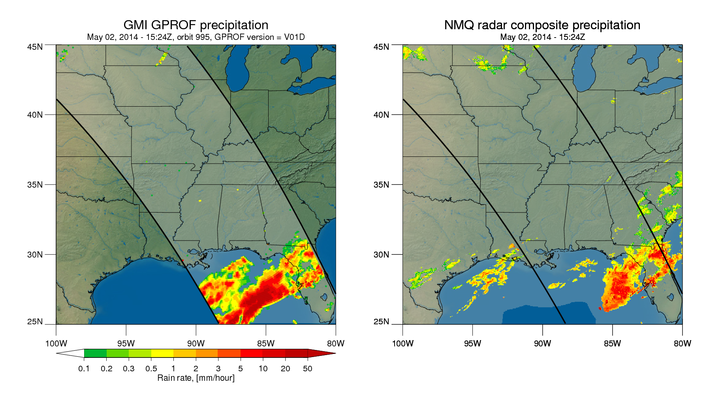
GMI - V1.4

Slide 37
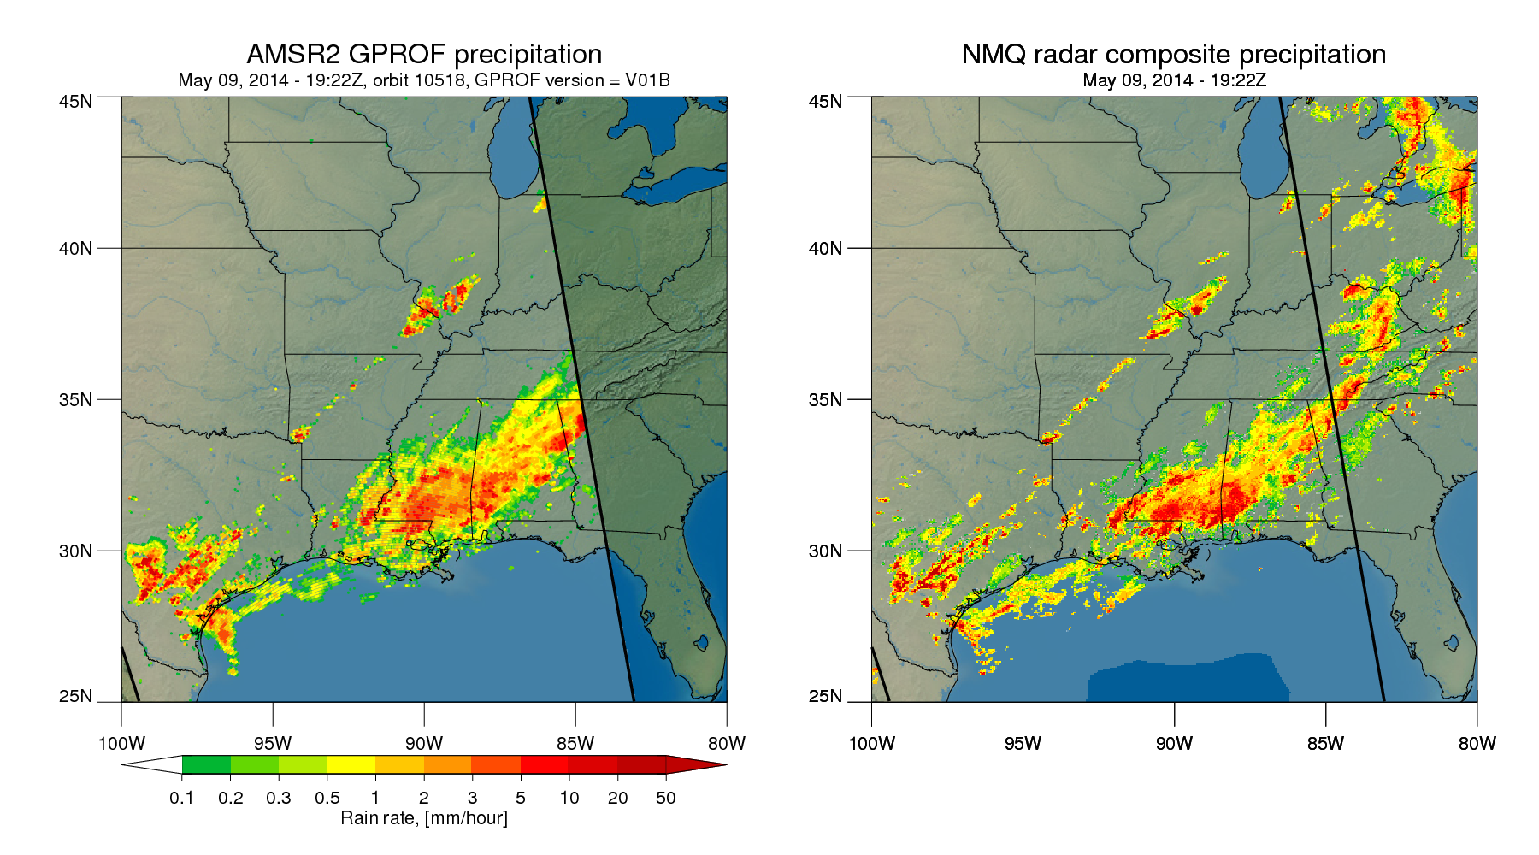
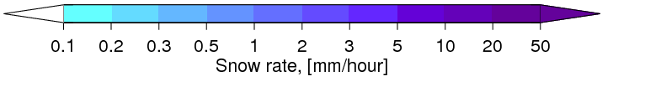
AMSR2 - V1.2

