Slide 1
An Updated Overview of NRL NWP and Data Assimilation
Presented by Benjamin Ruston
with contributions by NRL Scientists from the Marine Meteorology, Remote Sensing, Space Sciences and Oceanography Divisions

Slide 2
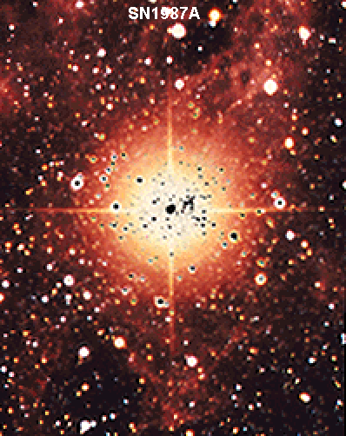
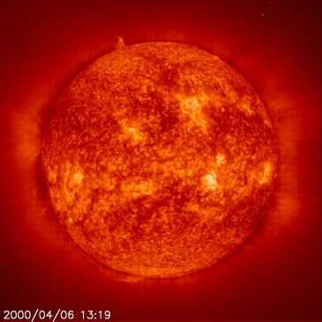
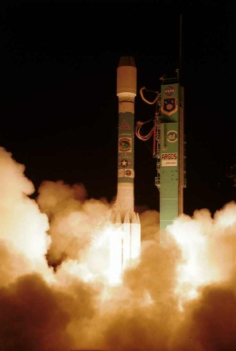
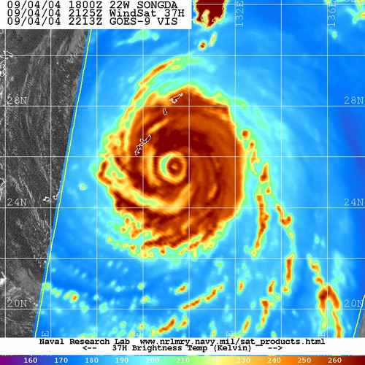
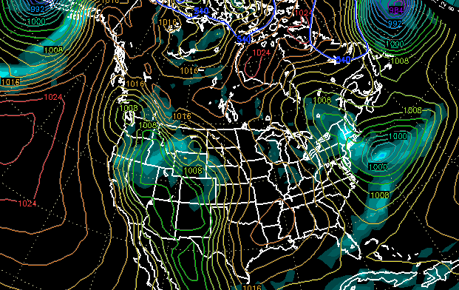
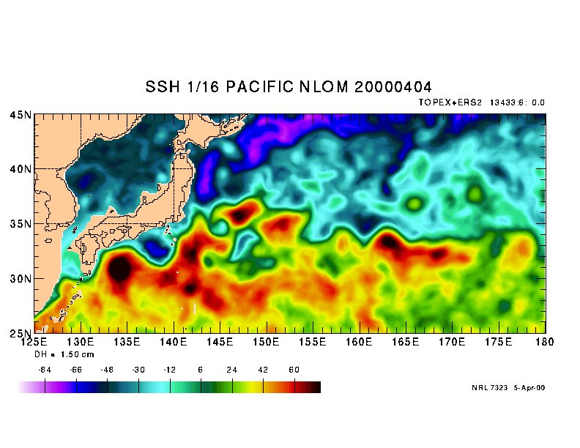
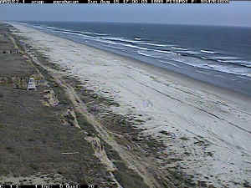
Ocean and Atmospheric Science and Technology Directorate (7000)
Six Divisions performing scientific and technological innovation, research and development from the bottom of the sea floor to the top of the atmosphere and into space.
This Directorate was formed in 1992, when meteorology and oceanography were integrated into NRL with the merger of smaller labs in CA and MS with NRL DC.
Space Sciences (DC, 7600)
Remote Sensing (DC, 7200)
Marine Meteorology (CA, 7500)
Oceanography (MS, 7300)
Acoustics (DC & MS, 7100)
Marine Geosciences (MS, 7400)

Slide 3
NRL/FNMOC/NAVO Systems
Observational Data
(FNMOC)
Data Assimilation
Global (Hybrid) 4DVar
Mesoscale 4DVar/3DVar
NCODA
Global EFS
Coupled NAVGEM/HYCOM/CICE/WWIII
(ESPC)
Global Forecast System
(NAVGEM/NAAPS)
NUOPC
Global & Mesoscale Forecast Sensitivity Observation Impact
Mesoscale Forecast System
(COAMPS/COAMPS-TC/
COAMPS-Arctic/COAMPS-EM
COAMPS-Hydro)
Mesoscale EFS
Ocean/Wave Forecast System
(COAMPS/NCOM/SWAN/WWIII)
Coupled EFS
COAMPS-OS
TDA Systems

Slide 4
NAVGEM 1.2.1
NAVGEM 1.2.1 Operational 08 Jul 2014 at FNMOC
Added/refined assimilation of …
  Surface temperatures over land
  IASI water vapor radiances
  *Suomi-NPP OMPS, and NOAA SBUV/2 Ozone Profiles
  IASI from MetOp-B
  MDCRS humidity
  *HDOB flight level obs (tropical and winter storm reconnaissance)
  *OceanSat scatterometer “OSCAT” , sensor failed 4/2/2014, next launch 2015
  DMSP-F19 SSMIS capability
Revised QC/code stability
  Lunar intrusion flag for ATMS
  GPS-RO tropospheric error update
  Additional QC check for GNSS (background pseudo-RH sanity check)
  Various code changes for error trapping, remove obsolete code, improve stability…
Additional diagnostics
  Verification against ECMWF
  Full column error norm for ob impact (except top two levels)
  Verification against all good quality assimilated and non-assimilated obs
  Aerosol source region verification
Ben Ruston, Pat Pauley, Nancy Baker, Tanya Maurer, Steve Swadley,
Rebecca Stone, Rolf Langland, Jim Goerss
Notes:
*Not activated due to deficiencies in current Ozone photochemistry in mesosphere
* Sensor failed
Inconsistent results

Slide 5
NAVGEM 1.2.1
Polar Orbiting Radiances
Imagers/Sounders
DMSP F16 SSMIS LAS, UAS, Imager
DMSP F17 SSMIS LAS, UAS, Imager
DMSP F18 SSMIS LAS, UAS, Imager
DMSP F19 SSMIS LAS, UAS, Imager
METOP-A AMSU-A, IASI, MHS
METOP-B AMSU-A, IASI, MHS
NASA EOS Aqua AIRS, AMSU-A
NOAA 15 AMSU-A
NOAA 16 AMSU-A
NOAA 18 AMSU-A, MHS
NOAA 19 AMSU-A, MHS
NOAA NPP ATMS, CrIS, VIIRS
GCOM-W1 AMSR-2
GPM GMI
Megha-Tropiques MADRAS, SAPHIR
OceanSat-2
GeoCSR (GOES -13, -15; MTP-MVIRI; MSG SEVIRI; MTSAT2; COMS1-MI)
FY-3A,B,C,D,E,F MWTS,MWHS,MAIRS,MERSI
FY-RM 1,2
Meteor 3M MTVZA
Satellite Derived Polar
and Geostationary Winds
Coriolis WindSat Ocean Wind Vector
DMSP F16 SSMIS Ocean Wind speed
DMSP F17 SSMIS Ocean Wind speed
DMSP F18 SSMIS Ocean Wind speed
METOP-A AVHRR, ASCAT
METOP-B AVHRR, ASCAT
NASA EOS Aqua MODIS
NASA EOS Terra MODIS, MISR
NOAA NPP VIIRS
MSG-09
MSG-10
MTSAT2, -1R, Himiwari-8
NOAA GOES E
NOAA GOES W
NOAA GOES-R
KMA COMS1
FY-2E,F,G,H (Geo Winds)
FY-4A,B,C (Geo Winds)
FY-4A,B,C IR Spectrometer, MW??
GPS Radio Occultation
C/NOFS CORISS
COSMIC FM1-6
GRACE-A, -B
MetOp-A GRAS
MetOp-B GRAS
SAC-C
TerraSAR-X
TanDEM-X
KOMPSAT-5 AOPOD
Other Satellite Products
NASA EOS Aura MLS, HRDLS, OMI
NASA TIMED SABER
NOAA SBUV
JPSS NPP OMPS
SMOS
SMAP
FY-3A,B,C,D,E,F TOU
Coriolis WindSat TPW
DMSP F1[6-9] SSMIS TPW
Jason-1 (SSH, SWH)
Jason-2 (SSH, SWH)
Cryosat2 (SSH, SWH)
Aquarius (Salinity)
Operational Research Only Planned Restricted Use
Notes:
*Not activated due to deficiencies in current Ozone photochemistry in mesosphere
* Sensor failed
Inconsistent results

Slide 6
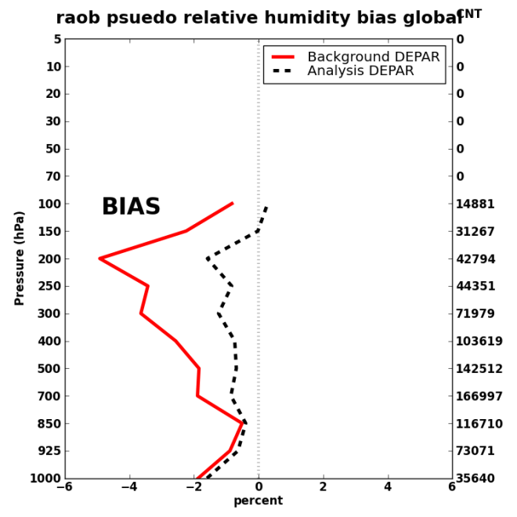
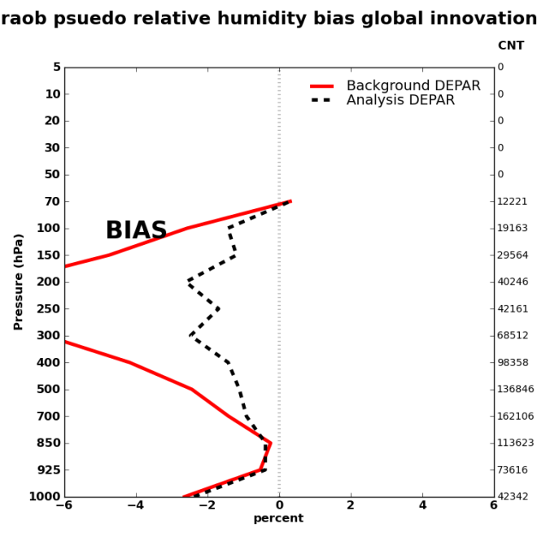
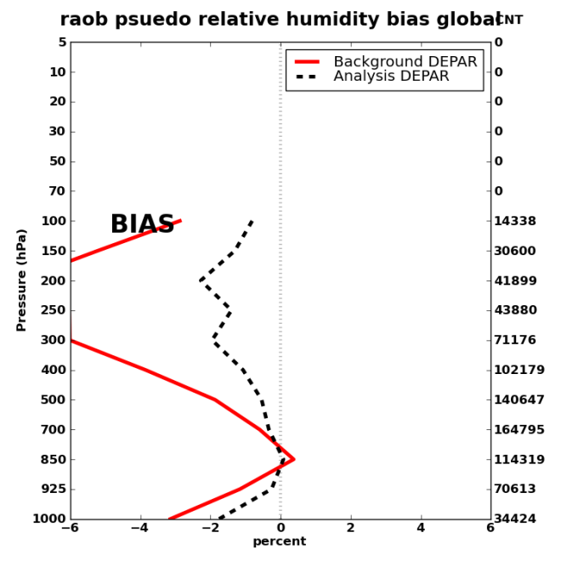
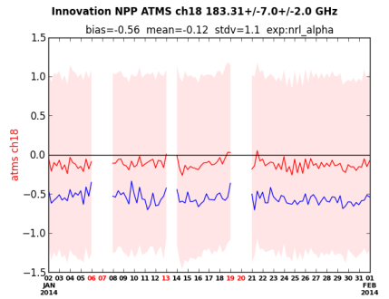
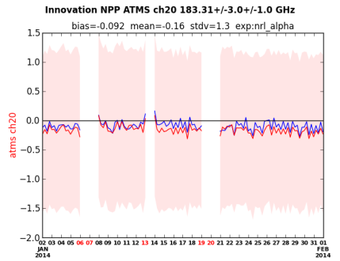
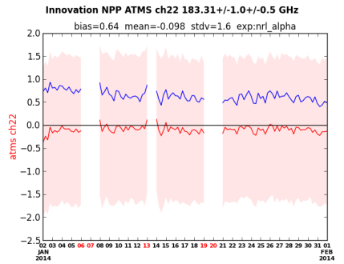
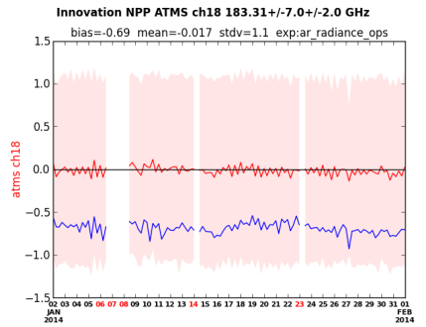
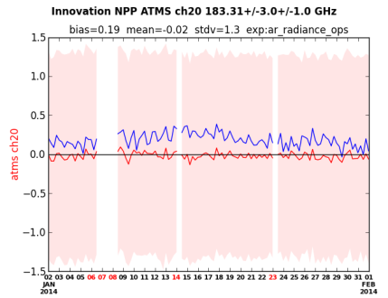
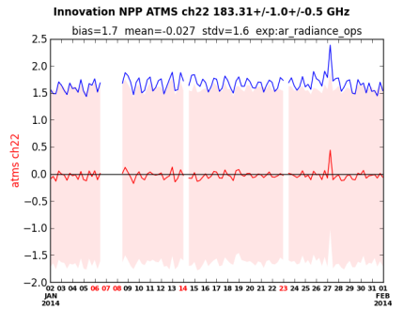
Improved background humidity enables IR (IASI) water vapor radiance assimilation
NRL-Alpha
01Jan-01Feb,2014
With IR-WV
01Jan-01Feb,2014
FNMOC-OPS
01Jan-01Feb,2014
  reduced radiosonde humidity bias at upper levels
  (red and black dashed lines)
  reduced MW radiance bias in water vapor channels
    (blue lines in top three images)
With IR-WV
Adding IR water vapor radiances improves fit to both Radiosonde and MW radiances
Jan
Feb
FNMOC OPS
Notes:
POC/credit Ben Ruston. Top figures show fit to radiosonde measurements both before (red) and after (dashed black) assimilation. When IR water vapor radiances are assimilated both the background fit (before) and analysis fit (after) are improved. Similarly, the raw departures (blue lines) for 3 ATMS water vapor channels all show a better fit if IR water vapor radiances are introduced.

Slide 7
NAVGEM v1.3
  NAVGEM 1.3 Operational Promotion Scheduled June 2015 at FNMOC
  Data Assimilation
  SSMIS Upper Atmosphere Sounding (UAS) data assimilation
  GPS-RO addition of GRACE-B and TanDEM-X
  SNPP VIIRS Atmospheric Motion Vectors
Forecast Model
T425L60 resolution (31km, top at 0.04 hPa or ~70km) Reduced Gaussian grids
New stratospheric physics for water vapor photo chemistry, sub-grid-scale non-orographic gravity wave drag, and stratospheric humidity quality control
New dynamics formulation utilizing perturbation virtual potential temperature to improve numerical stability and reduce semi-implicit decentering
Convective cloud fraction predicted based on Xu-Randall
Improved initialization of ground wetness and ground temperature
LIS soil moisture initialization
New snow albedo
Karl Hoppel, Ben Ruston, Nancy Baker, Tanya Maurer, Steve Swadley

Slide 8
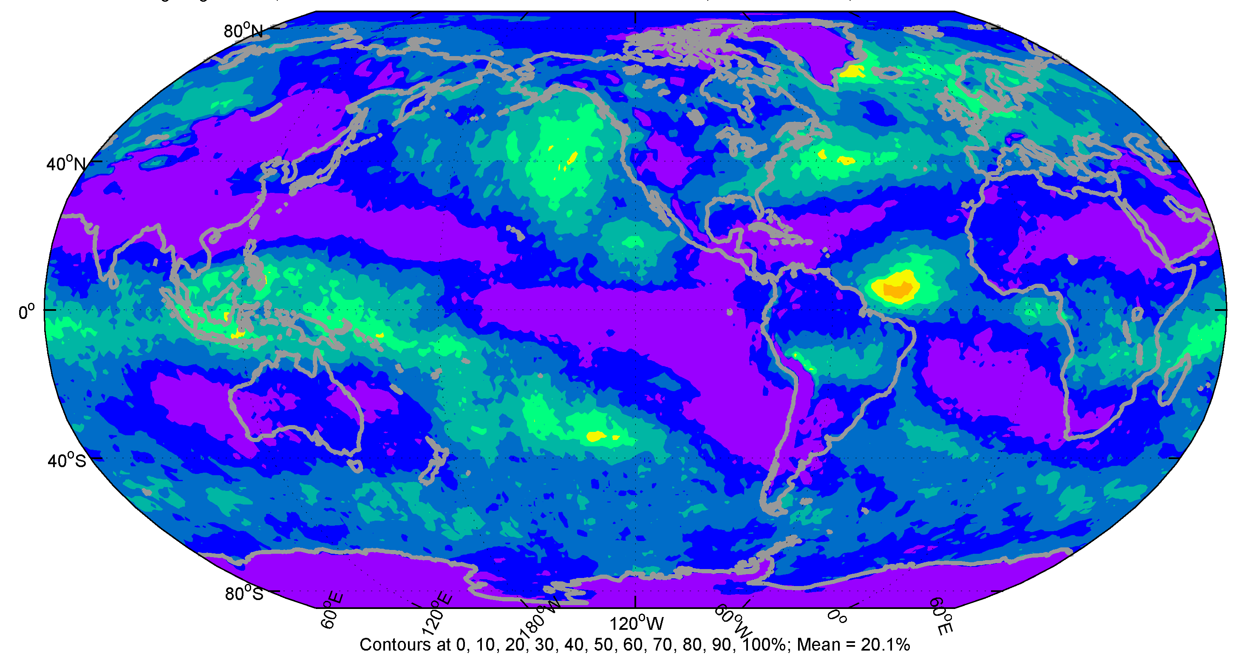
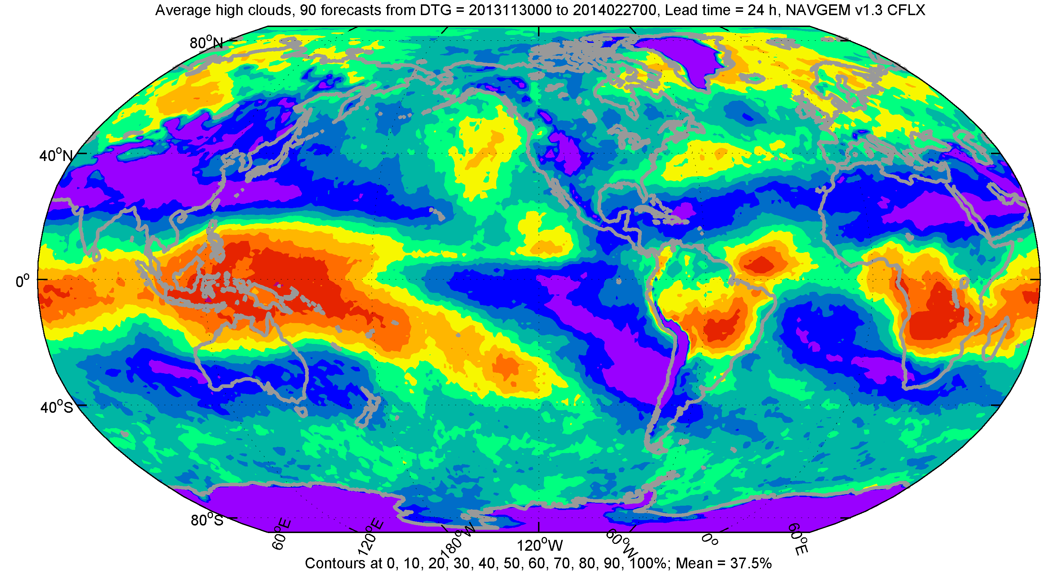
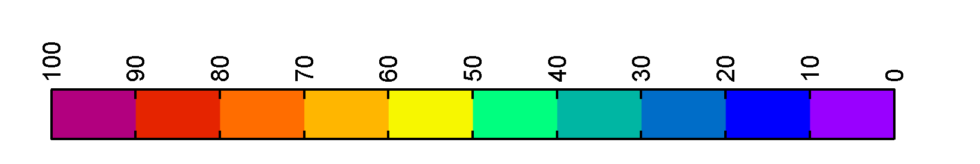
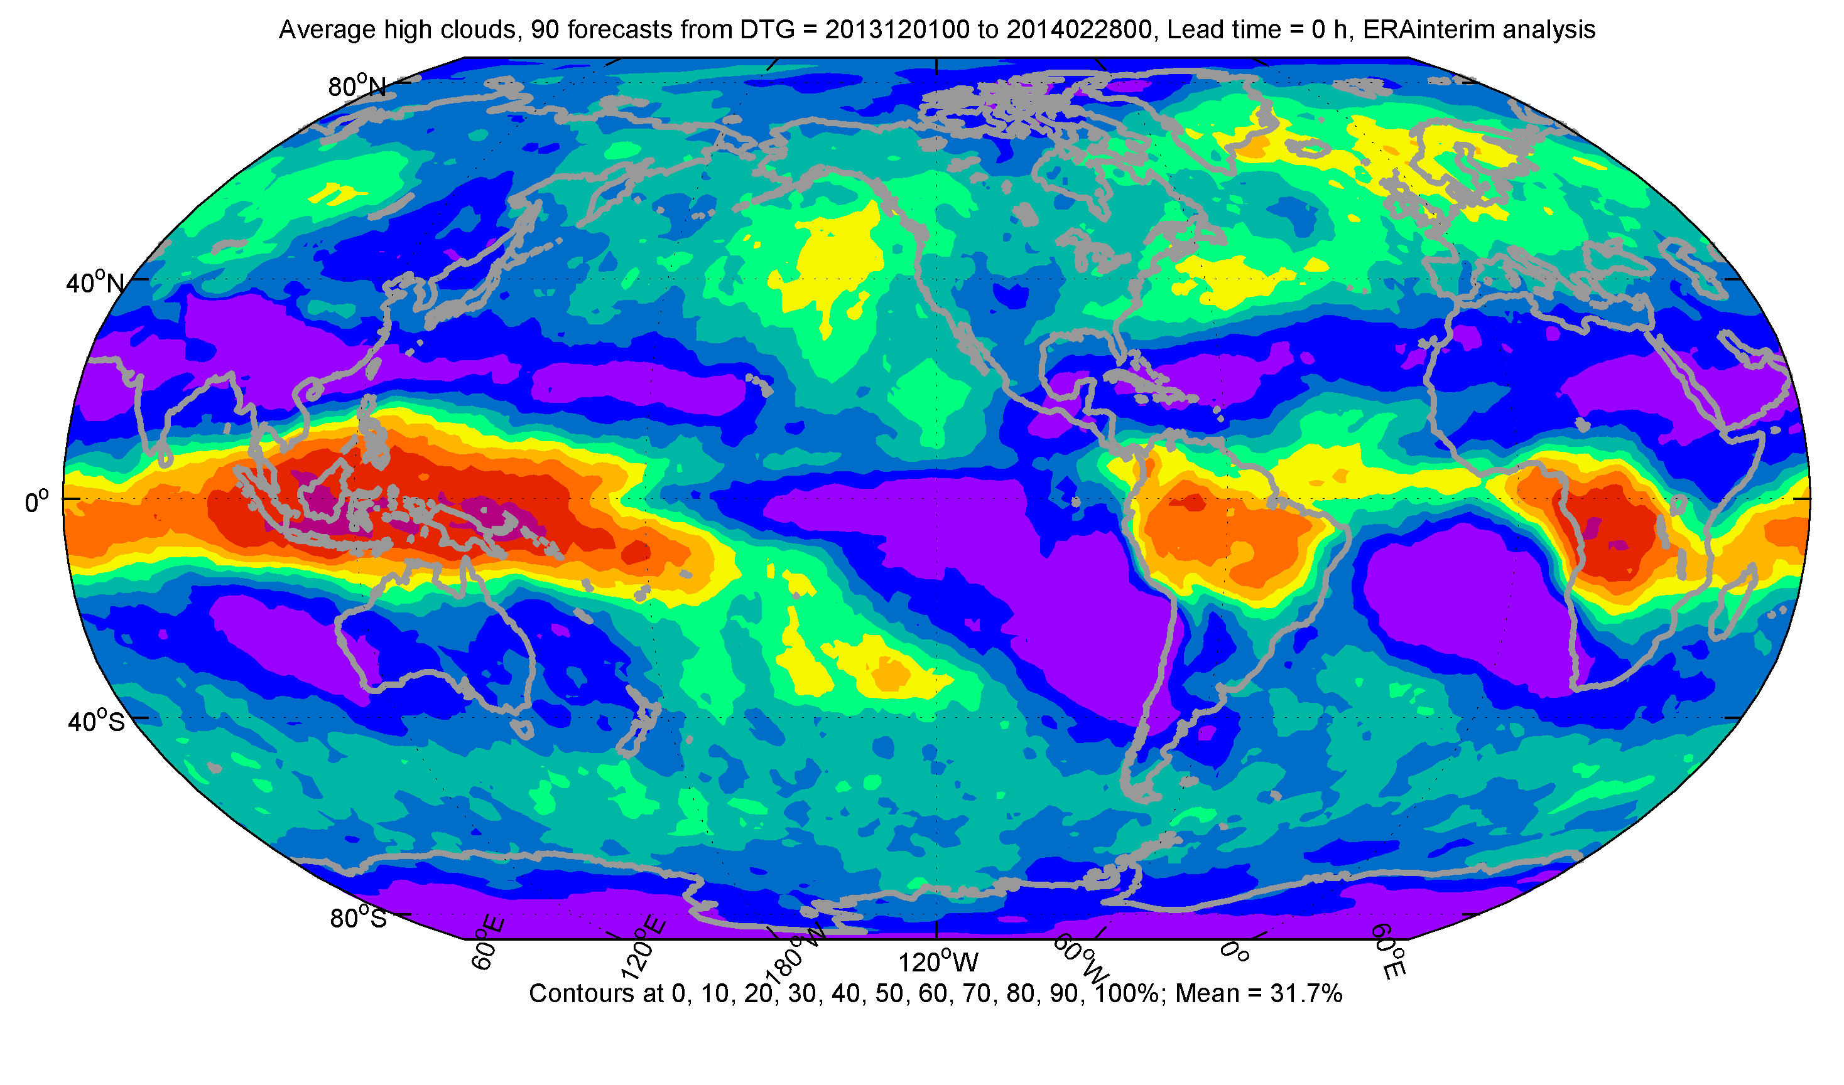
Improved Cloud Fractions
Xu-Randall
High cloud cover: DJF 2013/2014
NAVGEM v1.2.1
NAVGEM v1.3
Mean = 20.1%
Mean = 37.5 %
ERA-interim analysis
Mean = 31.7 %
Distribution Statement A:
Approved for Public Release
The high cloud cover shows perhaps the most notable improvement, particularly in tropical convective regions.
Significant improvement in the surface solar radiation budget.

Slide 9
NAVGEM v1.3.1
  NAVGEM 1.3.1 Planned October, 2015 at FNMOC
  SNPP CrIS temperature and water vapor radiances
  AQUA AIRS water vapor radiances
  Geostationary Clear Sky Radiance
  Terra MISR Cloud Motion Vectors
  MetOp A/B Global AVHRR AMVs
  Anchor channel ability in varBC (capability only)
  Stratospheric humidity scaling - paves way for Hölm transform
  TAC => BUFR transition for radisosonde and surface obs
  Winter Storm Reconnaissance and TC Obs (HDOB)
  Revised external digital filter
Ben Ruston, Pat Pauley, Nancy Baker, Karl Hoppel, Rebecca Stone, Liang Xu

Slide 10
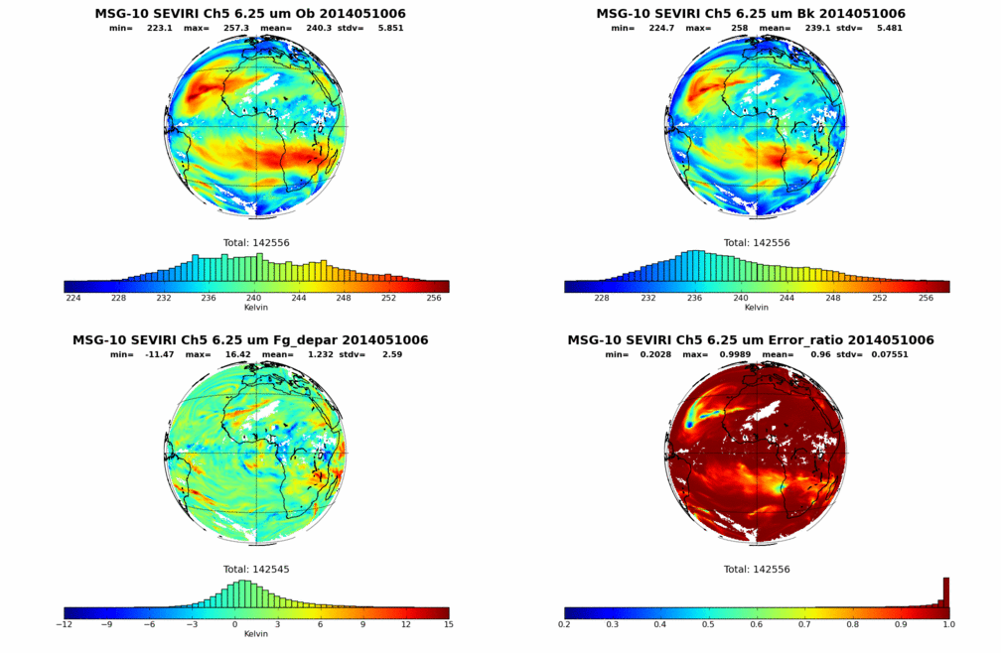
Geostationary Clear Sky Radiance Assimilation
Observation
Simulation
Difference
Weighting
Ben Ruston, Michelle Dai, Efren Serra

Slide 11
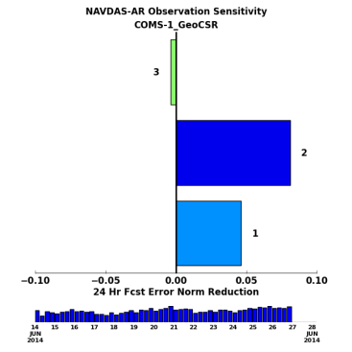
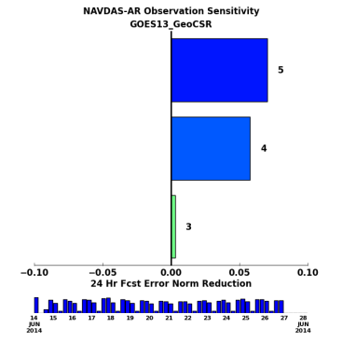
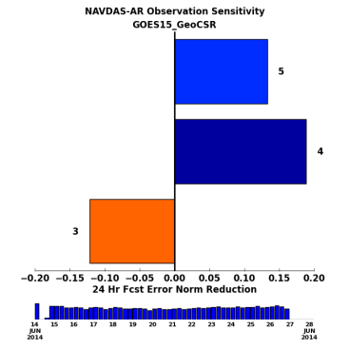
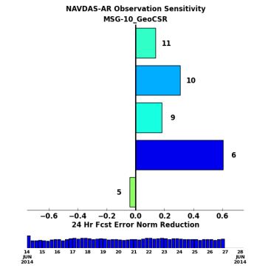
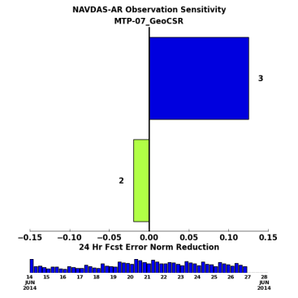
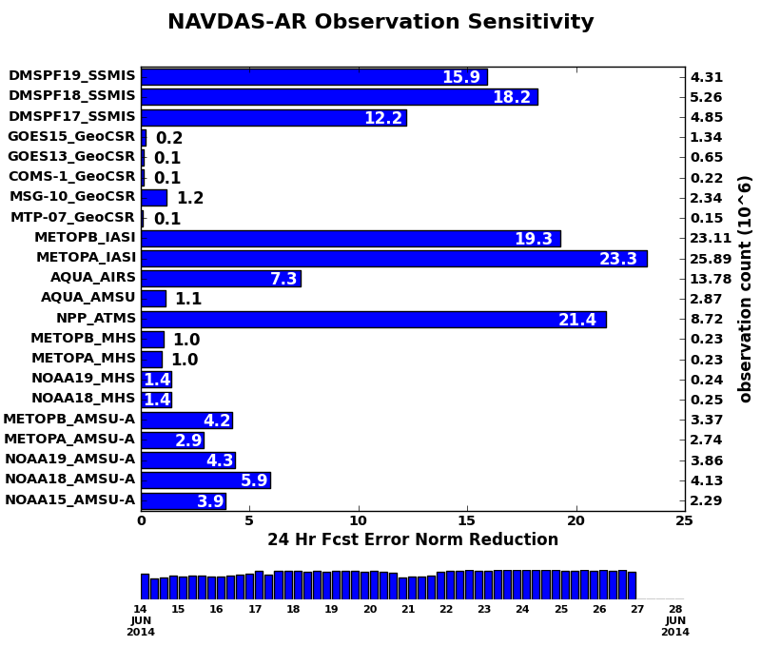
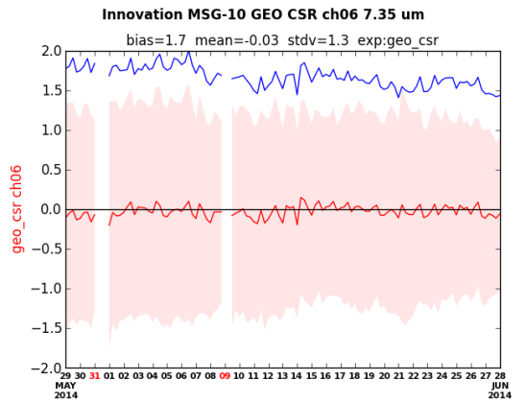
Geostationary Clear Sky Radiance Assimilation
COMS-1
GOES13
GOES15
MSG-10
MTP-07
Capability brings in 6 sensors
  MTSAT-2 not shown
Error reduction smaller than traditional sounders
Large bias (2-5°C)
  Good constraint
  Tracks NWP
  improvements
Ben Ruston, Michelle Dai

Slide 12
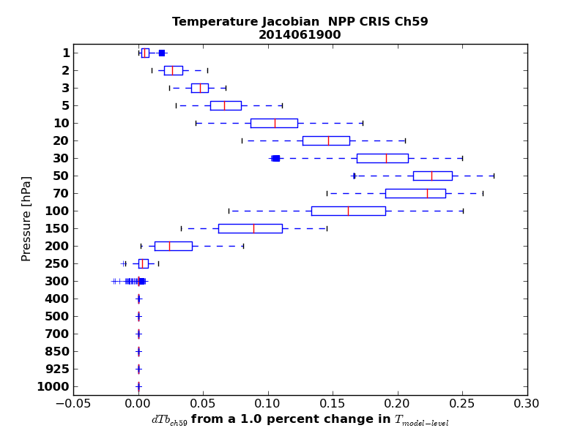
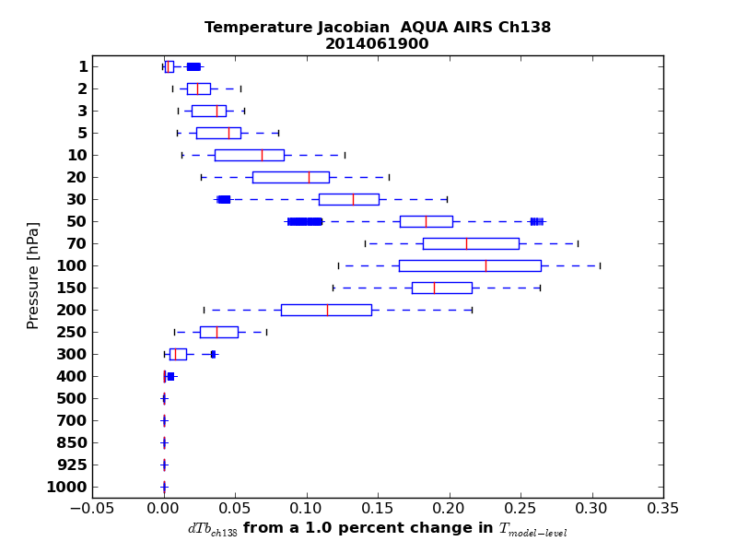
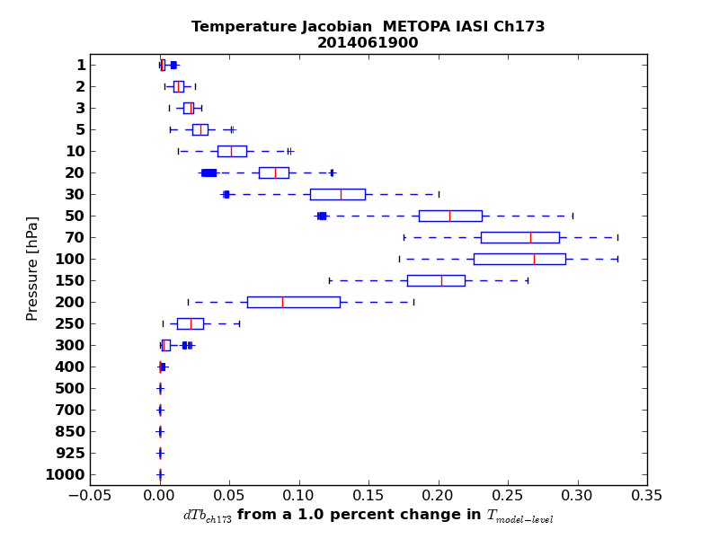
Monitoring of CrIS
Evaluate CrIS against currently assimilated AIRS and IASI
Jacobians from CrIS were evaluated on channel-by-channel basis

Slide 13
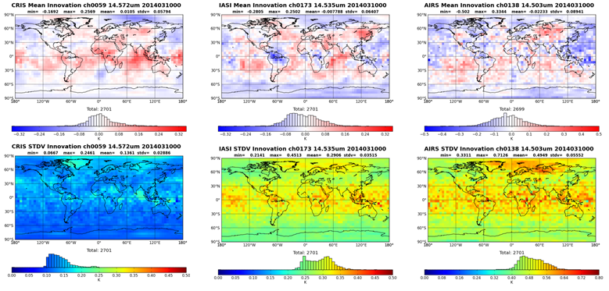
CrIS Assimilation
8-day summary for Innovation (O-B) for 5x5-degree box
CrIS has very good noise performance in this band
MEAN(O-B)
STDV(O-B)

Slide 14
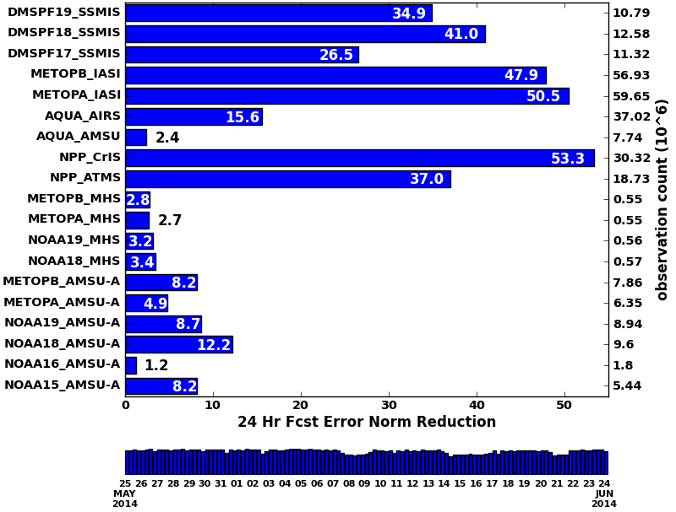
CrIS Assimilation
FY15 transfer: NPP CrIS
Per Ob
Impact
30-day Forecast Error Reduction (IR/MW Sounders)
3.23
3.26
2.34
0.84
0.85
0.42
0.31
1.76
1.98
5.09
4.91
5.71
5.96
1.04
0.77
0.97
1.27
0.67
1.51
x 10⁻⁶

Slide 15
Plans for 2016
NAVGEM v1.4 (primarily DA updates)
Hybrid 4DVar
New NAVGEM TLM and Adjoint model
Activate Ozone assimilation along with Mesospheric Ozone photochemistry
  Redefine humidity analysis variable (Hölm transform)
  Revised observation and background error covariances
  Activate anchor radiances capability
COMS-1 AMVs and MetOp A/B Global AVHRR AMVS
Correlated observation error for ATMS and IASI (and more …)
Ground-based GPS-MET integrated water vapor
Wind profiler assimilation
COAMPS® Mesoscale 4DVar
UAS (Unmanned Aircraft Systems) data assimilation to support experiments
Includes radiance and GNSS-RO assimilation
Data pre-processing and QC
Modernize code –benefits including system robustness (Complex Quality Control CQC for radiosondes, dropsondes, pibals - NGGPS)
Complete TAC → BUFR transition for RAOB, SYNOP
Ben Ruston, Pat Pauley, Nancy Baker, Karl Hoppel, Rebecca Stone, Liang Xu

Slide 16
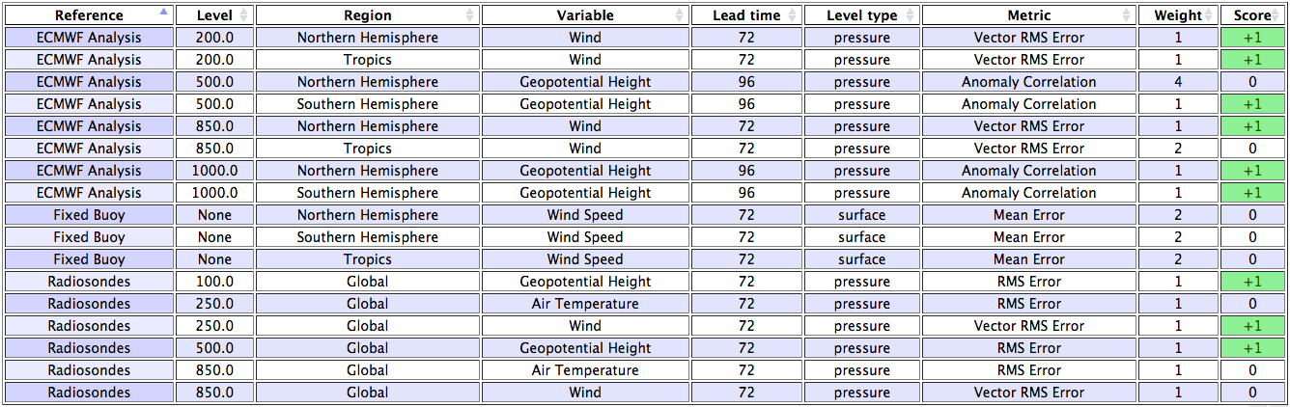
Global Hybrid 4DVar
“Scorecard” using ECMWF
Comparison of Hybrid 4DVar vs. 4DVar
Total Score=+9
Dave Kuhl, Nancy Baker, Craig Bishop, Liz Satterfield, Dan Hodyss, Ben Ruston
Notes:
Of the 19 minutes I’d estimate 4 minutes for I/O and other ensemble computations and 15 minutes for everything else.
A few minutes to run the ensemble forecasts

Slide 17
NAVGEM Stratosphere Development
As we move from NOGAPS to NAVGEM, changes to the forecast model are needed for assimilation of upper level radiances
  Extension of the model vertical domain, first to L60 (hybrid σ-p) up to 0.04 hPa (~65 km), then to L74 up to 6x10⁻⁵ hPa (~116 km)
  New stratospheric-mesospheric ozone photochemistry with diurnal variability in the upper stratosphere and mesosphere
  New parameterized stratospheric-mesospheric water vapor photochemistry and quality control
  New stochastic gravity-wave drag parameterization
  Important: Reduce upper-level temperature biases (i.e., improve modeled “climate”)
Notes:
POC/Credit John McCormack

Slide 18
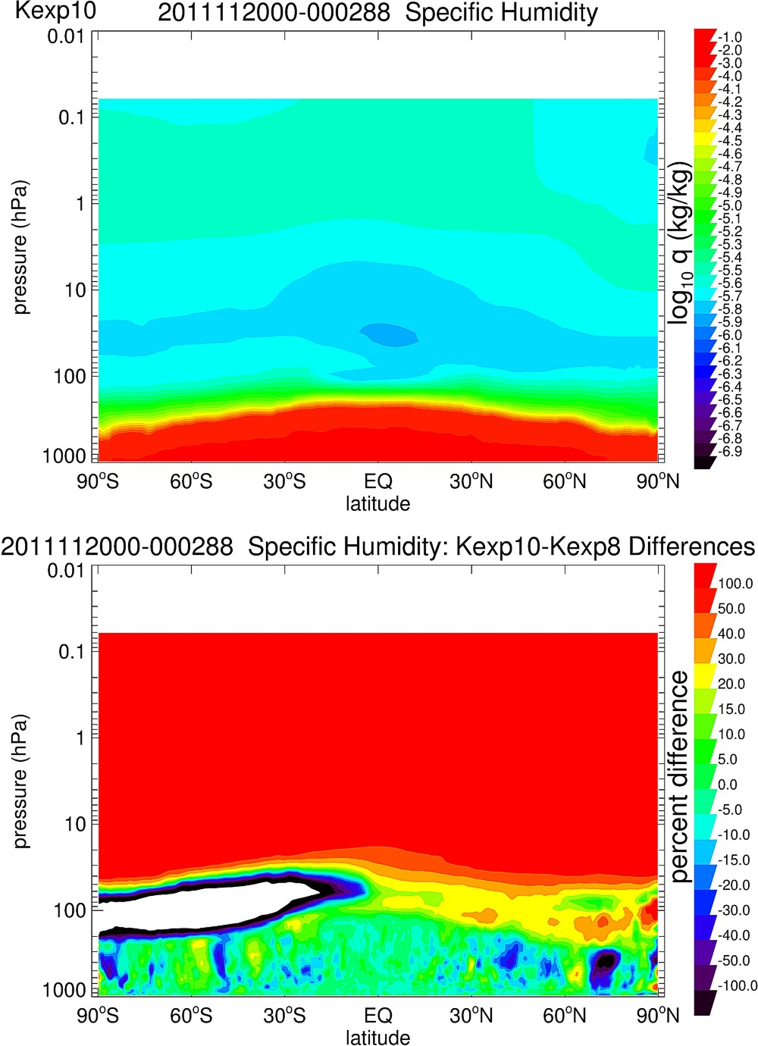
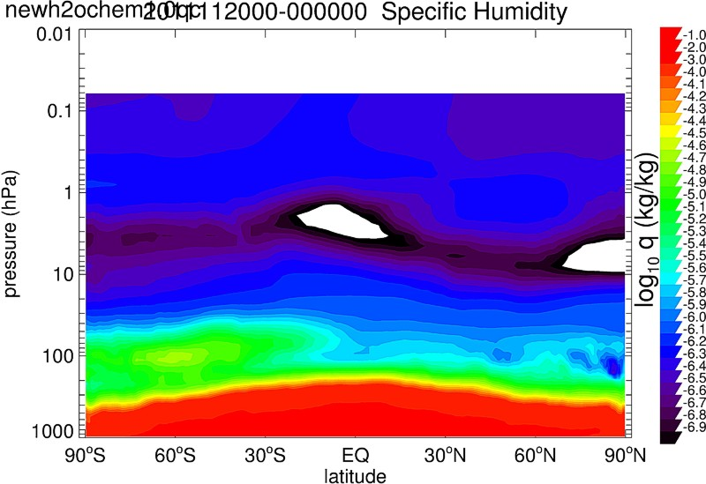
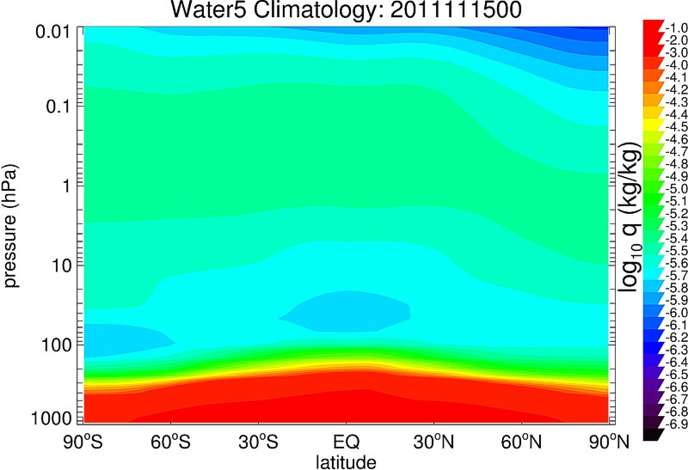
Parameterized H₂O Photochemistry
Spec. Humidity Analysis 15 Nov 2011
Spec. Humidity Analysis 15 Nov 2011
No H2O photochemistry
with H2O photochemistry
Nov Climatology
Percent Difference
H2O chem (with – without)
Notes:
POC/credit John McCormack Tests of parameterized H2O photochemistry (McCormack et al., 2008) in T425L60 NAVGEM

Slide 19
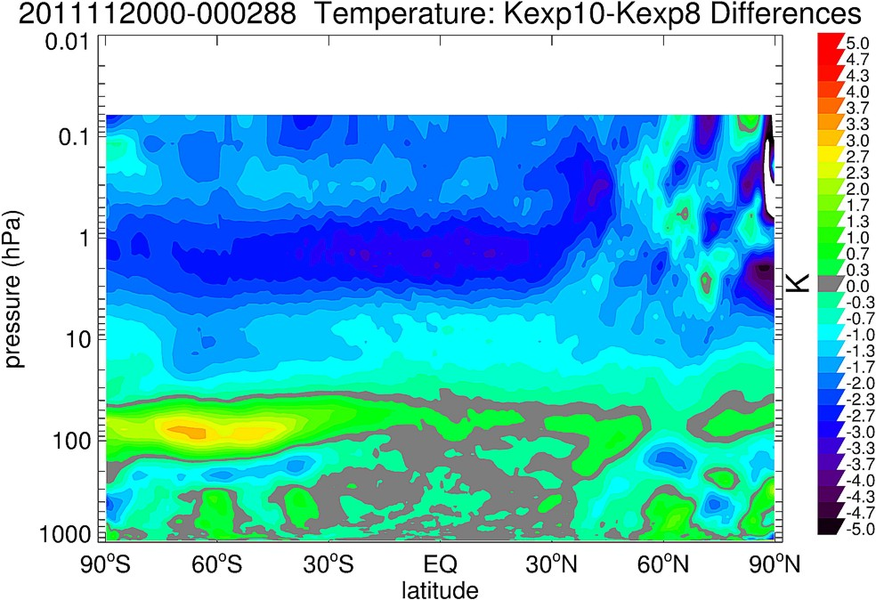
Parameterized H₂O Photochemistry:
Reducing Forecast Temperature Bias
288-Hour Forecast Temperature Difference: (H2O chem) – (no H2O chem)
KEXP10 - KEXP8
Negative (colder)
More water, more IR cooling
Positive (warmer)
Less water, less IR cooling
Notes:
POC/Credit Ben Ruston

Slide 20
NAVGEM Future Plans
NAVGEM 2.0 (FY16)
T681L80 (19km,0.01hPa~80km)
Integrated with Hybrid-AR
Improve computational efficiency
Upgrade of cloud water/ice prediction
Upgrade radiation scheme
Two-time level integration
New land surface model
High-order PBL scheme
Coupled CICE model
4 aerosol constituents prediction

Slide 21
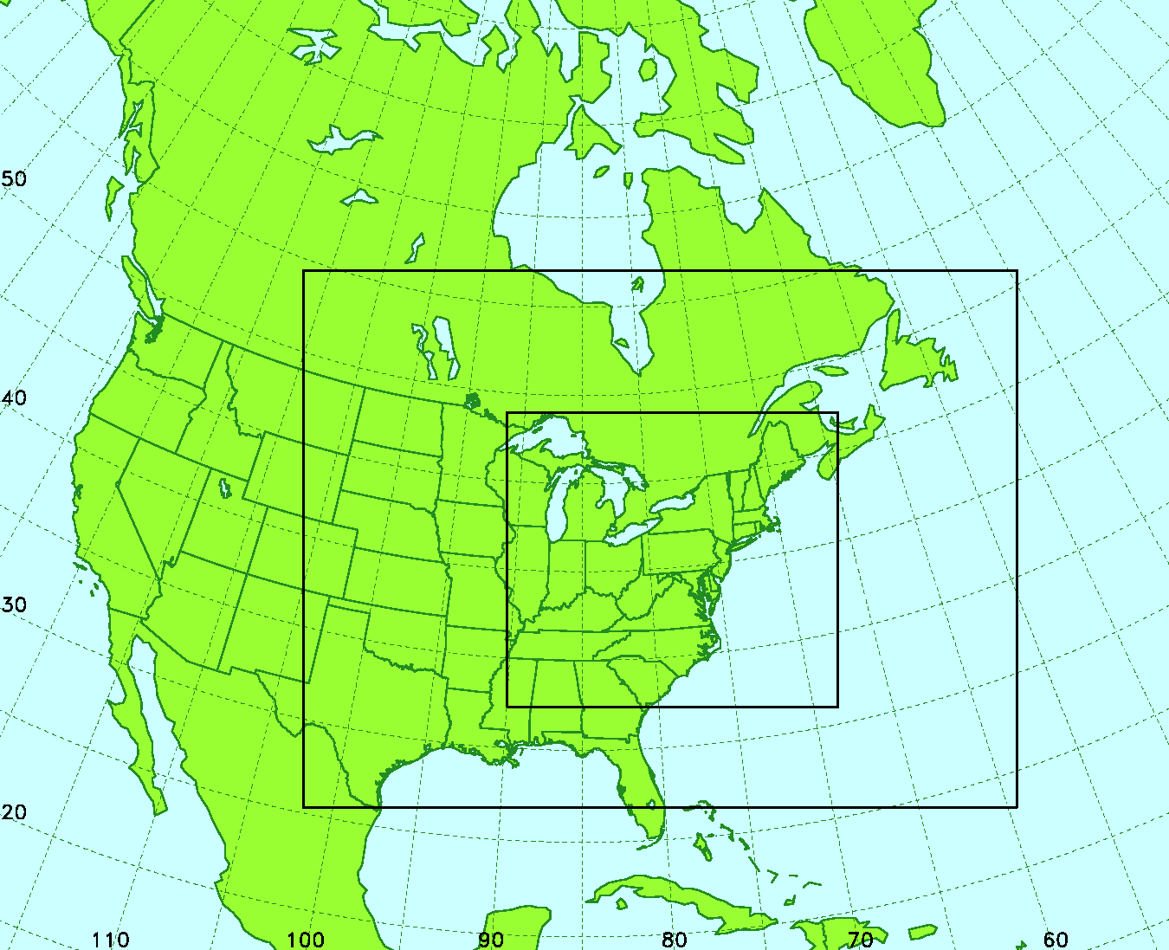
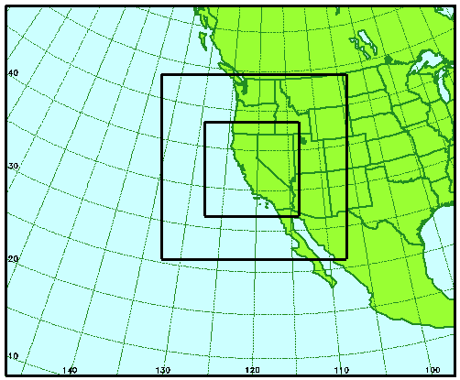
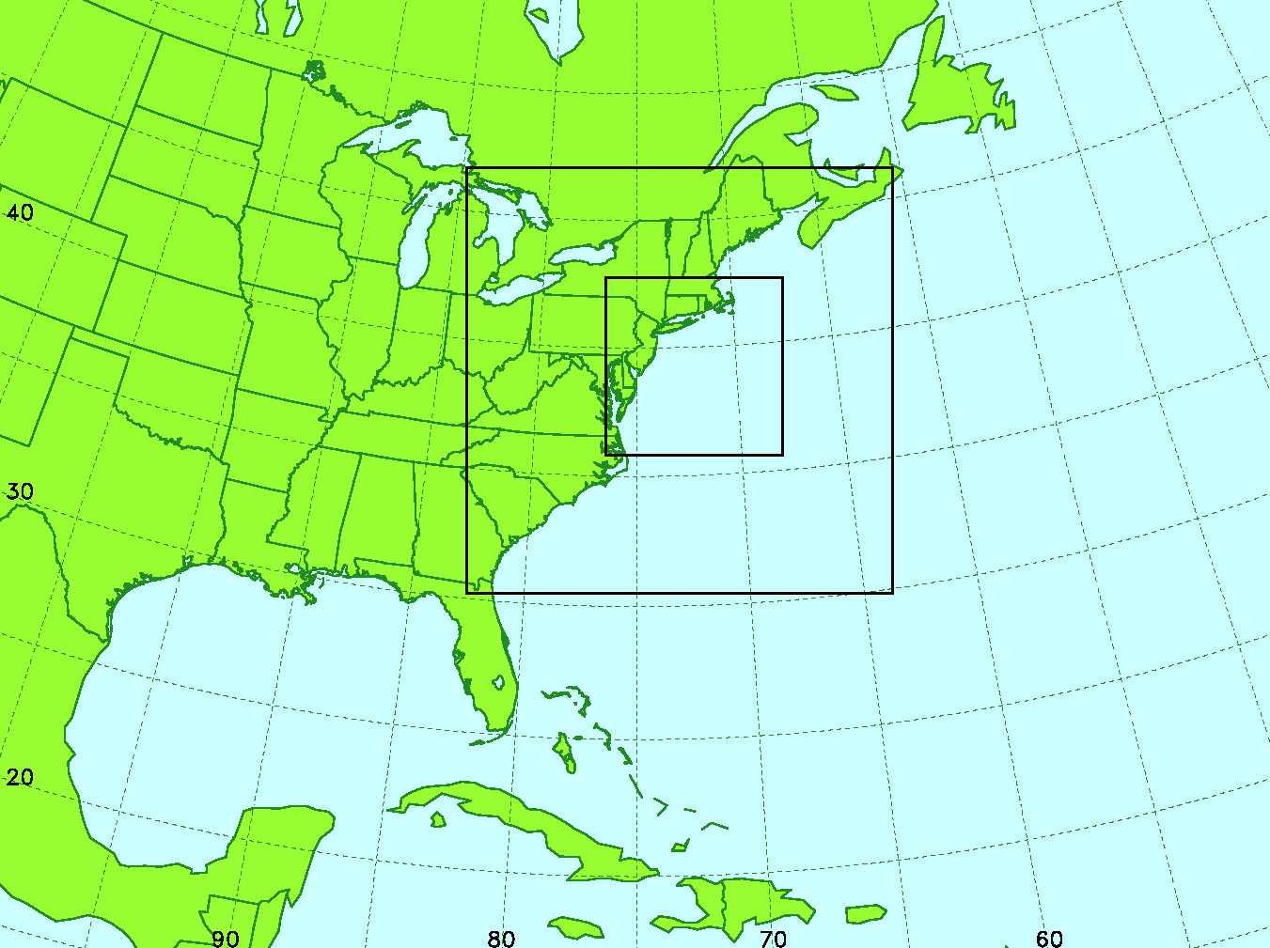
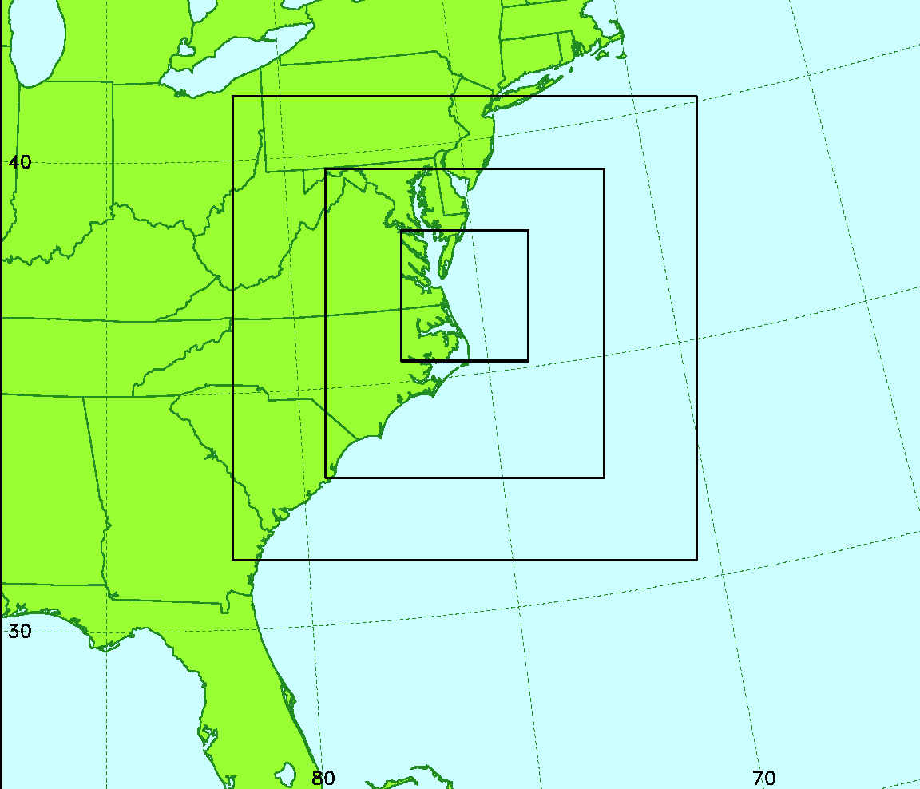
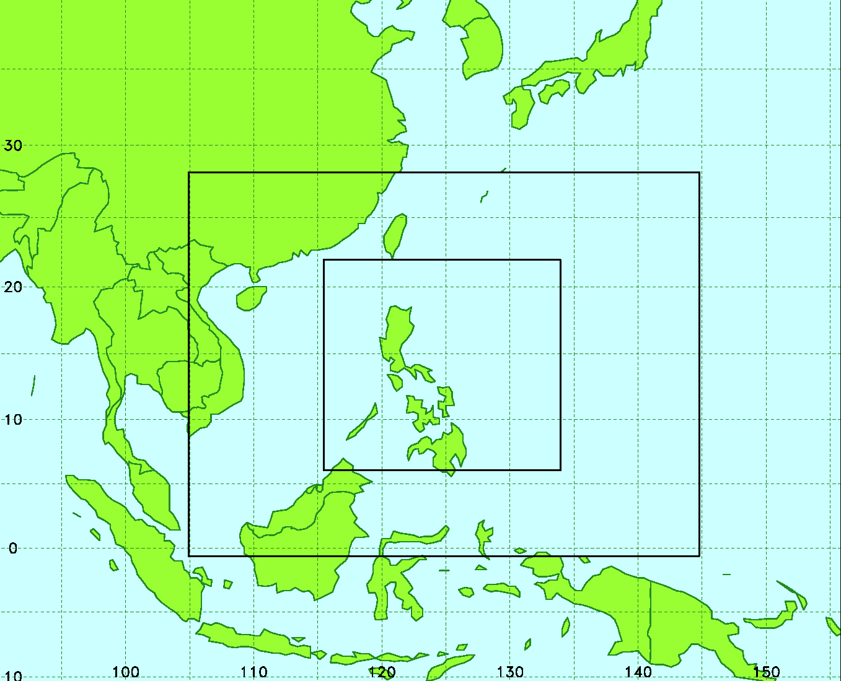
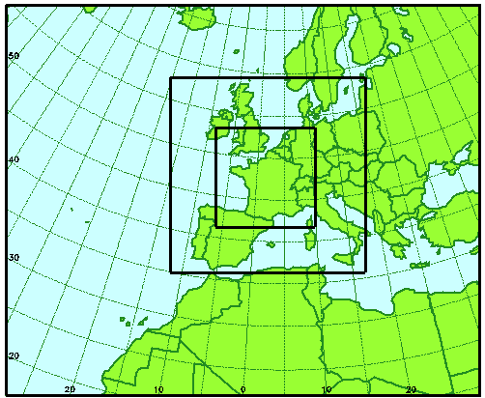
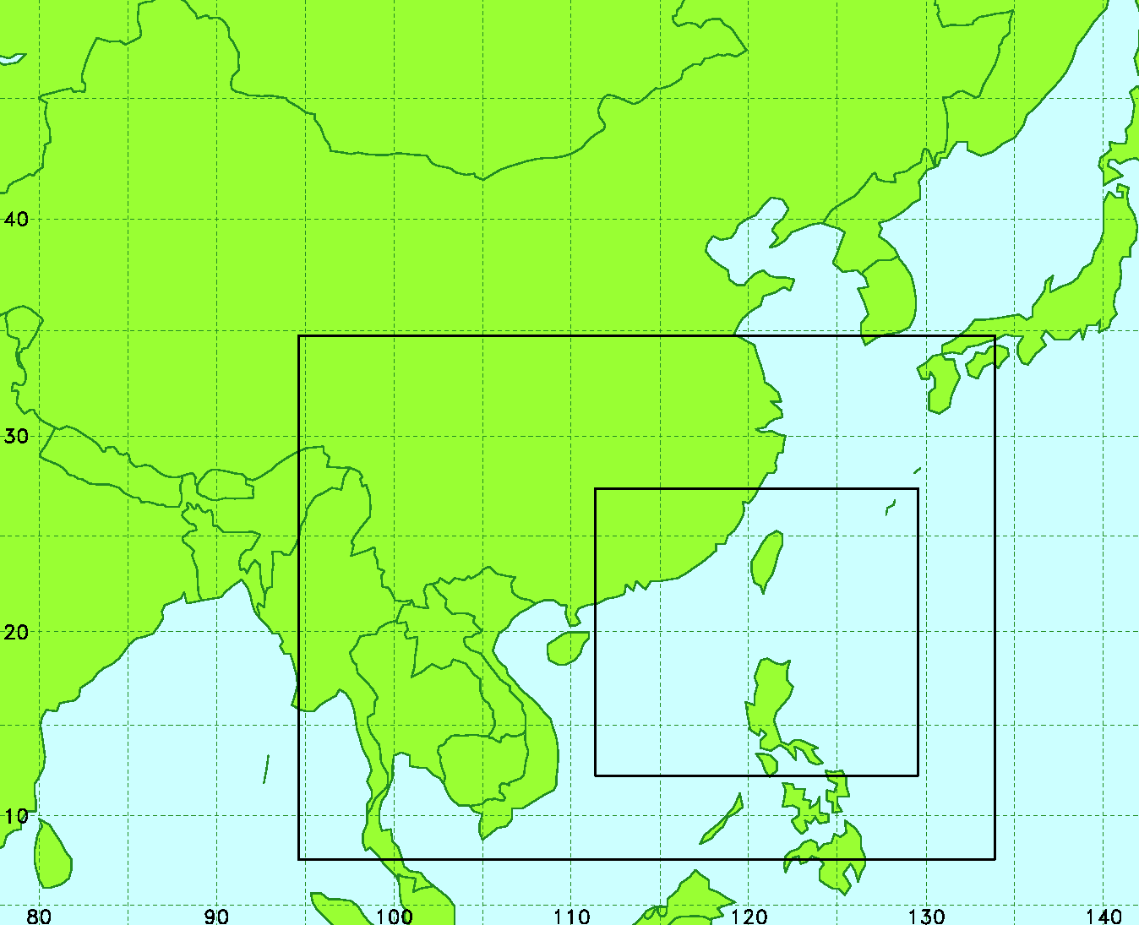
COAMPS 4DVar
Sample Model Domains
Much easier to assimilate radiances and GNSS-RO
COAMPS 4DVar has been tested over many regions with multiple nests, different map projections, and vertical levels. Wallclock ~15m for 45x45 km grid (121x91x30)
Notes:
~ 15 minutes, 80 processors, 130000 observations
45x45km (121x91x30)

Slide 22
New Research Activities
2. CalWater2: Atmospheric River
Multi-agency study of heavy California rainfall and rain influence on coastal upper-ocean temperature change. MMD employing CPP funded measurement suite, including microwave radiometers, laser disdrometer, all-sky camera to document cloud conditions, ceilometer, tipping bucket rain gauge, and surface meteorological station to record wind, pressure, temperature and relative humidity.
3. High Impact Weather Prediction Project (HIWPP)
  NOAA/ESRL collaborative investigation comparing NRL deterministic and probabilistic hydrostatic (NAVGEM T681L60) and non-hydrostatic (NEPTUNE) models with NOAA models to improve time-zero to two-week prediction of potentially dangerous storms (hurricanes, floods, and blizzards). We are currently running comparisons of NAVGEM with NOAA/ESRL and NOAA/EMC global models on local Cray DHPI supercomputer and is establishing the infrastructure to compare NAVGEM ensembles and NEPTUNE.
Next Generation Global Prediction System (NGGPS)
NOAA/NWS collaborative research to operations (R2O) initiative to expand and accelerate critical weather forecasting research to increase the accuracy of weather forecasts to provide forecast guidance for the next several decades. NEPTUNE has been selected for evaluation as a candidate.
HASI - Optimizing Global and Regional Earth Prediction
Leverage DoD HPCMP investments to implement new domain decomposition and optimization techniques for Navy Earth System Prediction models; including NAVGEM, COAMPS, NEPTUNE , NCOM, SWAN and WWIII. This effort will result in improved scaling on current platforms and provide a foundation for future efforts to migrate to emerging computational platforms (e.g. many-core, GPU systems).
Notes:
Asked Ted to update

Slide 23
ESPC Goals
National ESPC
National, multi-agency collaborative effort to leverage resources to develop the next generation earth prediction system
Extend current earth system prediction capability beyond weather regime to sub-seasonal, seasonal, interannual, and decadal time frame
Transition research to operations, support shared needs while accommodating diverse agency requirements
Navy ESPC
Support Navy for safety of flight, navigation, sensor and weapon performance, and mission planning, mitigation and effectiveness decisions.

Slide 24
Thank You

Slide 25
Backup

Slide 26
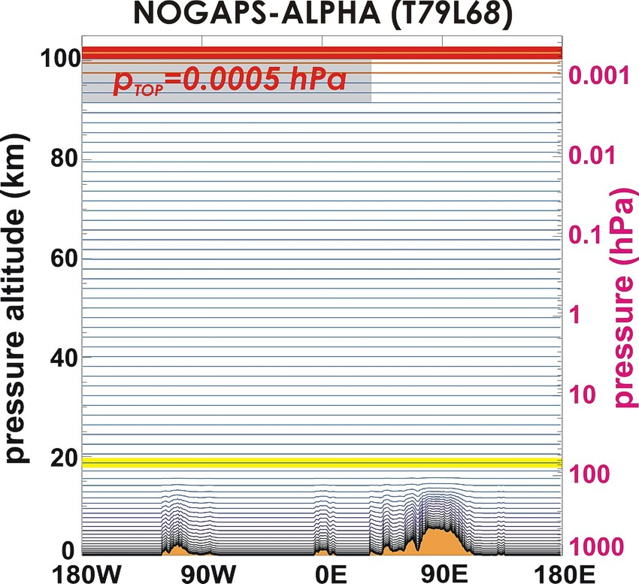
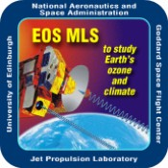
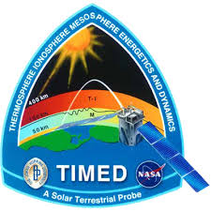
Current Middle Atmosphere Research Satellites
Aura MLS (O3, T, H2O)
- Launched July 2004
“Nominal mission lifetime of 5 years, with a goal of 6 years of operation”
TIMED SABER (O3, T)
Launched December 2001
“Original mission lifetime of 2 years extended to 5 years”
MLS
Temperature
SABER
Temperature
MLS Water Vapor
MLS Ozone
The future of middle atmospheric temperature, constituent observations for stratospheric DA research is uncertain
Notes:
POC/credit John McCormack.

Slide 27
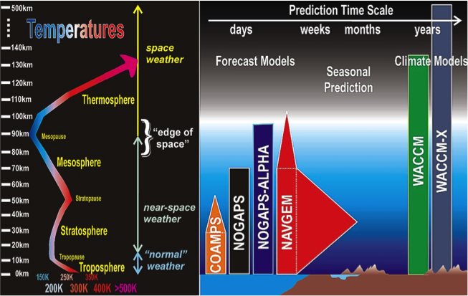

Slide 28
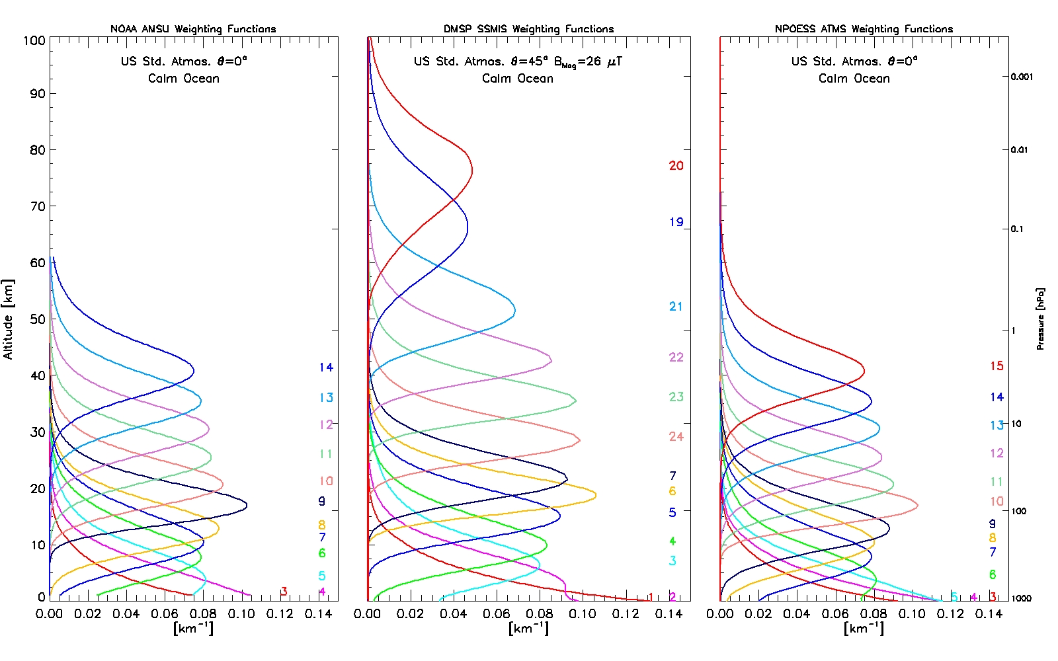
SSMIS UAS Assimilation
AMSU-A
SSMIS
ATMS
NAVGEM T359L50 Current Operational Navy Global NWP Model
Current operational MW data is capable of providing temperature information into the mesosphere
(e.g. Bell et al., 2008; Swadley et al., 2008; Hoppel et al. 2013)
Notes:
The SSMIS sensor is the only sensor with information above 65km with 3 channels 20, 19 and 21 able to provide information about the mesopause. Credit/POC Ben Ruston

Slide 29


High-Altitude Research with NAVGEM
Navy Global Environmental Model
NAVDAS-AR: Advanced Representer (4D-Var)
From Hoppel et al. (2013)
UAS assimilation uses CRTM with Zeeman splitting corrections
SSMIS – an operational sensor – can constrain the atmosphere nearly as well as research sensors MLS and SABER
Zonal mean temperature
On 14 July 2010 at 1200 UTC
Notes:
Credit/POC Ben Ruston (I think). Maybe Karl H. too.

Slide 30

Extending Model Top Past 100 km
Extension of NAVGEM model vertical domain past 100 km (left, blue curve) fully resolves atmospheric region sampled by SSMIS UAS channels on operational DMSP platforms (right).
Notes:
POC/Credit John McCormack

Slide 31

Extending Model Top Past 100 km
Zeeman splitting
UAS assimilation needs Community Radiative Transfer Model (CRTM) containing Zeeman Splitting corrections (Han et al. 2010)
Notes:
POC/Credit John McCormack

Slide 32

Parameterized Ozone Photochemistry
8.7 hPa 0.91 hPa 0.096 hPa 0.042 hPa 0.010 hPa 0.0033 hPa
NAVGEM currently uses a linearized ozone photochemistry parameterization based on diurnally averaged odd-oxygen (O3+O) production and loss rates in the stratosphere. It does not account for diurnal cycle in ozone present above 1 hPa.
A new generalized ozone photochemistry parameterization has been tested in NOGAPS-ALPHA (above), and is slated for testing in L74 NAVGEM.
Notes:
POC/Credit Steve Eckermann

