Slide 1
Overview of Short-term Prediction Research and Transition (SPoRT) Center
Mission: Transition unique NASA and NOAA observations and research capabilities to the operational weather community to improve short-term weather forecasts on a regional and local scale.
Close collaboration with numerous WFOs and National Centers across the country
SPoRT activities began in 2002, first products to AWIPS in 2003
Co-funded by NOAA since 2009 through “proving ground” activities
Proven paradigm for transition of research and experimental data to “operations”
Benefit:
Demonstrate capability of NASA and NOAA experimental products to weather applications and societal benefit
Prepare forecasters for use of data from next generation operational weather and climate satellites
Schematic of SPoRT R2O/O2R paradigm in test-bed environment

Slide 2
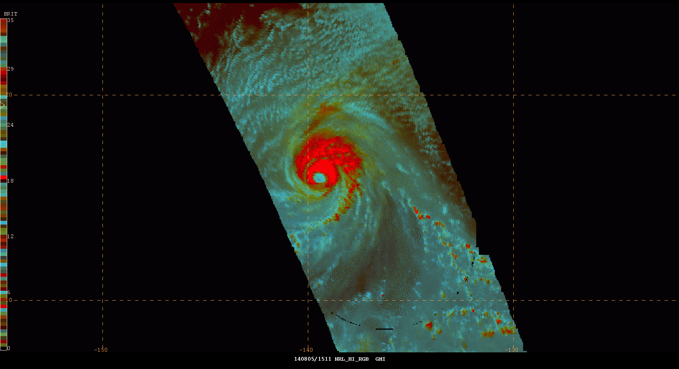
Transition of L1 GMI Data to Forecasters
Real-time processing and image by:
Frank LaFontaine (Raytheon)
Dr. Robert Atkinson (USRA)
Kevin McGrath (Jacobs)
Cyan: Non-convective clouds
Red: Colder cloud tops associated with intense convection and precipitation
Used by forecasters to get a fix on the center of a tropical system
Hurricane Iselle as observed by the GPM Microwave Imager; screen capture from N-AWIPS Decision Support System used at NOAA NHC and WPC
SPoRT has transitioned unique, real-time GPM products to NOAA’s National Hurricane Center (NHC) and Weather Prediction Center (WPC)
Image above shows combination of 3 channels (89 GHz) to from an RGB composite used by forecasters to locate the center and strongest convection of tropical systems
Notes:
The NASA Short-term Prediction Research and Transition (SPoRT) Center at Marshall Space Flight Center has been obtaining and processing L1 and L2 observations from the GPM Core and available Constellation satellites since last summer. We obtain the data from servers at Goddard, which serve the intercalibrated data products in near-real-time. SPoRT uses the L1 data to product multi-spectral composite imagery, which combines different channels to provide enhanced visualization of the imagery. In this example here, 3 channels are combined to form a composite that delineates the coldest cloud tops (in red) from other clouds (cyan). This imagery has been transitioned to the NOAA National Hurricane Center and Weather Prediction Center and is available for viewing by forecasters in their operational N-AWIPS decision support system (the image on this slide shows what the data looks like in N-AWIPS for Hurricane Iselle in August 2014). Forecasters have provided feedback on the product that this visualization and these data allow for easier pinpointing of the center of tropical systems and locating the areas of most intense convection.

Slide 3
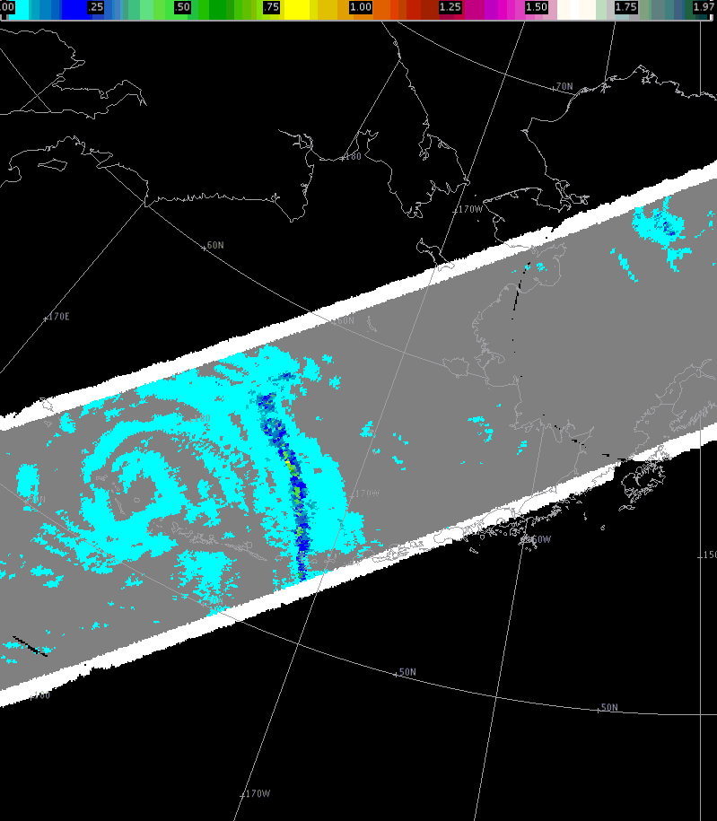
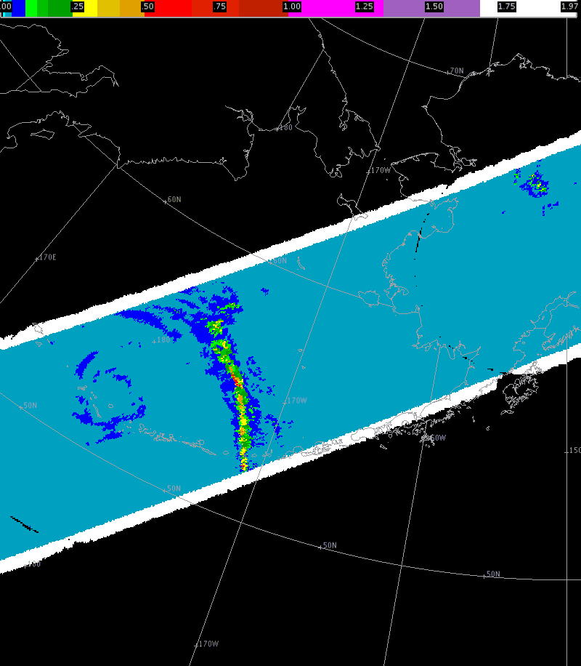
Transition of L2 Rain Rate Data to Forecasters
Default color curve
MRMS color curve in AWIPS II
Identifies very low rates and overall structure
Images by:
Frank LaFontaine (Jacobs)
Geoffrey Stano (ENSCO, Inc.)
Identifies strongest precipitation clearly
SPoRT obtains real-time L2 rain rate data from the GPM Processing System, formats for AWIPS II, and disseminates to forecasters via LDM
Can supplement radar information in data-void regions over water and parts of western U.S.
Evaluation planned for July/August with NWS WFOs to investigate operational impact of L2 observations in detecting and aiding in forecast of monsoon events
Notes:
The NASA Short-term Prediction Research and Transition (SPoRT) Center at Marshall Space Flight Center has been obtaining and processing L1 and L2 observations from the GPM Core and available Constellation satellites since last summer. We obtain the data from servers at Goddard, which serve the intercalibrated data products in near-real-time. SPoRT uses the L1 data to product multi-spectral composite imagery, which combines different channels to provide enhanced visualization of the imagery. In this example here, 3 channels are combined to form a composite that delineates the coldest cloud tops (in red) from other clouds (cyan). This imagery has been transitioned to the NOAA National Hurricane Center and Weather Prediction Center and is available for viewing by forecasters in their operational N-AWIPS decision support system (the image on this slide shows what the data looks like in N-AWIPS for Hurricane Iselle in August 2014). Forecasters have provided feedback on the product that this visualization and these data allow for easier pinpointing of the center of tropical systems and locating the areas of most intense convection.

Slide 4
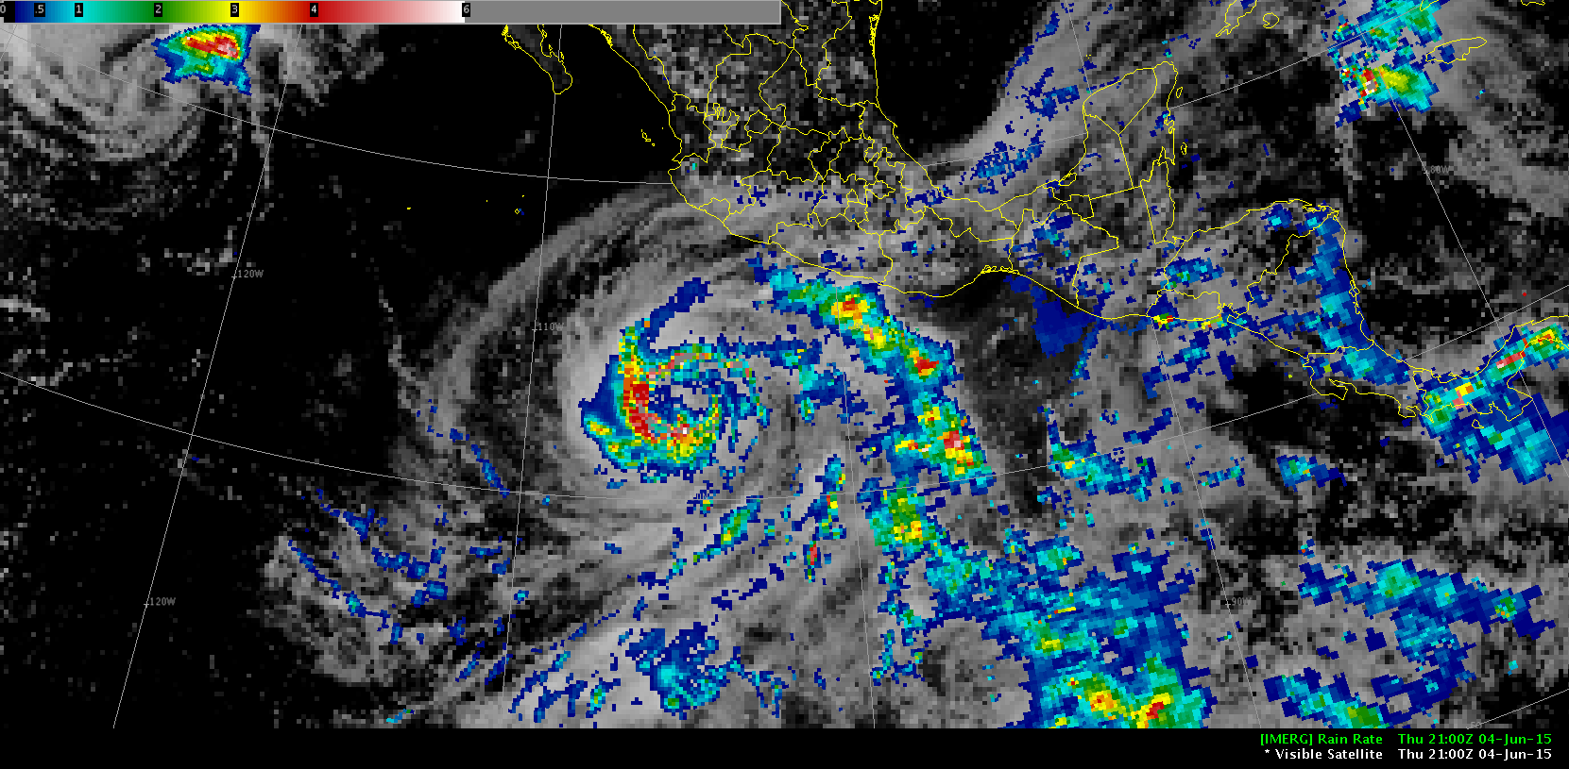
Transition of L3 IMERG Data to Forecasters
Image by: Matt Smith (UAH)
Hurricane Blanca
2100 UTC 4 June 2015
SPoRT obtains real-time IMERG data from the GPM Processing System, formats for AWIPS II, and disseminates to forecasters via LDM
Due to latency, most useful for hydrologic applications to pinpoint areas of heaviest rainfall outside of radar coverage
Evaluation planned for this fall with River Forecast Center forecasters in Southern Alaska
Notes:
The NASA Short-term Prediction Research and Transition (SPoRT) Center at Marshall Space Flight Center has been obtaining and processing L1 and L2 observations from the GPM Core and available Constellation satellites since last summer. We obtain the data from servers at Goddard, which serve the intercalibrated data products in near-real-time. SPoRT uses the L1 data to product multi-spectral composite imagery, which combines different channels to provide enhanced visualization of the imagery. In this example here, 3 channels are combined to form a composite that delineates the coldest cloud tops (in red) from other clouds (cyan). This imagery has been transitioned to the NOAA National Hurricane Center and Weather Prediction Center and is available for viewing by forecasters in their operational N-AWIPS decision support system (the image on this slide shows what the data looks like in N-AWIPS for Hurricane Iselle in August 2014). Forecasters have provided feedback on the product that this visualization and these data allow for easier pinpointing of the center of tropical systems and locating the areas of most intense convection.

Slide 5
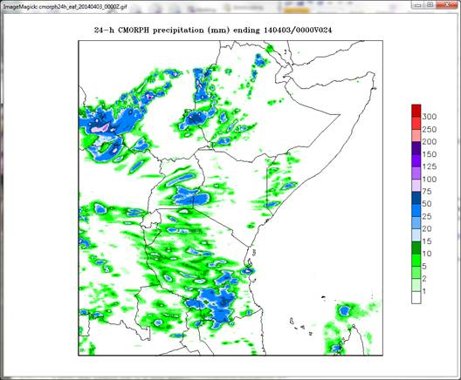
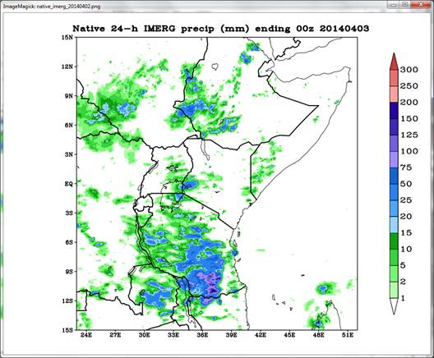
Integration of IMERG Product into Real-Time Land Surface Model
Images by: Jonathan Case (ENSCO, Inc.)
SPoRT has completed work to integrate the GPM L3 IMERG product into a real-time, high-resolution version of the NASA Land Information System (LIS) used by SERVIR partners in East Africa for soil moisture diagnostics and local NWP model initialization
IMERG (right) replaces legacy CMORPH (left) as the precipitation forcing dataset for OCONUS SPoRT-LIS
IMERG will also be used by forecasters to validate regional model forecasts of precipitation

Slide 6
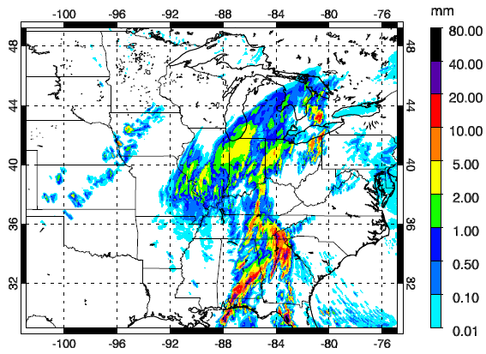
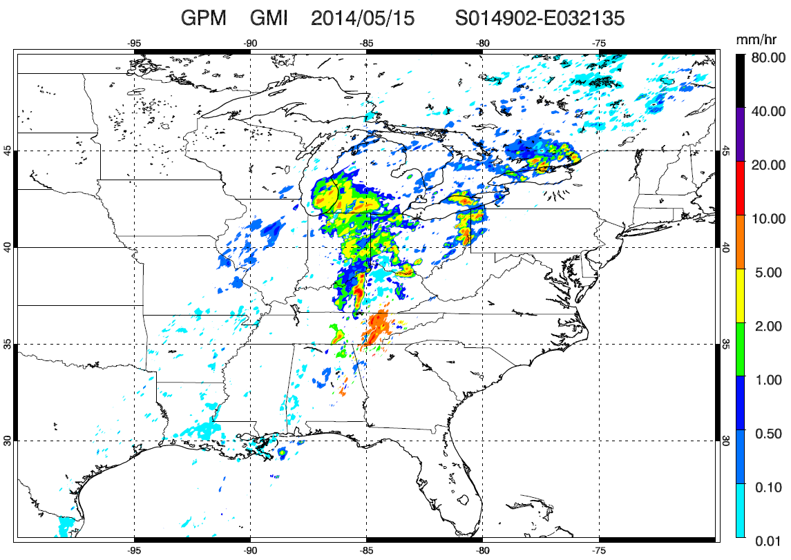
Assimilation of GPM Products into Regional NWP
Control Model Simulation
GMI L2 rain rates
Oversimulation of stratiform rain over IL/IN
Images by: Xuanli Li (UAH)
SPoRT-funded project to integrate L2 GPM observations into the Gridpoint Statistical Interpolation (GSI) data assimilation system for regional NWP applications
Generate packages in community GSI to assimilate GPM data (L2 GMI rainfall and DPR reflectivity)
Will work with Developmental Testbed Center (DTC) to transition new assimilation modules into the community GSI for use by the weather community and potential integration into operational systems

Slide 7
Summary
As part of SPoRT’s Early Adopter Efforts, GPM observations have been transitioned to operational forecasters to address specific forecast challenges
Forecast challenges addressed:
Pinpoint the center of tropical cyclones (NHC, WPC/OPC)
Supplement radar data for nowcasting precipitation in data void regions (WFOs)
More accurate accumulated precipitation observations in radar void regions for hydrologic applications (RFCs)
Forcing for international land surface models
Assimilation into regional forecast models to improve precipitation NWP forecasts
As assessments unfold, SPoRT will share feedback on the operational utility of GPM products with the Science Team

