Slide 1
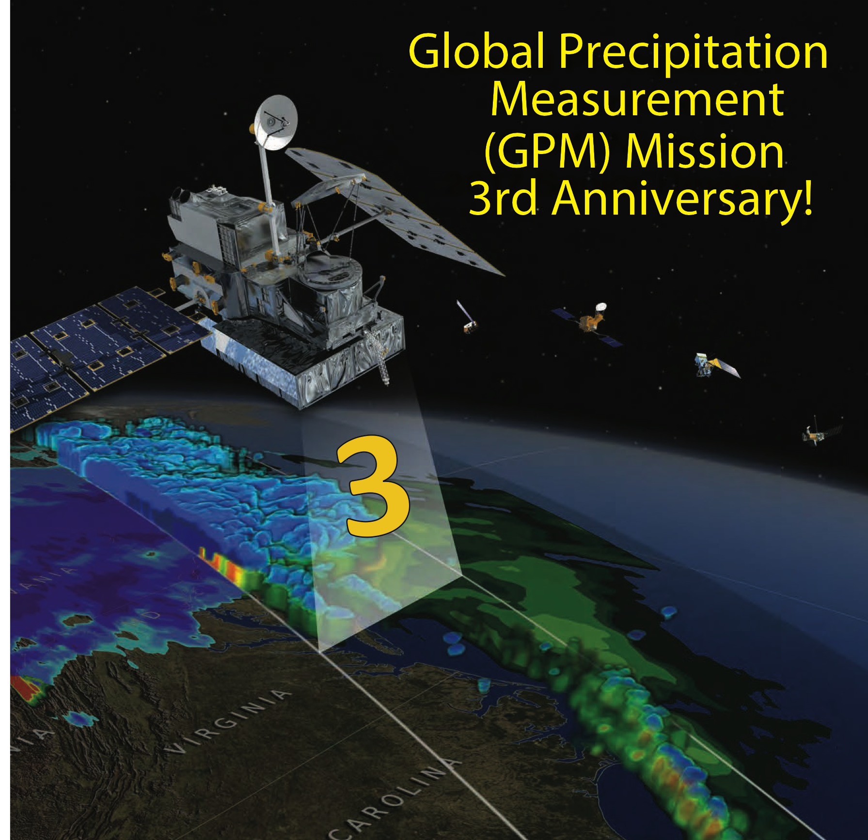
Global Precipitation Measurement (GPM)
Gail Skofronick Jackson
GPM Project Scientist
NASA Goddard Space Flight Center
Gail.S.Jackson@nasa.gov
Workshop on Agriculture Applications of NASA Water Data
World Resource Institute
1 August 2017

Slide 2
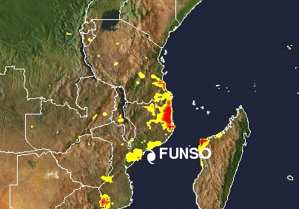
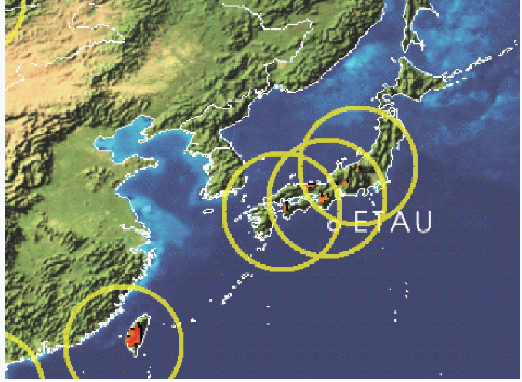
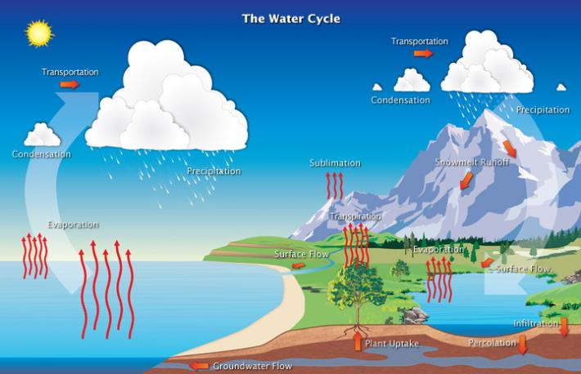
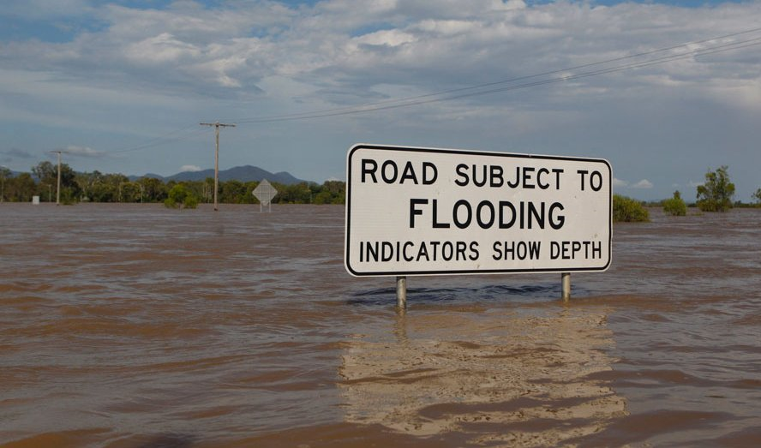
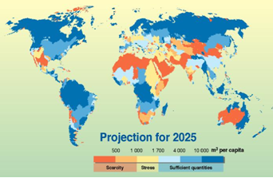
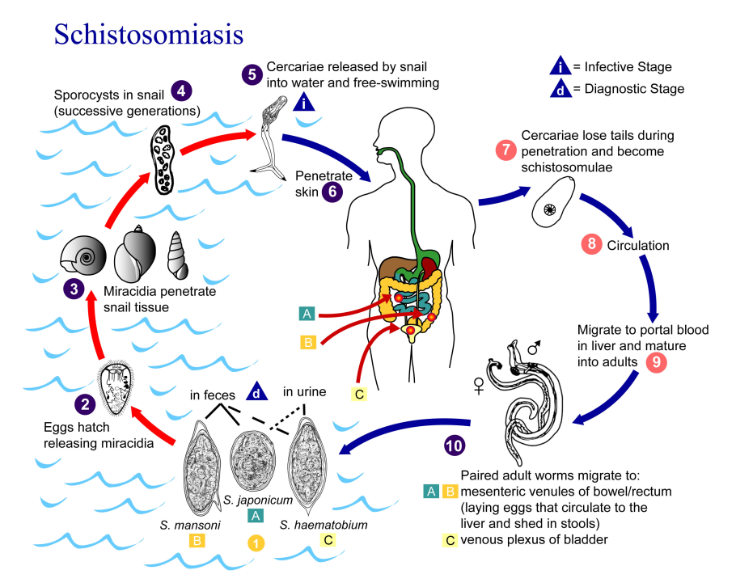
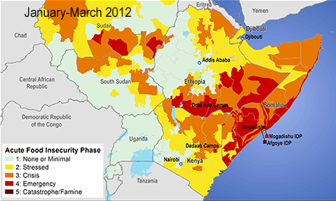
GPM: A Science Mission with Integrated Application Goals
Flooding
Landslides
Land surface and climate modeling
Freshwater Availability
GPM Science Objectives:
New reference standards for precipitation measurements from space
Improved knowledge of water cycle variability and freshwater availability
Improved numerical weather prediction skills
Improved climate prediction capabilities
Improved predictions for floods, landslides, and freshwater resources
Extreme Events
World Health
Agriculture/Famine Early Warning

Slide 3
GPM Core Observatory Spacecraft
The GPM Core Observatory will carry two advanced instruments that allow us to view precipitation (rain, snow, ice) in new ways and serve as a connector between the GPM Core and measurements taken on other partner satellites
0.2- 110 mm/hr and falling snow
GPM Microwave Imager (GMI): 10-183 GHz (NASA)
13 channels which provide an integrated picture of the energy emitted by precipitation (wide swath surface rain & snow data)
Dual-frequency Precipitation Radar (DPR): Ku-Ka bands (JAXA) Two different radar frequencies that can look at precipitation in 3-D throughout the atmospheric column.
Non-Sun-Synchronous orbit at 65º inclination (Arctic to the Antarctic Circle) at 407 km
Notes:
Gail

Slide 4
GPM Precipitation Products
GMI | DPR | Combined | Multi-Satellite
Level 1: Calibrated TB; Level 2: precip rates; Level 3: accumulations | Level 1: Calibrated powers; Level 2: Z & precip rates; Level 3: accum. | Level 2: Combined DPR & GMI; Level 3: accumulations | Level 2: precip rates; Level 3: accumulations
Latency: 1 hr (Avg: TB: 17 min; GPROF: 23 min) | Latency: Near real time 3 hrs (Avg: 76 min) | Latency: Near real time 3 hrs (Avg: 83 min) | Average latency 4-5 hrs
15 km resolution, 880 km swath | ~5 km horizontal res., 250-500 m vertical res, Ku: 245 km swath, Ka: 120 km swath | ~15 km resolution | ~10 km res., every 30 minutes, Uses IR to fill between microwave for 30 min data
Name: GPROF | Name: DPR | Name: CORRA | Name: IMERG
GPROF, DPR, & CORRA Version 05 released May 9, 2017

Slide 5
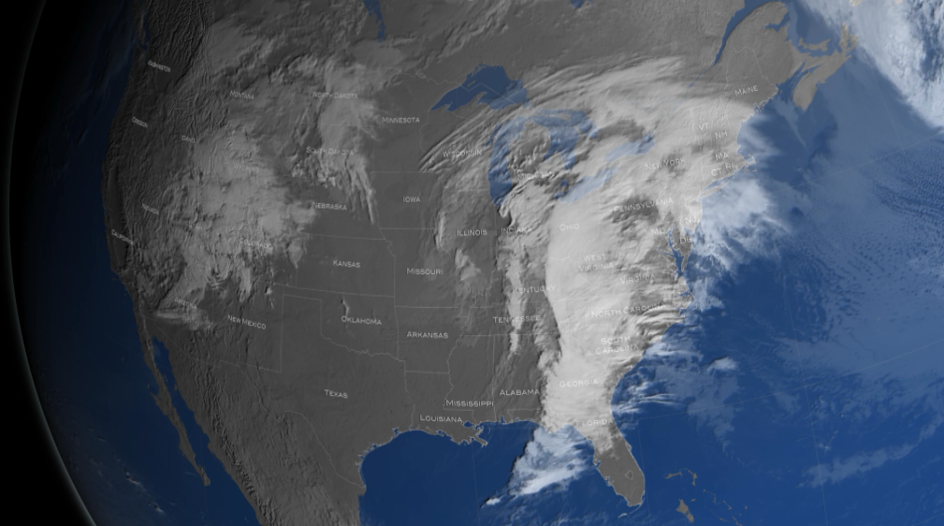
April 1, 2017 Snow Storm
NASA's Global Precipitation Measurement (GPM) Core Observatory satellite flew over the United States northeast coast during a snow storm on April 1, 2017. This snow storm delivered up to 18 inches of snow in some parts of New England.
Notes:
This visualization starts over the United States as the viewer watches a weather event form over the east coast. We then freeze on April 1, 2017 as GPM flies overhead collecting data over this weather system. Zooming down to the Northeast, GPM's DPR (3D volumetric precipitation data) is slowly cut away to reveal the inner precipitation structure of the snow storm. Looking closely, one can see a thin band of liquid precipitation that formed in the northern section of the storm eventually tapering into frozen precipitation in the far north. The visualization wraps with the camera pulling back to a bird's eye view of the snow storm.

Slide 6
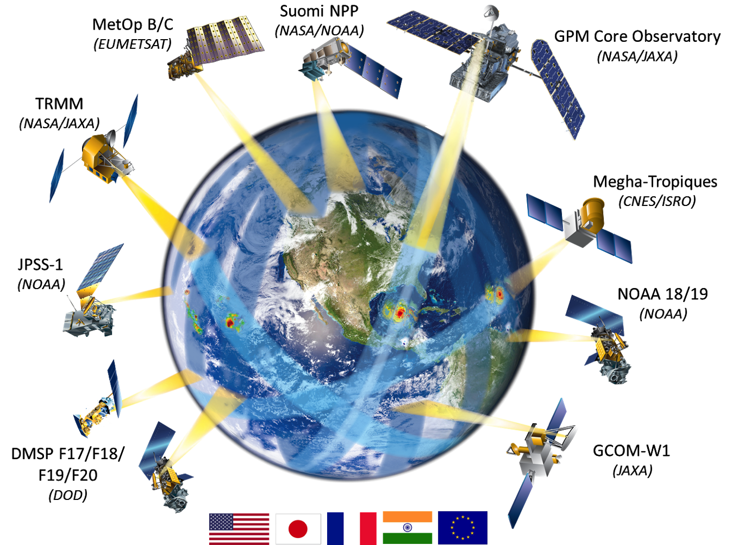
GPM Constellation Concept
DPR (Ku & Ka band)
GMI (10-183 GHz)
65º Incl & 407 km Alt.
5 km best resolution
Rain 0.2–110 mm/hr & snow
TRMM
1998-2015
1-year overlap with GPM
Next-Generation Unified Global Precipitation Products Using GPM Core Observatory as Reference
Notes:
Constellation members are passive microwave radiometers

Slide 7
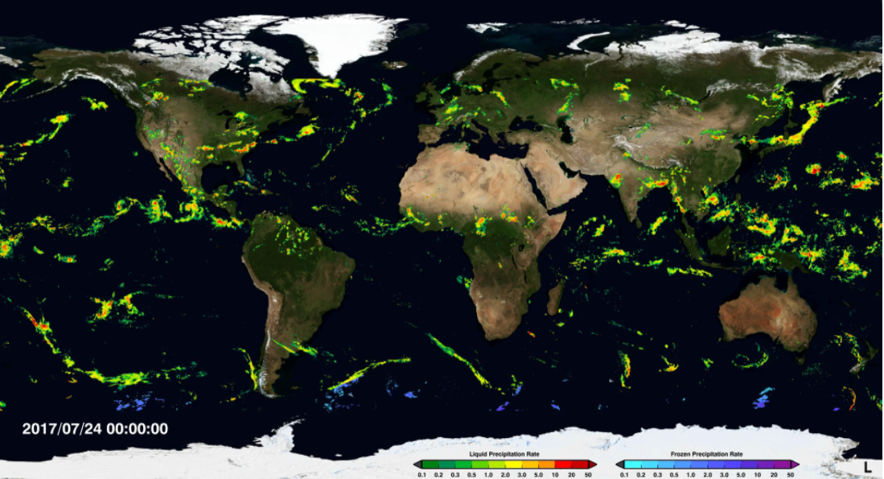
Precipitation: July 24-31, 2017
Integrated MultisatellitE Retrievals for GPM (IMERG) available (with a 4-5 hour latency from observations) every 30 min at a 0.1deg by 0.1deg gridbox

Slide 8
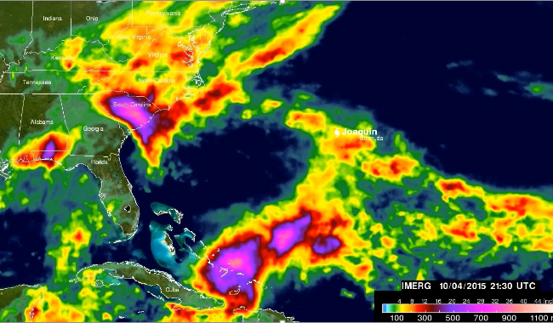
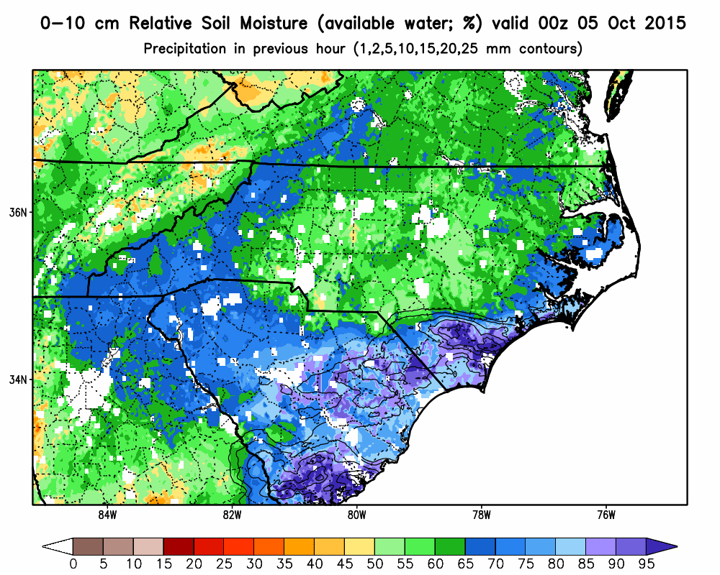
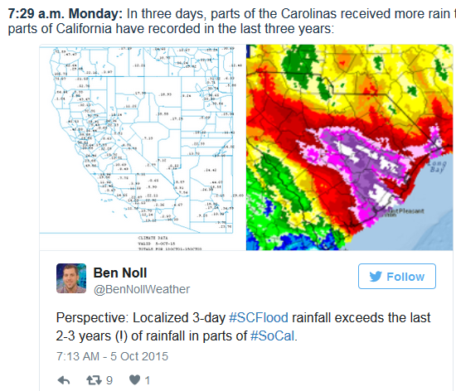
North Carolina and Hurricane Joaquin
Examples of Daily NASA Products Provided to FEMA via the U.S Hazard Data Distribution System for Disaster Response.
NASA Land Information System run operationally at MSFC using NOAA Stage IV precipitation and other forcing inputs to produce analyses and short term forecasts of soil moisture and other parameters. GPM and SMAP data are being integrated.
http://www.accuweather.com/en/weather-news/live-rain-lashes-eastern-us-ma/52740263
October 08, 2015
http://www.cnn.com
Notes:
Gridpoint Statistical Interpolation (GSI), NASA’s Land Information System (LIS) runs operationally at MSFC. GPM and SMAP data are being integrated into this system.
Extreme “relative” soil moisture maximums in the areas of heavy rain. Forecasters are provided this data in near real-time by SPoRT at MSFC and the data are actively being assessed with feedback provided by partners in Raleigh, among other Eastern Region NWS forecast offices. In the graphic, dark blues and purples suggest that these soils are holding 70-95+% of their water capacity, hence significant and immediate runoff that contributes to flash flooding.

Slide 9
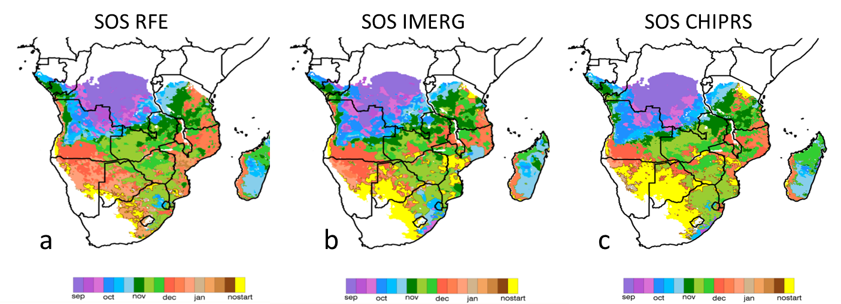
Agricultural Monitoring
Precipitation Estimates for Remote Agricultural Drought Monitoring
Start-of-season (SOS) for the 2015-16 Southern Africa growing season, computed with three different satellite derived rainfall estimates
Contribution from McNally et al.
Kirschbaum et al. 2016, BAMS
“While the IMERG product’s spatial resolution, temporal latency and, for this example, agreement with the CHIRPS shows great promise, its utility for FEWS NET will be better assessed when a longer time series is available.”

Slide 10
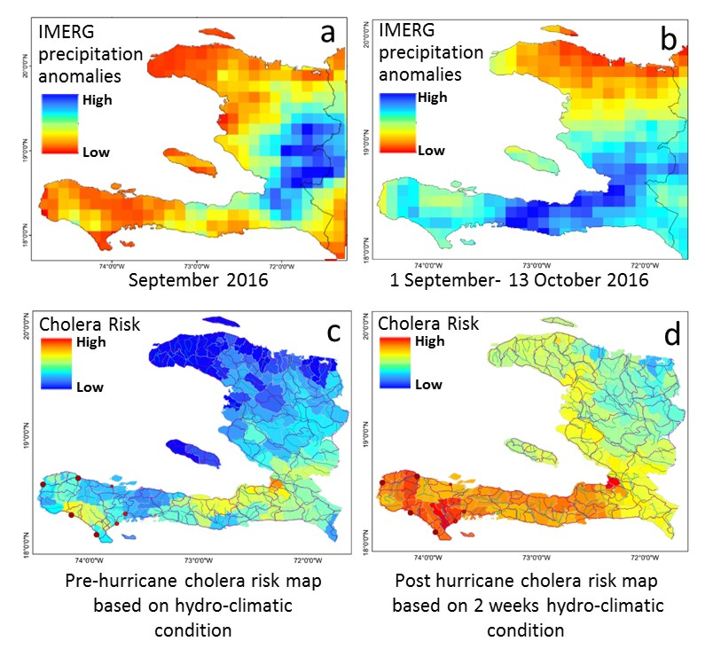
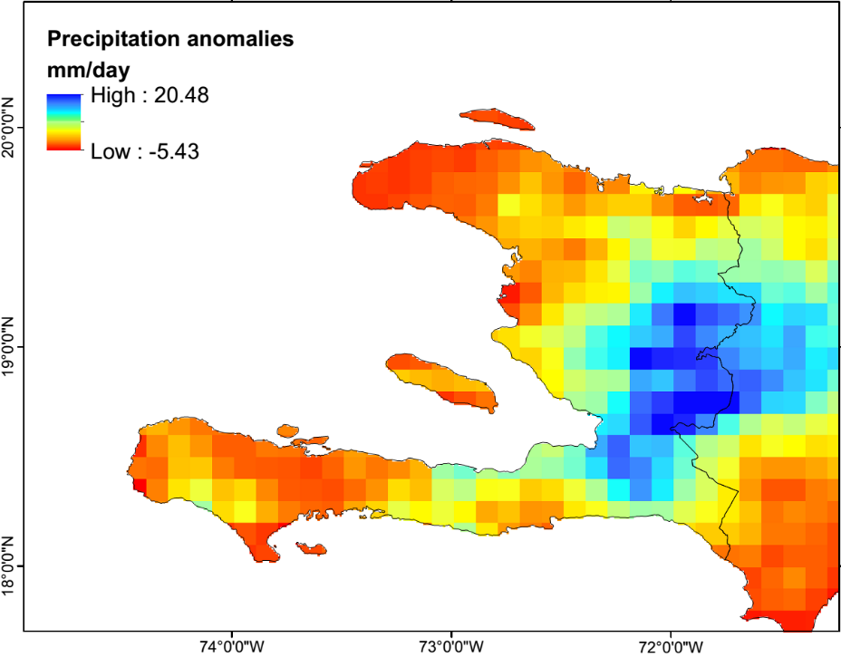
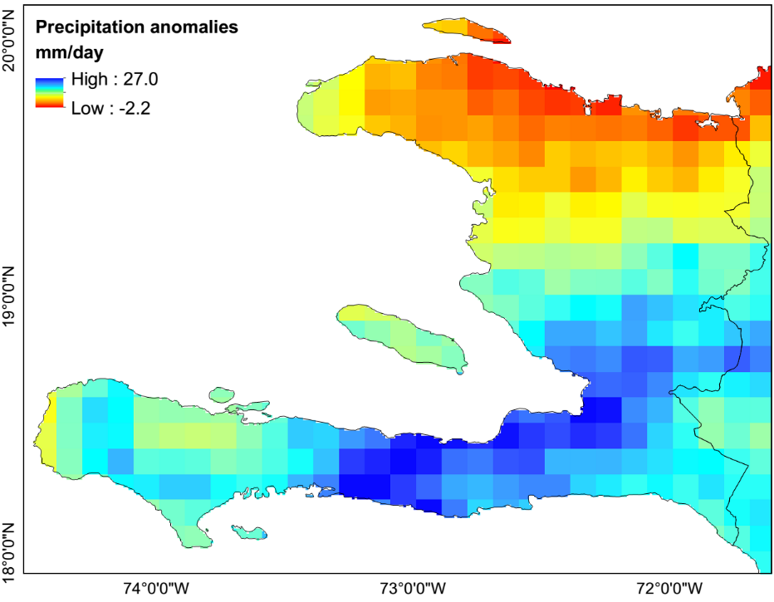
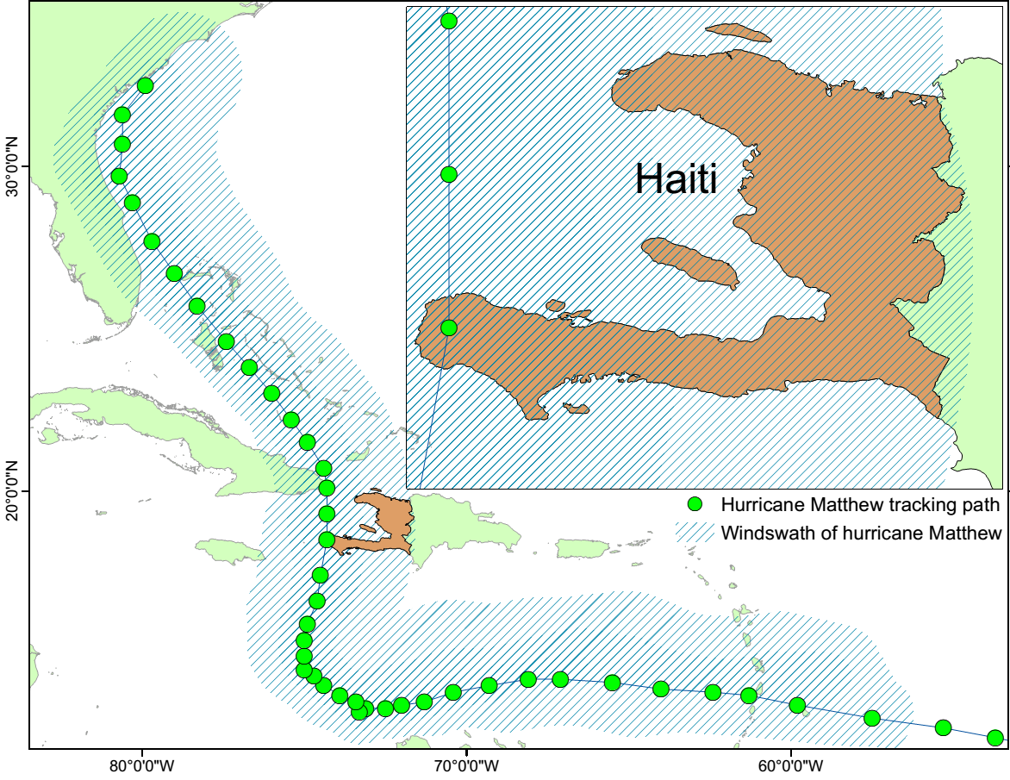
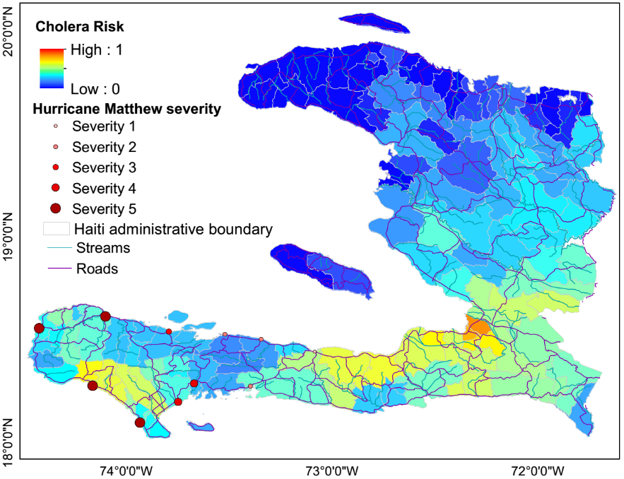
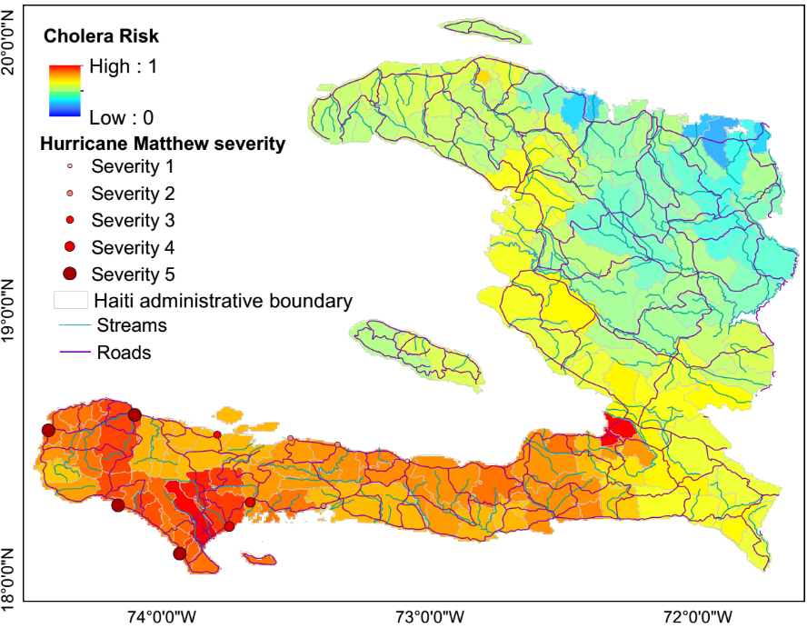
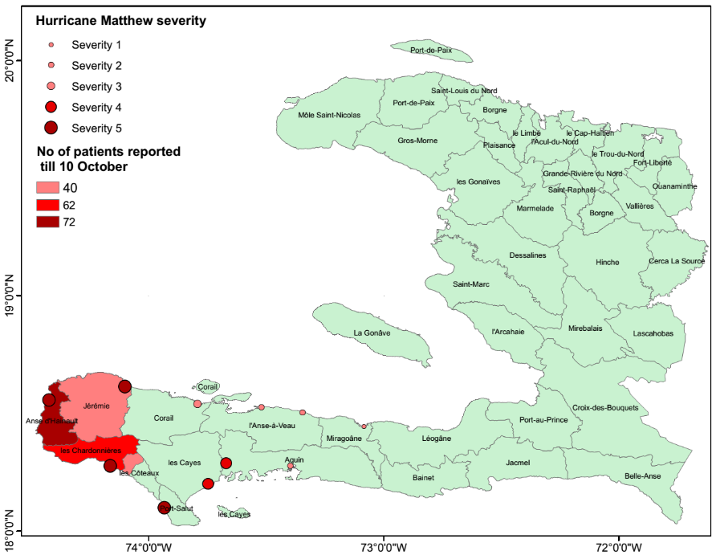
GPM Used to Estimate Cholera Risk
September precipitation anomalies
(Sept1-Oct13) precipitation anomalies
Hurricane Matthew track over Haiti
Cholera condition in Haiti till 10 October
Cholera risk map based
on 2 weeks post hurricane hydro-climatic condition
Cholera risk map based on
pre hurricane hydro-climatic condition
GPM IMERG data was used along with air temperature anomalies and population to compute maps of estimated cholera risk in Haiti following the passage of Hurricane Matthew 1-2 October, 2016. Plots show a) IMERG precipitation anomalies prior to and b) following Hurricane Matthew; c) track forecast for Matthew over Haiti, d) shows a Cholera risk map based on pre-hurricane hydroclimatic conditions, e) updated Cholera risk map 2 weeks after Hurricane Matthew, and f) reported cases of Cholera as of 10 Oct 2016.

Slide 11
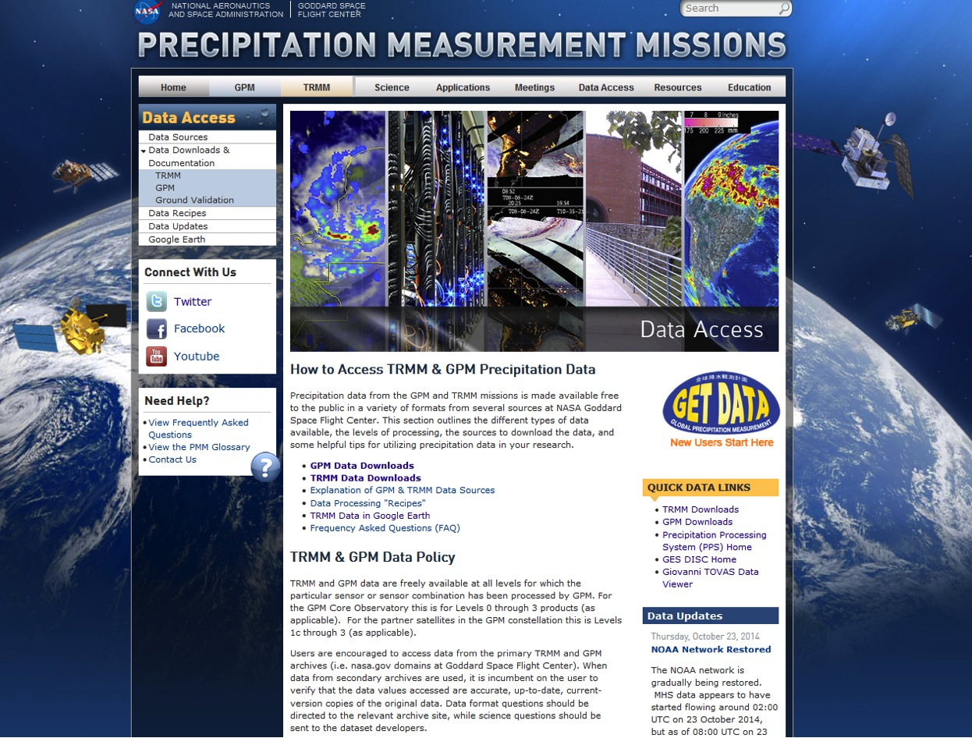
Data Access (http://gpm.nasa.gov)

Slide 12
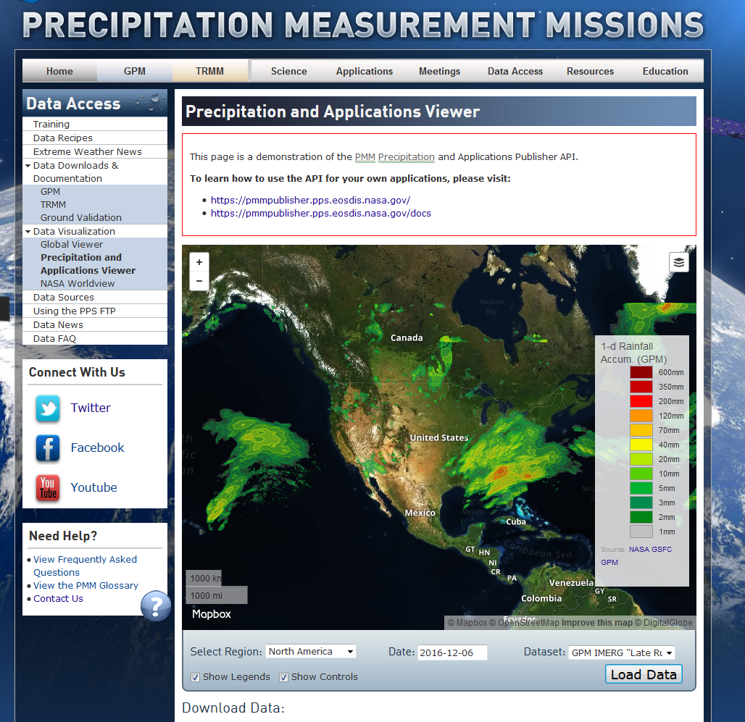
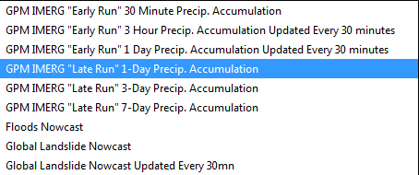
GPM Data Publisher
Available datasets:
IMERG 30mn, 3hr, 1day, 7day
Flood Nowcast (GFMS, U of MD)
Global Landslide Nowcast Model (NASA GSFC)
Export file formats: geoJSON, topoJSON, arcJSON, TIF, SHP
Publisher / consumer architecture – use the API to automate data collection or write your own consumer UI.
NOW AVAILABLE: https://pmm.nasa.gov/precip-apps

Slide 13
Spacecraft, Science, and Outreach
Spacecraft & Instruments
Excellent performance & Accuracy
Fuel projected to last into 2030’s
Science Team
60 NASA funded Principal Investigators
22 International (no cost) teams
Outreach
Twitter & Facebook: NASARain
INFO/DATA: gpm.nasa.gov
MOVIES: svs.gsfc.nasa.gov
EDUCATION: gpm.nasa.gov/education

