Slide 1
Mapping Commodity Flows for Strategic Freight Policy The Case of Minnesota’s agricultural and medical supply chain
Photo by Orbon Alija/iStock

Slide 2
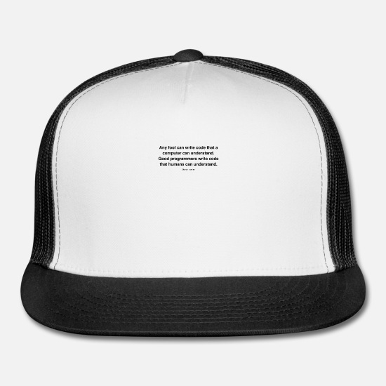
Quick context
Work conducted 2016 – 2018, as grad RA
University of Minnesota
Connections to sustainability
Considerations for GPM

Slide 3
Why Freight policy? Implications for climate and cities.
By 2050, demand for goods is expected to more than triple. In the U.S., already 80% of all goods start or end in cities.
Climate:
Transport contributes 14% of the planet’s greenhouse gas emissions, 40% of comes from freight.
Air quality:
China: diesel trucks contribute a half to two-thirds of major pollutants.
Road safety:
EU: Despite a small fraction of the vehicle pop., trucks responsible for a quarter of road fatalities.
Colombia: quarter of bicyclist deaths last year were due to trucks.
We should be aiming for a “triple zero” bottom-line for freight: zero emissions, zero road deaths and zero exclusion.
Photographer: Asim Hafeez/Bloomberg; SOURCE: WRI 2020

Slide 4
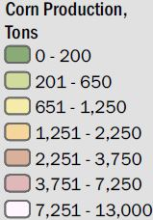
Let’s Start with Ag
Minnesota corn production, 2014
28% of all freight volume on the roadways is grain related, the highest share of any commodity in the state
And it’s growing. between 1990 and 2016, state corn production increased by more than half.
Source: Fried et. al. 2018
Notes:
Minnesota produced over 43 million tons of corn and 11 million ton of soybeans (2014)
3rd biggest producer of grain and oilseed in the country.
Production growing - between 1990 and 2016, state corn production increased by more than half.

Slide 5
“Farmers are [trucking] more outputs over longer distances compared to the previous pattern where farmers would focus on short moves to local consolidation points and rail terminals”
“We hauled [crops] over 50 miles. We're going to haul where the money's good. It doesn't really matter how far we have to go.”
Source MnDOT, Interviews with farmers

Slide 6
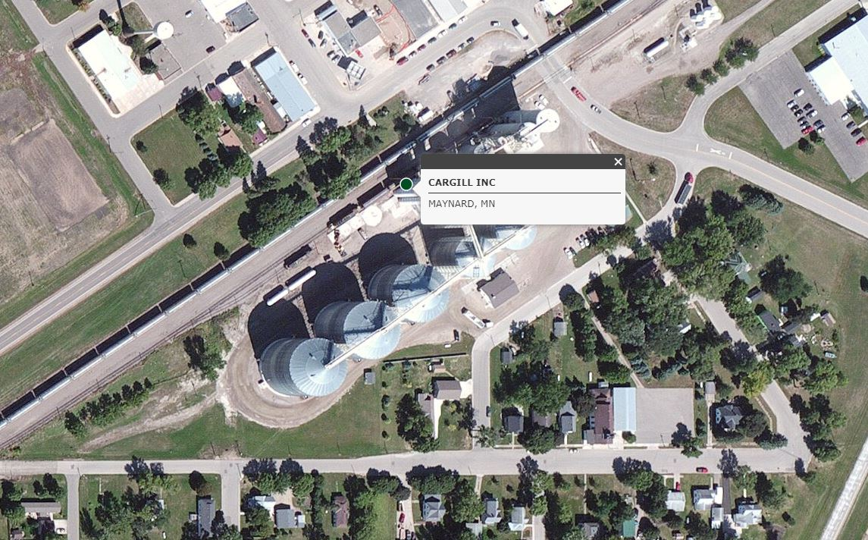
Traditional Markets are consolidating – shuttle elevators
Rail companies have incentivized large, rail-served elevators to up loading capacity to serve ‘shuttle’ trains, out-competing small elevators
In North Dakota, less than a dozen shuttle grain elevators handled two-thirds of the state’s crop production.
Minnesota is estimated to have 37 shuttle elevators, out of a total 384 elevators
SOURCE: FHWA 2016, Tolliver et. al. 2005, Fried et. al. 2020
Notes:
Farmers reporting driving upwards to 100 miles to reach markets
Rail companies incentivize large, rail-served elevators to up loading capacity to serve ‘shuttle’ trains, out-competing small elevators = fewer market options.
In North Dakota, less than a dozen shuttle grain elevators handled two-thirds of the state’s crop production.
Minnesota is estimated to have 37 shuttle elevators, out of a total 384 elevators
According to ReferenceUSA and MnDOT, Minnesota has over 384 elevators (green dots). Of these, 11 are barge-serving elevators on the Minnesota and Mississippi River (blue diamonds), which connect bulk grain to export ports in New Orleans. It is estimated that 37, perhaps more, are modern, high-capacity, rail-serving elevators (large green dots). These elevators are capable of loading 100-150 car trains, or 'shuttles', at remarkable speeds. Shuttles are primarily responsible for carrying grain to export ports in the Pacific Northwest
Minnesota is also home to 20 ethanol refineries (orange squares) producing renewable alternatives for car and diesel fuel. Last year Minnesota produced 1.2 billion gallons of ethanol, making the state the fourth largest producer of biofuel in the country.
With greater freedom to adjust shipping prices, major railroads incentivize larger, Class-I rail-served elevators to up loading capacity, out-competing smaller country elevators. In North Dakota, for instance, less than a dozen shuttle grain elevators handled two-thirds of the state’s crop production (1).
In the past, country elevators were important local hubs connecting producers to the broader marketplace. Today, some farmers are reporting driving upwards to 100 miles to reach destination markets (2). Trucks are increasingly occupying a greater modal share of cereal grain transportation at the expense of rail and barge, which have experienced a steady decline in modal usage.
(*) Major rail companies are having a substantial hand in solidifying truck’s modal role for shorter and in-state hauls to domestic grain markets. In 1980, the U.S. passed the Stagger's Act, which allowed railroad companies to operate as a 'profit-driven business.' Federal deregulation policies since then has increasingly granted railroad companies, like BNSF, Union Pacific, and Canadian National (all of whom operate in Minnesota) greater economic freedom in consolidating less profitable shortline rails and adjusting rate incentives for bulk, primarily agricultural, shippers.
(*) With greater freedom to adjust shipping prices, major railroads incentivize larger, Class-I rail-served elevators to up loading capacity to serve shuttle trains, often out-competing smaller country elevators. In North Dakota, for instance, less than a dozen shuttle grain elevators handled two-thirds of the state’s crop production.
Tolliver, D., M. Berwick, and K. Vachal. Farm-to-Market Transportation Patterns and Truck Use in the Northern Plains. Prepared for Bureau of Transportation Statistics and U.S. Department of Transportation, 2005.

Slide 7
New-ish markets are emerging - Biofuel
Minnesota is also home to 20 ethanol refineries
USDA to invest $100 million to increase biofuel sales through Higher Blends Infrastructure Incentive Program as part of COVID Relief
Not much compared to $17.5 billion investment in fossil fuels, but may lead to future increases
SOURCE: DOE 2020; EPT 2020; USDA 2020
Notes:
According to ReferenceUSA and MnDOT, Minnesota has over 384 elevators (green dots). Of these, 11 are barge-serving elevators on the Minnesota and Mississippi River (blue diamonds), which connect bulk grain to export ports in New Orleans.
It is estimated that 37, perhaps more, are modern, high-capacity, rail-serving elevators (large green dots). These elevators are capable of loading 100-150 car trains, or 'shuttles', at remarkable speeds. Shuttles are primarily responsible for carrying grain to export ports in the Pacific Northwest
Minnesota is also home to 20 ethanol refineries (orange squares) producing renewable alternatives for car and diesel fuel. Last year Minnesota produced 1.2 billion gallons of ethanol, making the state the fourth largest producer of biofuel in the country.
With greater freedom to adjust shipping prices, major railroads incentivize larger, Class-I rail-served elevators to up loading capacity, out-competing smaller country elevators. In North Dakota, for instance, less than a dozen shuttle grain elevators handled two-thirds of the state’s crop production (1).

Slide 8
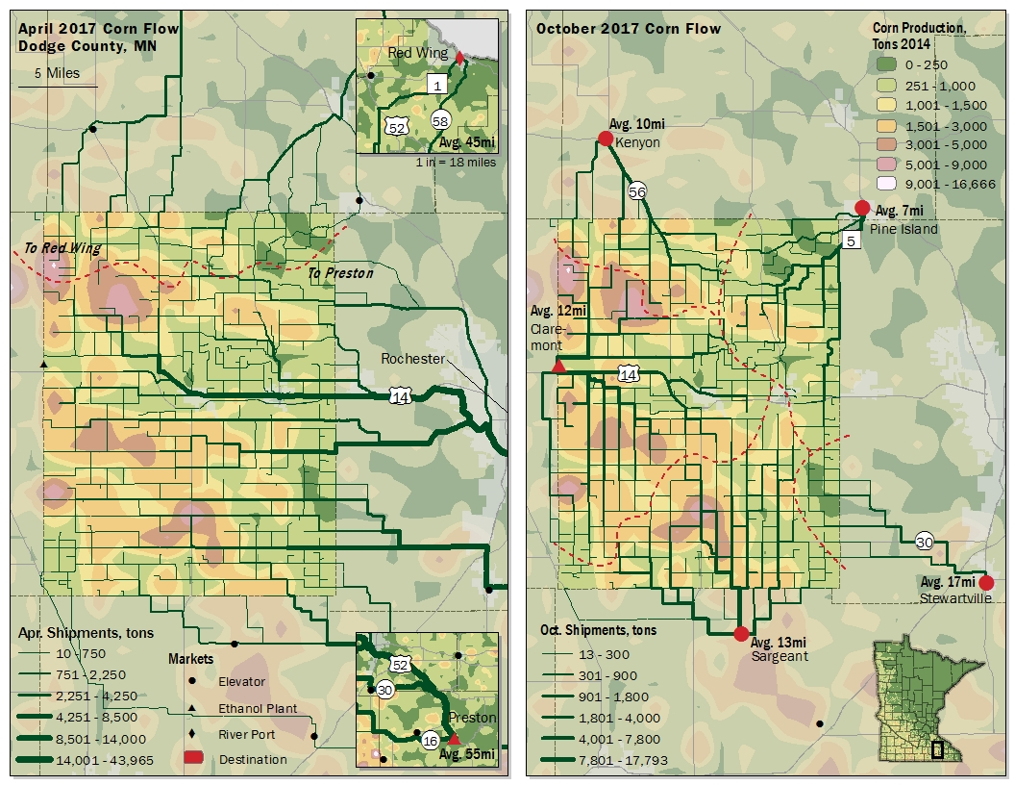
So where does all that grain go?

Slide 9
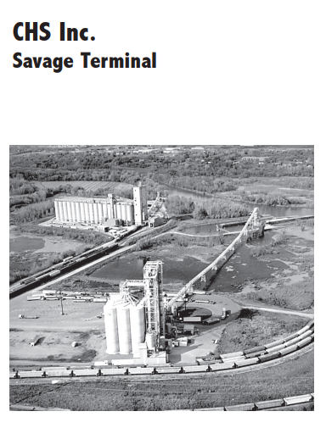
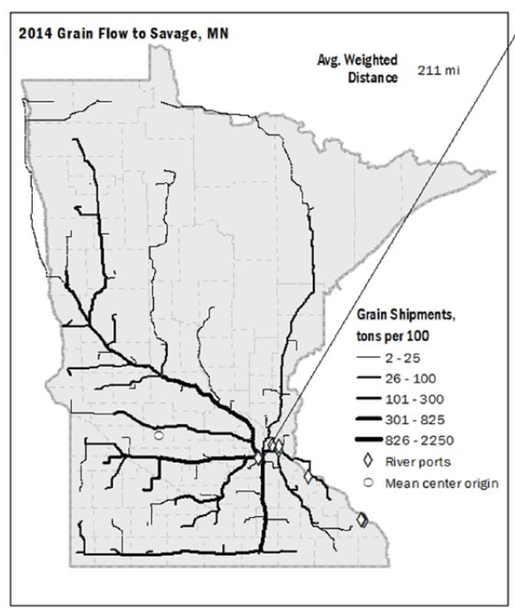
Lessons for cities
Savage wanted to identify safe infra. projects around river ports
Understanding infrastructure within the context of the grain economy
Over 3,600 truckloads, roughly 225,000 tons of grain, terminate in Savage.
Weighted mean traveling distance of 211 mi
Notes:
The 2014 network simulates the routes taken by over 3.6 thousand truckloads, carrying roughly 225 thousand tons of cereal grain.
This map shows the georeferenced 2013 development plans for the HWY 13 corridor as well as cereal grain flows between county centroid origins and Scott County. Savage lies in the northern end of Scott County, with four grain ports located just off HWY 13. Since these locations represent the only market option in Scott County, it is assumed that all grain flowing to Scott County terminates at one of these four ports.
Lack of capacity for heavy commercial trucks, passenger delays, and growing accidents have officials investing in development projects in the area.

Slide 10
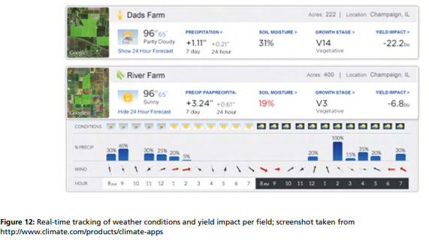
Considerations for Precipitation data
Climate resilience for food production
Predictive modeling for farm output
Implications for strategic freight planning
SOURCE: DHL 2013
Notes:
Climate sensitivity is a characteristic of the agriculture industry, as local temperatures, sunshine hours, and precipitation levels directly impact crop yield. With the increasing occurrence of extreme weather conditions due to global warming, climate variation has become a substantial risk for farmers.2

Slide 11
In a fog: Mayo Medical Lab’s airy supply chain
MML is the largest nonprofit medical testing facility in the world
$2 bil. supply chain; transportation is largest expense
To cut supply chain costs, Mayo and MML slimmed inventory by 75%.
This means almost everything is ‘Just-in-time’
~12% of all flights in-bound to RST are diverted to MSP because of fog.
$5 million in regional economic loss each year

Slide 12
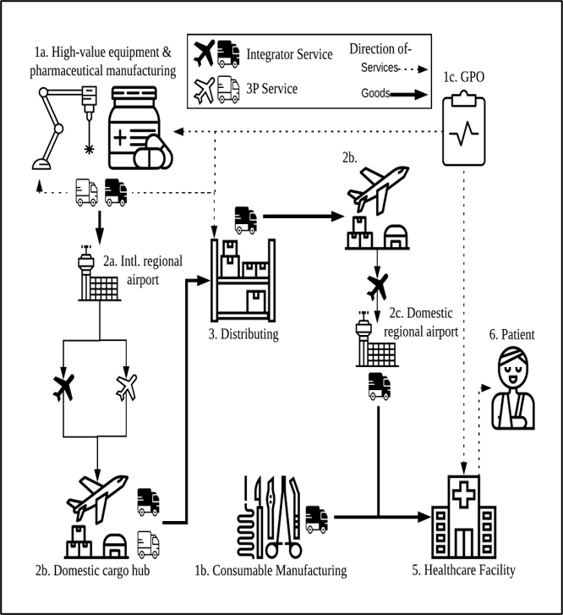
Most MN domestic airfreight carried by integrators (~50%)

Slide 13
Mapping Linkages
Value of medical goods originating from MN airports
Value of medical goods terminating at from MN airports

Slide 14
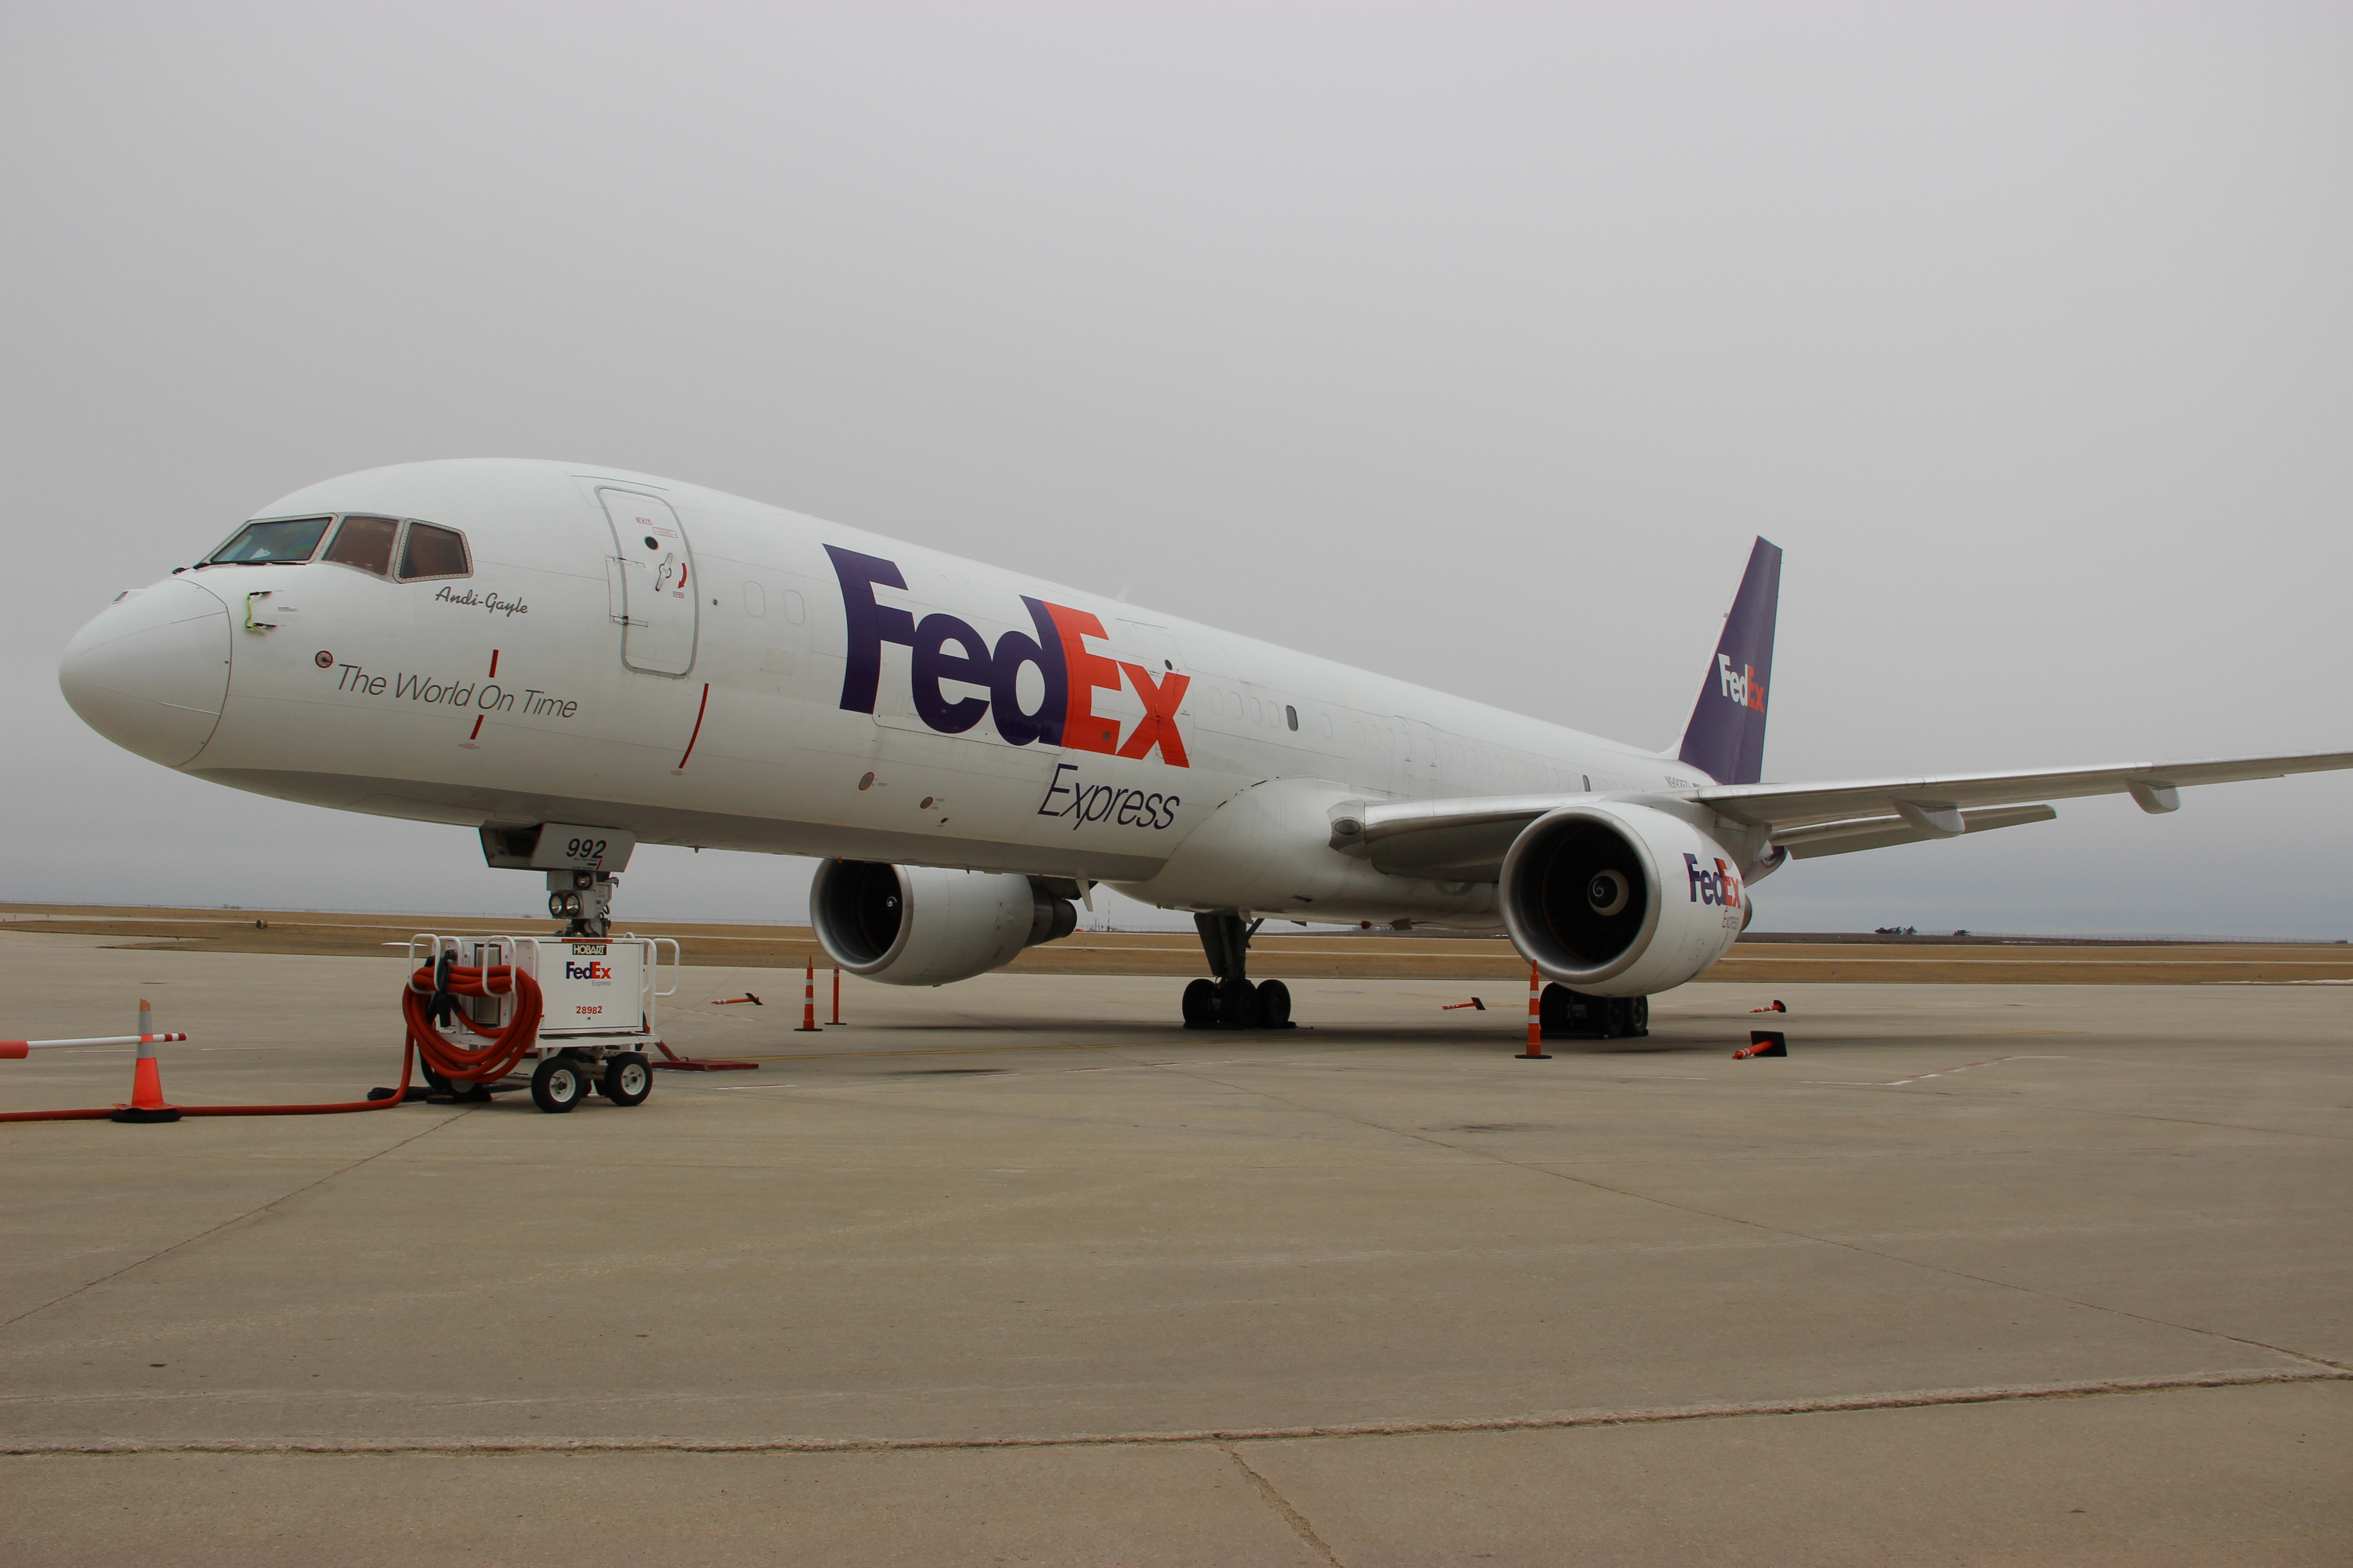
Rochester Airport (RST): The Vital link
to RST
Lawmakers invested $4.5 million investment to improve runway lighting at RST. The investment is a next-step in a 5-year-long process to improve Category 2 (CAT-II) fog landing capabilities at the airport

Slide 15
Learn more!
Fried T, Munnich L, Horan T, Hilton B. Evolving Supply Chains and Local Freight Flows: A Geographic Information System Analysis of Minnesota Cereal Grain Movement. Transportation Research Record. 2018;2672(9):1-11. doi:10.1177/0361198118759952
Presenting at 54th Annual Hawaii International Conference on System Sciences! Jan 5-8, 2021
Check out our Story Maps! Global Airfreight Networks and Regional Competitiveness and Amber Roads of Grain
Learn more about WRI’s ‘Triple Zero’ Vision for Freight on The City Fix
Upcoming paper on Green Transport Recovery for Transport Decarbonisation Alliance

