Slide 1
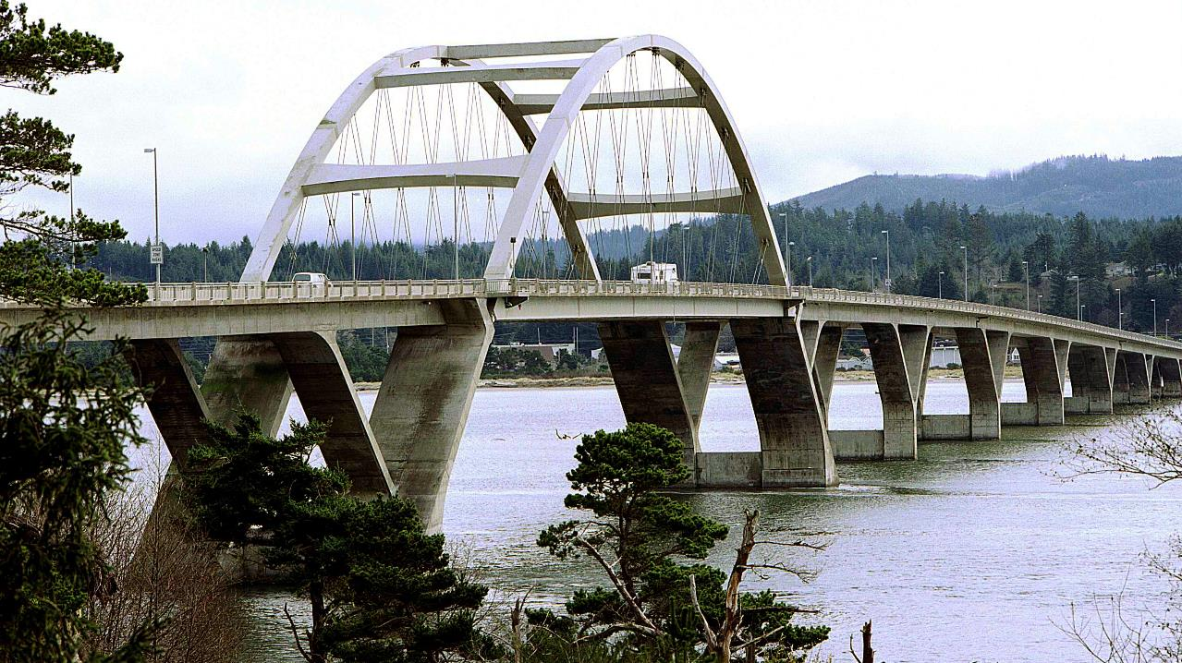
Precipitation vs. Highway Design and Operations
Curran Mohney, CEG
Engineering Geology Program Leader
Oregon Department of Transportation

Slide 2
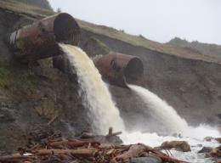
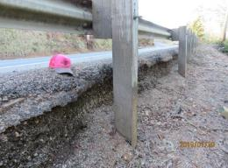
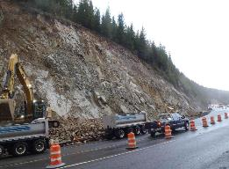
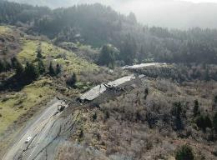
Precipitation, Weather, and Climate Effects:
Culverts
Surface Drainage
Construction
Unstable Slopes
Design
Degradation Rate
Maintenance
Highly Sensitive
Driver Safety
Degrades Rapidly
Worker Safety
Dewatering
Timing/Staging
Landslides
Debris Flows
Rockfall

Slide 3
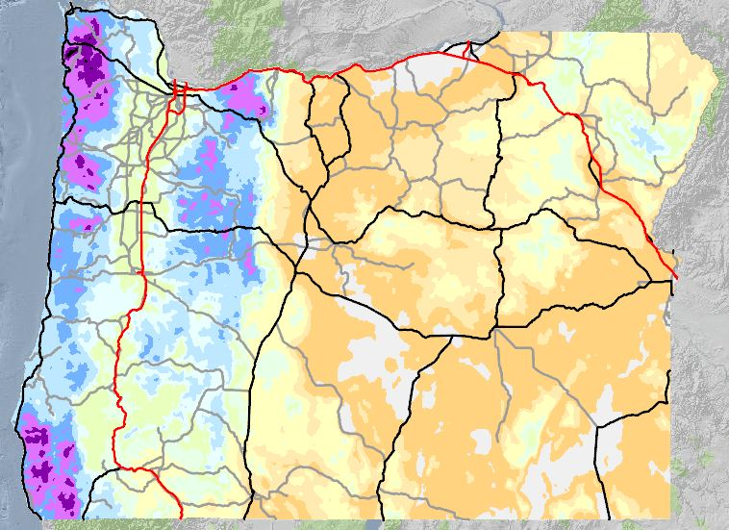
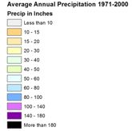
Annual Rainfall

Slide 4
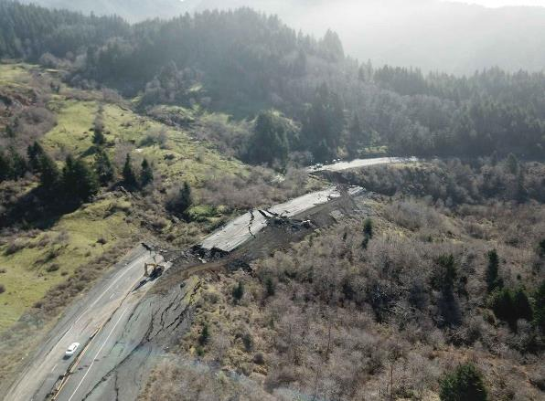
Landslides:
Static Groundwater
Precipitation Trigger

Slide 5
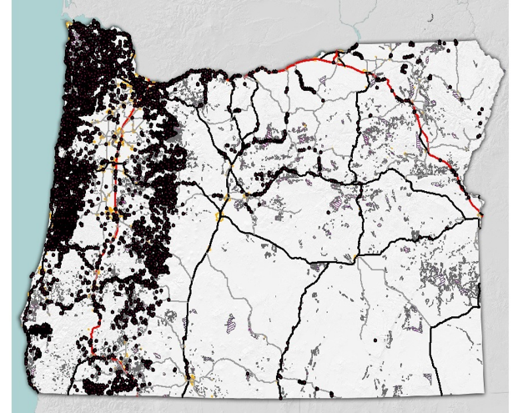
Landslides in Oregon:
Mapped Landslides in Oregon (SLIDO)
Landslide susceptibility map of the state of Oregon (from Burns et al. 2016)

Slide 6
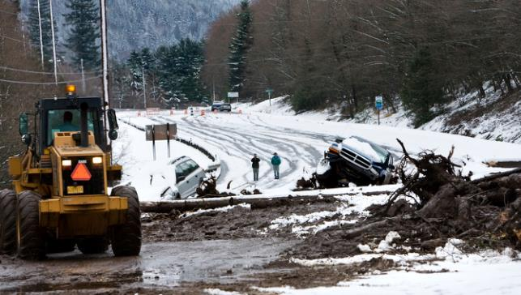
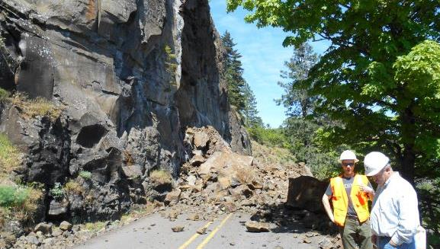
Rapidly Moving Landslides (RML’s)l
Debris Flows
Rockfalls

Slide 7
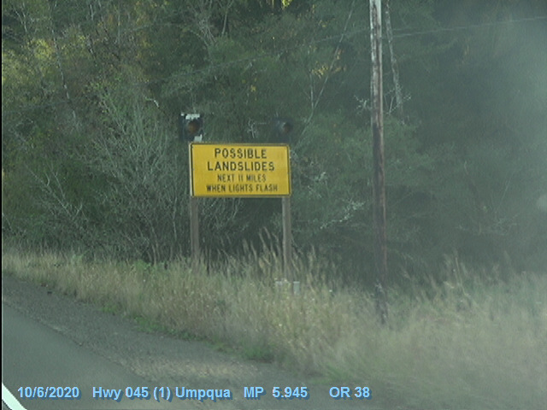
Early Warning Systems
Rainfall Threshold
Drainage basin values
Direct link between real-time Precipitation and Traffic Warning

Slide 8
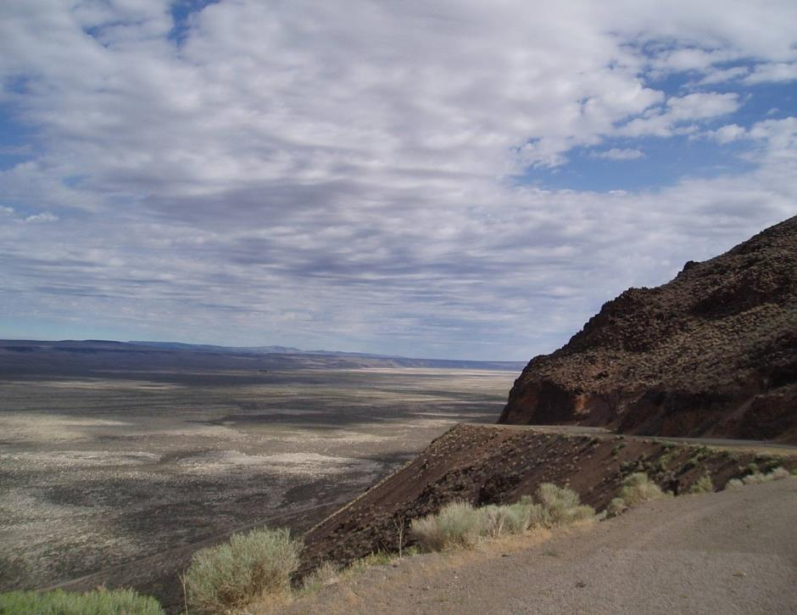
Thank You!

